Slide 1
Scalable Teaching of Software Engineering Theory and Practice: An Experience Report
Solal Pirelli EPFL

Slide 2
Strongly enforce lightweight mechanisms

Slide 3

Constraints
4 credits / 30
2 semesters: theory + project
~150 students
~1 FTE staff

Slide 4


Slide 5



Slide 6



Breaking habits
Equivocation
AI
Big chunks of work
No big picture view
+ more in the paper!

Slide 7


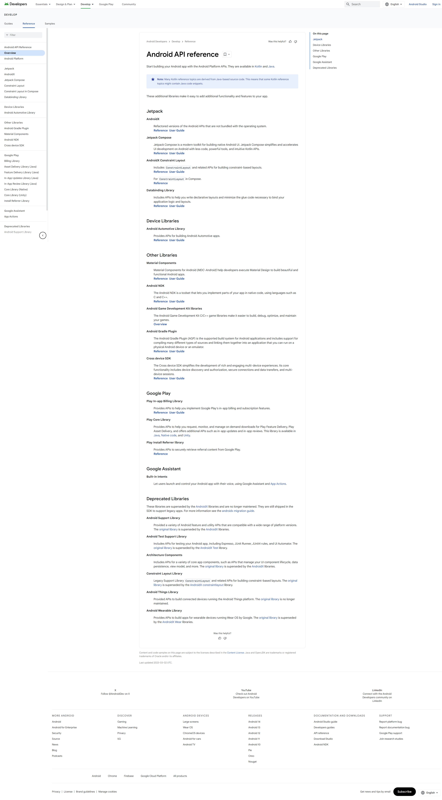
Chunks of work
Read all docs
Ship all code

Slide 8




Interactivity
15min teaching
15min exercises
Frequent
merges

Slide 9

Equivocation
“It depends”
“Maybe”

Slide 10


Theory exam questions
Help!
Real-world situation
1-2 sentence answer
~1min to grade!
...

Slide 11


Big picture view

Slide 12

Practical exam questions
Real-world expectations
No nitpicks
~1min to grade!

Slide 13


ChatGPT

Slide 14


Slide 15
AI for exams
Common misconceptions
Grade grubbing
Wrong focus

Slide 16


AI for projects

Slide 17
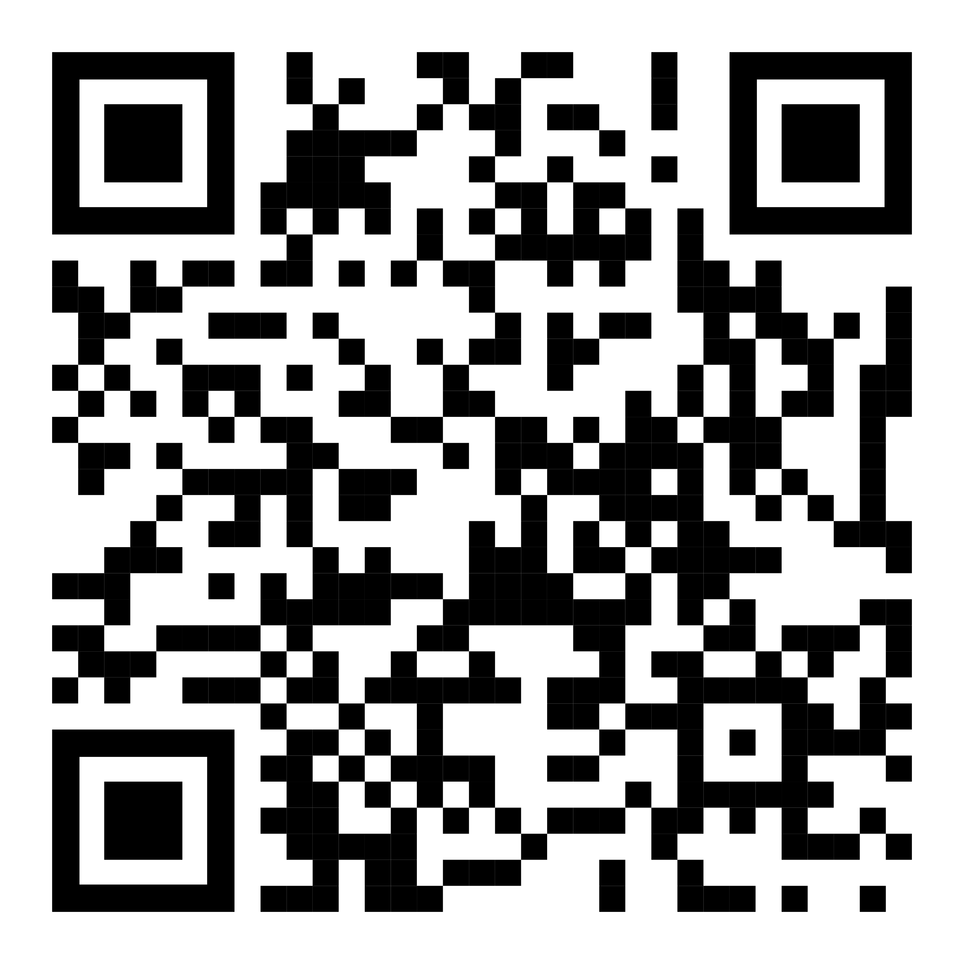


Summary
paper & artifact
Strongly enforce lightweight mechanisms
Work against bad student habits
Good SE practices lead to good courses!

