Slide 1

Safe Low-Level Code Without Overhead is Practical
Solal Pirelli, George Candea

Slide 2


Safety vs Correctness

Slide 3

if (a != null) {
if (0 <= n && n < a.length) {
a[n] = 0;
} else ...
} else ...

Slide 4

Overhead of checks
$ε$ $>0$

Slide 5
Heuristics?
for (int n = 0; n < a.length; n++) {
a[n] = 0;
}

Slide 6
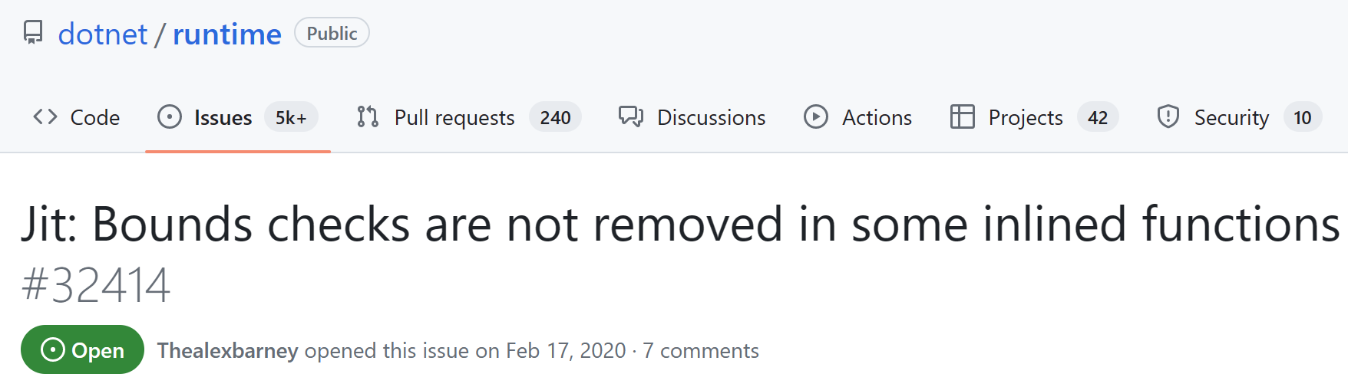

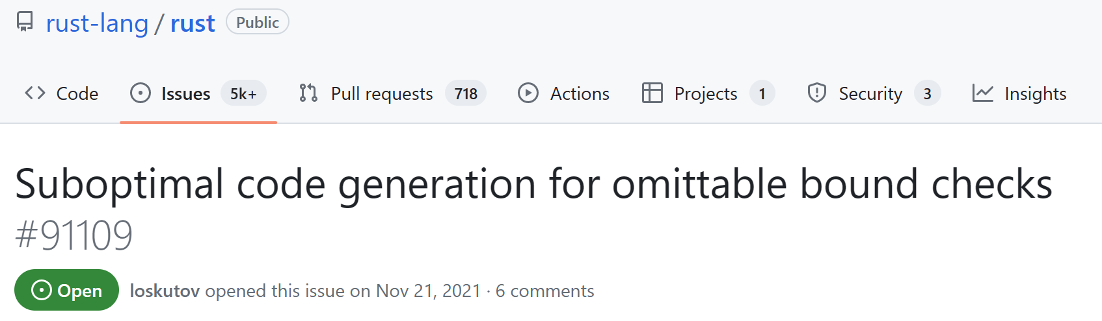
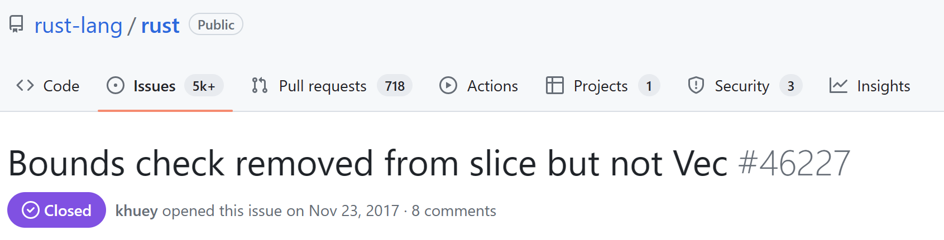

Slide 7
Idea: Type invariants
let n: NonZeroU32

Slide 8
We provide evidence that safe low-level code without overhead is practical using type invariants

Slide 9


Invariant examples

Slide 10
Too lax
int get(int[] a, int n) {
return a[n];
}

Slide 11


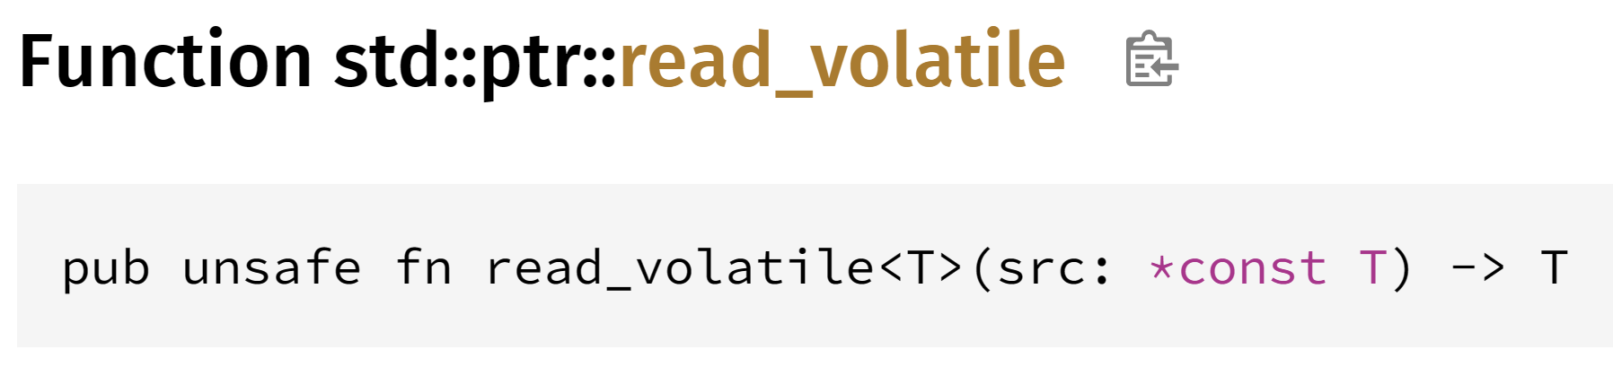
Too strict
“Aliasing XOR Mutability”

Slide 12
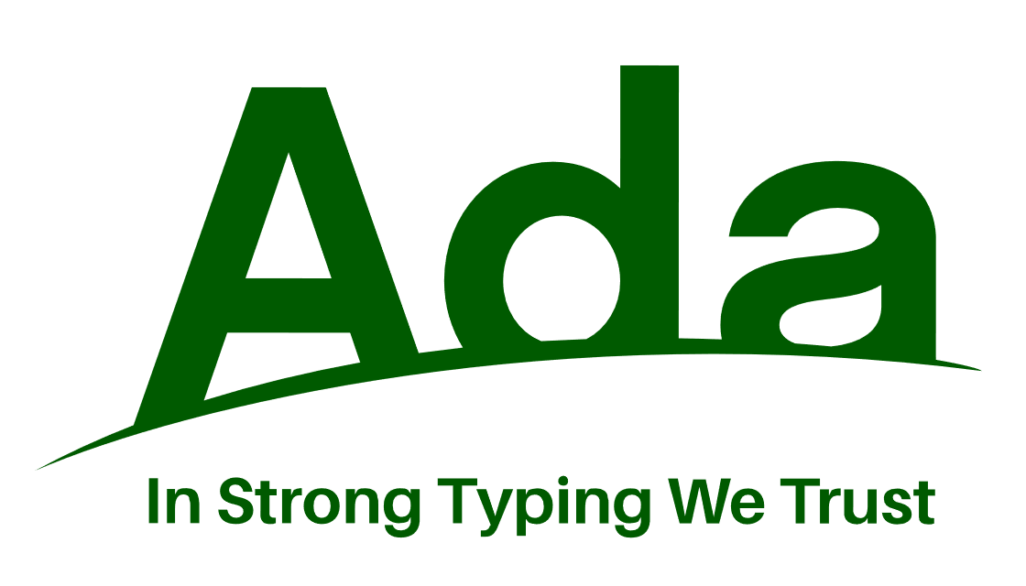
Just right
type Small is range 0..9;
type SmallArray is array(Small) of Integer;
for N in Small loop ...

Slide 13
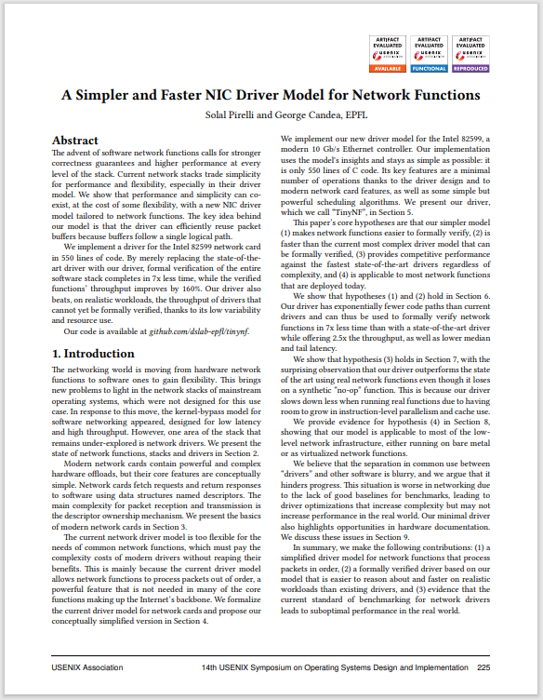
Case study
C#
with extensions
Rust
with extensions
C
baseline
Ada
unmodified

Slide 14
Performance results
As good as baseline
But proven safe by compilers!

Slide 15
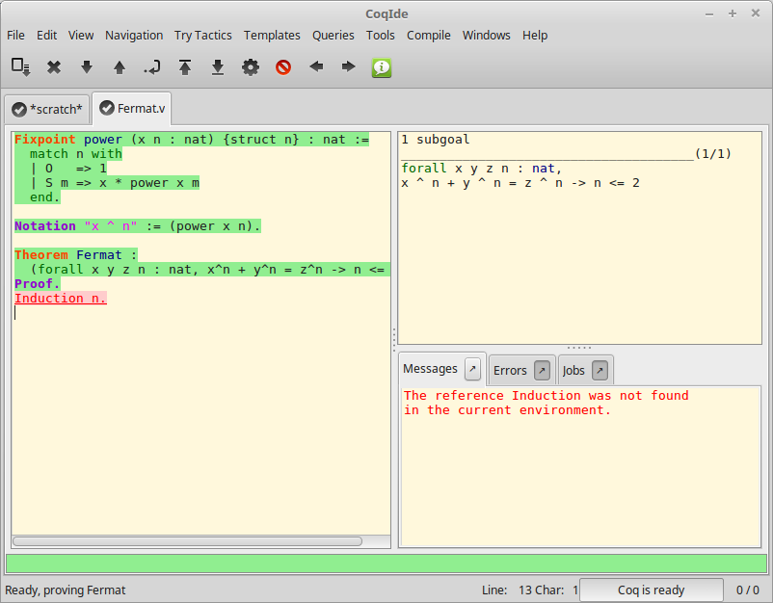
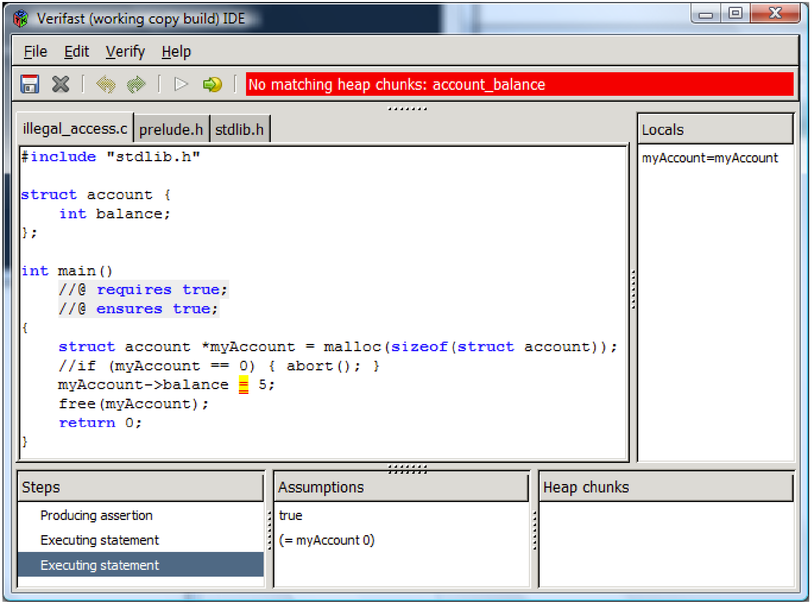
Engineers need tools

Slide 16


Summary
Decoupling safety from correctness is key
Languages and compilers should target 0-overhead
github.com/dslab-epfl/tinynf

