Slide 1




A Simpler and Faster NIC Driver Model for Network Functions
Solal Pirelli,
George Candea
Notes:
Hi, I’m Solal Pirelli, and I’ll be presenting “A Simpler and Faster NIC Driver Model for Network Functions”.
This is joint work with my advisor George Candea.

Slide 2
Designing for verification can help with performance!
Notes:
The key takeaway from this talk is that designing for verification can help with performance.
Having to think about how a system will be proven correct, and keeping in mind the limits of automated reasoning when designing the system, is not a hindrance in development, but can actually lead to a faster design.

Slide 3


Network
Bridge
Router
Firewall
Notes:
A modern network contains many single-purpose hardware devices, such as bridges, IP routers and firewalls.

Slide 4

Network future
Bridge
Router
Firewall
↑ Flexibility
↓ Dependability
↓ Performance
Notes:
In the future, we can expect these devices to be replaced by software network functions, running on commodity hardware.
This increases flexibility, at the cost of dependability and performance, because we do not have the same tools to verify software as we do for hardware, and general-purpose hardware is slower than special-purpose hardware.

Slide 5
Ethernet speeds (Mb/s)
<2 ns/pkt
67 ns/pkt
67 μs/pkt
Notes:
The performance aspect is particularly important due to growing Ethernet speeds. Back in 1983, when Ethernet was first standardized as 10 megabit Ethernet, a machine had 67 microseconds to process each packet, assuming packets arriving at line rate and of the smallest possible size.
With 10 gigabit Ethernet, this budget shrank to 67 nanoseconds, which is less than accessing main memory. With 400 gigabit Ethernet, this budget is now under 2 nanoseconds, so even accessing the cache is too much!
This budget is a conservative estimate, as we do not expect all packets to be of the smallest size and we can use more than a single core to handle packets.
However, it is clear that the overheads that we could afford when we counted in microseconds are no longer acceptable. We must design network stacks without these overheads, and without sacrificing correctness either: we want to formally verify that the resulting software network functions meet their specifications.

Slide 6
Verifying fast NF stacks
Network Function NAT, IP router, firewall, bridge, …
p4v (SIGCOMM’18) Alembic (NSDI’19)
Vigor (SOSP’19) Gravel (NSDI’20)
…
I/O framework
DPDK, Netmap, Click, …
Network Driver
Complexity bottleneck!
Network Card
Out of scope
Notes:
There has been a lot of recent work on verifying fast network stacks. Systems such as Vigor and Gravel can verify that network functions follow a specification such as an RFC, including part of the I/O framework they use such as DPDK or Click. However, drivers have remained a complexity bottleneck.

Slide 7
The driver bottleneck
?
Simple
Verified
(Vigor[1])
Unverified
(DPDK)
Fast
[1]: A. Zaostrovnykh et al., Verifying software network functions with no verification expertise, SOSP’19
Notes:
In Vigor, which our lab presented last year at SOSP, we had to pick a subset of an existing network driver to make verification possible.
There was a tradeoff between a subset simple enough to be verified but not as fast, and the full version that is fast but too complex to verify.
This work was motivated by the question “Can we write a driver that is faster but still verified?”

Slide 8
Bridge
Router
Firewall
Process packets 1 by 1, in order
also: NAT, load balancer, … non-TCP functions
Notes:
Our key insight is that core network functions such as Ethernet bridges and IP routers operate in a restricted way: they process packets one by one, without reordering them.
This also applies to functions such as NATs, load balancers, traffic policers, and other functions that do not handle TCP and thus do not have to deal with out-of-order packets, unlike for instance some firewalls.
Can we make these functions fast by designing a driver specifically for them?

Slide 9
Core networking can be fast and simple (and verified)
Notes:
The answer is yes! Core network functions can be both fast and simple.
This means we can verify network functions without sacrificing performance.
In fact, our performance is even better than with the full DPDK driver!

Slide 10
Key results
25% more throughput than full DPDK
160% more than Vigor
8x faster to automatically verify
Pure C implementation
Notes:
Our key results are that our driver allows for 25% more throughput than the full DPDK driver, while also making network functions 8x faster to verify than the driver subset that Vigor used.
Our implementation is in pure C: we do not use inline assembly or compiler built-ins such as vectorized operations.

Slide 11
How?
New driver model
Efficient use of NIC
From-scratch implementation
Notes:
How did we manage this? We designed a new driver model specifically for functions that do not handle TCP, meaning they process packets one by one in order.
We made efficient use of network card features, both in the model design and in the implementation.
We also wrote our implementation from scratch: it is not a subset of DPDK, it does not contain code from any other driver.

Slide 12
Outline
Intro
Design
Implementation
Evaluation
Notes:
In the rest of this talk, I’ll walk you through the design, implementation, and evaluation of our driver model.
Let’s start with the design.

Slide 13
Classic model (e.g., BSD)
recv()
Copy
Receive
send()
Copy
Transmit
Notes:
First, let’s review the classic driver model that we can for instance find in BSD sockets.
When a program wants to receive data, it calls the receive function, which causes the operating system to copy data from its internal buffers that the network card filled with data.
When a program wants to transmit data, it calls the send function, which causes the operating system to copy the program data to an internal buffer that it then gives to the network card.
This is an open system: the program can use any buffer it wants, and the operating system manages its own buffers.
The main overhead comes from data copies: copying data is not necessary for correctness, it’s an artifact of how the operating system isolates programs.

Slide 14
Closed model (e.g., DPDK)
Process
Process
Pool
Process
Receive
Transmit
Notes:
To avoid copies, frameworks such as DPDK introduced a closed model, in which all buffers are pre-allocated and put into a buffer pool. They are shared between the network function and the driver.
Some buffers are then given to the network card to receive data in. The network function can then process these buffers, and then has three choices: put a buffer back in the pool, which means dropping the packet, keep the buffer around for later, for instance to reorder out-of-order TCP packets, or give the buffer to the network card to transmit. Once buffers have finished transmission, they are put back into the pool.
This model has no copying or allocations, but the buffer pool is now a complexity and performance bottleneck.

Slide 15
Our model: “TinyNF”
Process
Receive
Transmit
/ drop
Notes:
To avoid this bottleneck, we designed a model we call “TinyNF”, for “Tiny Network Function”. It does away with the buffer pool entirely. The total number of buffers is exactly as many as the network card can have in use at once, and they all begin by being used to receive data. The network function can then process buffers one by one, after which it must either transmit or drop them. It cannot keep buffers around. One key aspect of this design is that transmitting and dropping packets are done in the same way, thanks to modern network hardware. In the widely used Intel 82-5-99 network card, for instance, transmitting a buffer with zero length corresponds to doing nothing, but it uses the same code path. This allows for a linear flow of buffers, without any obvious bottlenecks.

Slide 16
Outline
Intro
Design
Implementation
Evaluation
Notes:
So the key idea behind our design, in essence, is to remove the buffer pool and allow for a linear flow of buffers. Now let’s look at the key steps of the implementation

Slide 17
Separate rings
No overlap
Receive
Transmit
Notes:
As I mentioned earlier, we use exactly as many buffers as the network card can handle at once. The network card uses rings to manage buffers, with one part of the ring used by the hardware and one part available to the software.
For instance, here are rings containing 8 buffers each. The part used by the hardware of the reception ring corresponds to buffers being used to receive data, while the other part corresponds to buffers that have been filled with data and are waiting to be processed. The transmission ring works in the same way, with buffers to transmit or who have finished transmission. Usually, the reception and transmission rings are unrelated. But in our model, the two rings contain the exact same buffers, except that a given buffer cannot be used for both reception and transmission at the same time. There is no overlap between rings.

Slide 18
Merged rings
Transmit
Process
Receive
Notes:
This allows us to merge the rings into a single logical ring, which contains one reception ring and one or more transmission rings. Buffers switch from state to state in the logical ring, which corresponds to switching from the hardware-owned to the software-owned part of the physical rings. All buffers stay at the same location in every ring, it’s only their logical state that changes. For instance, let’s look at this buffer here, currently being processed. When the network function has finished processing it, it will switch to the transmission state, which could mean dropping it, then once the card has finished transmitting the buffer, it will switch to being used to receive data, and once that is done, it will switch back to being processed.

Slide 19
Packet path
TinyNF vs. DPDK:
No pointer changes
No pool operations
No explicit batches
Read input metadata
Process
Write output metadata
Maybe
Flush NIC state
Maybe
Recycle buffers
Notes:
Let’s see what this looks like in terms of code. First, the driver reads input metadata to see whether there is a packet and gain other information such as the length of the packet if there is one. If there is a packet, it will be processed, and then the driver will write output metadata corresponding to transmitting or dropping it. After that, regardless of whether there was a packet, the driver may flush the network card state, to let the network card know there is data to transmit, and recycle buffers, to move buffers that have been transmitted back to being used for receiving data. These last two operations are expensive, so the driver does not do them every time. Compared to a standard driver such as DPDK, TinyNF does not need to change any pointers, since the same buffers are used everywhere, and does not have any pool operations such as fetching buffers from the pool. This also means the corresponding failure cases, such as the pool being empty, do not exist. There are also no explicit batches of packets: they are processed one by one.

Slide 20
Flushing NIC state
Expensive operation
DPDK “batching” estimates network load
We flush when idle or every N packets
Notes:
Flushing the state to let the network card know about buffers ready to transmit is particularly expensive, because it is a write through PCI Express, not to main memory. This can affect both throughput and latency: if the driver flushes too often, too much time will be spent flushing compared to processing packets, and packets will be delayed. DPDK’s use of adaptive batching effectively allows it to estimate the network load: flushing at the end of a small batch is likely to be a performance win because if the batch is small then the network load is low. We do not look at future packets, unlike DPDK, so instead we flush when there are no packets to receive, or after a few packets if we don’t become idle. This gives us good throughput, but it can increase latency depending on the workload.

Slide 21
Code
Driver: 550 lines
Environment abstraction: 300 lines
(endianness, memory, PCI, time)
100% user mode
Notes:
In terms of code, our driver is 550 lines of code, around 10% of which is interesting code, with the rest being initialization boilerplate. It only depends on an environment abstraction in 300 lines of code, which itself uses Linux and the C standard library. The environment abstraction contains functions to convert endianness, to allocate and free memory, to translate virtual memory addresses to physical ones and back, to talk to PCI devices, and to sleep. We believe this is close to the minimum necessary; our driver is entirely in user mode and has no kernel mode dependencies.

Slide 22
Writing drivers
Not as complex as one would think
Publicly available data sheet
Many interpretations; most are trivial
Notes:
To finish the implementation section, a note about writing drivers. It is commonly believed that drivers are a special category of software that is hard to write because hardware never works as expected. This may be the case for some specific pieces or categories of hardware, but this was not our experience. The data sheet for our network card was publicly available, and most of the interpretations we had to make were trivial, such as correcting typos or conservatively assuming timeouts.

Slide 23
Outline
Intro
Design
Implementation
Evaluation
Notes:
So the key aspect of our implementation is that it avoids unnecessary operations thanks to the simplicity of its model. Now let’s see how well it performs.

Slide 24
Evaluation
NAT, Bridge, Policer, Firewall, Load Balancer
Throughput, latency, complexity
Baseline: DPDK
Notes:
We used the same five network functions used by the Vigor SOSP paper in our evaluation: a NAT, a bridge, a policer, a non-TCP firewall, and a load balancer. We compared our driver to DPDK on three main metrics: maximum throughput without dropping packets, latency, and complexity. We measured throughput and latency using two machines, connected by Ethernet cables.

Slide 25
Complexity
 | Lines of code
 | DPDK |  | TinyNF
Init | 3204 |  | 245
Receive | 136 |  | 17
Transmit | 122 |  | 29
Number of code paths
DPDK |  | TinyNF
- |  | -
1 + AF + 288AS |  | 3
(8 + 14(FFT + P((FS + FF)T – FFT))L |  | 2 + 2L
L = #links
7x fewer paths in real NFs
8x lower verification time
Notes:
In terms of complexity, our driver is clearly simpler. It has 10 times less code in the initialization, and 5 times less to receive and transmit packets, despite providing the same features to our network functions. The complexity difference is even stronger when we look at the number of code paths: whereas the DPDK driver has hundreds of paths, including here variables that refer to the number of paths in the rest of the DPDK codebase, ours has only a single-digit number. The only variable in our driver’s paths is the number of output links. Overall, this corresponds to 7 times fewer paths in our verified network functions, which we can then verify 8 times faster.

Slide 26
Complexity
 | Lines of code
 | Ixy[1] |  | TinyNF
Init | 3204 |  | 245
Receive | 136 |  | 17
Transmit | 122 |  | 29
Number of code paths
Ixy[1] |  | TinyNF
- |  | -
1 + AF + AS |  | 3
14L |  | 2 + 2L
L = #links
[1]: P. Emmerich et al., User Space Network Drivers, ANCS’19
Notes:
We also compared our driver to Ixy, another research project presented at ANCS last year which implemented a driver for the same network card. Their driver uses the same model as DPDK but focuses on simplicity for educational value. We see that the amount of initialization code is roughly the same, which shows that initialization in DPDK could be simpler, but that Ixy still has over twice the amount of code to receive and transmit packets, mainly because of the use of a buffer pool which our model does not need.

Slide 27
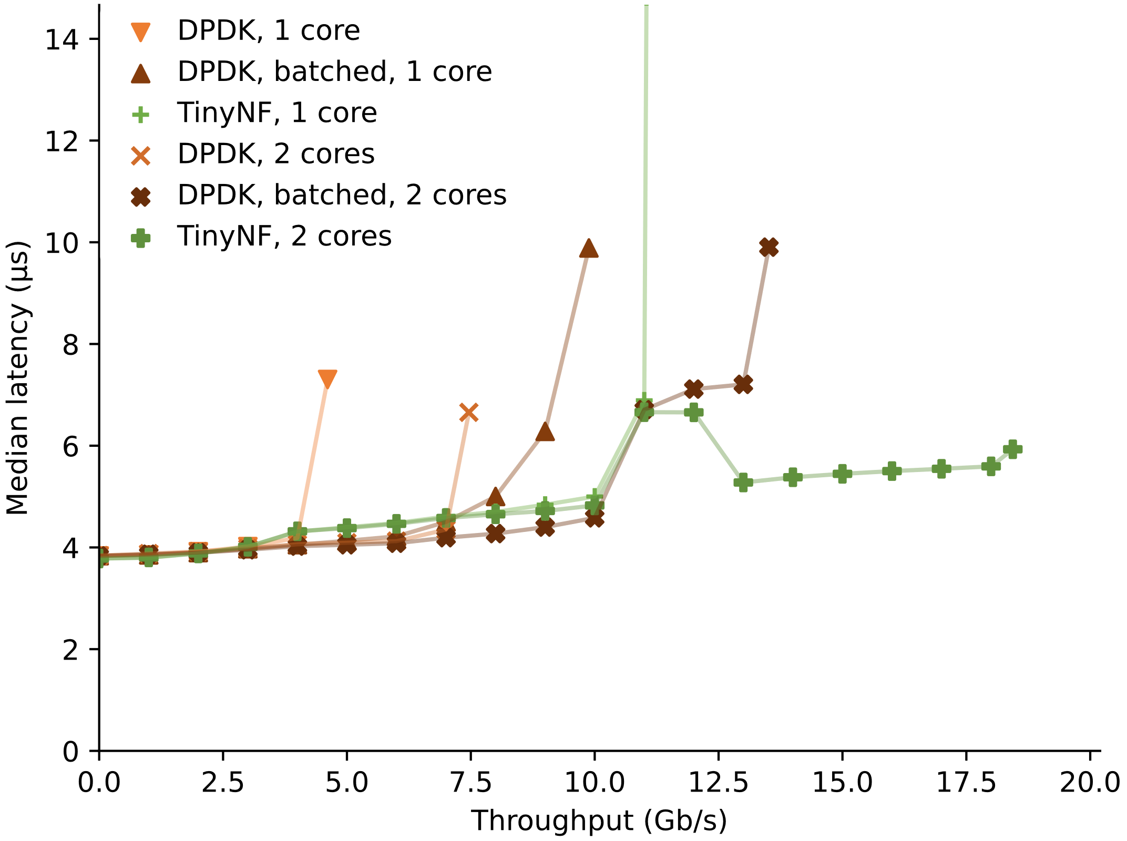
Performance
1.25x vs. unverified
2.6x throughput vs. verified
Much more in the paper
Virtualization, low-level metrics…
dslab.epfl.ch/research/tinynf
Notes:
In terms of performance, here is one of the many graphs from our paper. It plots the throughput of the traffic policer on the X axis, up to a maximum of 20 Gb/s as we use two links, and the latency on the Y axis, stopping when the policer drops packets. We measured three drivers: the verified DPDK driver subset from Vigor, the full DPDK driver, and our driver. All three come in one and two-core variants, to make sure our driver can work with parallelism. The further right a driver goes, the more throughput it can sustain, while the further down it goes, the lower the latency. Overall, not only does our driver allow for 2.6 times the throughput using the verified driver subset, but it allows for 1.25 times the throughput using the full DPDK driver! There is a lot more performance evaluation in the paper, including virtualization and low-level metrics, which we summarized in the project webpage as well.

Slide 28
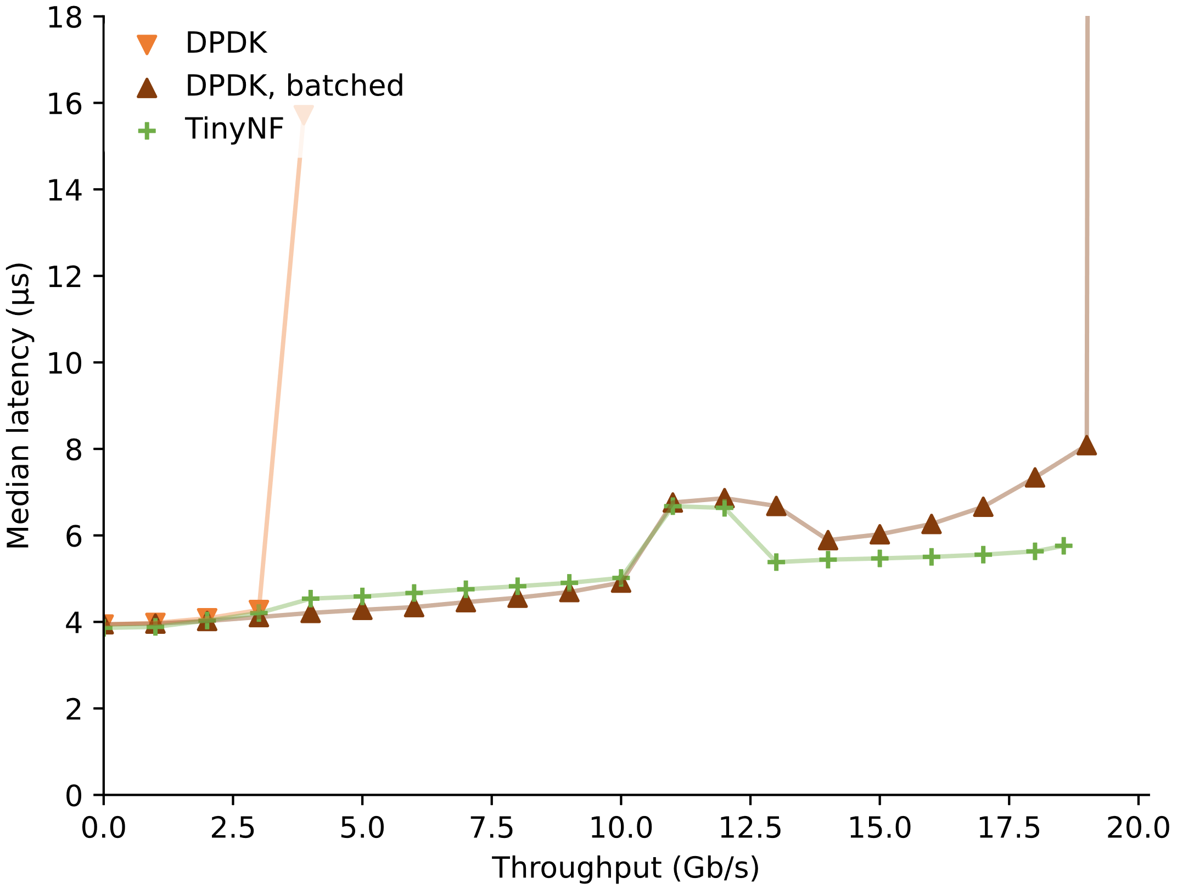
Performance
Worse in “no-op”
35 instructions to receive + transmit
100 for DPDK
Lower cache footprint
➔ Less interference
CPU frequency reduced to avoid NIC bottleneck
Notes:
We also measured performance using the classic “no-op” network function, which as its name implies does not actually perform a useful operation: it only writes constants to the MAC addresses of each packet without any other processing. The semantics of the graph are the same as before, but we used only one core and had to lower the CPU frequency so the Ethernet links wouldn’t be bottlenecks, and we got a surprising result: our implementation performs worse than DPDK in this case!
To explain the performance results, we measured low-level metrics such as the number of CPU cycles, assembly instructions and cache hits per packet. Overall, TinyNF does so little that it can receive and transmit a packet in 35 instructions, compared to DPDK’s 100. It also has a lower cache footprint, causing fewer cache misses in the network function. These differences are not visible in artificial benchmarks such as no-ops, in which instruction-level parallelism and cache sizes hide them and make DPDK shine, but when measuring real network functions our driver causes less interference and improves performance.

Slide 29
Conclusion
Designing for verification can help performance!
Core network functions
can be both fast and verified
dslab.epfl.ch/research/tinynf
Notes:
In conclusion, I made the case that designing a system for verification can help with performance, because minimizing the number of operations, removing complex data structures and making data flow linearly all improve performance. Having to think about how a system will be proven correct, and keeping in mind the limits of automated reasoning when designing the system, is not a hindrance in development, but can lead to a faster design. We showed that core network functions that form the backbone of the Internet do not have to choose between performance and verifiability: they can have both! Our code is publicly available, and we encourage you to use it for your own work on network functions or drivers. You can find it, along with more details, by following the link on this slide. Thank you.

