Slide 1
SAL EDUCATION Project Submission
“Smart Migrant Labor Welfare & Skill Mapping Platform”

Slide 2

Project Tile – [ Smart Migrant Labor Welfare & Skill Mapping Platform ]
Domain of Project – [ Social Governance ]
Student Name | Recent Passport Photo | Email ID | Mobile number [WhatsApp]
Solanki Aryan Nileshkumar |  | aryansolanki4904@gmail.com | 8758362956

Slide 3
Problem Statement -
Problem Statement : Smart Migrant Labor Welfare & Skill Mapping Platform
The Challenge :
Gujarat hosts a large interstate migrant workforce in construction, textiles, and diamond polishing, many of whom lack access to welfare schemes, fair wage information, and safe working condition reporting, leaving them vulnerable to exploitation.
The Objective :
Develop Agentic AI solutions that map migrant labour skills and locations, connect them to welfare entitlements, and flag unsafe or exploitative working conditions.

Slide 4
Proposed Solution -
The proposed solution is a multi-agent AI platform that helps migrant workers with job opportunities, welfare schemes, fair wages, and workplace safety.
Skill Mapping Agent – Matches skills with suitable jobs.
Welfare Agent – Finds eligible government schemes.
Wage Monitoring Agent – Identifies possible wage exploitation.
Grievance & Safety Agent – Handles workplace complaints.
Dashboard Agent – Displays worker and welfare insights.
RAG provides reliable scheme and labor-law information, while IBM Granite LLM delivers personalized AI assistance.

Slide 5
Technology Used
IBM Bob – For designing and developing the AI-powered multi-agent platform and creating the user-friendly application interface.
IBM Granite LLM – For natural language understanding, reasoning, summarization, and personalized recommendations for migrant workers.
IBM Cloud – Provides a secure, reliable, and scalable environment to deploy and run the platform and its AI services.
RAG (Retrieval-Augmented Generation) – Fetches reliable information about government welfare schemes, labor laws, minimum wages, and worker rights before generating responses.
Vector Database – Stores and retrieves welfare scheme information, labor regulations, wage data, and other relevant documents for efficient RAG-based retrieval.
Multi-Agent Architecture – Enables specialized AI agents to work together for skill mapping, welfare eligibility, wage monitoring, grievance reporting, and labor welfare analytics.

Slide 6
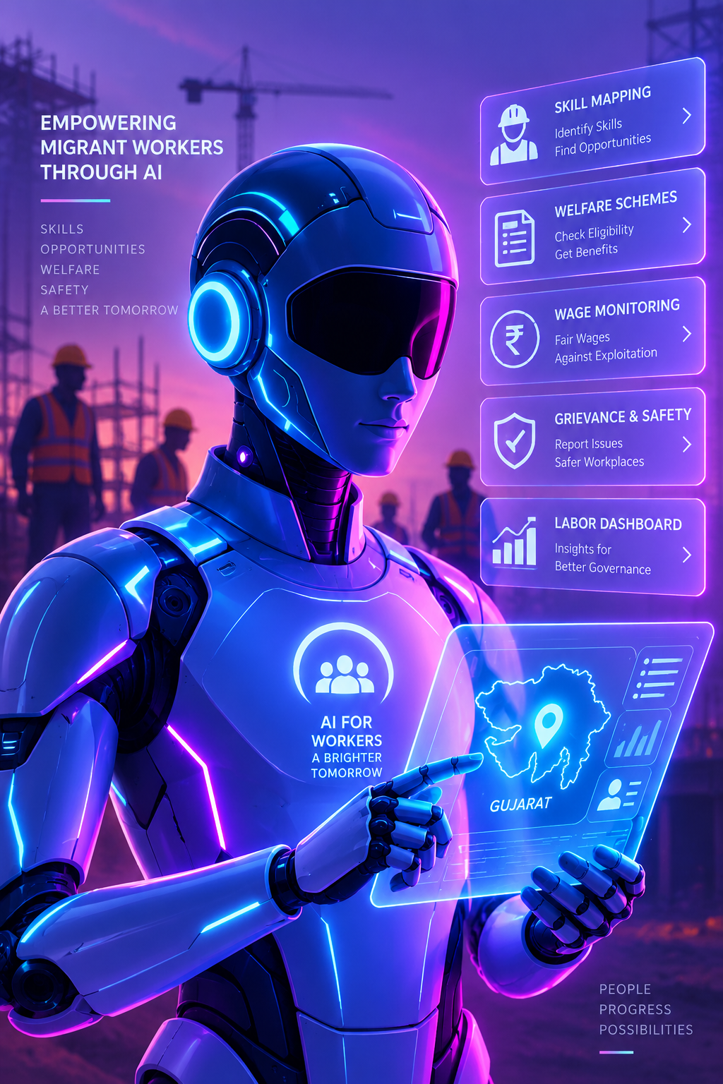
Role of Agentic AI in the solution
Role of Agentic AI in Smart Migrant Labor Welfare & Skill Mapping Platform:
Agentic AI enables the platform to work as an intelligent, autonomous system that coordinates multiple specialized agents to support migrant workers.
Each agent performs a specific task such as skill mapping, welfare scheme eligibility, wage monitoring, and grievance reporting, while collaborating with other agents.
It provides personalized and context-aware assistance based on the worker’s skills, location, occupation, wages, and welfare needs. Using RAG, it retrieves reliable information about government schemes, labor laws, wages, and worker rights.
Overall, Agentic AI makes the platform proactive, personalized, and efficient, helping migrant workers access jobs, welfare benefits, fair wages, and safer working conditions.

Slide 7
Novelty and Uniqueness
The proposed platform combines Agentic AI, RAG, skill mapping, and welfare assistance into one intelligent system.
Multi-Agent Intelligence – Specialized agents collaborate for skill mapping, welfare eligibility, wage monitoring, and grievance handling.
RAG-Based Accuracy – Retrieves reliable information on government schemes, labor laws, and minimum wages.
Personalized Support – Provides recommendations based on workers’ skills, location, occupation, and experience.
Wage & Safety Monitoring – Identifies potential wage exploitation and unsafe working conditions.
Multilingual Accessibility – Makes welfare and labor information easy to understand for migrant workers.
Overall, the solution provides a smart, adaptive, and worker-centric digital welfare platform.

Slide 8
Git Hub Link
Please create public github repository (Enable Add README button while creating repository) with format –
Github Static URL –
https://github.com/Solanki-Aryan/MigrantShield
Github Dynamic URL –
https://github.com/Solanki-Aryan/migrantshield-platform
·
·
·

Slide 9
Future Scope
1. Government & Job Portal Integration –
The platform can be integrated with government welfare portals and job platforms to provide real-time information about available schemes, job opportunities, and application status. This will make welfare access and employment matching faster and more convenient.
2. AI-Powered Voice Assistant & Multilingual Support –
Adding voice-based interaction and multiple Indian languages will help migrant workers access the platform easily, especially users with limited literacy or language barriers. Workers can interact naturally through voice, text, or images.
·
·
·

Slide 10
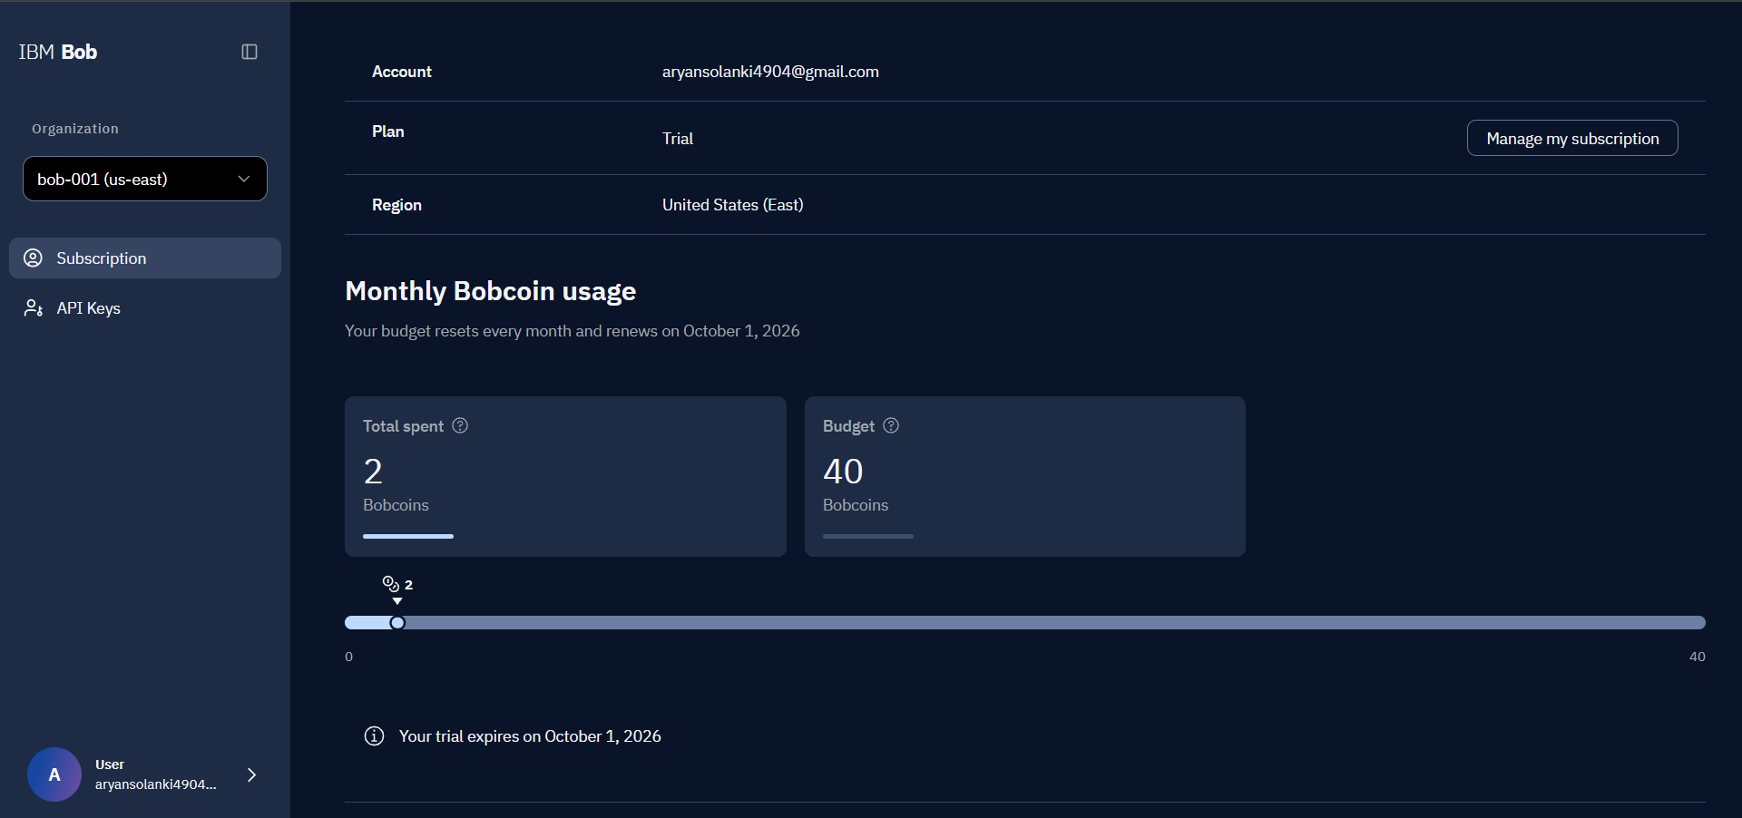
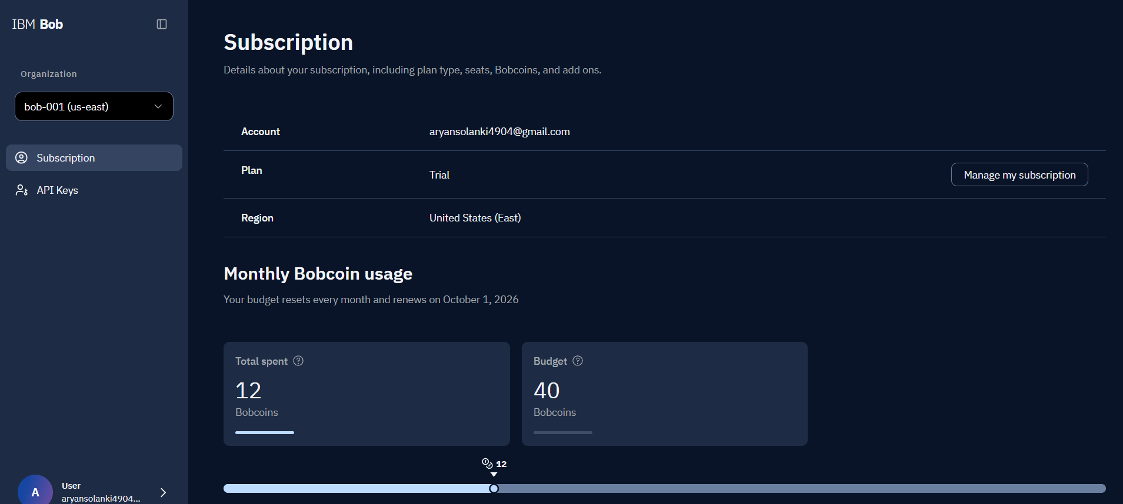

Slide 11
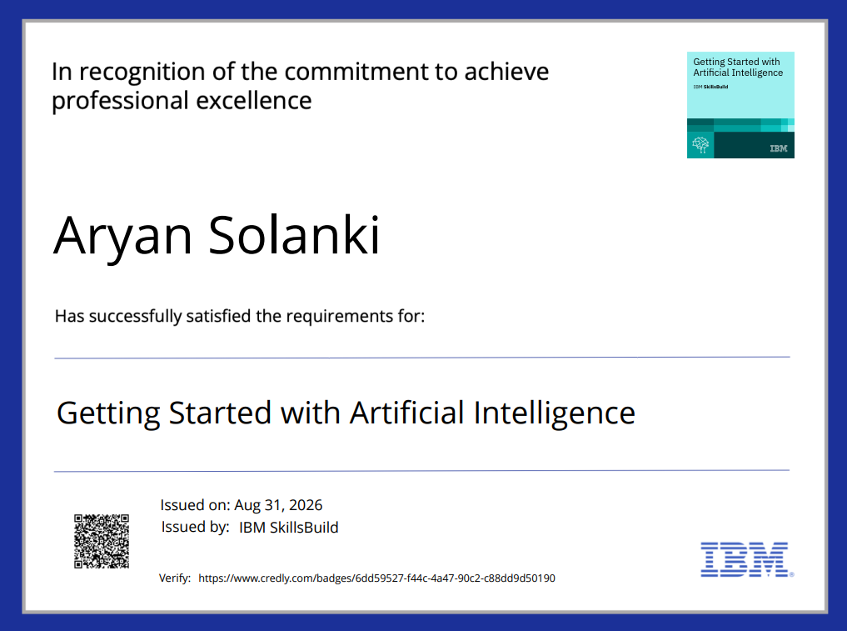
Certificates Earned:

Slide 12
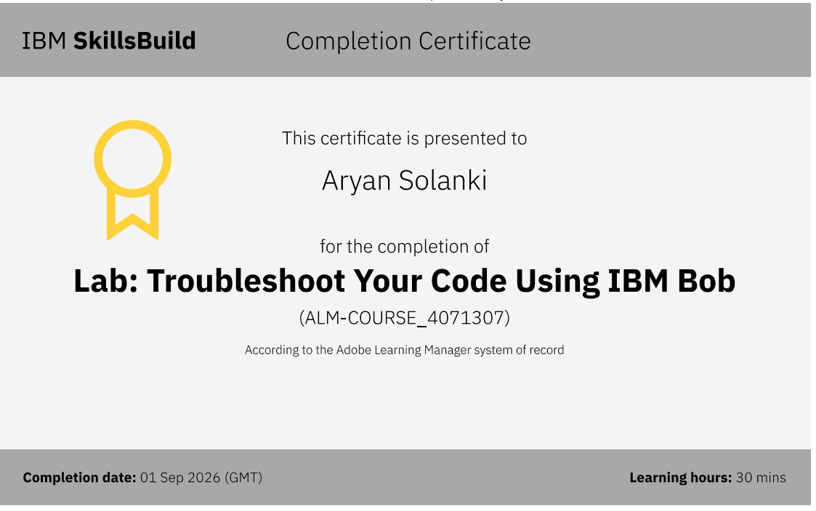
Certificates Earned:​

Slide 13


