Slide 1
Bank Loan Case Study
-HARSH SINGH

Slide 2
Project Description
This Project is all about the Bank loan data. In the given dataset , data is all about the information given by the appliers during the time of loan applying. Using EDA it will helps us to analyse the defaulters and one who are punctual. This is also comes under Financial Risk analytics.

Slide 3
Tech Used
Microsoft Excel 365

Slide 4
Data Cleaning
First of all I removed the null values and replaced them
The column having null values greater than 30 % is removed
The days columns whiczh are negative is converted into positive.

Slide 5
OUTLIERS
In Case of Number of children ,most of the loan appliers are having
children 0 to 4 , maximum density is on the scale of 0. So Maximum loan appliers
is having 0 Children.
All most all the person is having the income less than 2000000 and only one
is having income up to 10000000, So it is clearly a outliers which need to removed.
The Amount credit is lies up to 25 lakh and there is one or two credits
which is beyond 25 lakh.
The Amount Annuity is lies in between 0 to 1 lakh and there are some outliers
but some are extra ordinarily out.
Analysis File

Slide 6
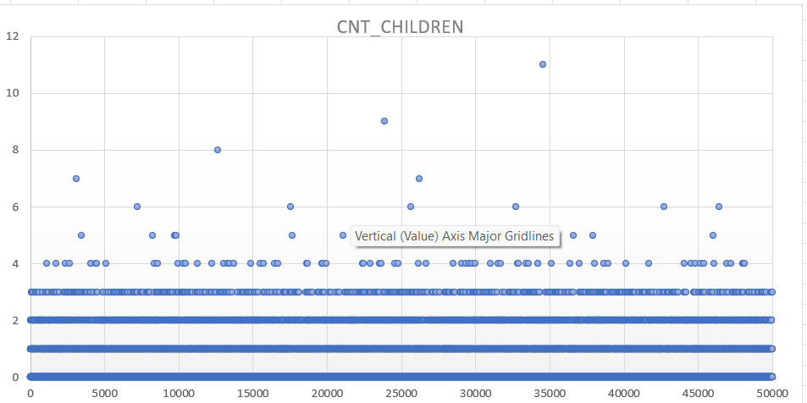
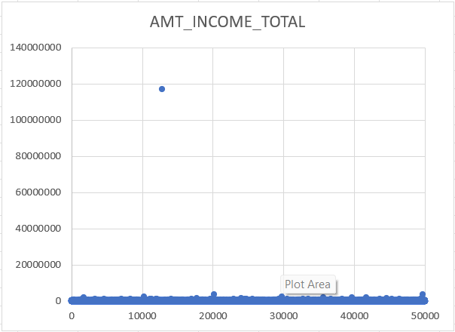
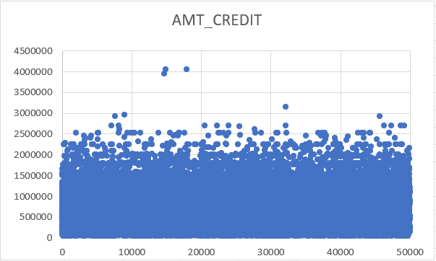
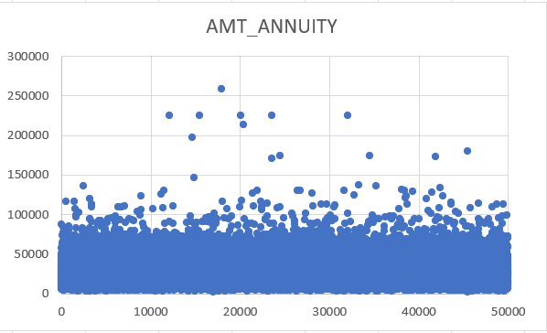

Slide 7
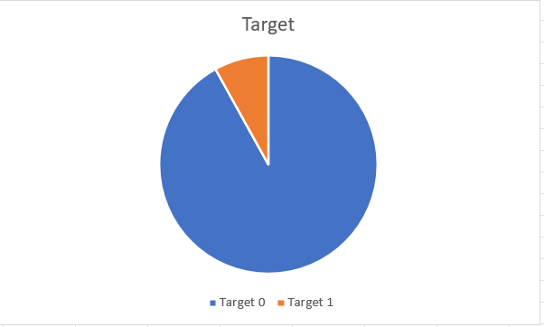
DATA IMBALANCE
The given Pie chart is showing the data imbalance of Target Variable.
The Target 1 are the people with payment difficulties.
Target 0 are the people with some other problem.
The given chart is showing the distribution of Gender of the loan Appliers.
The female are dominating the male .
Analysis File

Slide 8
Univariate Analysis
HOUSE_TYPING | Count of NAME_HOUSING_TYPE
Co-op apartment | 191
House / apartment | 44368
Municipal apartment | 1845
Office apartment | 427
Rented apartment | 769
With parents | 2399
(blank)
Grand Total | 49999
The most of appliers are having House and Apartments.
Work_type | Count of NAME_INCOME_TYPE
Businessman | 2
Commercial associate | 11543
Maternity leave | 1
Pensioner | 8920
State servant | 3512
Student | 5
Unemployed | 6
Working | 26010
(blank)
Grand Total | 49999
Most of the Appliers are working Professionals
Analysis File

Slide 9
Education_Type | Count of NAME_EDUCATION_TYPE
Academic degree | 20
Higher education | 12167
Incomplete higher | 1620
Lower secondary | 620
Secondary / secondary special | 35572
(blank)
Grand Total | 49999
The Most of the loan appliers had completed secondary level of schooling.
FAMILY_STATUS | Count of NAME_FAMILY_STATUS
Civil marriage | 4859
Married | 32094
Separated | 3142
Single / not married | 7306
Unknown | 1
Widow | 2597
(blank)
Grand Total | 49999
The most number of appliers are married
Analysis File

Slide 10
Segmented analysis
Analysis File

Slide 11
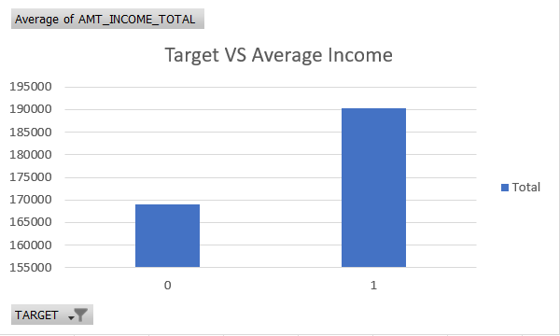
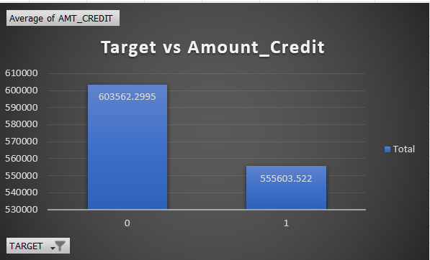
Bivariate Analysis
The given analysis shows the bivariate analysis of the income of targets. Bivariate analysis means the analysis between two variable.
So the client with payment difficulties is having the average salary less than 2 lakh.
The amount of credit given to target 0 is higher than target 1 .
The target 1 is having payment Difficulties may be due to this
Credit amount is less as compared to target 0.
Analysis File

Slide 12
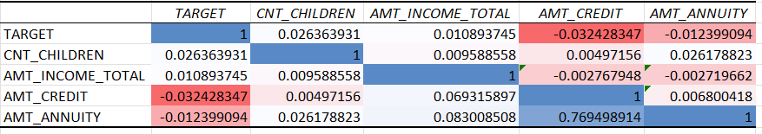
Finding Corelations
The Columns or we can say that data which is used for finding the correlation are as follows:-
Count Of children
Amount of total income
Amount of Credit
Annuity Amount
Analysis File

Slide 13
Previous Application

Slide 14
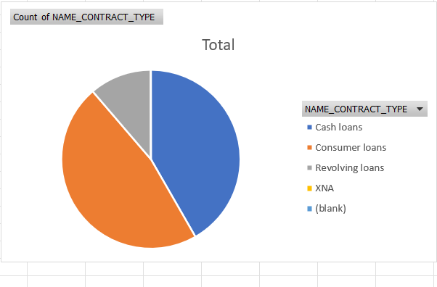
Data Imbalance
The given Pie chart shows the distribution of Contract Type
The maximum type of contarct are consumers loan.
Analysis File

Slide 15
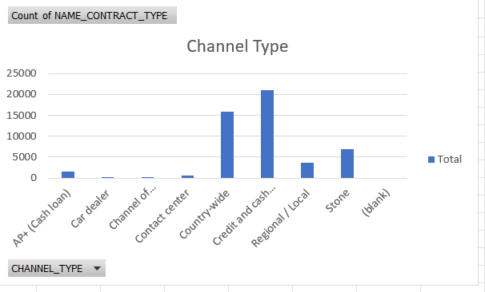
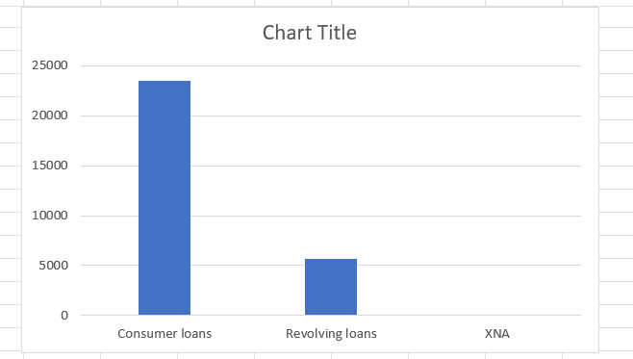
Univariate Analysis
The Smooth Channel for getting the loan is Credit and Cash Office.
The Most Preferred type Of Contract is Consumer Loans
Analysis File

Slide 16
Bivariate Analysis
The Given Chart is in Between Contract Type and Income
And it has been found that sum of income of Consumer loan is
highest.
The Given Chart is in Between the Contract Type and
amount Of Annuity. The Amount Of Annuity is Maximum 0
for Cash Loans.
Analysis File

Slide 17
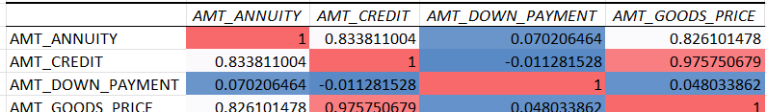
Finding Corelations
The Columns or we can say that data which is used for finding the correlation are as follows:-
Amount of Annuity
Amount Of Down Payment
Amount of Credit
Annuity Amount
Analysis File

Slide 18
Result
The Loan appliers are mostly women, may be the man seeks for the loan in the name of their
wife or Female of their family
The Seekers who are having payment difficulties are having low income sources.
The One who is having good previous loan history easily get the loan as compared
to are seeking for the first time.
The information used for analyse the behaviour and daily needs of the customer.
The loan seekers are applying for a little amount of loan
which means they are lending it for personal use.

