Slide 1
gen-N
WebStore
Prepared By:
- Divyesh Chauhan
- Pratik Ranpara
Guided By:
- Kartik Trivedi

Slide 2
Projet Profile
  Project Title : Gen-N Web-Store
  Front-end Tool : P.H.P
  Back-end Tool : My SQL
  Other Tool : JavaScript, C.S.S, H.T.M.L
  Team Size : 2

Slide 3
Online Classifed
  In today’s modern, sophisticated and fast world, online classifieds have become a medium of communication among the internet users.
  On one end it is informative and on the other end it is convenient and cost effective.
  Online classifieds are most effective and proved market winner in current vast competitive business era. No one can ignore such a powerful medium in totally changed market environment.

Slide 4
gen-N
  Gen-N Web-Store is available to serve as your online marketplace, which gives following benefits:
  It offer simple solutions to your classified advertising needs allowing you to post electronic products classifieds.
  Promote your electronic product, company or service to a vast audience
  Build consideration, awareness, and buyer response
  Customize ads to fit individual or company needs
  Convenient and easy to use

Slide 5
gen-N
  Gen-N Web-Store website provides different categorized classifieds/ads. It also allow user to upload their ads.
  Gen-N Web-Store allows two types of registration:
    User registration
    User can get own account id to interact with Companies, Administrator.
    Company registration
    Companies can register themselves as Companies who can upload advertisements and launch electronic products.

Slide 6
gen-N
  There are three major section of online classified portal.
  ➢ User section
  ➢ Company section
  ➢ Admin section

Slide 7
User Section
  In this section, user can view categorized electronic product classifieds.
  User can search particular classified.
  User can update their personal profile and password.
  User can give a reviews for the site or classified products.

Slide 8
Company Section
  In this section Companies can freely upload their electronic product classifieds.
  Companies can update their personal profile and password.
  Companies can upload and manage different electronic product classifieds.
  Companies can receive reviews from user and able to give response too.

Slide 9
Admin Section
  Admin can manage different database entries.
  Admin can view the information related to registered users, companies with their classified product’s details.
  Admin can add and update home page slider.
  Admin can add and remove categories of classifieds.
  Admin can view and delete mails received by registered users or companies.

Slide 10
Benifits
  By using this system customers will be able to to post their electronic products classifieds.
  Problems may be solved.
  It is fully web based system.
  Easy maintenance of volume of data.
  No delay in any retrieving procedure.
  Lesser manpower and manual work.

Slide 11
Goals
  To maintain users to add any kind of electronic products classified records with the help of “My SQL”.
  Add product classified online and maintain full process also.
  To maintain records of users and companies.
  Give information of registered users and companies and their classifieds to administrators.

Slide 12
Technical
Specification
  Software Specification
    Operating System: Windows XP/7/8/10
    Xampp (Apache Server & My SQL)
    Browser (Internet Explorer, Google Chrome, Mozilla Firefox)
  Hardware Specification
    1.70A-GHz or higher processor
    Display Device with Minimum 1200 X 800 Resolutions.
    512 MB of RAM
    1 GB of available disk space

Slide 13
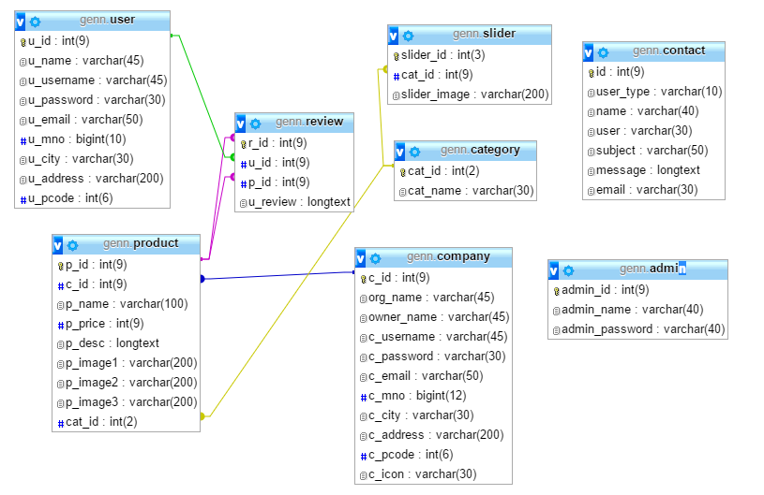
Database
Design

Slide 14
Testing
  Unit Testing
  Integration Testing
  White Box Testing
  System Testing
  Environment Testing

Slide 15
Drawbacks
  Once the classified is added it can not be modified it can only be deleted.
  User can not sort the classified based on the company or price list.
  User and companies cannot interact directly.

Slide 16
Future Plans
  We would like to implement the facility that user and companies can interact directly.
  We would also like to implement the facility of instant messaging.
  Advanced sorting facility and subcategories can be added to our system

Slide 17
Bibiliography
  To develop this project I have taken help of following Books:
  ✓PHP Bible
  ✓Beginning PHP5
  ✓Pure JavaScript
  To develop this project I have taken help of following Websites:
  ✓www.w3schools.com
  ✓www.google.com

