Slide 1


LDO WITH HIGH PSRR VL804 : ANALOG POWER IC DESIGN
MAY 10, 2024
Malobi Mukherjee - MS2023006
Vartika Barnwal - MT2023535
Akhil Ganesh Asati -MT2023502
Pratikkumar AshokKumar Solanki - MT2023527

Slide 2
CONTENTS
Specification Table
Circuit Diagram
Key Challenges Addressed
Theoretical analysis or Design approach
Simulation result-1 (DC-operating points – Schematic snapshot)
Simulation result-2 (AC analysis/Loop gain, plots)
Simulation result-3 (PSRR plots)
Simulation result-4(Load transient plots)
Simulation result-6 (Line and Load regulation plots)
Simulation Results Table
Backup Paper and Project Slides

Slide 3
Key Challenges Addressed
Increase PSRR Value by using suitable value of Cc Miller Capacitance
Enhance the vale of PSRR at High Frequency (MHz) range

Slide 4
Reference Paper Specification Table
 |  | Units | Paper 1 | Paper 2 | Paper 3 | Paper 4 | Paper 5 | Paper 6
Techniques
Technology |  | nm | 65 | 180 | 130 | 180 | 90 | 180
Power Transistor |  |  | NMOS |  |  |  |  | PMOS
Maximium ILoad |  | mA | 100 |  | 25 | 200 | 140
Nominal Vin |  | V | 1.2 | 8-45 | >1.15 | 1.8-2.5 | >1.15
Vout |  | V | 1 | 5 | 1 | 1.6-2.5 | 1
Minimum Dropout |  | V | 80 |  | >0.15 | 0.2 | >0.15 | 0.178
Cout |  | uF | 4.7 |  |  | 1
Load Regulation |  | uV/mA | 10
Quiescent Current |  | uA | 40 |  | 50 | 0.6-160 | 33-145 | 5.6-35.6
Overshoot |  | mV | 2 |  |  |  |  | 28.7
Undershoot |  | mV | 4 |  |  |  |  | 36.36
PSRR Heavy Load | ILoad | mA | 100 | 50 | 25 | 200 |  | 250
 | 100KHz | dB | 89 |  | 60 |  | 53 | 80
 | 1MHz | dB | 70 | 70 | 67 | 40.5 | 62 | 70
 | 10MHz | dB | 62 | 57 | 56 |  | 56 | 60
PSRR Light Load | ILoad= | uA | 100
 | 100kHz | dB | 81
 | 1MHz | dB | 75
 | 10MHz | dB | 91
Area |  | mm^2 | 0.048 |  | 0.0049 | 0.037 | 0.015 | 0.12
Iout(max) |  | mA | 50
Line Regulation |  | mV/V |  | 0.0397 | 26 | 4.86
Load Regulation |  | mV/mA |  | 0.00018 | 0.048 | 0.055 | 0.043 | 0.112

Slide 5
Used Specification Table
Parameters | Units | Values
Supply Voltage | V | 2.1
Output Voltage | V | 1.8
Dropout Voltage | V | 0.2
Dropout Voltage | V | 0.2
C_Load | nF | 200
Quiescent Current | uA | 25
I_Load(maximum) | mA | 50
I_Load(minimum) | mA | 10
PSRR(@ High Frequency) | dB | 40.9
PSRR(@ Low Frequency) | dB | 70.8

Slide 6
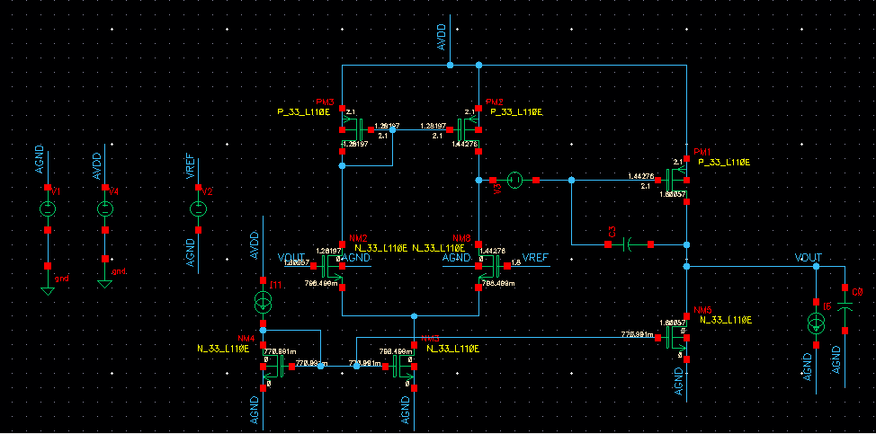
Circuit Diagram(Schematic)

Slide 7
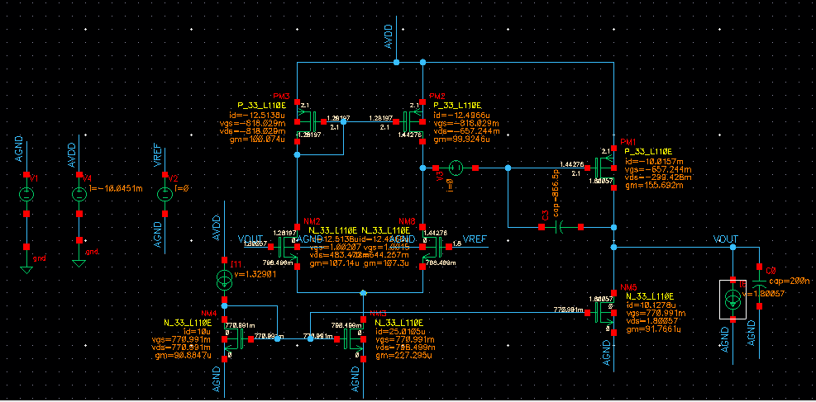
Simulation Result-1 (DC Operating Points for Compensated 10mA)

Slide 8
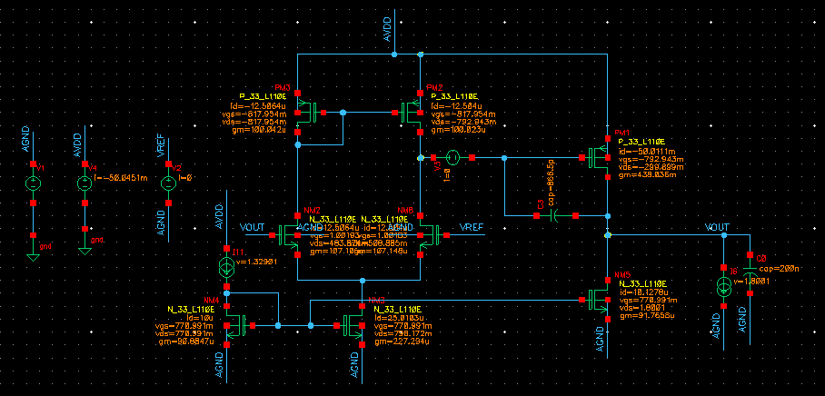
Simulation Result-1 (DC Operating Points for Compensated 50mA)

Slide 9
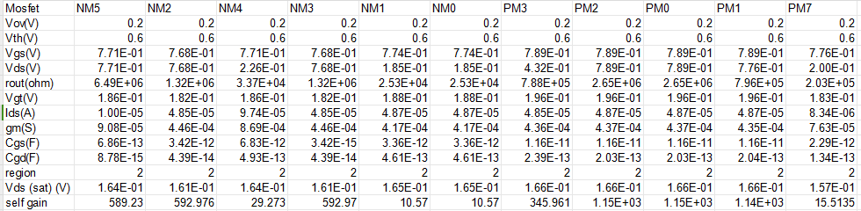
Theoretical Analysis or Design Approach
DC_Operating_Point_Values_of_All_Transistor_at _ILoad=50mA

Slide 10
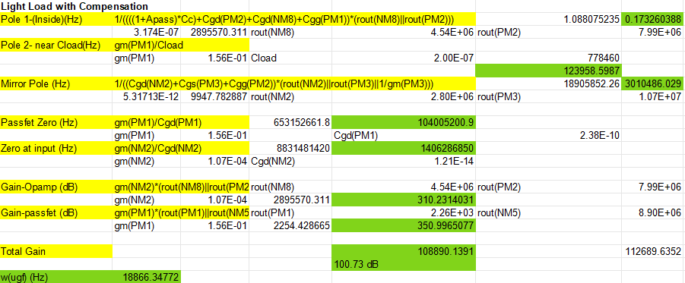
Light Load ILoad=10mA with Compensation Theoretical Calculation

Slide 11
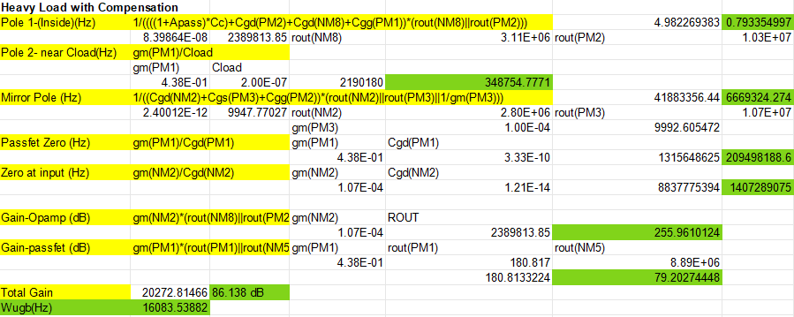
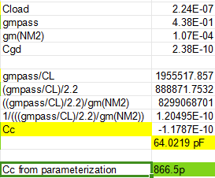
Heavy Load ILoad=50mA with Compensation Theoretical Calculation & Cc Parameterization

Slide 12
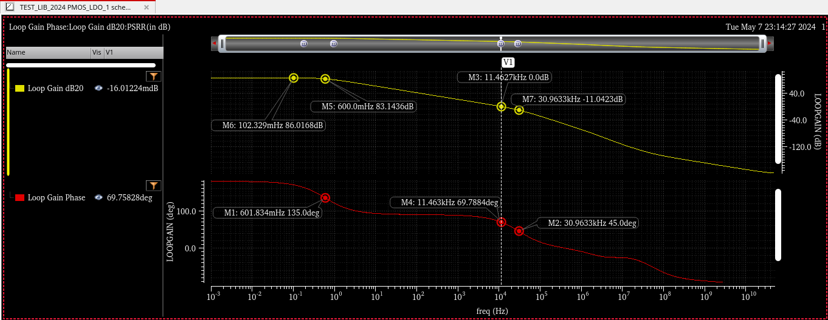
Simulation Result-2 (Gain & Phase Plots For Compensated ILoad=50mA)

Slide 13
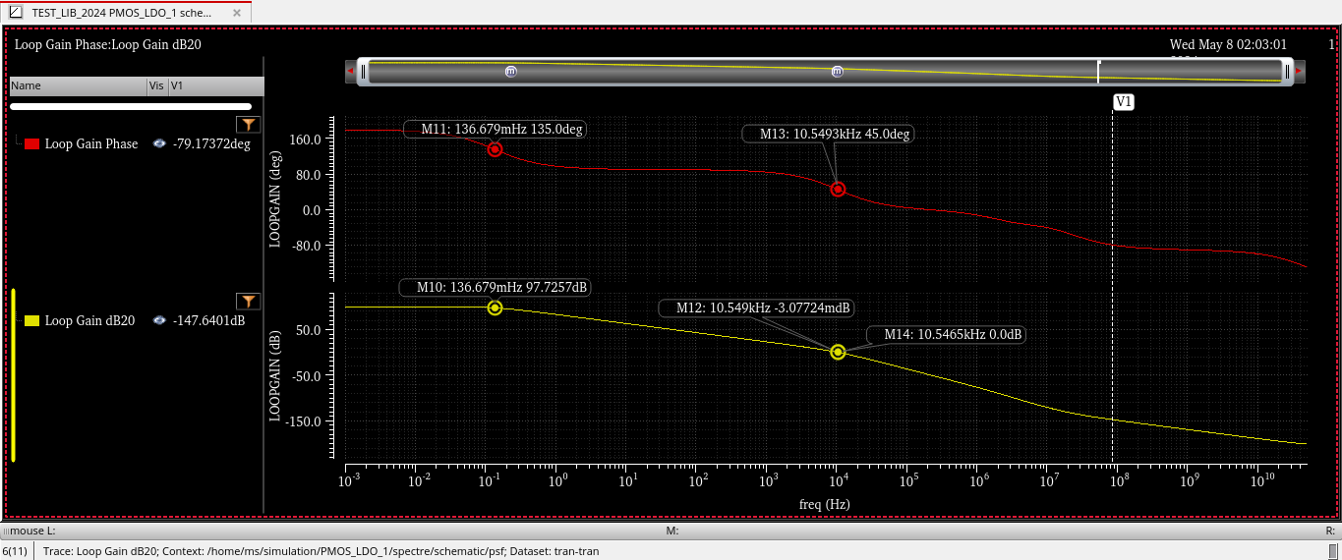
Simulation Result-2 (Gain & Phase Plots For Compensated ILoad=10mA)

Slide 14
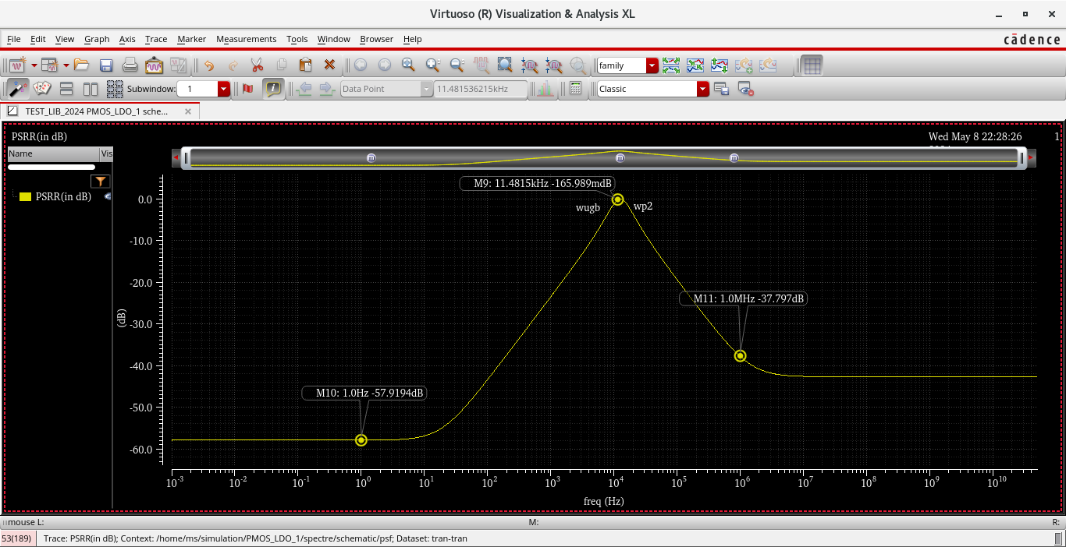
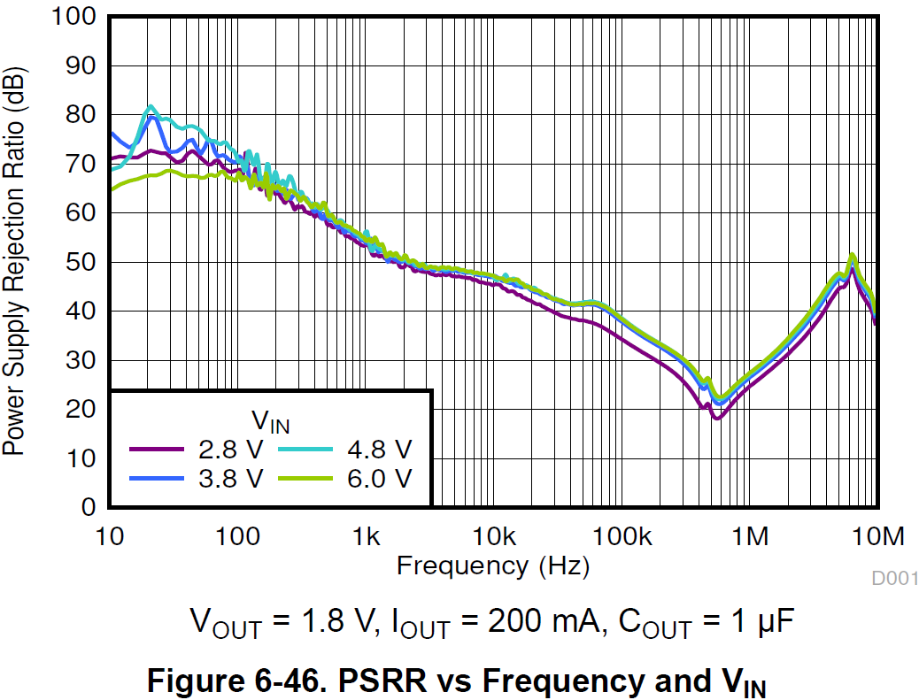
Simulation Result-3 PSRR at ILoad=10mA

Slide 15
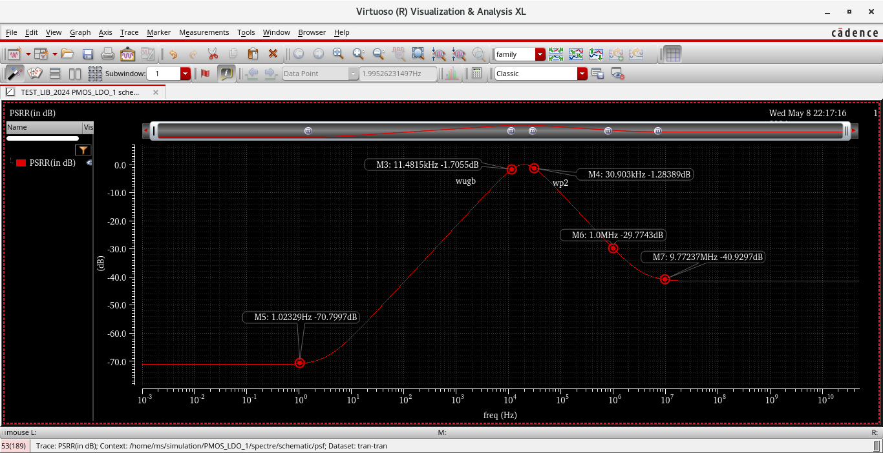
Simulation Result-3 PSRR at ILoad=50mA

Slide 16
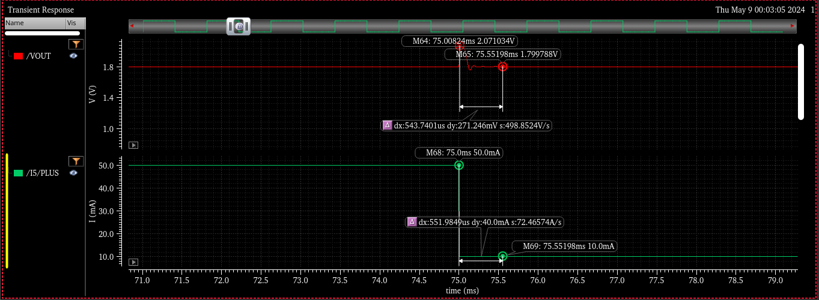

Simulation Result-4 Load Transient(ILoad=50mA to 10 mA)

Slide 17
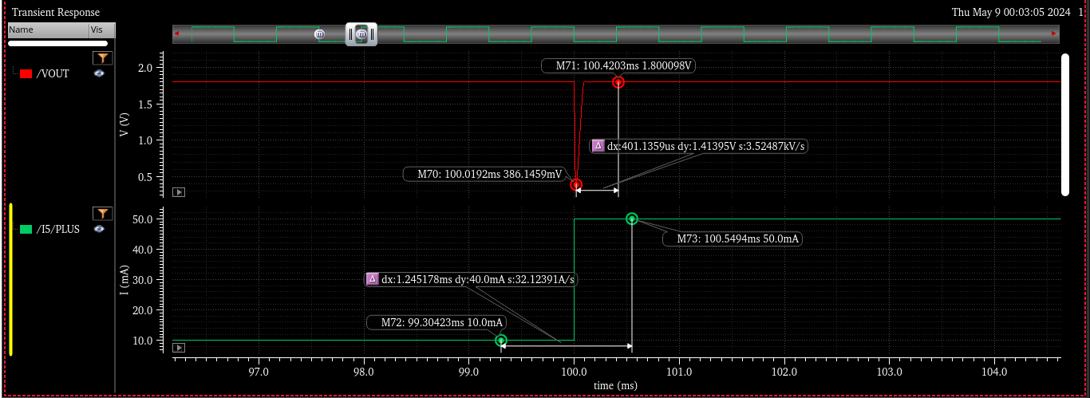
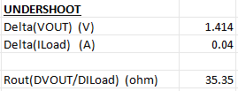
Simulation Result-4 Load Transient(ILoad=10mA to 50 mA)

Slide 18
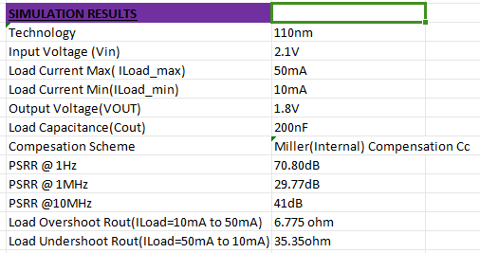
Simulation Results Table

Slide 19
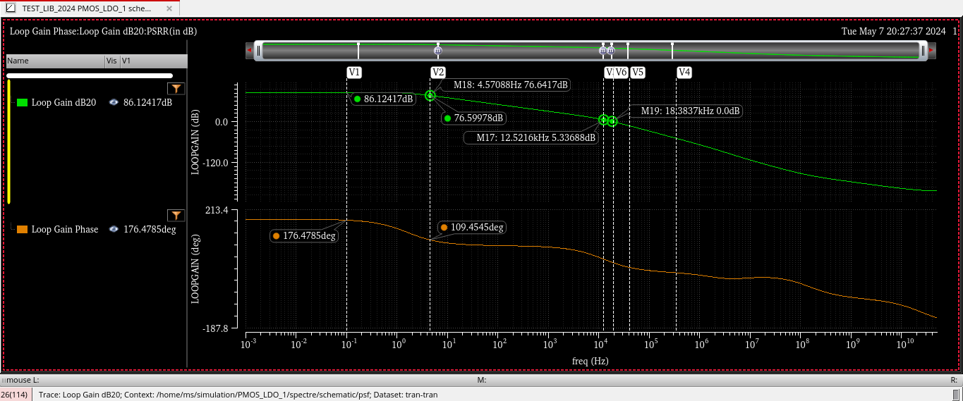
Simulation Result-2 (Gain & Phase Plots For Uncompensated ILoad=50mA)
Backup Slides

Slide 20
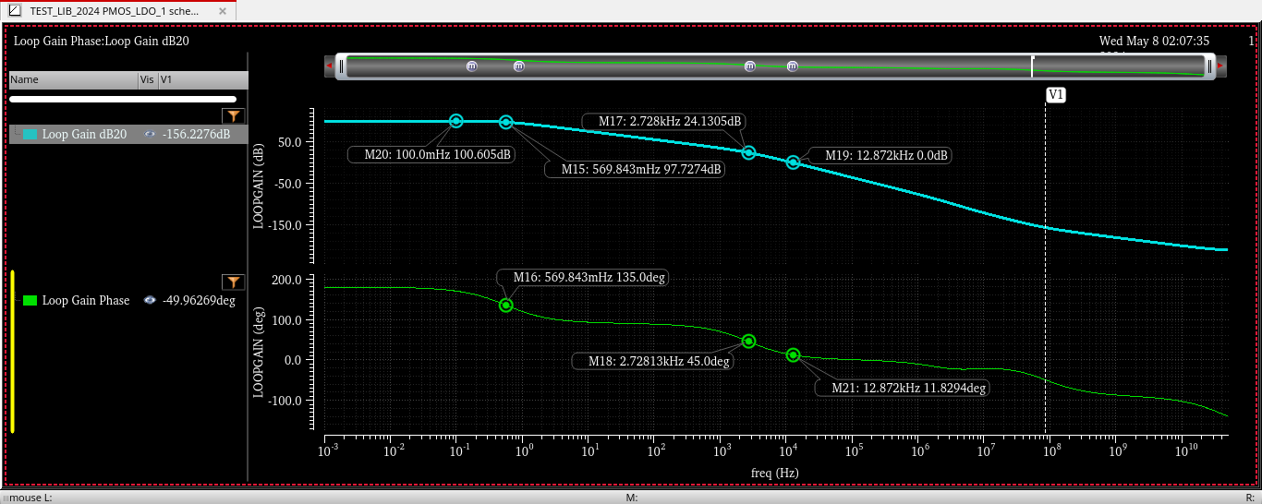
Simulation Result-2 (Gain & Phase Plots For Uncompensated ILoad=10mA)

Slide 21
Reference Paper 1: A 65-nm CMOS Low Dropout Regulator Featuring >60-dB PSRR Over 10-MHz Frequency Range and 100-mA Load Current Range
This paper presents an NMOS Passfet LDO, realized in 65-nm CMOS, featuring >60-dB PSRR over a 10-MHz frequency range and a 100-mA large load current range.
The high PSRR is achieved by anadaptive feed forward ripple cancellation (FFRC) technique embodying an adaptive load current tracking scheme.
By means of embodying an NMOS-based power stage, the LDO alsoachieves very low dropout voltage of 80 mV and features very small overshoot and undershoot of 2 and 4 mV respectively.

Slide 22
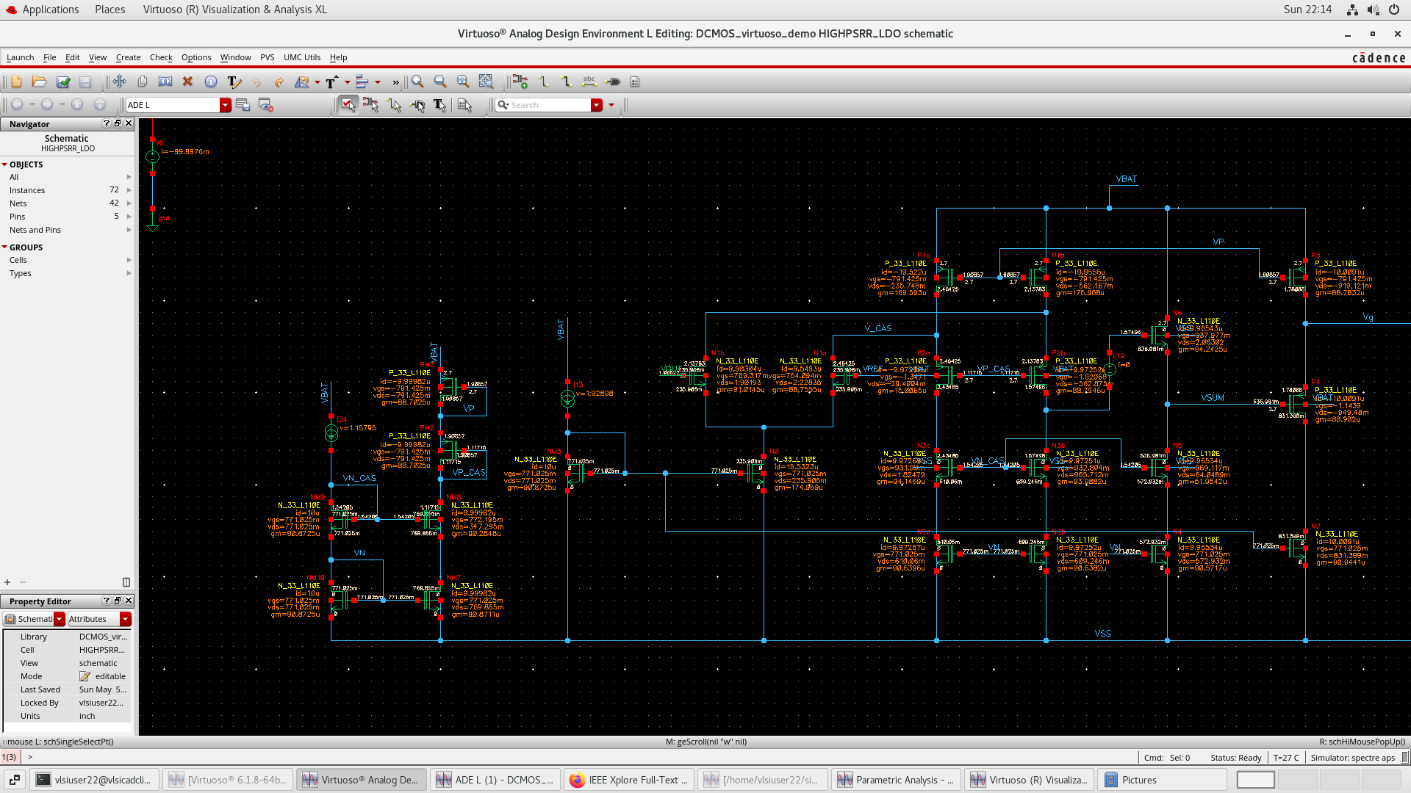
DC OPERATING POINT

Slide 23
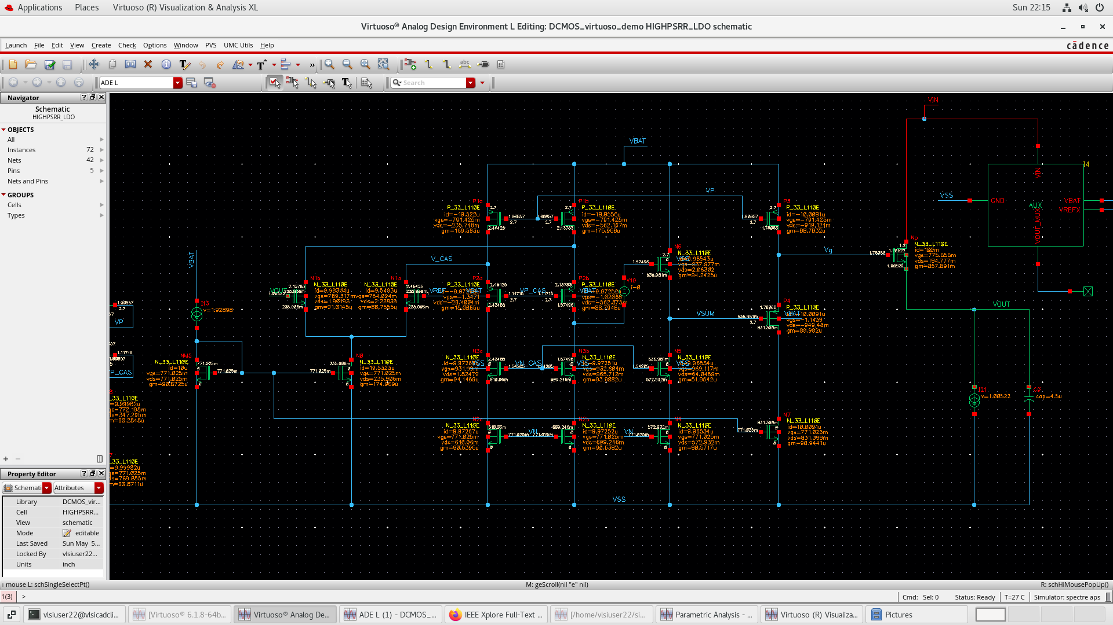

Slide 24
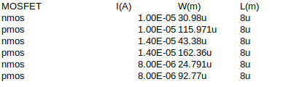
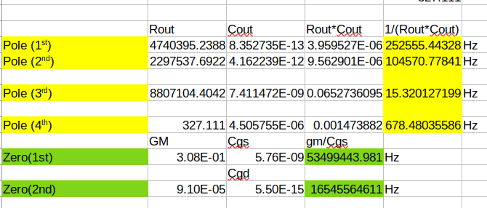
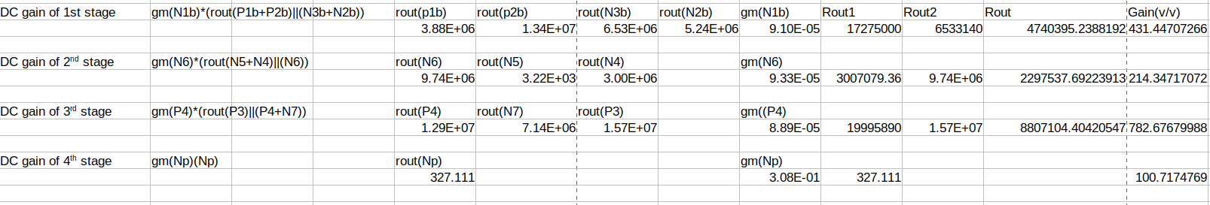
Theory Calculations

Slide 25
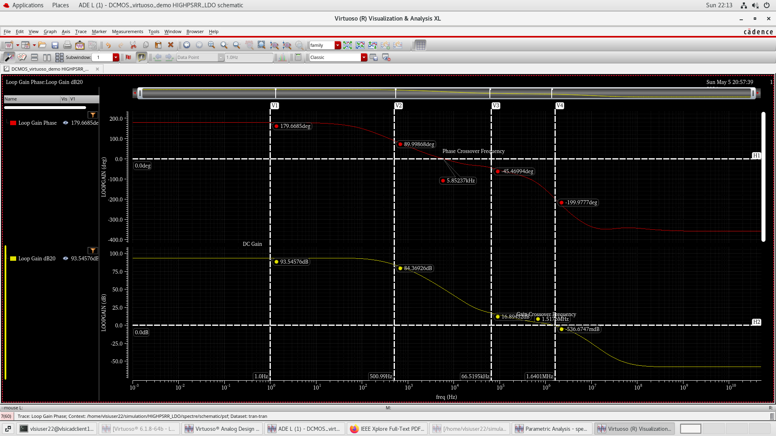
GAIN PLOT AND PHASE PLOT(Without AUX)

Slide 26
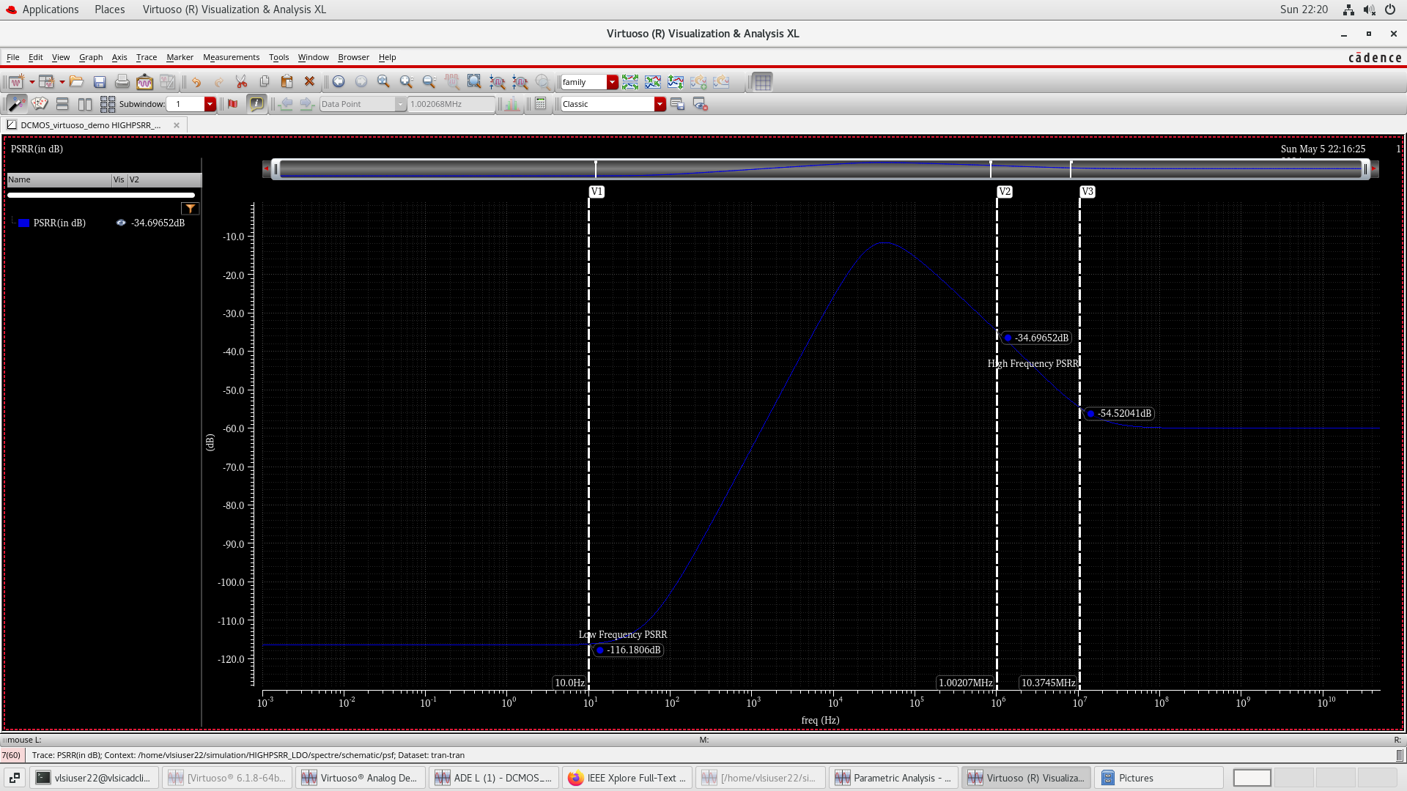
PSRR PLOT(Without AUX)

Slide 27
REFERENCE_TABLE_PAPER
https://ieeexplore.ieee.org/document/8369352/authors#authors
https://ieeexplore.ieee.org/document/10212011
https://ieeexplore.ieee.org/document/5419190
https://ieeexplore.ieee.org/document/9745733
https://ieeexplore.ieee.org/document/5617585
https://ieeexplore.ieee.org/document/9036907

Slide 28
THANK YOU

