Slide 1
A Brain-Computer Interface Control
System Design Based on Deep Learning
Third Year Individual Project Final Presentation
Zheng Xu | Student ID: 11314389 | Supervisor: Alex Casson
May 2026
1 / 16

Slide 2
Objective of This Presentation
1
Why MI-BCI robotic control is difficult
2
Which datasets and methods were selected
3
How the EEGTransformer decoder works
4
How channel reduction supports OpenBCI
5
How DQN closes the control loop
6
What the results, limits, and next steps show
Main message: the contribution is an integrated decoder -> controller -> deployment-oriented pipeline.
2 / 16

Slide 3
Project Aim and Problem
Project aim
Translate motor-imagery EEG into robotic arm commands using deep learning and reinforcement learning.
1
Non-stationary EEG
Different users and sessions shift the signal distribution.
2
Open-loop fragility
A single misclassified epoch can push the arm in the wrong direction.
3
Deployment gap
High-density 64-channel studies do not map cleanly to low-cost hardware.
The project therefore evaluates an offline/simulated perception -> decision -> action loop, not classification accuracy alone.
3 / 16

Slide 4
Background: Motor-Imagery BCI
1
2
3
4
EEG
Scalp electrodes record microvolt brain activity
Motor imagery
Labels depend on dataset; imagined movement becomes command evidence
Mu/Beta rhythms
8-30 Hz activity over sensorimotor cortex changes
Robot command
Predicted intention becomes a directional control cue
Why motor imagery?
It requires no external stimulus and supports voluntary assistive control, but single-trial EEG is noisy and user-dependent.
Control challenge
A robot must recover from wrong cues over time, so the controller must be closed-loop rather than a fixed label-to-action map.
4 / 16

Slide 5
Literature Review: Method Gap
CSP / FBCSP
Interpretable spatial filters
Sensitive to covariance drift
EEGNet / CNNs
Learn compact spatial-temporal filters
Mostly independent single-trial decisions
EEG-Conformer / ATCNet
Stronger CNN-attention decoders
Classifier output still treated as endpoint
RL for EEG
Useful for feature selection or adaptation
Less often used for actuator control
73.80%
Ours on BCI IV-2a
77.7%
EEG-Conformer
80.5%
ATCNet
Positioning: indicative literature context, not a direct leaderboard; the main contribution is the closed-loop pipeline.
5 / 16

Slide 6
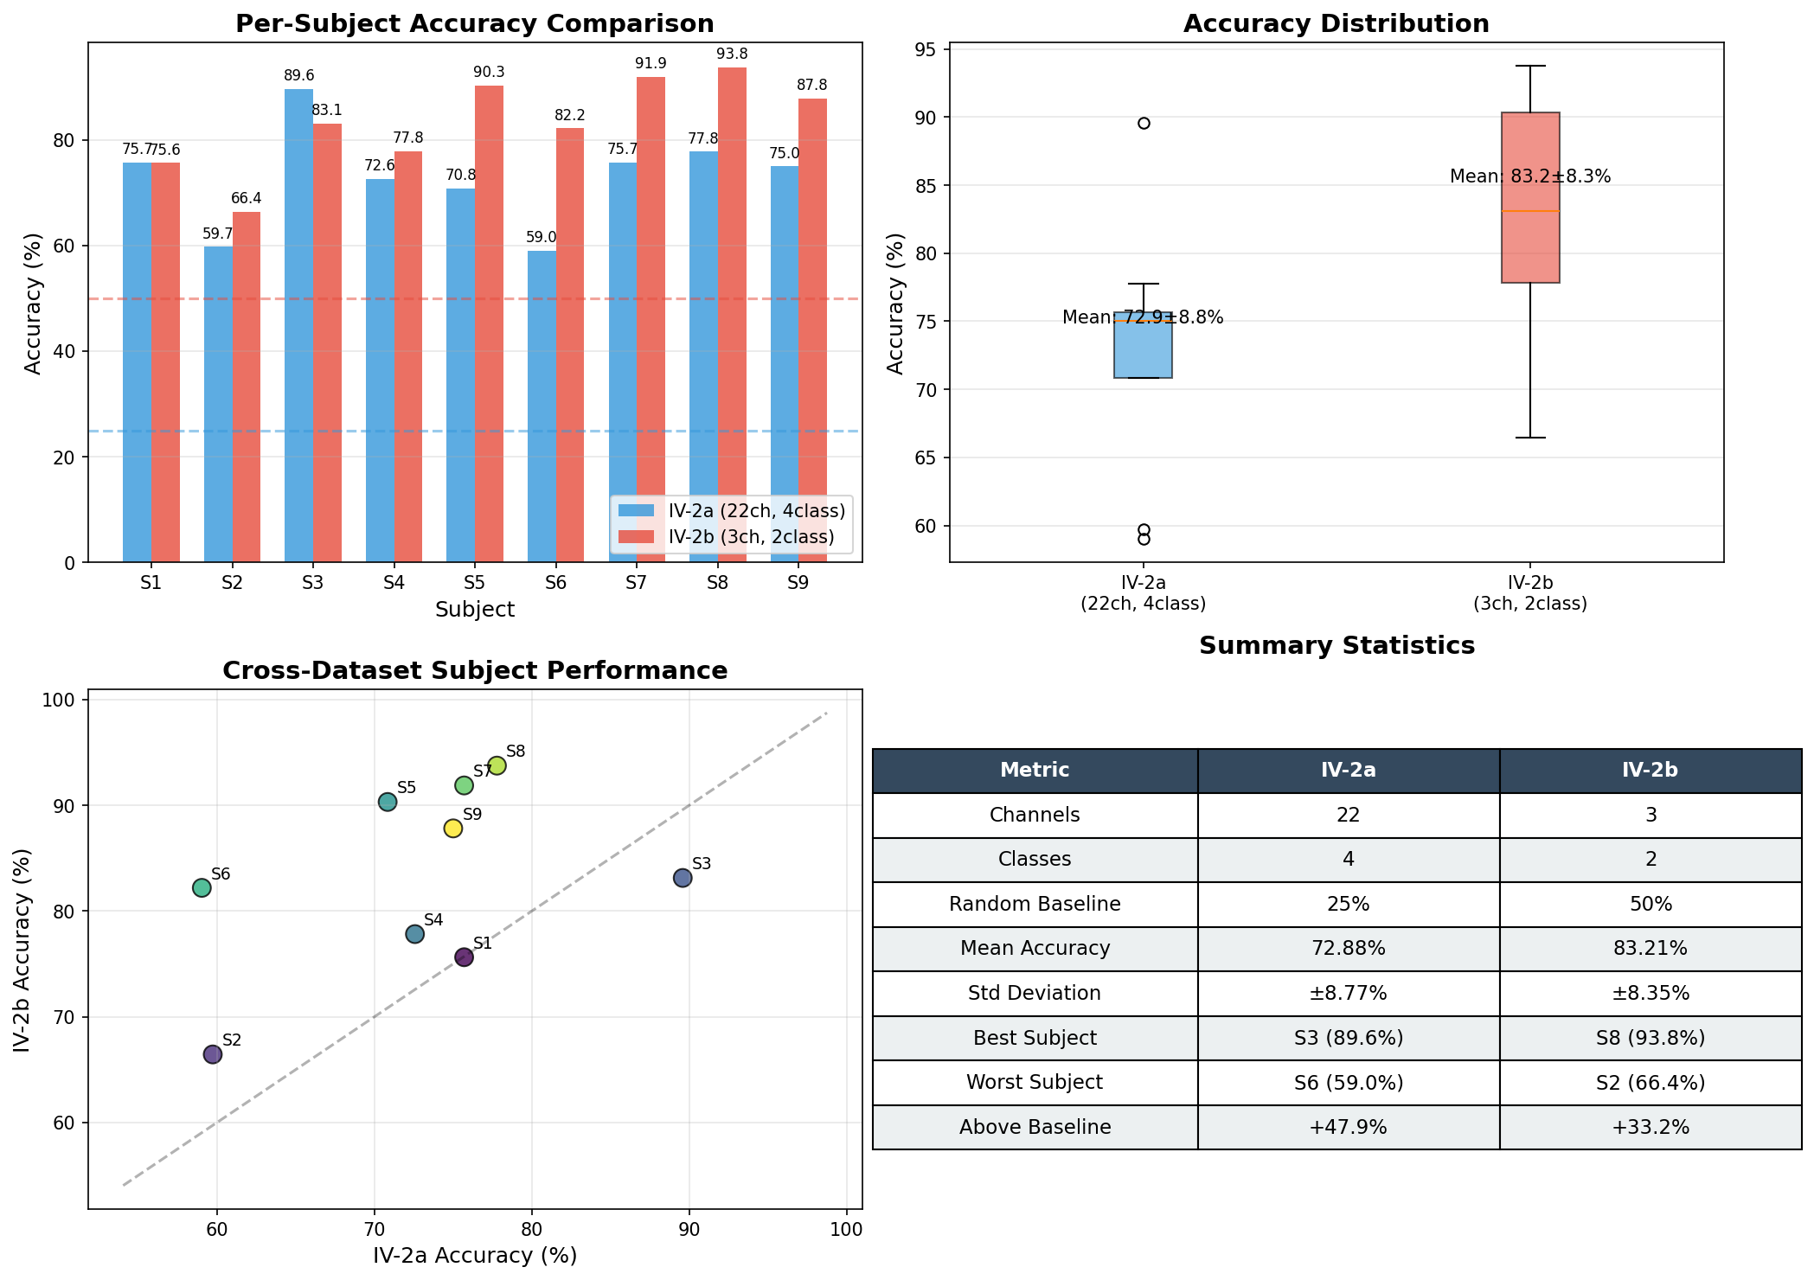
Dataset and Method Choice
BCI IV-2a
22 ch | 4 classes | 9 subjects
Standard multi-class benchmark for literature comparison.
BCI IV-2b
3 ch | 2 classes | 9 subjects
Minimal-channel stress test under strong hardware constraint.
PhysioNet EEGMMIDB
64 ch | 4 classes | 109 subjects
Large subject pool for cross-subject pre-training and fine-tuning.
The datasets are evaluated independently because their montages, class definitions, and published protocols differ.
6 / 16

Slide 7
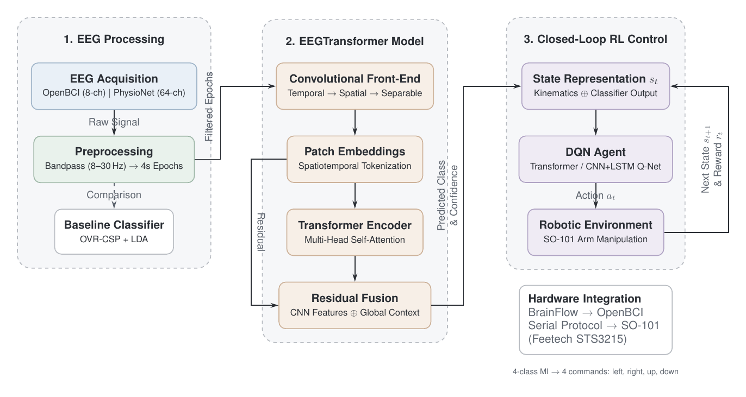
Overall System Architecture
Classifier output is noisy DQN evidence; OpenBCI was interface/synthetic-board validated, not live EEG controlled.
7 / 16

Slide 8
Preprocessing and Evidence
Raw EEG
EDF / MAT loading, channel standardisation
8-30 Hz bandpass
Keeps motor-imagery Mu/Beta information
Epoch + resample
Fixed input tensor for EEGTransformer
Normalise
Training statistics reused on held-out data
+18.44%
5-subject PhysioNet filter ablation
+1.51%
3-subject BCI IV-2a ICA test
Resulting choice
Use a bandpass-only pipeline for the main experiments. ICA is reported as limited-scope evidence, not a universal conclusion.
8 / 16

Slide 9
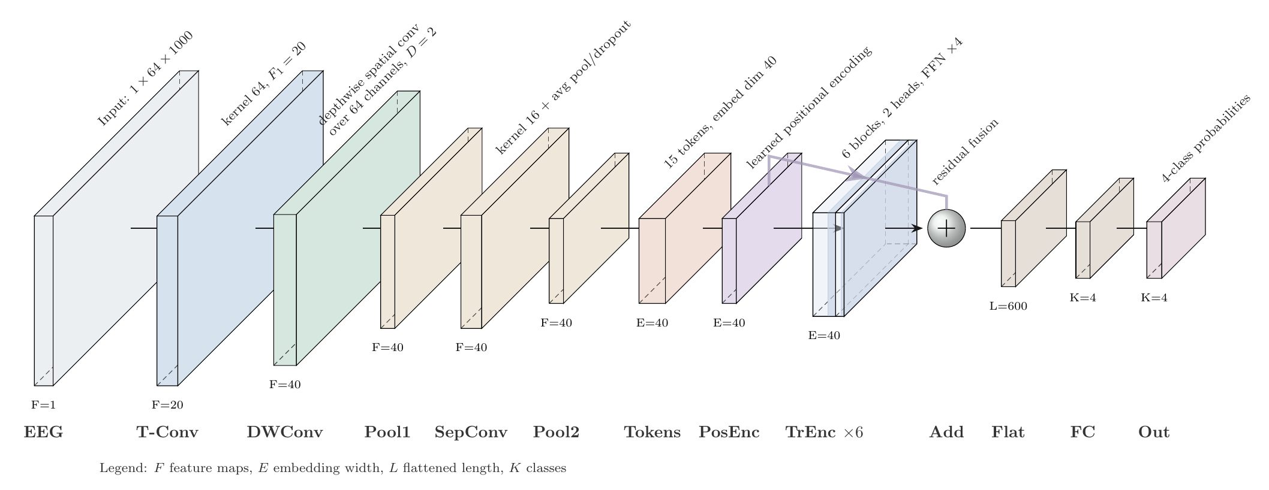
EEGTransformer Design
CNN front-end
Learns temporal filters and data-driven spatial filters.
Transformer encoder
Models long-range structure across the MI window.
Residual fusion
Combines local EEG features with global context before classification.
64 x 1000
Main PhysioNet input
15 tokens
After pooling
4 classes
MI command output
9 / 16

Slide 10
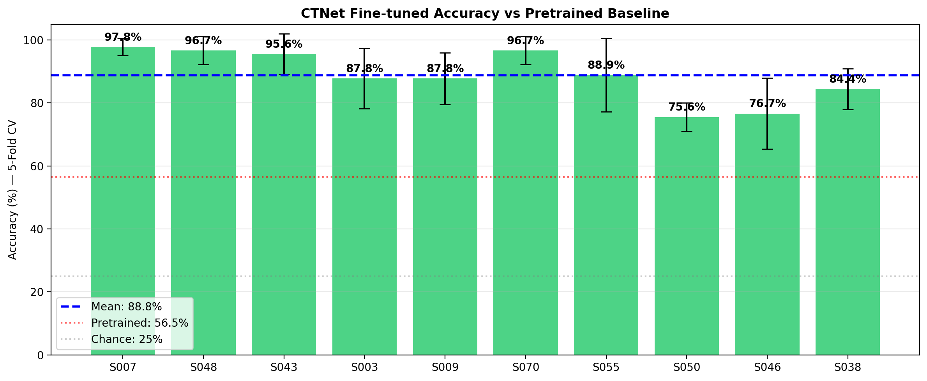
Training and Transfer Learning
56.54%
Pooled cross-subject PhysioNet
88.78%
Fine-tuned mean | 10 subjects
+32 pts
Gap reduced in fine-tuning eval
Interpretation: fine-tuning adapts a transferable MI representation; broader full-cohort validation remains future work.
10 / 16

Slide 11
Classification Results: Useful Decoder, Not SOTA
73.80%
BCI IV-2a | 22 ch | 4 class
82.87%
BCI IV-2b | 3 ch | 2 class
88.78%
PhysioNet | fine-tuned
Literature context: competitive with CNN baselines, below stronger recent attention models; contribution is system integration.
FBCSP + SVM
67.6%
Classical baseline
EEGNet / ShallowConvNet
68-72%
Compact CNN family
EEG-Conformer
77.7%
CNN + Transformer
ATCNet
80.5%
Attention temporal CNN
EEGTransformer (ours)
73.80%
Competitive, system-oriented
11 / 16

Slide 12
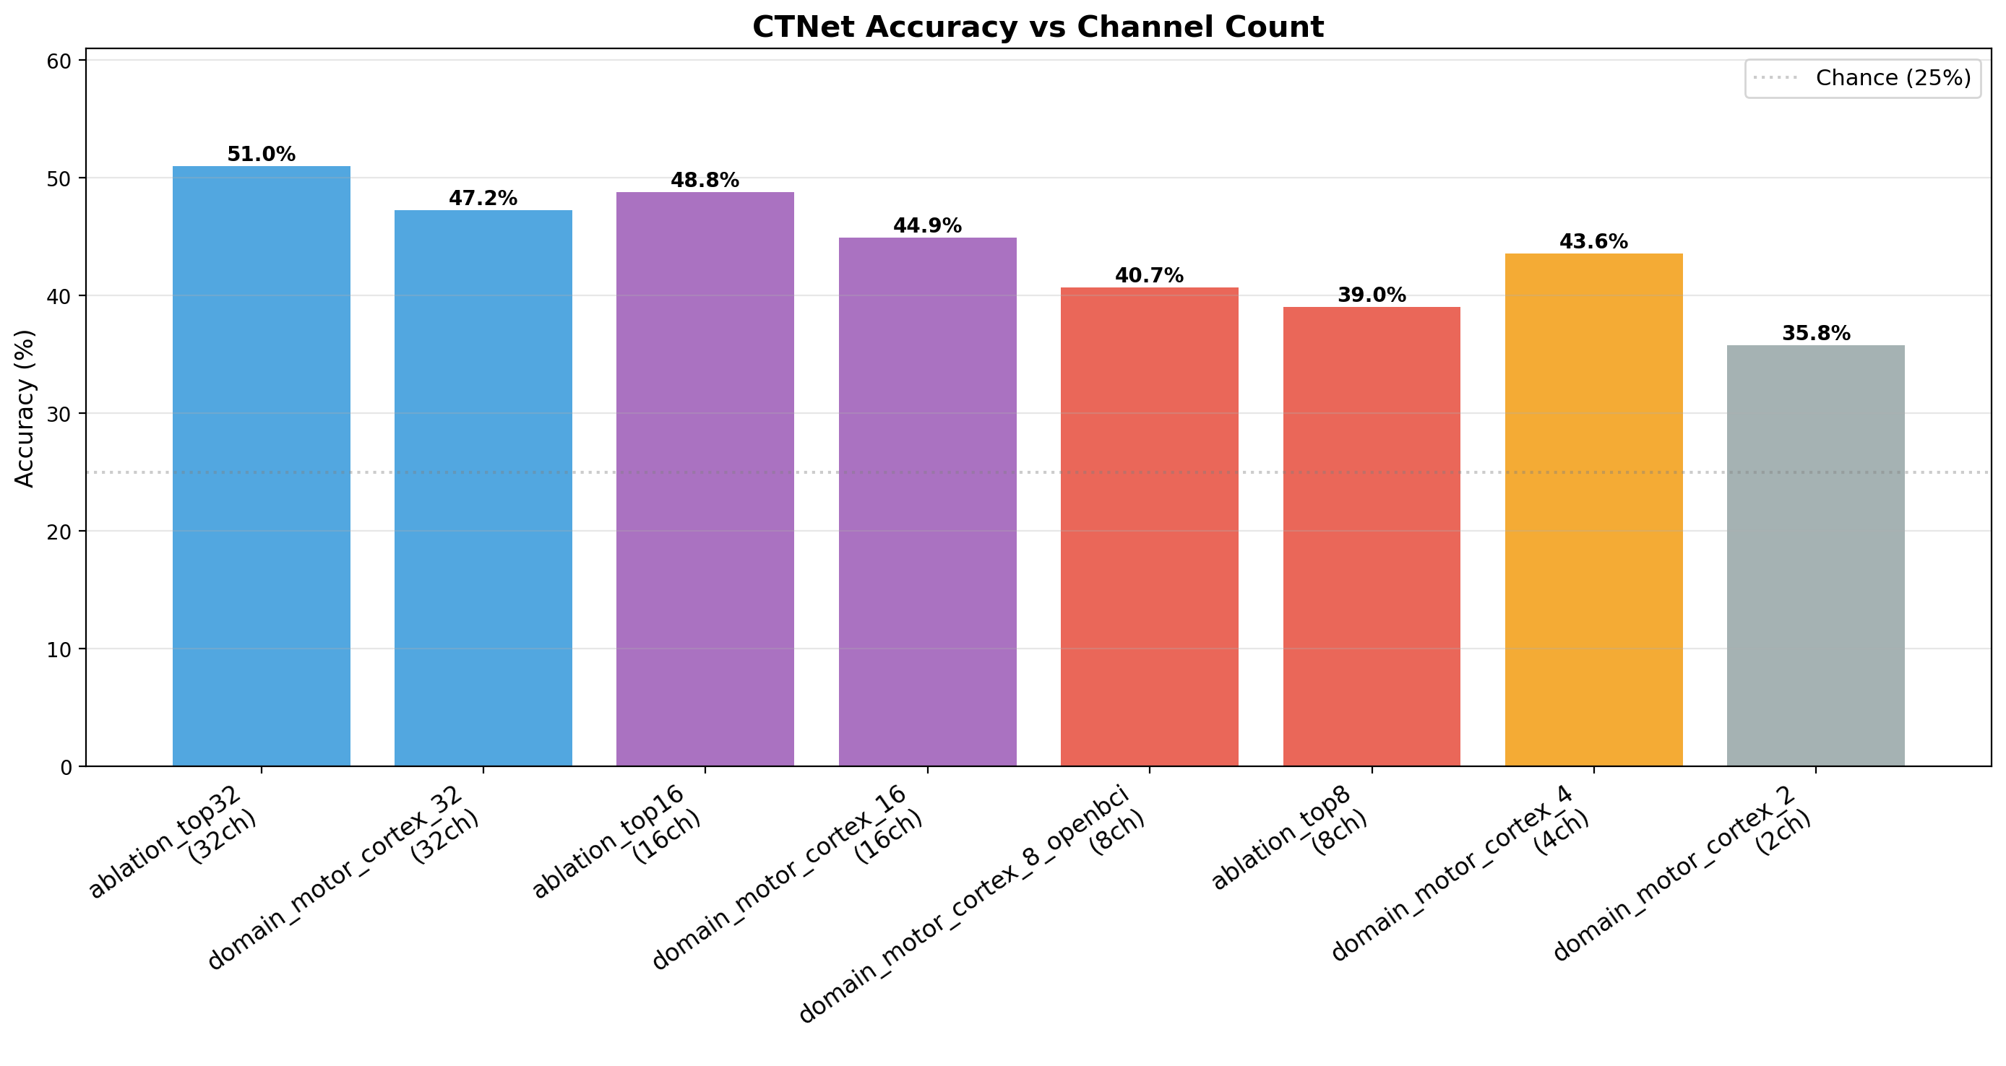
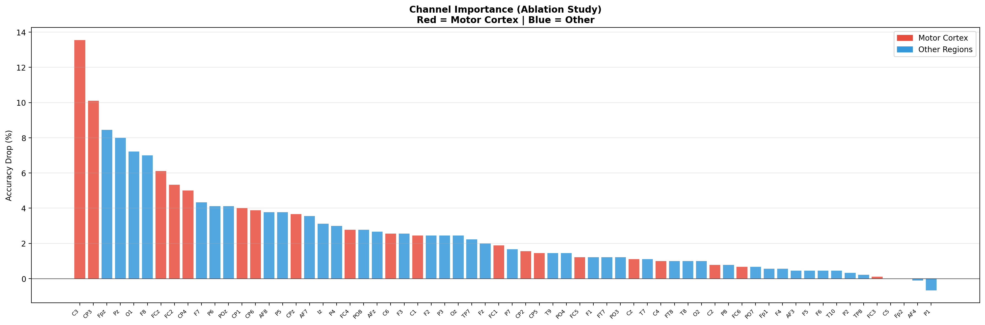
OpenBCI-Oriented Channel Reduction
C3
Largest ablation drop
8 ch
OpenBCI-compatible montage
72.54%
Fine-tuned accuracy
Boundary: this is offline evidence for an 8-channel montage; native live OpenBCI validation is future work.
12 / 16

Slide 13
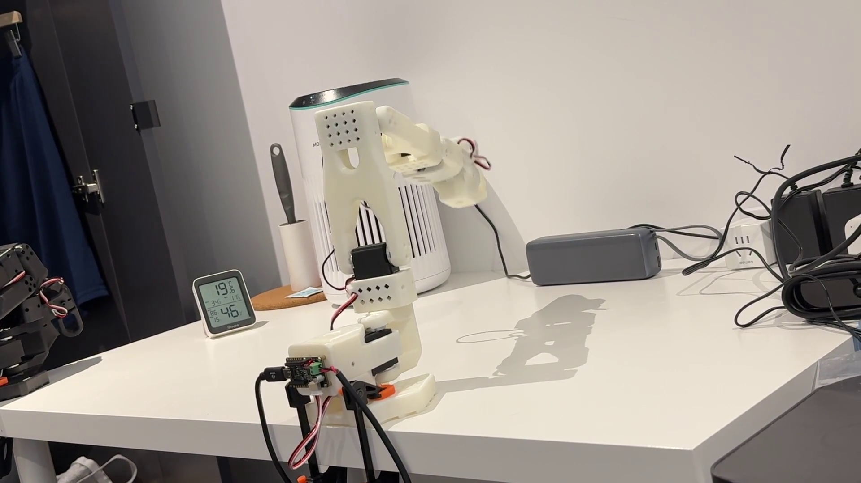
Robotic Control and RL Method
State
End-effector position, target position, distance, optional EEG class + confidence
Action
Four discrete directions: left, right, up, down
Reward
Target reaching, distance improvement, step penalty, boundary penalty
Environment
PyBullet / planar reaching simplification before richer SO-101 manipulation
Top: physical SO-101 interface frame. Bottom: animated control GIF plays in PPTX; PDF shows a static frame.
Controller role: use the current state to correct transient EEG misclassifications instead of blindly executing each label.
13 / 16

Slide 14
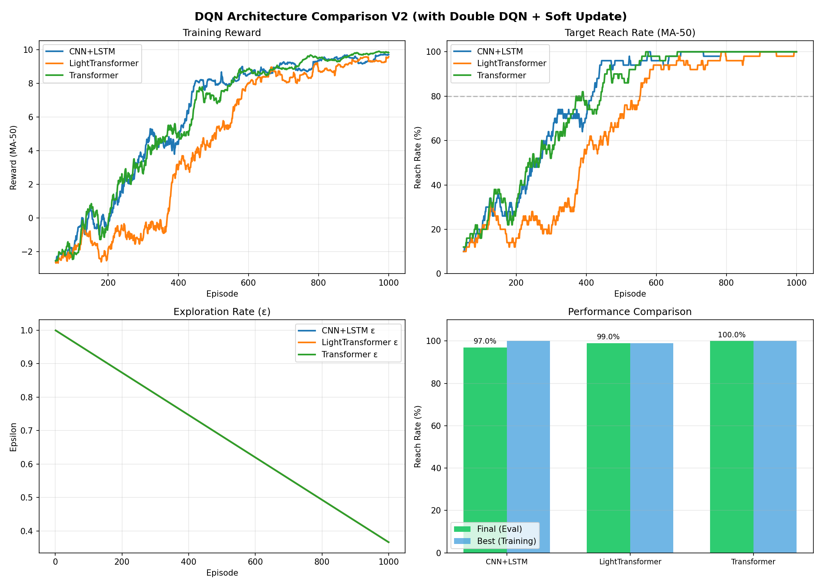
RL Results
97%
CNN+LSTM final reach rate
99%
Light Transformer reach rate
100%
2D benchmark reach rate
10.39
Transformer final reward
Under this simulated reaching protocol, the full Transformer scores highest; Light Transformer is a practical trade-off.
14 / 16

Slide 15
End-to-End Results
82.22%
EEG accuracy on 630 trials
98.7%
EEG-aware reach rate
99.0%
State-only reach rate
668s
With EEG state
1130s
Without EEG state
Why control can exceed decoding
The DQN does not execute each class label blindly.
It observes state, target distance, class, and confidence over multiple steps.
Reward feedback allows wrong directional cues to be corrected.
What EEG added in this test
Final reach rate was similar: 98.7% with EEG vs 99.0% state-only.
Training was faster with EEG evidence: 668 s vs 1130 s.
This supports usefulness, not proof that EEG is essential in the simplified task.
Main interpretation: closed-loop DQN compensates for imperfect EEG; EEG evidence mainly accelerates learning in this simulation.
15 / 16

Slide 16
Discussion, Conclusion, and Next Steps
What was shown
EEGTransformer works competitively: 73.80%, 82.87%, 88.78%
Fine-tuning reduces cross-subject weakness: 56.54% -> 88.78%
8-channel montage remains usable offline: 72.54%
End-to-end simulation: 98.7% EEG-aware, 99.0% state-only
What was not shown
No live human-subject EEG control
BrainFlow was synthetic-board interface validation
8-channel OpenBCI result is offline, not native live deployment
4 s online window may be too slow for real-time use
Next steps
Ethics-approved live-user OpenBCI study
Native real-time 8-channel inference path
Shorter overlapping windows or asynchronous MI
Richer SO-101 manipulation beyond planar reaching
Validation boundary: EEG classification is offline; control is simulated; live human closed-loop testing requires ethical approval.
16 / 16

