Slide 1


ACTivate Groups
A Secure Hub for Private Groups: A decentralized information sharing application designed for private, self-organizing groups that is resistant to censorship.
Built on Swarm: It uses Swarm for decentralized storage
and peer-to-peer communication, ensuring there are
no central servers.
The Problem It Solves: Traditional communication platforms are vulnerable to surveillance, censorship, and shutdowns. This puts activists, journalists, and other at-risk individuals in danger by exposing their sensitive communications.
This app provides a secure and resilient alternative.

Slide 2

Anonymous & Secure Onboarding
Public Keys for Anonymity: Your identity is protected. Users are identified only by a Swarm public key, not their real-world identity.
Offline Key Sharing: To join a group, you share your public key with the group's admin. This can be done offline, in secret – for example written on paper and passing it discreetly.
Controlled Access: Distributing public keys this way ensures that only trusted and verified individuals are given access, maintaining the group's privacy and security from the very first step.

Slide 3

How Group Admins Grant Access
Creating a Group: A group administrator initiates a new group within the ACTivate Groups application.
Managing Membership with ACT: The admin uses Swarm's Access Control Trie (ACT), a decentralized and tamper-proof membership list, to manage who is in the group.
Adding Members: Admin adds the public keys, received from potential members, to the group's ACT. This action officially grants those individuals access to view the group's private content feed.

Slide 4

Notified of Access via a Smart Contract
On-Chain Invitation: An admin sends an invitation to a new member's public key via a smart contract transaction.
Encrypted Info: This transaction contains the encrypted group details: its content feed address, feed topic and ACT reference.
Automatic Access: The member's app listens for this transaction, automatically decrypts the information, and joins the group feed.
Optional Funding: Admins can include funds (xBZZ) in the tx. to empower new members to start their own groups.

Slide 5
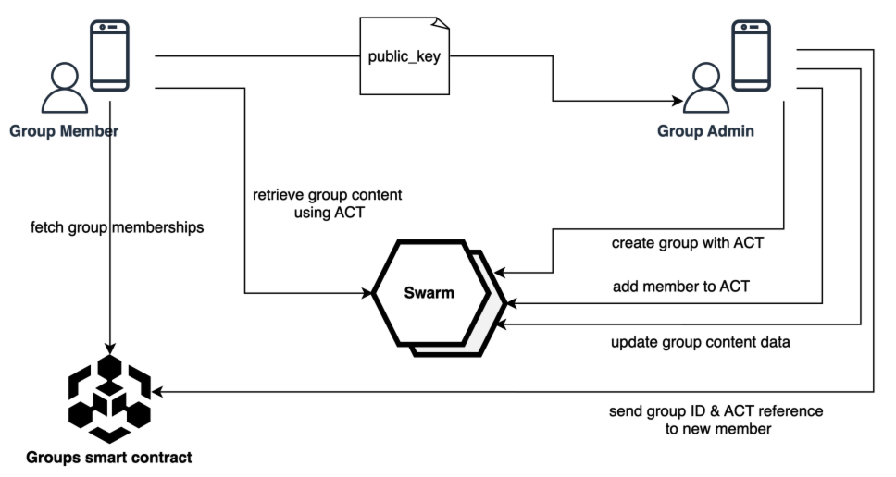
How ACTivate Works

Slide 6

Unstoppable Privacy & Security
Total Anonymity & E2E Encryption: Your identity is protected, and messages are fully encrypted, ensuring only group members can read them.
No Central Point of Failure: With no central servers, there's nothing to block or seize. Data is distributed across the peer-to-peer Swarm network.
Resists Takedowns: The network is designed for resilience. Even if central services like DNS are blocked, the app can run on self-hosted nodes, ensuring it stays online.

