Slide 1
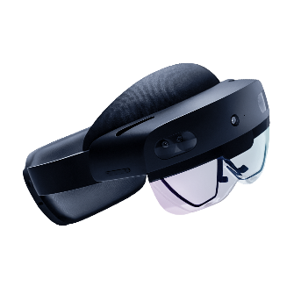
Unity App
Scene
update pose
SolAR Cloud Client
SolAR Cloud Service Frontend
C# scripts
gRPC
Image, poses
transform3D
start/stop
Image, poses
C++ plugin
Fetch frames
Windows Media Capture
Research Mode API
PV (RGB camera)
Tracking cameras, IMU, Depth

