Slide 1
Group 8 Project: IntelliJ Airport Booking System
14 December 2020

Slide 2
Meet the team
Everyone
Ciaran O’Boyle
B00793232
Melissa Melaugh
B00743475
Michelle Loughran
B00797038

Slide 3
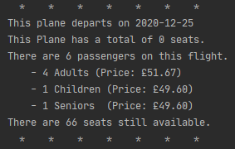
What’s the Project?
IntelliJ Airport Booking System
Book
Book plane tickets for yourself and your family
Find the plane you want to take
Input your details
Get your tickets
Get the price owed
View
View a plane
Find the plane you want to view
See details about the flight

Slide 4
Requirements
A Checklist

Slide 5
Methods
Burn Down Chart

Slide 6
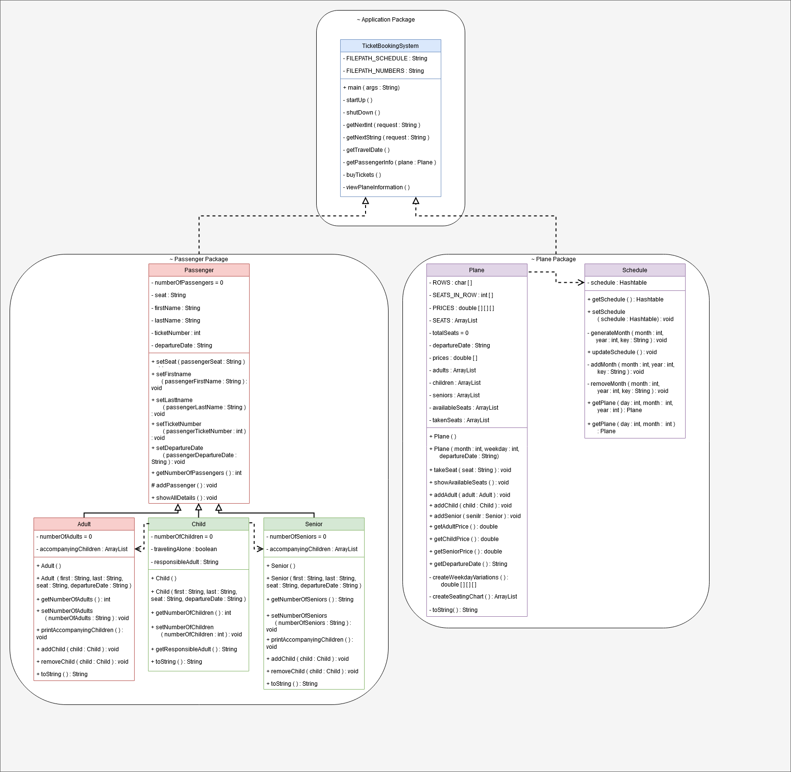
Methods
UMLs Overview
Application Package
Plane Package
Passenger Package

Slide 7
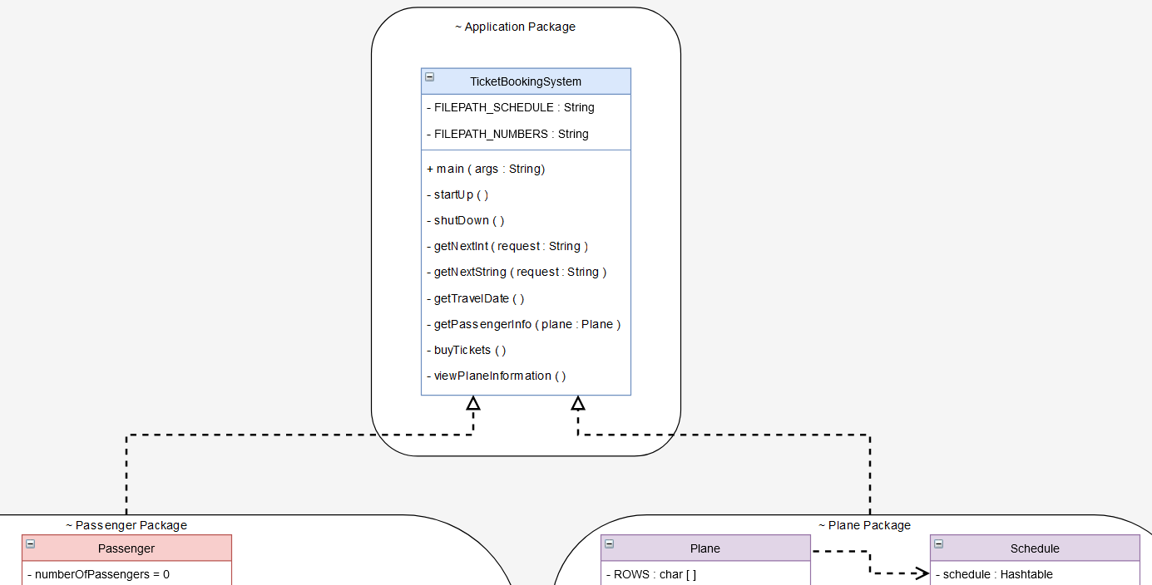
Methods
UMLs – Application Package

Slide 8
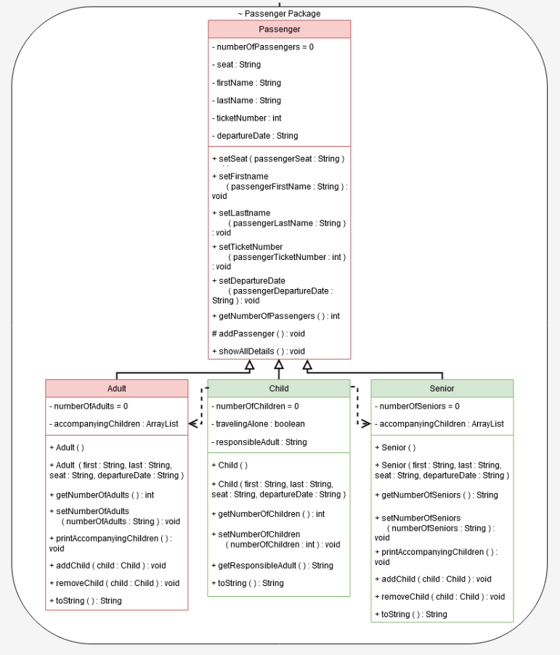
Methods
UMLs – Passenger Package

Slide 9
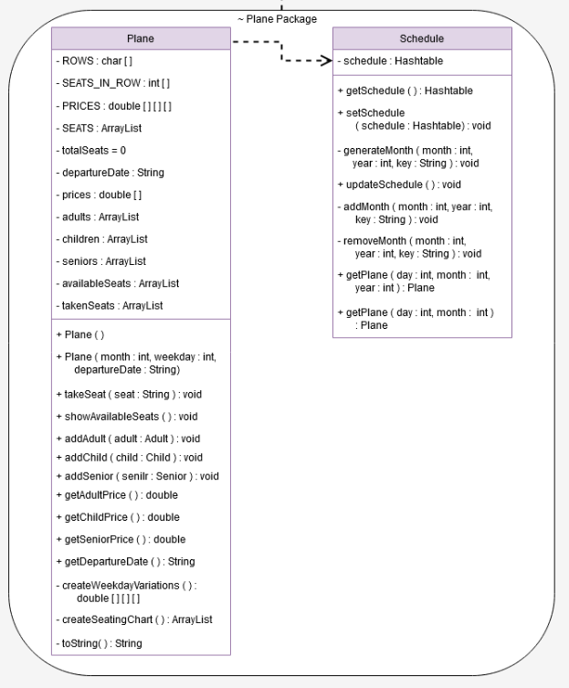
Methods
UMLs – Plane Package

Slide 10
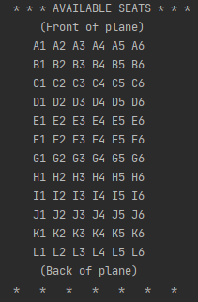
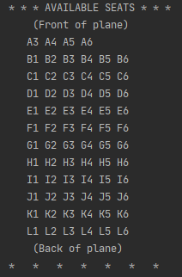
Methods
Testing
Every member was responsible for testing their classes
Tests for the Plane Package and Passenger Package were performed in the Test package
TicketBookingSystem was tested manually by running the program and inputting data

Slide 11

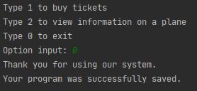
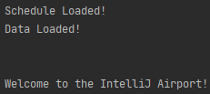
Features
What can it do?
Get User Input
Create Plane Tickets
Calculate Prices for multiple ticket purchases
View information on a Plane
Save and Load Schedules and Passenger Details

Slide 12
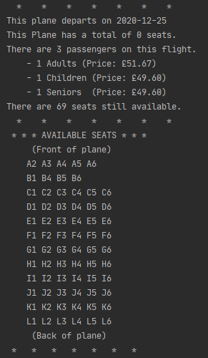
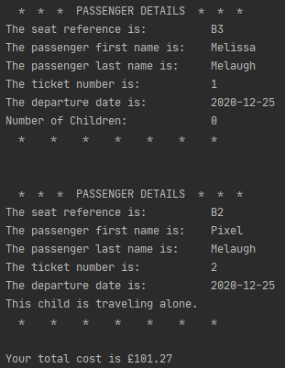
Features
What can it do?

Slide 13
Future Direction
Things we couldn’t get to
Schedule/Plane: Departure Time
Schedule/Plane: Delays
Schedule/Plane: Arrival Time
Plane: Destination
Plane: Departure Place
Plane: Use this as an Abstract class and have Child classes of different plane types.
Plane: Be able to remove a passenger from the list
Plane: Be able to let a passenger change seats
Passenter: Account for when the number of passengers becomes too big for an int value
TicketBookingSystem: Add error handling for incorrect menu choices (incorrect passenger type, incorrect date)
TicketBookingSystem: Find a better place to save your files
TicketBookingSystem: Find a better place to save your files

Slide 14
Thank you
Any Questions?

