Slide 1
Loving That New Car Smell
until it kills you!
By: Melissa Moyer

Slide 2
A smell that can kill…
There are more than 275 different chemicals that are found on the dashboards, steering wheels, armrests and seats.
Brominated flame retardants and polyvinyl chloride have been found in many new cars.
These chemicals aren’t yet regulated.

Slide 3

So many Chemicals
More than 275 chemicals make up the “new car smell”.
It is so well liked that companies try to make air fresheners to capture this smell
These chemicals can be hazardous to your health

Slide 4
A smell that can kill…
There are more than 275 different chemicals that are found on the dashboards, steering wheels, armrests and seats.
Brominated flame retardants and polyvinyl chloride have been found in many new cars.
These chemicals aren’t yet regulated.

Slide 5
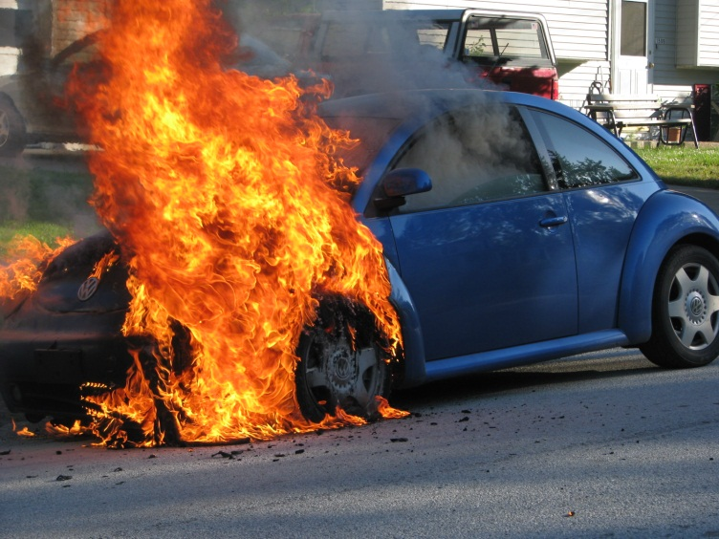
Brominated Flame Retardants
Linked to:
Thyroid problems
Learning and memory impairment
Decreased fertility
Behavioral changes

Slide 6
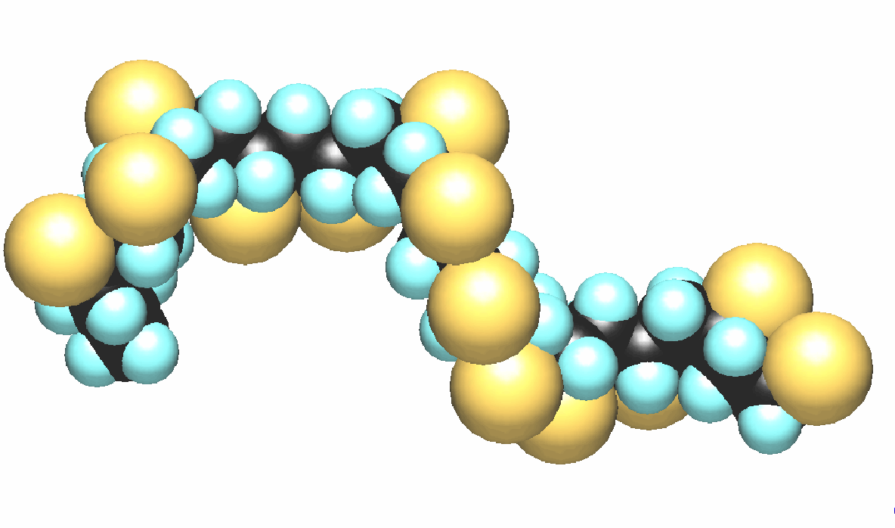
Polyvinyl Chloride
Linked to:
Decreased fertility
Problems with
Liver
Testes
Thyroid
Ovaries
Kidneys
Blood

Slide 7
A smell that can kill…
There are more than 275 different chemicals that are found on the dashboards, steering wheels, armrests and seats.
Brominated flame retardants and polyvinyl chloride have been found in many new cars.
These chemicals aren’t yet regulated.

Slide 8

Regulation?!
As of February 2012 only 17% of new cars were free of polyvinyl chloride, while 60% are free of brominated flame retardants.
Prior to 2006 there were no polyvinyl chloride free cars.
Some other chemicals of concern were lead and other heavy metals

Slide 9

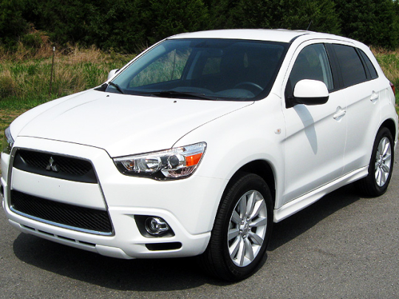
CBS Cares According to their study
Healthiest
2012 Honda Civic
Unhealthiest
Mitsubishi Outlander Sport (TIE)

