Slide 1


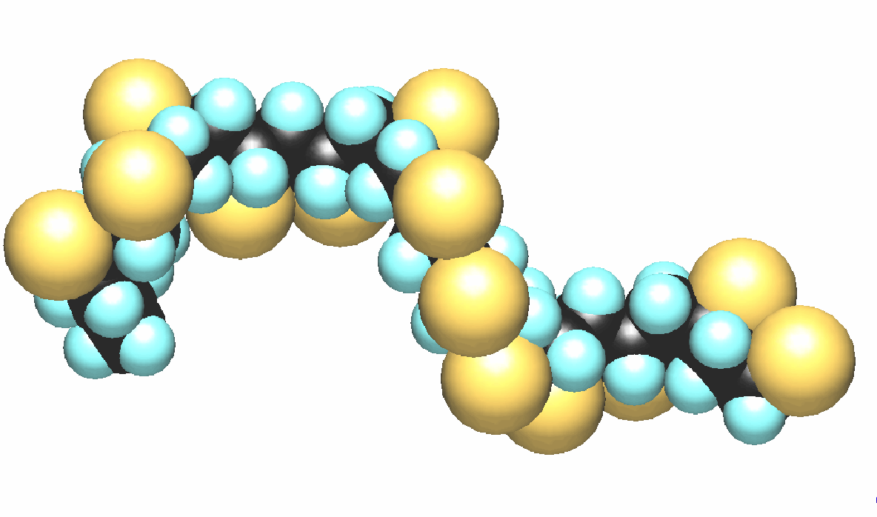


Love that new car smell
There are more than 275 different chemicals that are found on the dashboards, steering wheels, armrests and seats.
Brominated flame retardants and polyvinyl chloride have been found in many new cars
The smell is so well liked that companies try to make air fresheners to capture this smell, and yet, they can be detrimental to your health.
These chemicals are linked to thyroid problems. learning and memory impairment, decreased fertility, behavioral changes, and problems with the liver, kidneys and blood.
As of February 2012 only 17% of new cars were free of polyvinyl chloride, while 60% are free of brominated flame retardants. Prior to 2006 there were no polyvinyl chloride free cars. Some other chemicals of concern were lead and other heavy metals

