Slide 1
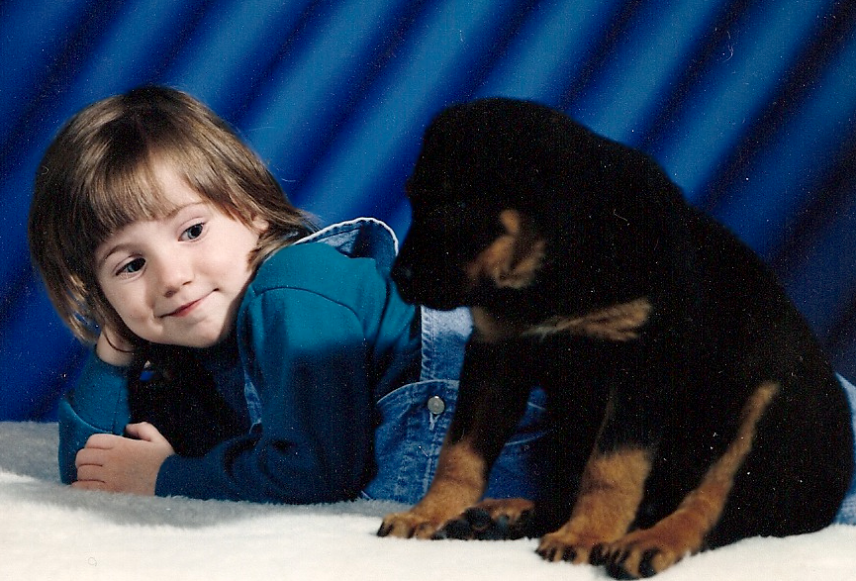
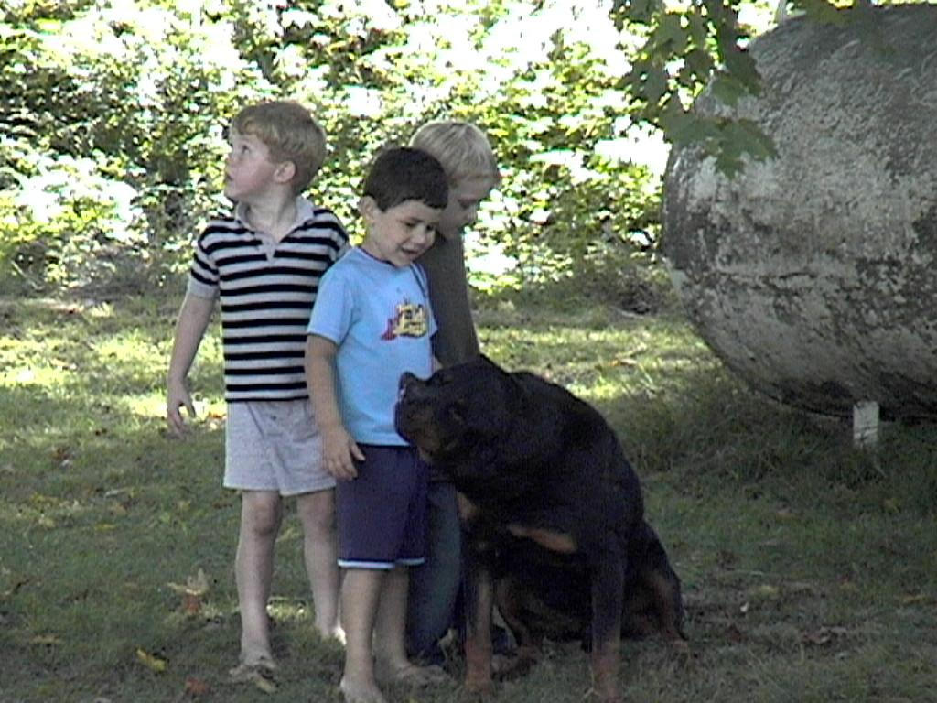
Rottweilers
The Breed
The History
The Love
In memory of Rocko
Melissa N. Moyer

Slide 2
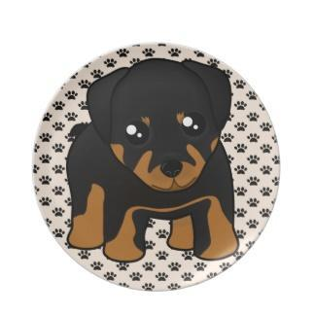
Rottweilers
The FCI Standards
The History of the Rottweilers
The Rottweiler Love
http://www.zazzle.com/cartoon+puppies+plates

Slide 3
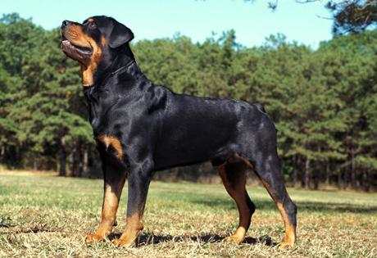
The FCI Standards
Medium sized
22-27 inches at the shoulder
77 - 132 pounds
Cropped Tails
This is now banned in many countries
Still legal in the USA
Low maintenance coats with seasonal heavy shedding
http://www.akc.org/breeds/rottweiler/index.cfm

Slide 4
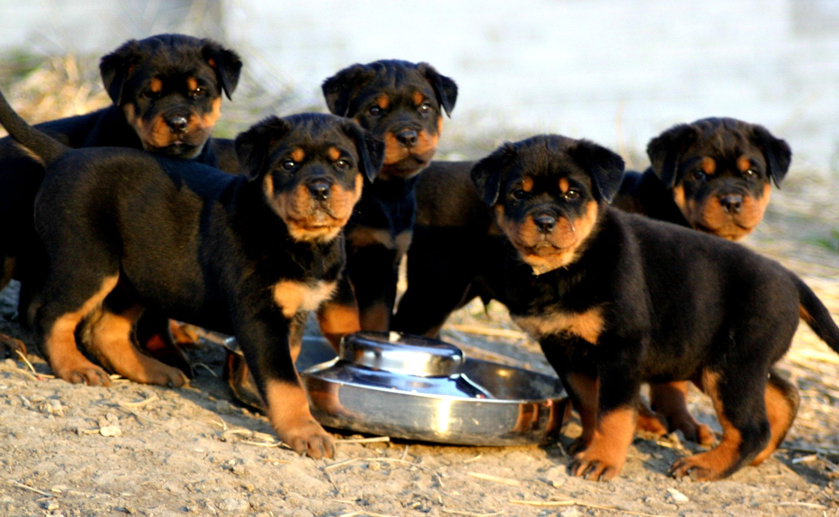
The FCI Standards
Good working dog
Main use is for herding or as pets
Temperament
Calm, Confident and Good-Natured
Healthy
Relatively Healthy
Prone to Parvovirus, Obesity, and Cancer
Average life span
9 - 10 years
http://www.dogwallpapers.net/rottweiler/rottweiler-puppies-wallpaper.html

Slide 5

Rottweilers
The FCI Standards
The History of the Rottweilers
The Rottweiler Love
http://www.zazzle.com/cartoon+puppies+plates

Slide 6
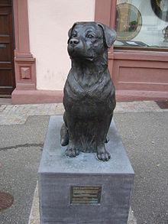
The History of Rottweilers
Dating back to the Roman Empire
Herding dogs - protected the herd
World War I and II
Police dogs
Ambulance dogs
Messenger dogs
Draft dogs
Guard dogs
Memorial (right) in Rottweil Germany
http://en.wikipedia.org/wiki/Rottweiler

Slide 7
Rottweilers
The FCI Standards
The History of the Rottweilers
The Rottweiler Love
http://www.zazzle.com/cartoon+puppies+plates

Slide 8
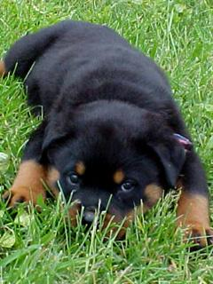
The Rottweiler Love
Rated to be:
Very affectionate with the family
Very good with Children
Alright with other dogs
Not good with Strangers
Very protective
http://fonepics.net/animals/53449-cute-rottweiler.html

Slide 9
The love of a Rottweiler
Rocko RIP 1994-2003

