Slide 1
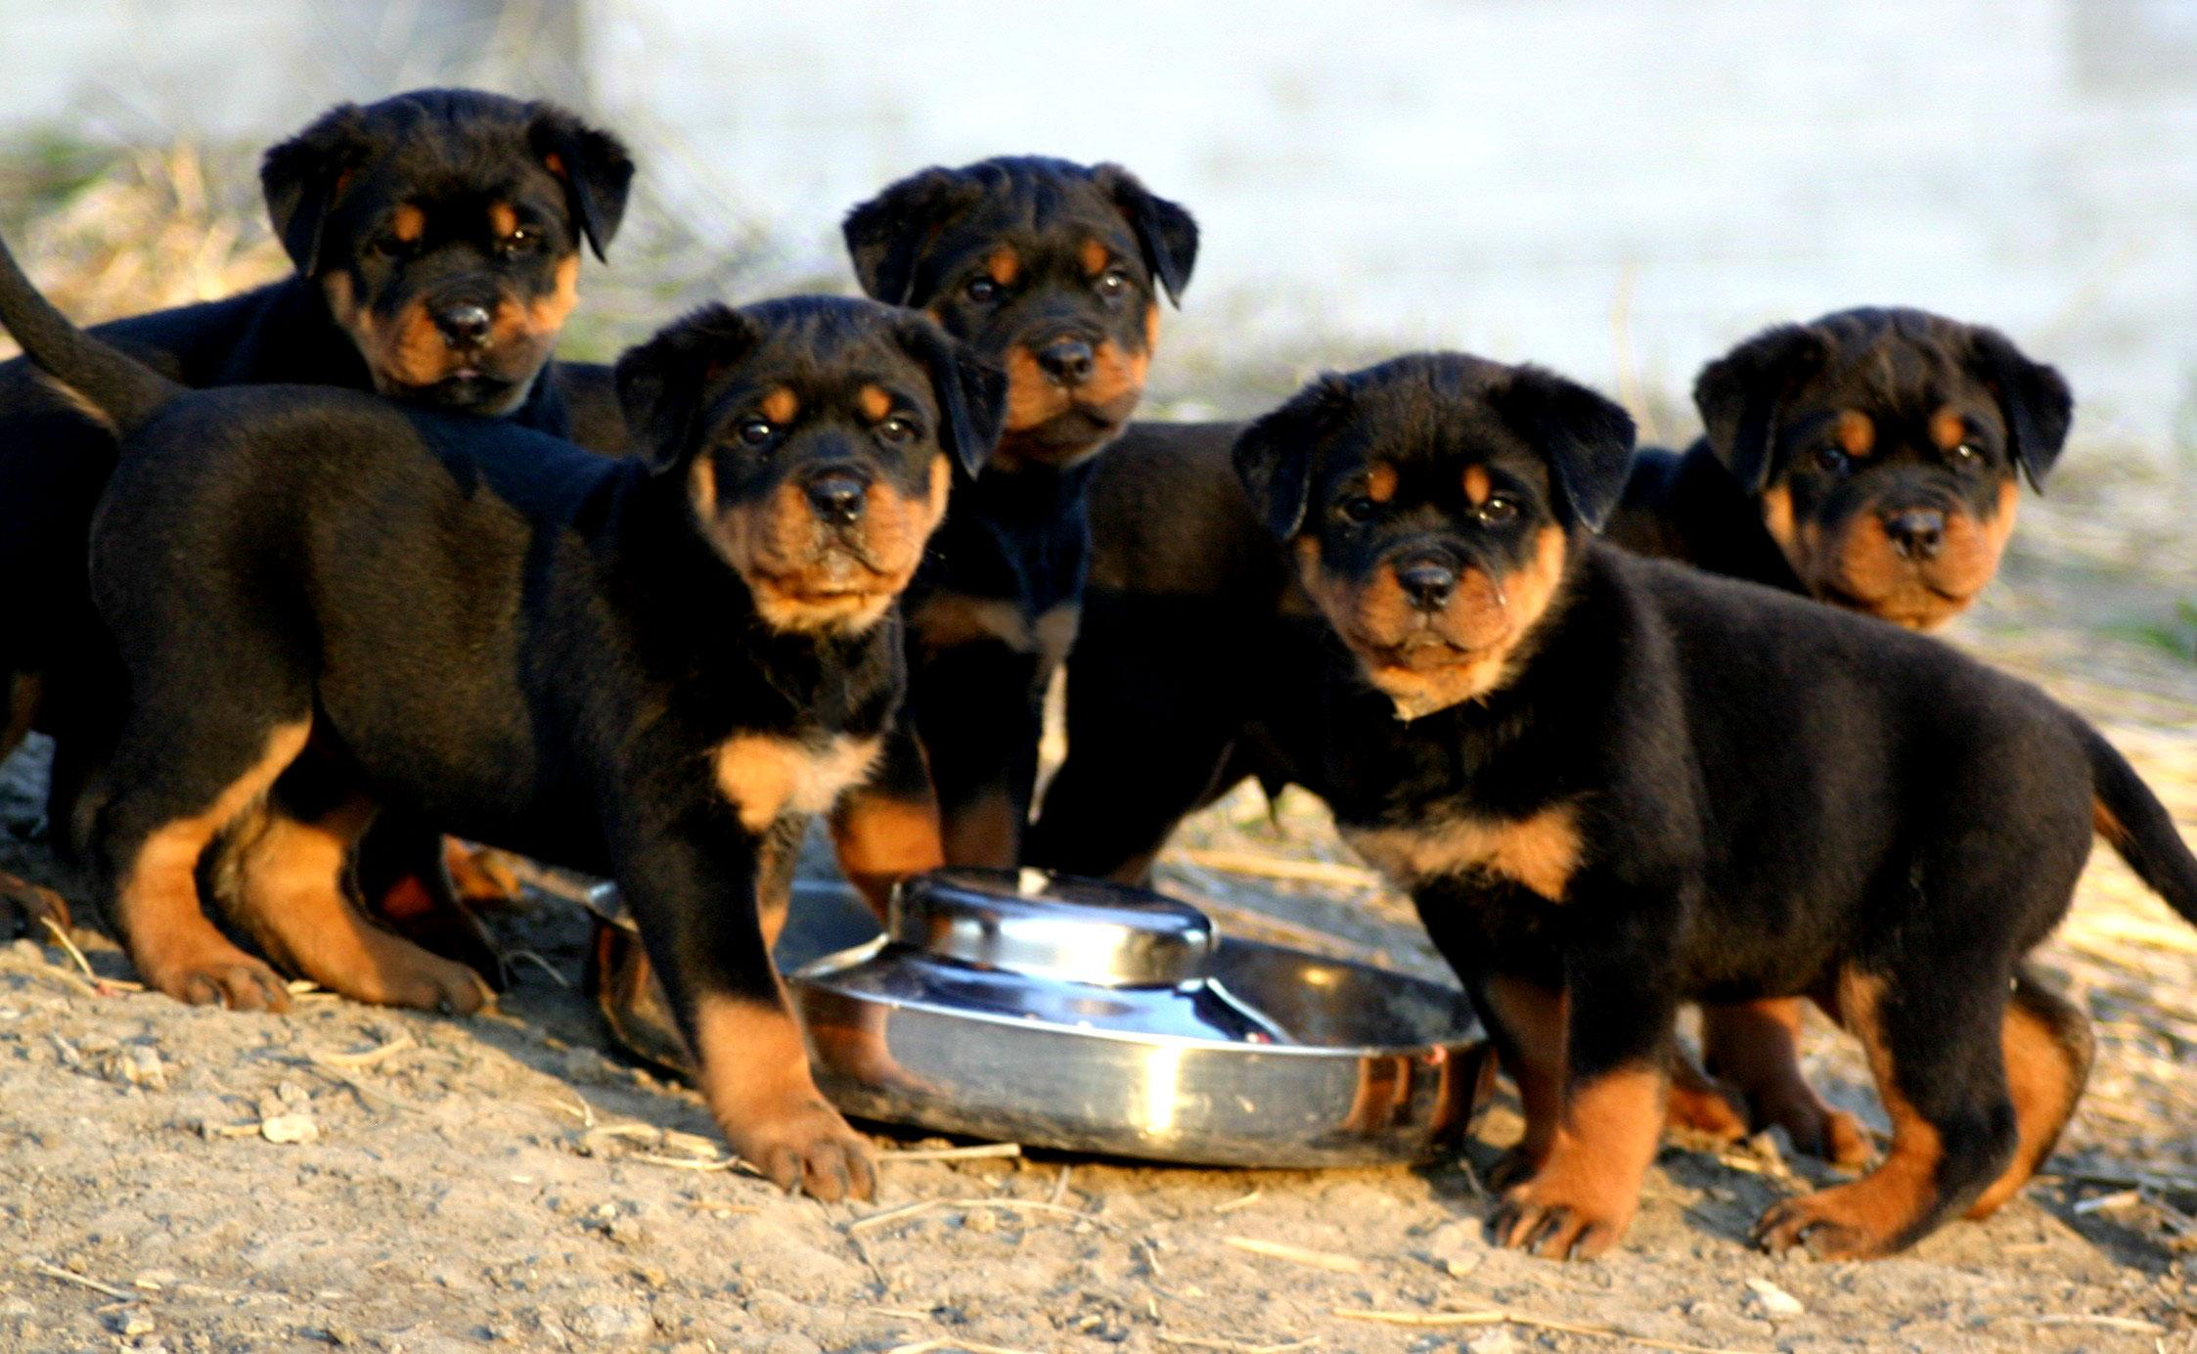
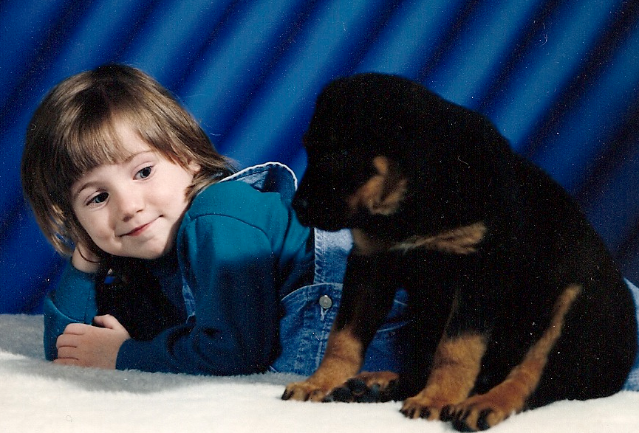
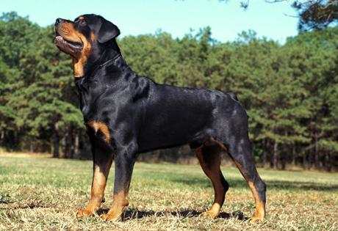
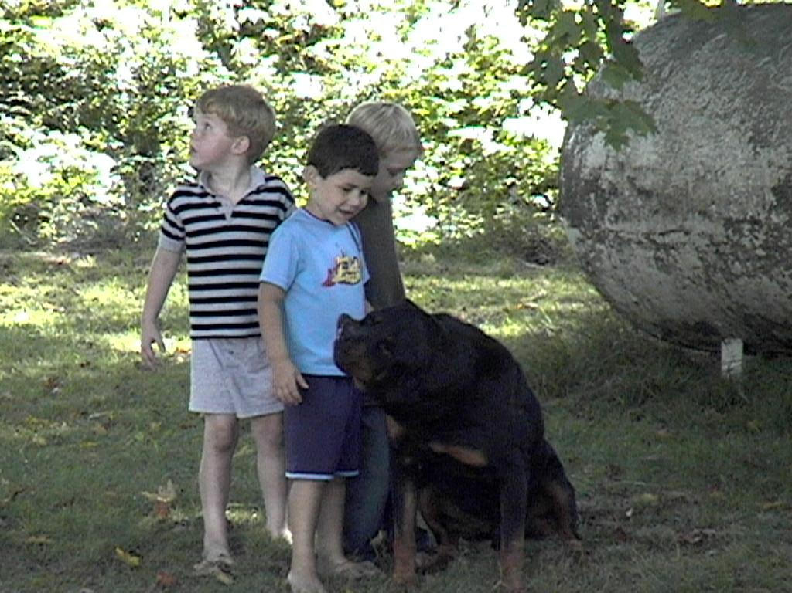
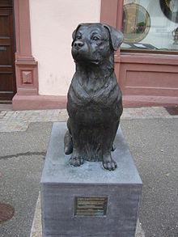
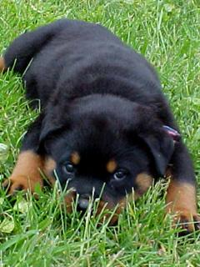
Rottweilers The Breed, The History, The love
Melissa N. Moyer
The Breed Standards
The History of Rottweilers
The Love
Rottweilers are medium sized dogs that range from 22 to 27 inches high at the shoulder. They typically weigh between 77 and 132 pounds. Their tails are typically cropped, though the action of cropping the tail is illegal in many countries, though the United States still allows it.
Their coats are low maintenance, and they are good working dogs. Rottweilers have a calm, confident and good natured temper.
The average life span for a Rottweiler is 9 to 10 years. These years will be relatively healthy, though there is an increased risk for Parvovirus, obesity and cancer.
All are FIC standards for Rottweilers.
Rottweilers have a lot of history behind
their breed. Their origin can be traced
back to the Roman Empire, where they
were first used as herding dogs. They were
loved for their ability to keep after cattle
and round up the stubborn ones that
other herding dogs would miss. These
Rottweilers were sometimes referred to as butchers. Here, they were also known to keep intruders from stealing cattle while they were on duty watching the herds.
Their popularity skyrocketed during World War I and World War II where they became police dogs, ambulance dogs, messenger dogs, draft dogs and guard dogs. As draft dogs, the Rottweilers replaced donkeys that were much harder and more costly to take care of.
Today, Rottweilers are still doing much of the work that they did during World Wars I and II, however, it is not as popular to use them as draft dogs. They are also more popular as house hold pets.
The center picture below is a Rottweiler memorial in Rottweil, Germany.
Rottweilers are known to be very affectionate with the family, as well as good with children. They can be temperamental and territorial with other dogs and animals. They are also not very good with strangers. This varies between dogs. The way the dog was raised and trained can have a lot to do with the way the Rottweiler acts and behaves. The media has a tendency to pick out the bad dogs with Rottweilers the way they also do with some of the other “fighting” breeds, but a well trained, well loved Rottweiler can be a great addition to any family.
The Pictures
http://www.akc.org/breeds/rottweiler/index.cfm
http://www.dogwallpapers.net/rottweiler/rottweiler-puppies-wallpaper.html
http://en.wikipedia.org/wiki/Rottweiler
http://fonepics.net/animals/53449-cute-rottweiler.html

