Slide 1
q-PCR Real Time Quantitative Polymerase Chain Reaction
Melissa Nicole Moyer

Slide 2
q-PCR
Information
Methods
Advantages of q-PCR as a method of screening for gene targeting in mammalian cells using conventional and whole BAC-based constructs
Background
Results
Conclusion

Slide 3
Information
Real Time Quantitative Polymerase Chain Reaction (q-PCR)
Works like regular PCR where you amplify a desired gene
Differences from regular PCR:
Quantifies (counts) the amount of PCR Product
You can watch the products being produced in real time!
A Rotor-Gene Q can be used to preform q-PCR
Methods will be explained based off of the Rotor-Gene Q and its 72-Well Rotor for up to 72 0.1 ml strip tubes with caps

Slide 4
q-PCR
Information
Methods
Advantages of q-PCR as a method of screening for gene targeting in mammalian cells using conventional and whole BAC-based constructs
Background
Results
Conclusion

Slide 5
Methods
Ingredients:
Purified DNA
taq Polymerase
Nucleotides
Primers
MgCl₂
Buffer
Nuclease-free water
Double stranded DNA Dye – such as SYBR Green
Kits can be ordered with most of the ingredients mixed together. The primers, nuclease-free water and the purified DNA are the missing components.

Slide 6
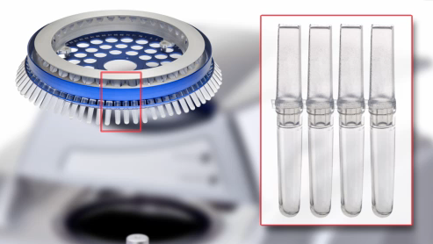
Methods
10-50 µL total volume per tube is recommended for the above four strip tubes.
The tubes are then placed in the Rotor which is placed in the Rotor-Gene Q
There are several other tubes that can be used with this machine for q-PCR
http://www.qiagen.com/media/product-tools/flash/RotorGeneQ/360/index.html

Slide 7
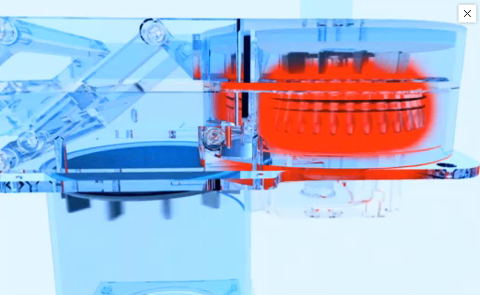
Methods
95 ºC for3 minutes
35 cycles of:
94 ºC for 45 seconds
60 ºC for 45 seconds
68 ºC for 120 seconds
http://www.qiagen.com/media/product-tools/flash/RotorGeneQ/360/index.html

Slide 8
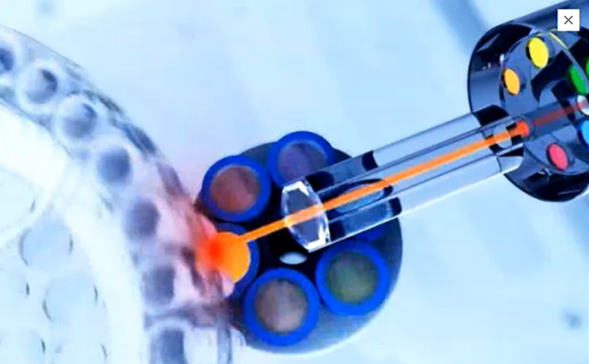
Methods
A light passes through the samples and is read by the sensors as the reactions are denaturing, annealing, amplifying and spinning around
http://www.qiagen.com/media/product-tools/flash/RotorGeneQ/360/index.html

Slide 9
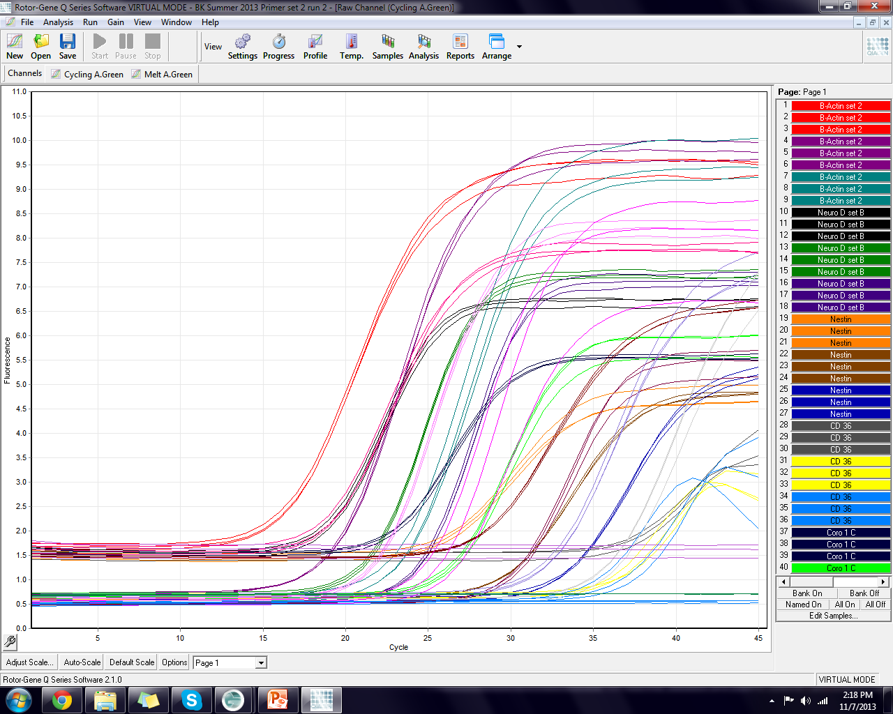
Methods

Slide 10
q-PCR
Information
Methods
Advantages of q-PCR as a method of screening for gene targeting in mammalian cells using conventional and whole BAC-based constructs
Background
Results
Conclusion

Slide 11
Background
Advantages of q-PCR as a method of screening for gene targeting in mammalian cells using conventional and whole BAC-based constructs
Julio Go´mez-Rodrı´guez, Valance Washington, Jun Cheng, Amalia Dutra, Evgenia Pak, Pentao Liu, Daniel W. McVicar and Pamela L. Schwartzberg
Received March 31, 2008; Revised July 28, 2008; Accepted July 31, 2008; Published online 18 August 2008
Nucleic Acids Research, 2008, Vol. 36, No. 18 e117

Slide 12
Background
The authors studied:
The accuracy of q-PCR by comparison to Southern Analysis
The accuracy of fluorescent in situ hybridization (FISH) compared to q-PCR

Slide 13
q-PCR
Information
Methods
Advantages of q-PCR as a method of screening for gene targeting in mammalian cells using conventional and whole BAC-based constructs
Background
Results
Conclusion

Slide 14
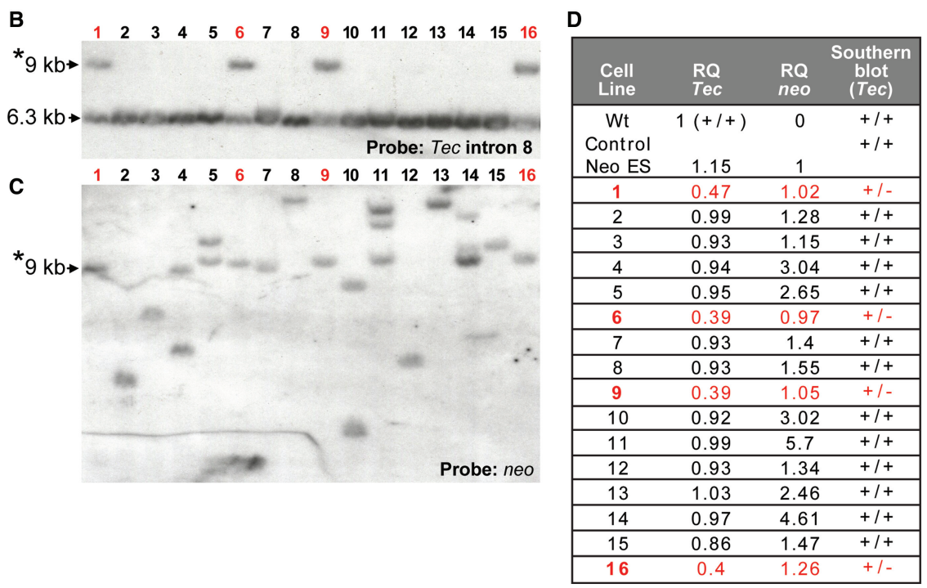
Results
Figure 1

Slide 15
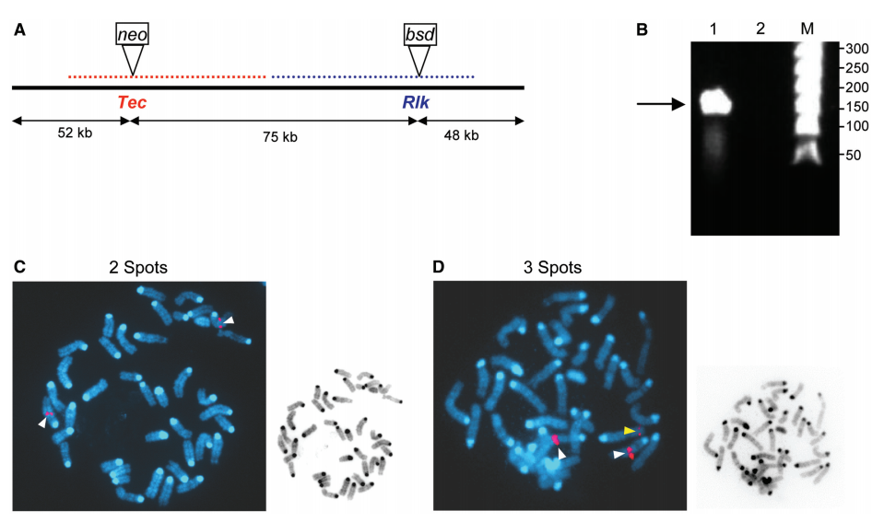
Results
Figure 2

Slide 16
Results
FISH
36% targeting frequency when there was only a 14% Tec construct.
There were weakened signals suggesting partial BAC integration into the genome.
This lead to weakened signals at the places of random short insertions.
q-PCR revealed:
The multiple inserts of BAC into the Genome
There are both false positives AND false negatives with FISH

Slide 17
q-PCR
Information
Methods
Advantages of q-PCR as a method of screening for gene targeting in mammalian cells using conventional and whole BAC-based constructs
Background
Results
Conclusion

Slide 18
Conclusion
q-PCR
Highly sensitive and reproducible
Reduces the number of colonies for further analysis (via Southern Analysis)
Superior to Regular PCR
Not limited by false negatives
False positives by primer-primer interaction was not an issue
Detects multiple inserts of the gene because of its real time quantitative approach

Slide 19
Conclusion
q-PCR vs. FISH
q-PCR is superior in the detection of BAC-based constructs
FISH is prone to false positives and false negatives
q-PCR was able to identify both the false positives and false negatives

Slide 20
q-PCR
Advantages of q-PCR as a method of screening for gene targeting in mammalian cells using conventional and whole BAC-based constructs
Julio Go´mez-Rodrı´guez, Valance Washington, Jun Cheng, Amalia Dutra, Evgenia Pak, Pentao Liu, Daniel W. McVicar and Pamela L. Schwartzberg
Received March 31, 2008; Revised July 28, 2008; Accepted July 31, 2008; Published online 18 August 2008
Nucleic Acids Research, 2008, Vol. 36, No. 18 e117

