Slide 1
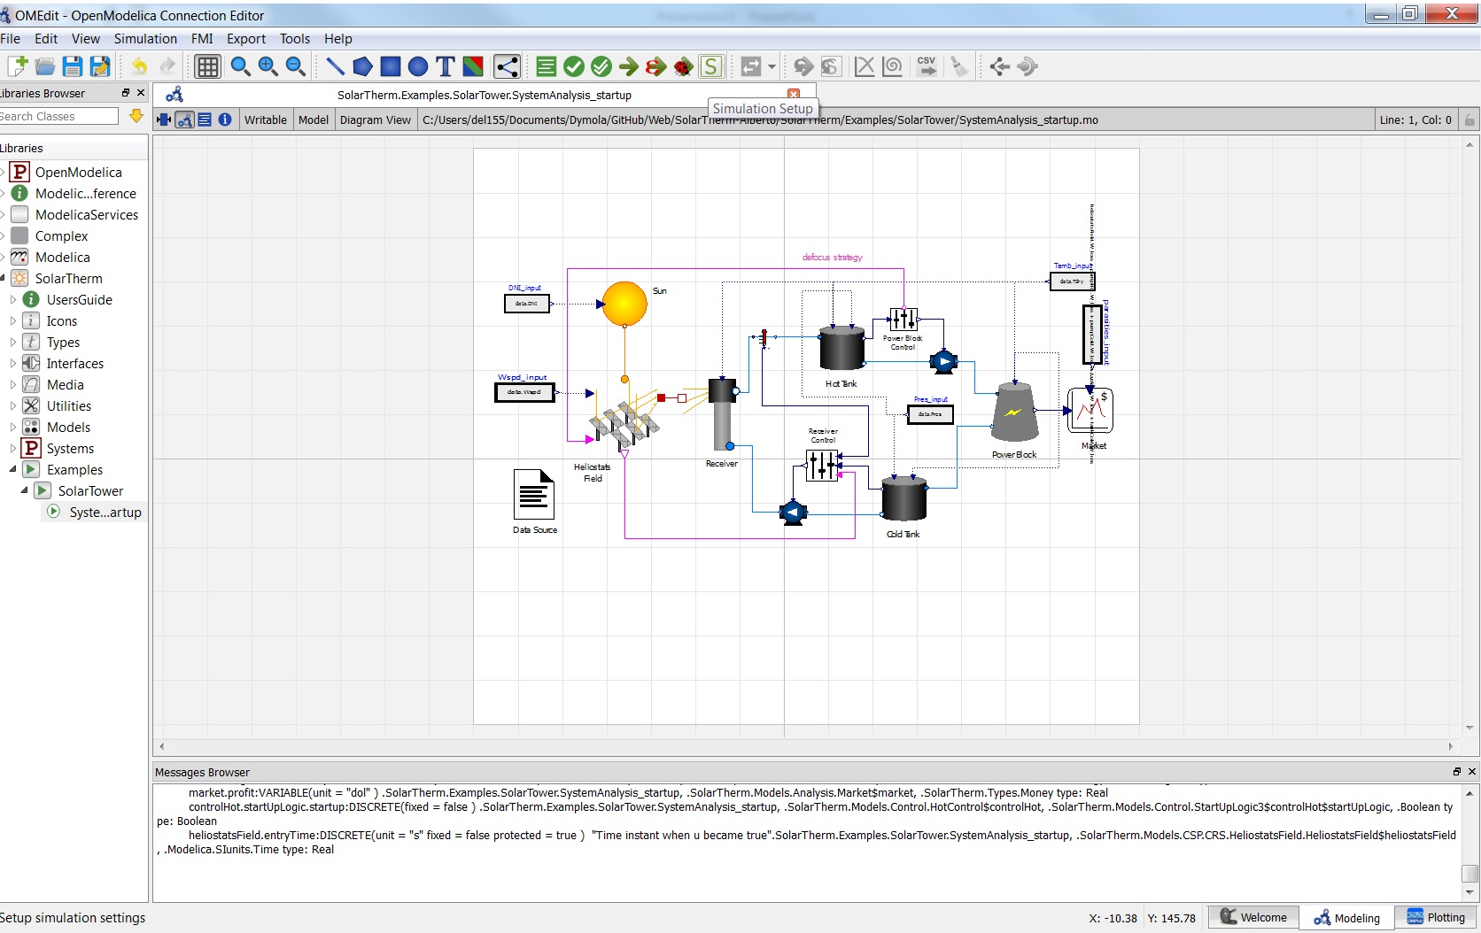
Configure the simulation

Slide 2
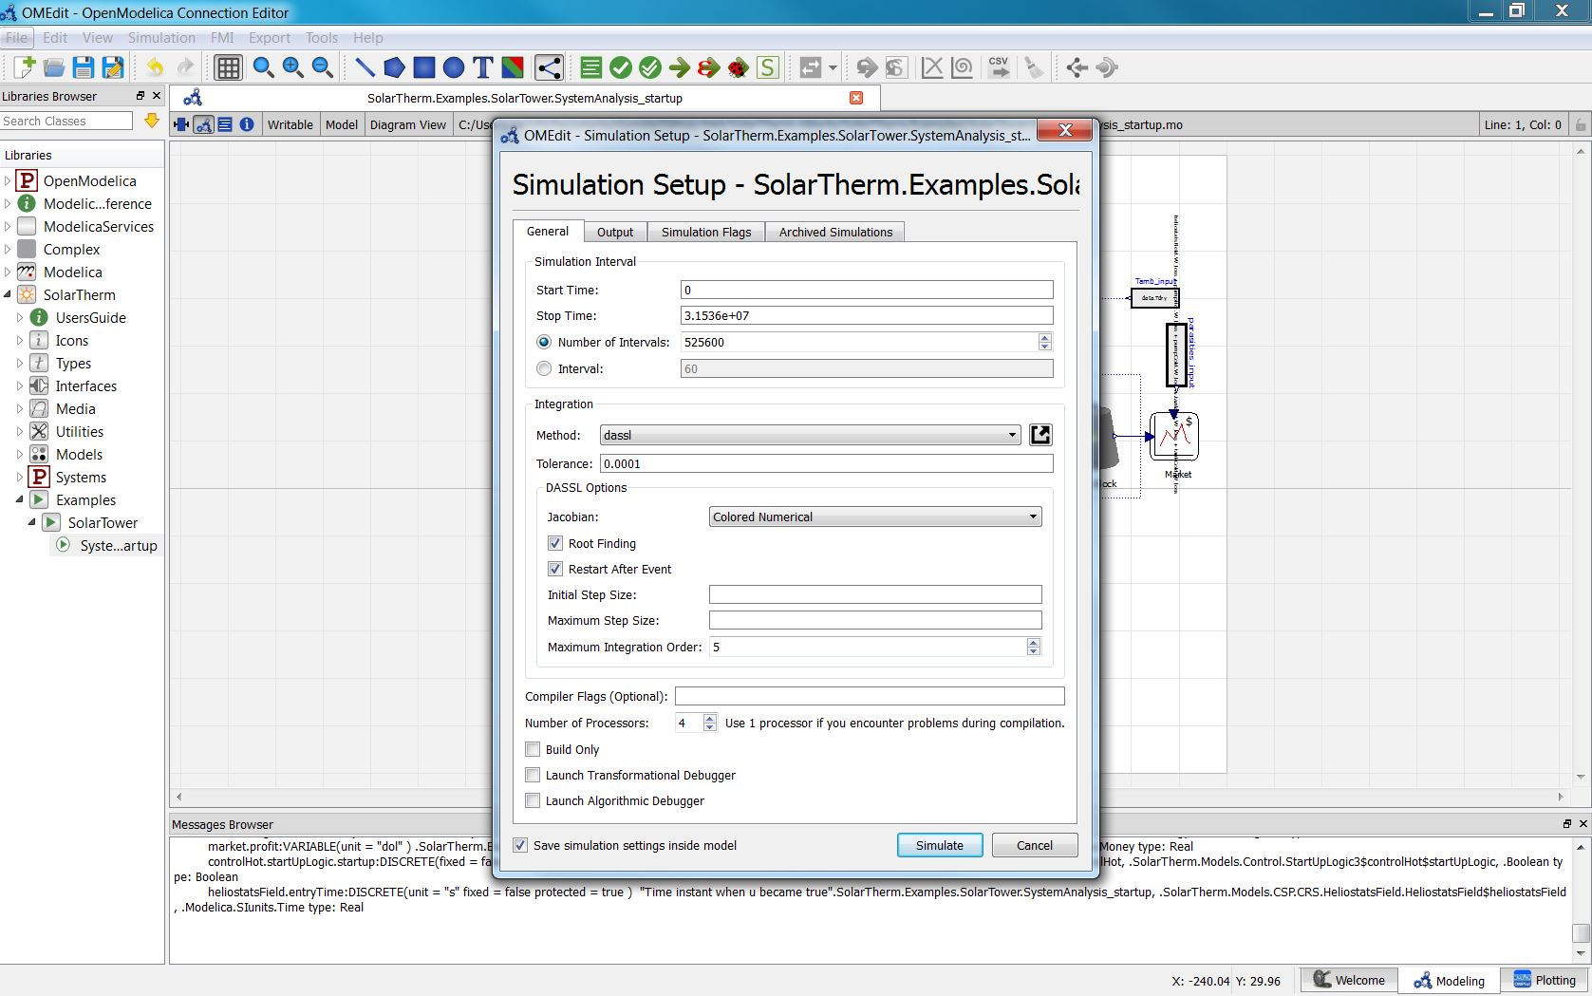
Simulation flags

Slide 3
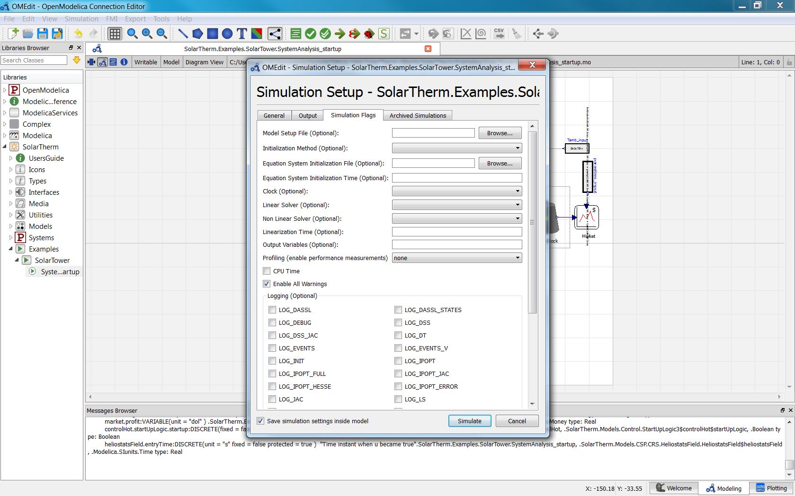
Non linear solver

Slide 4
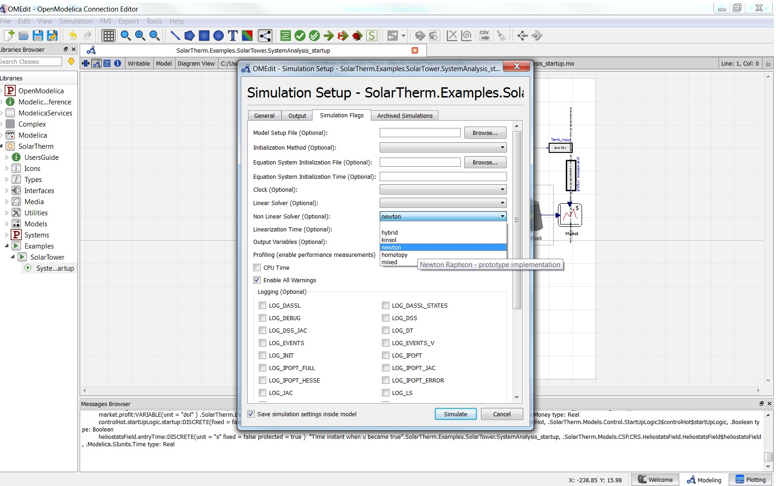
Select Newton

Slide 5
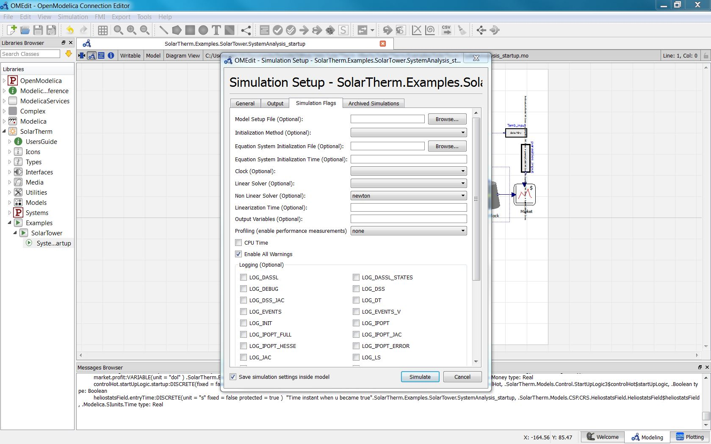
Preserve the settings for next simulations

Slide 6
Run the simulation

