Slide 1
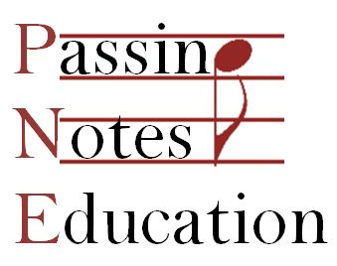
Eduqas GCSE – Toto: Africa Student Revision (2022 exam)
Patrick Johns
www.passingnoteseducation.co.uk
info@passingnoteseducation.co.uk
F: facebook.com/passingnoteseducation
T: @passingnotesed

Slide 2
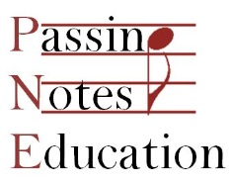
Introduction
Context and Overview
Recapping Verse 2 and Chorus 2
Harmony and Tonality
Rhythms
The Role of the Rhythm Section
The Vocals
Exam Questions
Q&A

Slide 3
Quick Reminder
Metre:
2/2; cut common time
Articulation:
Mostly legato; Riff A is partly staccato
Dynamics:
Verse 2 is mf [mezzo forte]; Chorus 2 is f [forte]
Texture:
Homophonic
Structure:
Verse-Chorus form
Harmony & Tonality:
V2 is in B major; C2 is in A major
Diatonic harmony, with use of extended harmony, and slash chords (inversions)
Instrumentation:
Rock band (vox, guitars, bass, keys, drums)
Extras: marimba, other perc, recorders
Rhythm:
Lots of syncopation, and some on-beat rhythms
92 bpm / moderately fast
Tempo:

Slide 4
Quick Reminder
You don’t need to know the musicians’ names for the exam, except for two… the song’s composers… who were they?
Line-up
Toto have had many changes of personnel over the years, but the line-up on the recording of Africa is:
David Paich: lead vocals (Verse), backing vocals (BVs), and synthesizer
Bobby Kimball: lead vocals (Chorus), BVs
Steve Lukather: electric guitar, 12-string acoustic guitar, BVs
Steve Porcaro: synthesizers
David Hungate: bass guitar
Jeff Porcaro: drums, cowbell, gong, other percussion
Toto were joined by some extra musicians:
Lenny Castro: congas, shakers, other percussion
Jim Horn: recorders
Joe Porcaro: marimba, percussion
Timothy B Schmit: backing vocals

Slide 5
Quick Reminder
This is where Verse 2 and Chorus 2 fit into the whole song.
Intro
Verse 1
Chorus 1
Link 1
Verse 2
Chorus 2
Link 2
Solo
Chorus 3
Chorus 4
Outro
Why do we need to know this?
There could be a question such as:
Name the harmonic pattern played by the synthesizer at the end of the every line of Verse 2.
In which section of the whole song is this pattern first heard?
Answer: Riff A / a riff
Answer: The Intro

Slide 6
Harmony and Tonality
Here is a diagram of the whole song.
C# minor
B major
A major
Intro
Verse 1
Chorus 1
Link 1
Verse 2
Chorus 2
Link 2
Solo
Chorus 3
Chorus 4
Outro

Slide 7
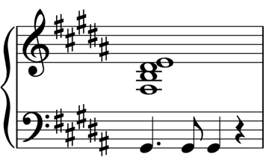
Harmony and Tonality
Verse 2
Verse 2 of Africa is in the key of B major.
Verse 2 is shorter than Verse 1: three phrases (rather than four)
Each phrase is nine bars long – very unusual!
And can be sub-divided into three, shorter, unequal parts
Part 1 [4 bars] | B The wild dogs | D#m cry out in the night | G#m As | B/F# they grow restless
Part 2 [3 bars] | A/E Longing for some | F#^{11 (aka E/F#)} solitary | E^{maj9}/G# compa-
Part 3 [2 bars] | A -ny. (RIFF A) | –G#m–C#m (RIFF A)
Eduqas has identified this chord as G#m
There is a high chance that there’ll be a question asking you to fill in missing chords in a grid, either as chord names (eg ‘B major’), or as Roman numerals.
Learn ’em…!

Slide 8
Harmony and Tonality
Verse 2 – Chord names
Part 1 [4 bars] | B The wild dogs | D#m cry out in the night | G#m As | B/F# they grow restless
Part 2 [3 bars] | A/E Longing for some | F#^{11 (aka E/F#)} solitary | E^{maj9}/G# compa-
Part 3 [2 bars] | A -ny. (RIFF A) | –G#m–C#m (RIFF A)
Verse 2 – Roman numerals
Part 1 [4 bars] | I The wild dogs | iii cry out in the night | vi As | Ic they grow restless
Part 2 [3 bars] | ♮VIIc Longing for some | V^{11 (or IV/V)*} solitary | IV^{maj9}b compa-
Part 3 [2 bars] | ♮VII -ny. (RIFF A) | –vi–ii (RIFF A)
Or vi, if you go with G#m
*Eduqas have labelled this chord as iv⁹d, but this would be E⁹/D…

Slide 9
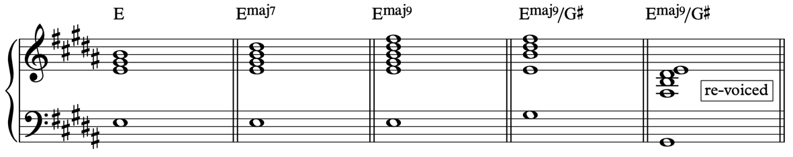
Harmony and Tonality
Advanced harmony within Africa
The E^{maj9}/G# chord
The notes in the chord are: G#–F#–B–D#–E
It’s been described as G#m⁷ (G#–B–D#–F#), but this overlooks the presence of the E, at the top, which is prominent in the synth and the 12-string guitar.
A more accurate way of thinking of this chord is as: E^{maj9}/G#.
E major: E–G#–B
E^{maj7}: E–G#–B–D#
E^{maj9}: E–G#–B–D#–F#
And then move the G# into the bass, creating a 1st inversion, and re-voice, to give E^{maj9}/G#.
This makes more harmonic sense, too, as it acts as a dominant chord leading to the next chord, of A major.
This won’t come up in the exam – it’s just if you have a thirst for knowledge!

Slide 10

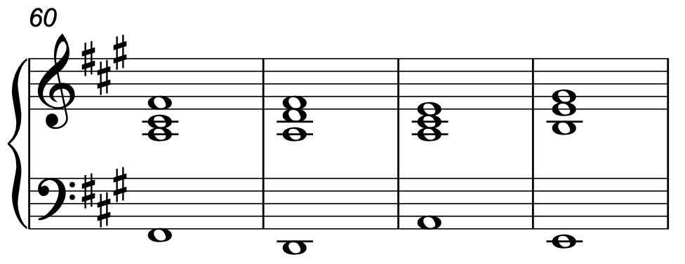
Harmony and Tonality
The Chorus of Africa is in A major
It uses a very well-known, and well-used, chord sequence: vi – IV – I – V
You can compare it to other well-known 4-chord songs, by singing their melodies over Africa’s chords. Wake Me Up (Avicii) works well.
F#m D A E
vi IV I V

Slide 11
Harmony and Tonality
All the chords in the Chorus are in root position (in contrast to the verses’).
Note the slash chord here, leading to a perfect cadence.
F#m | D | A | E
F#m | D | A | E
F#m | D | A | E
F#m | D | A | C#m | E | F#m E/G#
Possible exam question: Give the bar number of a bar containing a first inversion chord.
Or, “Identify a bar that contains a dominant chord” or “…chord V”

Slide 12
Harmony and Tonality
What could be asked about this harmony in the exam?
…to fill in some chords, as letters and/or Roman numerals, but not to identify all the advanced extensions correctly
…to identify a first- or second-inversion chord on a score
…to identify a tonic, dominant, etc. chord on a score
…to comment on the use of harmony and tonality in a section of the song (eg “Uses extended harmony, use of inversions/slash chords”, “all chords in root position”)
…to compare and contrast the harmony of different sections

Slide 13
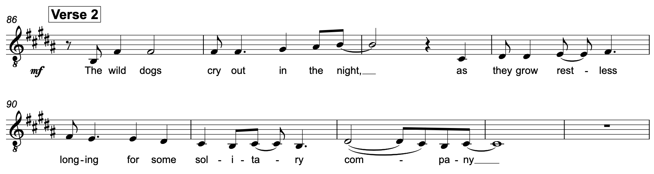
Rhythm
Syncopation – Vocals
It’s Pop/Rock music… syncopation is everywhere!
Syncopation
Syncopation
Syncopation
Syncopation
Syncopation
Syncopation
Syncopation
Syncopation
Syncopation

Slide 14
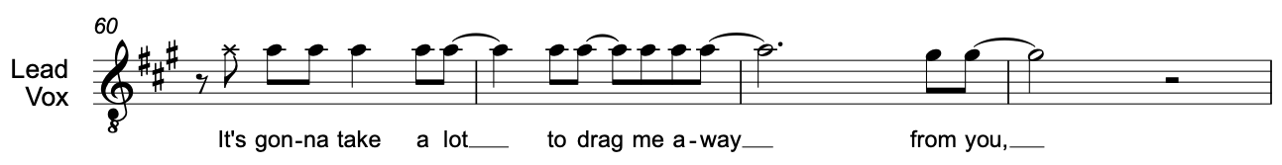
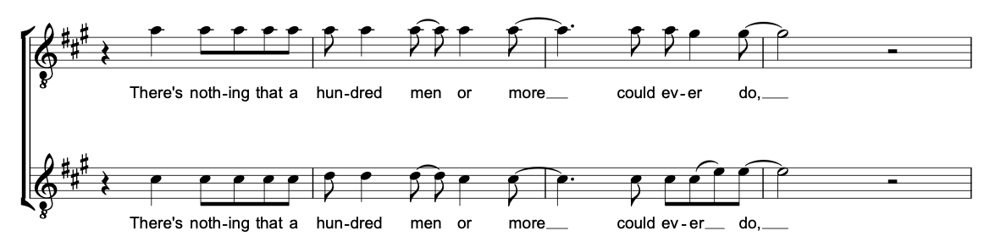
Rhythm
Syncopation – Vocals

Slide 15
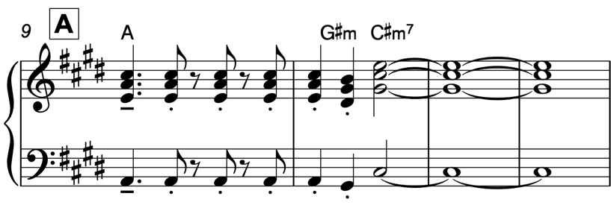
Rhythm
On-Beat Rhythms
There’s lots of syncopation, but a lot on the beat, too.
For example: Riff A, that we hear three times in Verse 2.
On-beat
Syncopation
On-beat

Slide 16
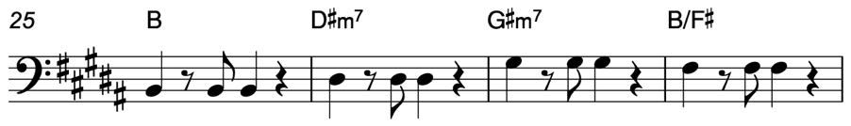
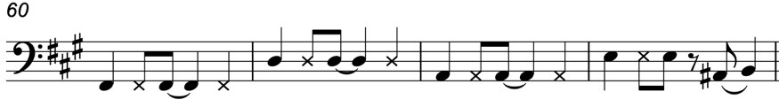
Rhythm
On-Beat Rhythms
The bass is on the beat in the Verses (apart from Riff A)…
…but uses a mix of on-beat and syncopation in the Choruses

Slide 17
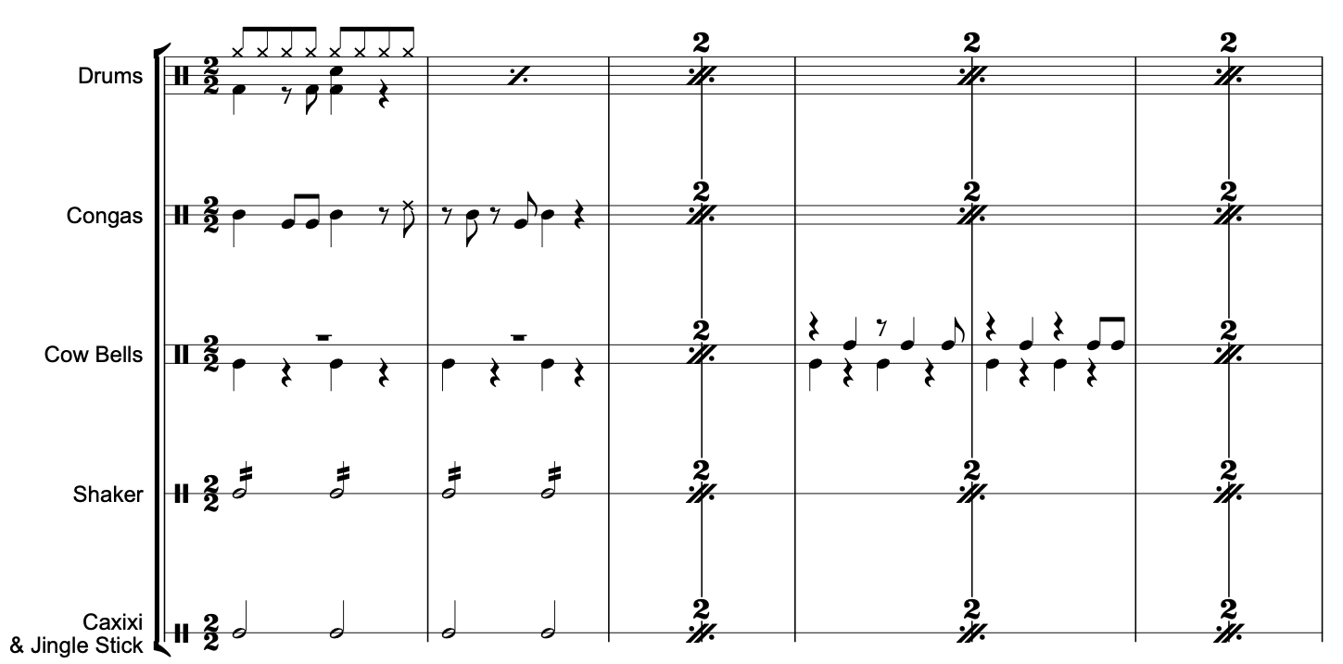
Rhythm
There won’t be a question about the Intro in the exam, but as these polyrhythms are played throughout, and they’re easiest to hear in the Intro, they’re worth being aware of.
Polyrhythms
Intro

Slide 18
The Rhythm Section
Rhythm Section
Perhaps an unusual term to use in the context of Rock
Just to distinguish how the synths, guitars, bass, drums and marimba support the melodies.

Slide 19
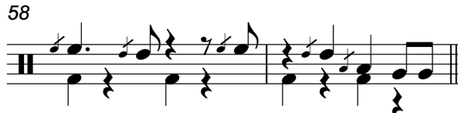
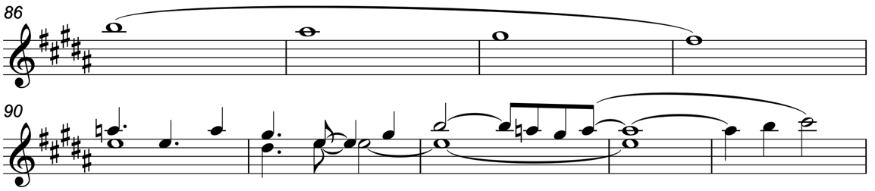
The Rhythm Section
Bass, Drums, Marimba, Gong, Recorder (yes, really)
The bass guitar plays the bottom notes of the chord
The drums alternate between the pre-recorded loop in the Intro, Verses, Solo and Outro; and live drums, focussing on the ride cymbal, recorded in the studio in the Choruses (introduced by the iconic fill-in)
The marimba, played by Joe Porcaro (Jeff’s dad!), doubles Riff A every time
A gong sounds after every Chorus…
And multi-tracked recorders (OK, not rhythm section!) play a countermelody in Verse 2.

Slide 20
The Rhythm Section
The Synths and Piano
As a supporting role, the synths basically just play chords (and Riff A in the verses)
In the Verses, they use a brass voice, and in the Choruses, additional synths are added, playing a string sound, to thicken the texture.
A piano plays for most of the song, too, becoming more prominent later. It doubles Riff A, and plays supporting chords.

Slide 21
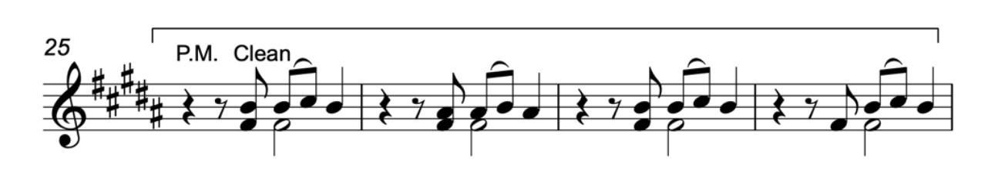
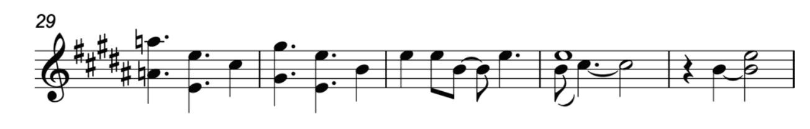
The Rhythm Section
The Guitars
The guitars play a relatively minor role in Africa
In the Verses, the electric plays a palm-muted figure for four bars, answered by the 12-string acoustic

Slide 22
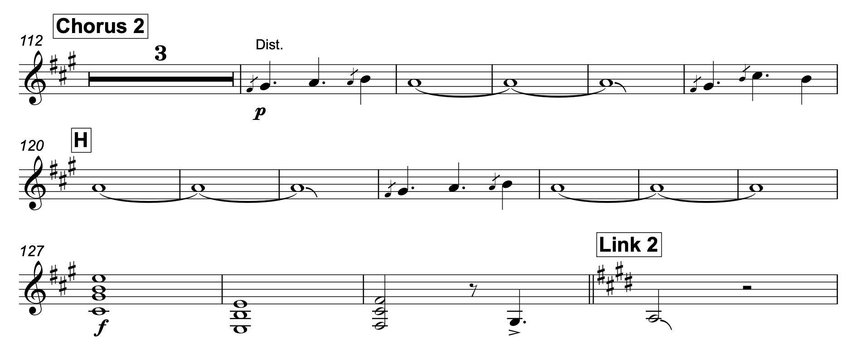
The Rhythm Section
The Guitars
In the Choruses, the 12-string guitar plays arpeggios.
…and the electric plays a repeated 4-note idea, using distortion.
It’s barely audible in Choruses 1 and 2, but it is there. (It’s much more prominent in Chorus 3.)
At the end of the Chorus, the electric guitar plays three chords (C#m, E⁵ and F#⁵) before doubling the bass back into the Link.
These open 5th chords (chords without 3rds) are power chords.

Slide 23
The Vocals
Lead vocals
The melody in Verse 2:
Is diatonic (B major)
Is mainly conjunct
Is in a low tessitura
Is syncopated
Has a range of an octave for phrases 1–2, rising to a 12th in the final phrase
Ascends and descends

Slide 24
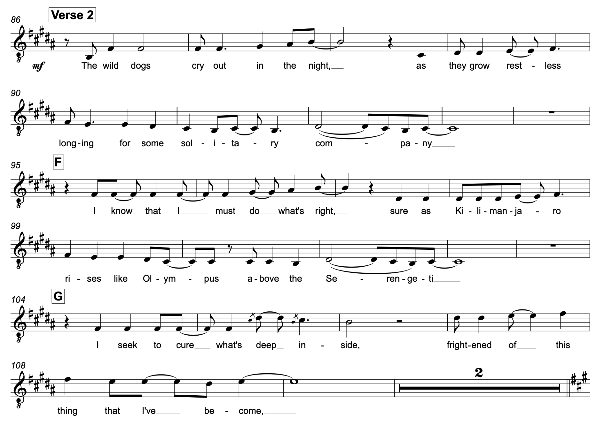
The Vocals
Word-setting – Verse 2
The word-setting is almost all syllabic, but with a (sort-of!) melisma at the end of the first line of Verse 2 (“company”), and the last word of the Chorus. This is in contrast to Verse 1, which has three melismas.
NB word-setting does not count as part of the melody in the exam!
Not a melisma…

Slide 25
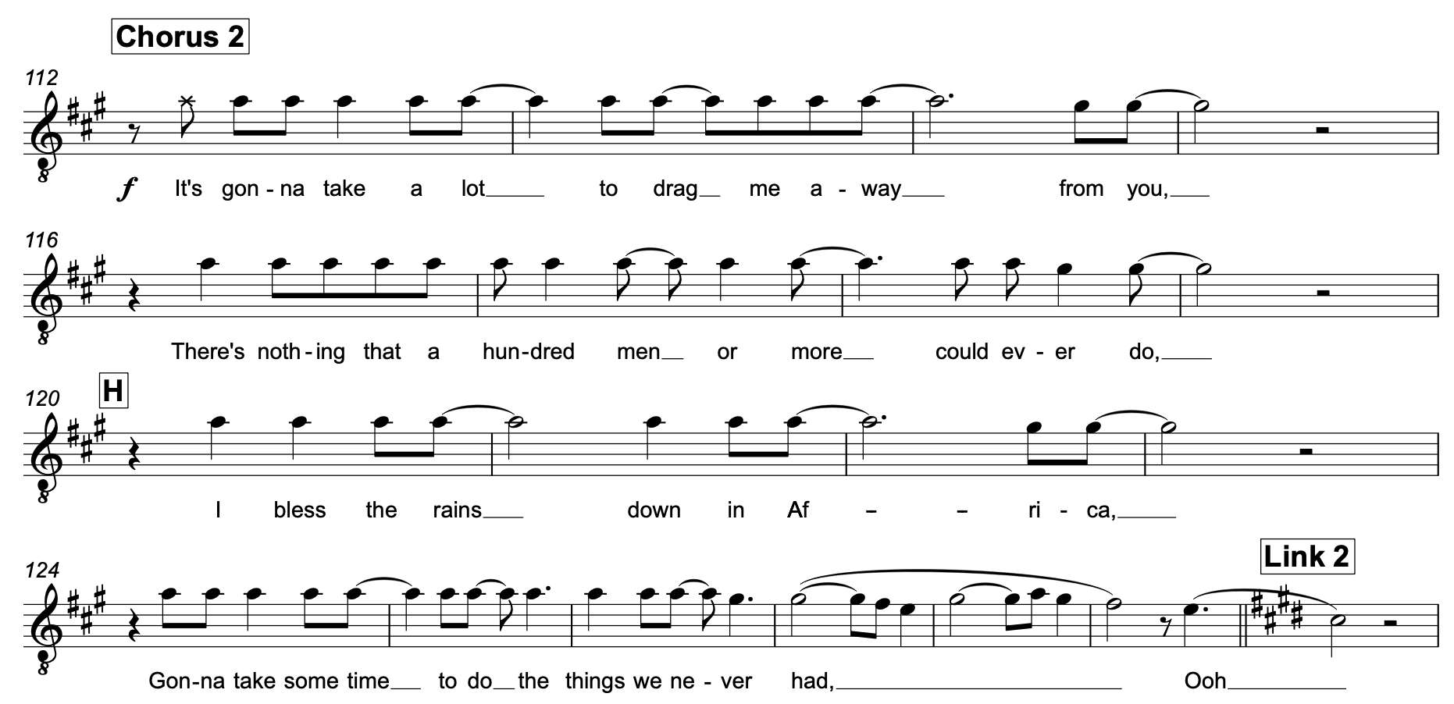
The Vocals
Word-setting – Chorus 2
The word-setting is almost all syllabic, but with a melisma on the final word “had”.
This is the same as in Chorus 1.

Slide 26
The Vocals
Lead vocals
The melody in the Chorus:
Is diatonic (A major)
Is mainly conjunct
Is in a high tessitura
Is syncopated
Has a narrow range: mainly a minor 2nd, extending to a 4th (or 6th if you count the “Ooh”)
Based on two notes (A and G#)

Slide 27
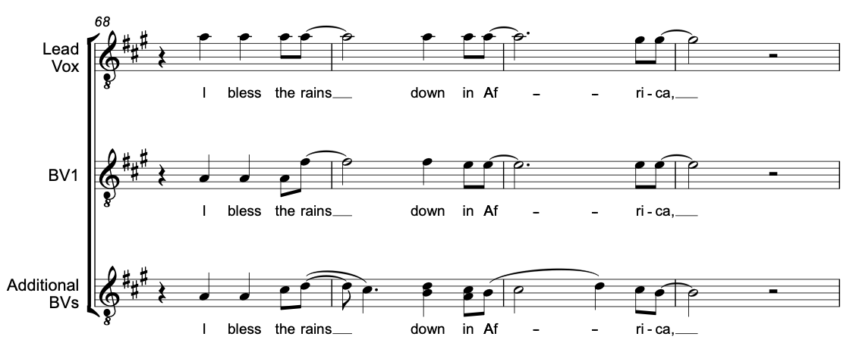
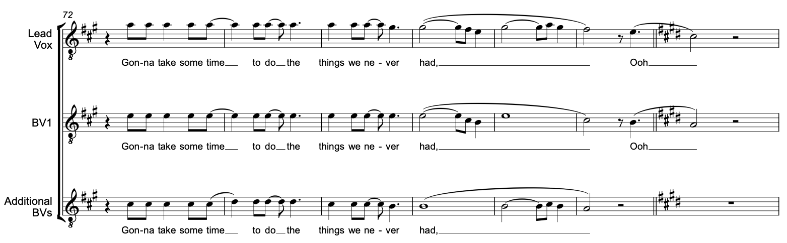
The Vocals
Chorus vocals
In Chorus 2, vocals and BVs build up gradually, extending to 3 / 4 parts over the four phrases.

Slide 28
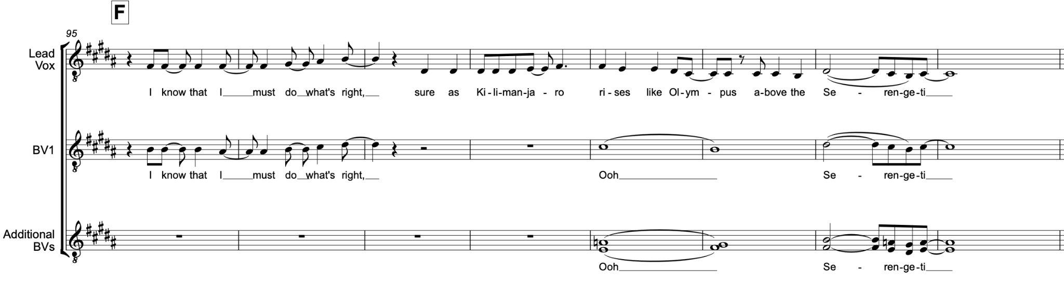
The Vocals
Backing vocals (BVs)
In Verse 2, there is greater use of BVs, often singing a 3rd apart from the lead vocal
BVs sing a mixture of “ooh” and the lyrics, in harmony, and homorhythmically.

Slide 29
The Exam
What could the exam ask?
Anything… in theory! ☺
Eduqas has said it will base the exam on the free analysis on its website
It has also said that all correct answers will be credited – great news! ☺
Let’s have a look at the last four exam papers, three of which were on Since You Been Gone, but these are still very much worth looking at, to see the style of questioning.

Slide 30
The Exam
What could be asked in the exam?
Since You Been Gone
a) Identify three sections of the song [3] [AO3]
b) Fill in missing chords [3] [AO3]
c) Identify instrument playing quavers [1] [AO3]
d) Harmony based on which other section of song [1] [AO3]
e) Which section has the thinnest texture (MCQ) [1] [AO3]
f) Which section has a rising sequence (MCQ) [1] [AO3]
g) Texture of the song (MCQ) [1] [AO3]
h) Name the composer [1] [AO3]
Africa – official Eduqas SAM
2018
a) Identify the texture throughout [1]
b) Fill in missing chords [names and Roman] [4]
c) Identify three features of the vocal melody [3]
d) Describe how the chorus is different from previous choruses [3]
e) Name one of the composers [1]
2021
a) Identify an aspect of the melody (MCQ) [1] [AO4]
b) Identify a rhythmic device [1] [AO3]
c) Fill in the chords [3] [AO3]
d) Describe how the keyboard is used [2] [AO4]
e) Identify the drum kit’s volume (MCQ) [1] [AO4]
f) Identify the beat where the ‘uh’ happens (MCQ) [1] [AO3]
g) Describe three differences between Choruses [3] [AO4]
2019
a) Identify the section [1] [AO3]
b) Identify the instrument that plays the melody [1] [AO3]
c) What does G/B mean? [1] [AO4]
d) Give bar numbers for a dotted minim, chord IV, 8ve leap, power chord. [4] [AO3]
e) Describe two features of the bass line [2] [AO4]
f) Three ways it contrasts with the rest of the song [3] [AO4]
2020

Slide 31
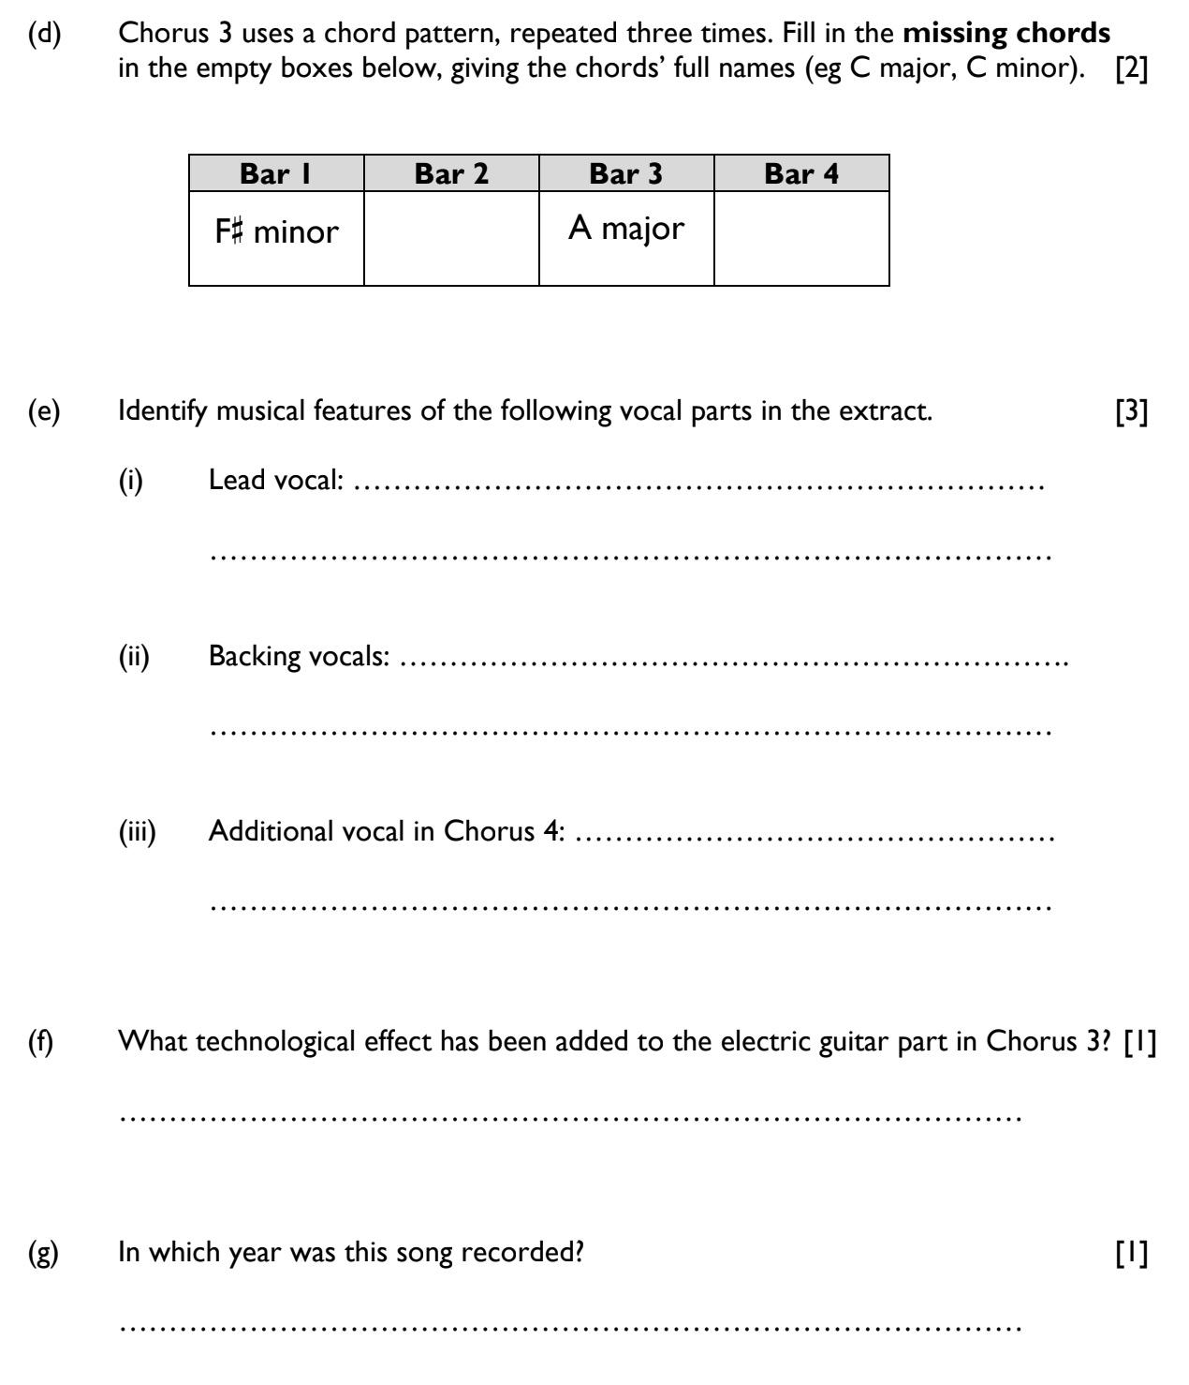
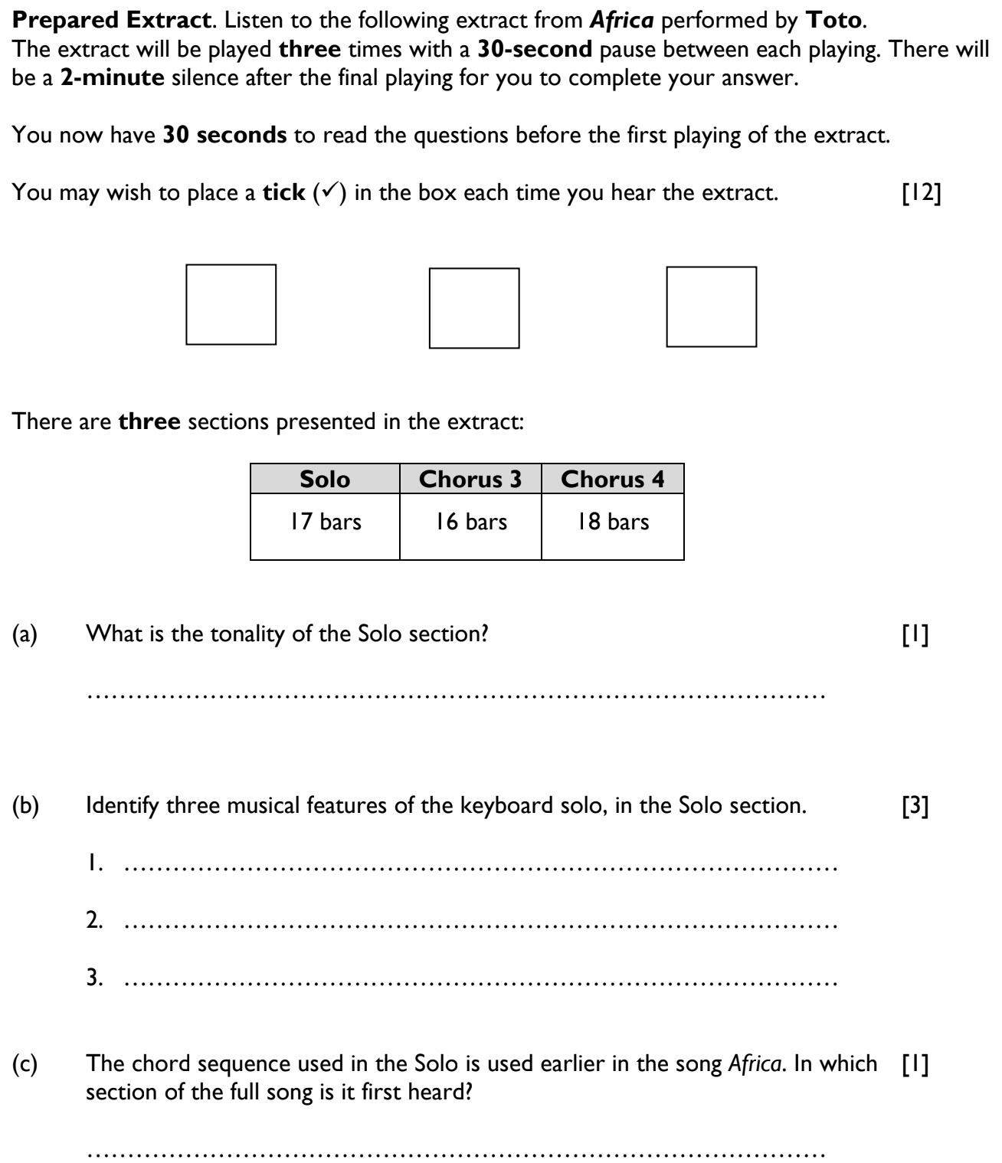
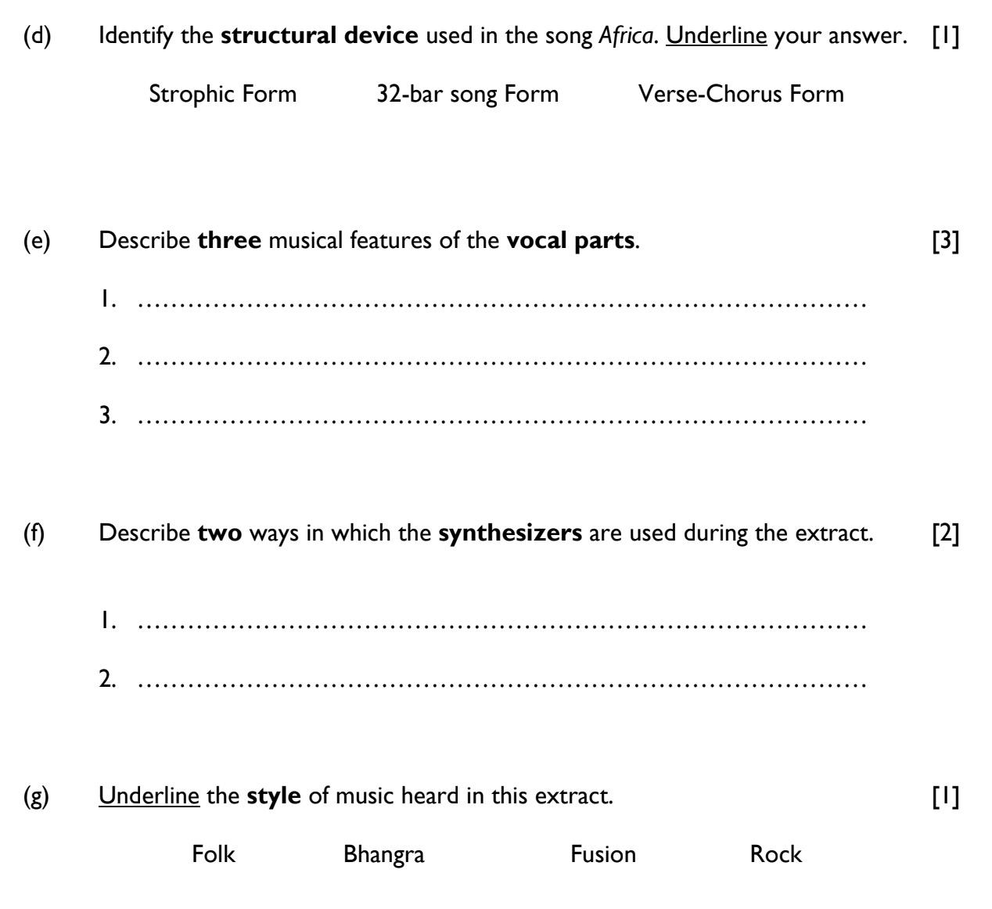
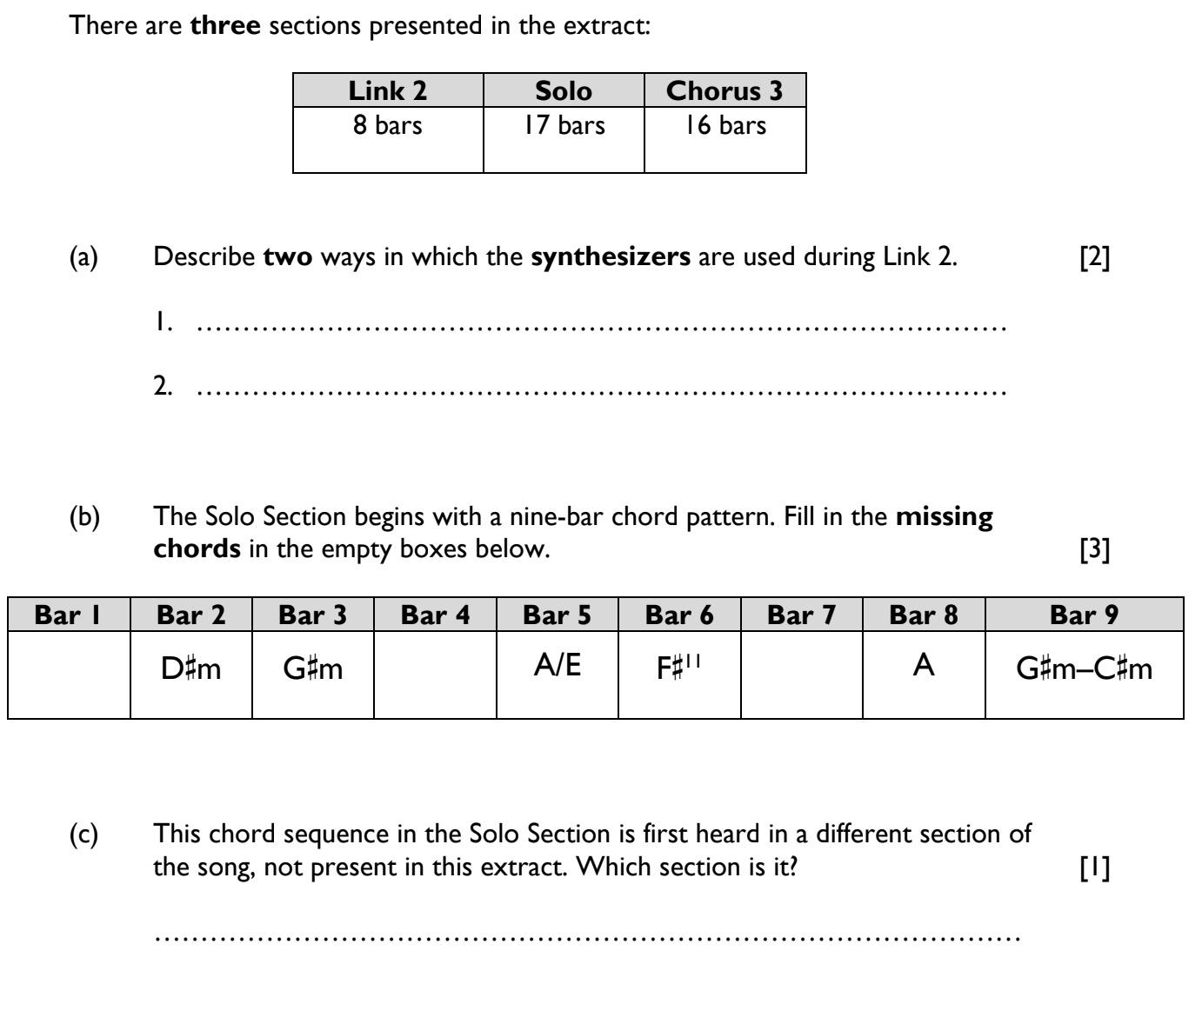
Some Sample Questions

Slide 32
The Exam
Typical exam question: “Comment on the melody in Verse 2”
Students should therefore consider the following points:
Which scale is used? Major? Minor?
Is it mainly conjunct (moving by step) or disjunct (moving by leap)?
Does it ascend or descend? Or both?
High or low tessitura (part of the voice)?
What is the overall range of the vocal line?
Anything about the rhythm?

Slide 33
The Exam
Typical exam question: “Comment on the melody in Verse 2”
Students should therefore consider the following points:
Which scale is used? Major? Minor?
Is it mainly conjunct (moving by step) or disjunct (moving by leap)?
Does it ascend or descend? Or both?
High or low tessitura (part of the voice)?
What is the overall range of the vocal line?
Anything about the rhythm?
Uses notes from the (B) major scale
It is mainly conjunct
Begins by ascending; second phrase ascends and descends
It is in a low tessitura (range) for the voice
It has a range of an octave, for most of the Verse
It is highly syncopated

Slide 34
Q&A
Ask me anything!
Shameless plug ☺
I have various Africa-related resources available, including:
Full analysis PDF
Full analysis PPT
Ten sample questions
Knowledge organiser
50 quick-fire questions on Verse 2 & Chorus 2 (2022 exam)
Full score/transcription is on Sheet Music Plus (search for “Eduqas GCSE Africa Toto score”. This transcription goes into more detail than students will need, and is best used by teachers to get to know the song inside out, and for students to be able to see the inner workings of the song.
Plus: 50 quick-fire questions on JS Bach Badinerie Part B, and Ten Sample Popular Music Questions: Rock, Pop, Reggae, Hip Hop, Soul, Ballads, Bhangra, Fusions (incl. comparison)
And I present a fortnightly music education podcast, called Teaching Notes, on behalf of the Music Teachers’ Association: www.musicteachers.org/podcast

Slide 35
Thank you for attending today.
We could really appreciate your feedback. You can email us at:
info@passingnoteseducation.co.uk
Stay in touch. We’re on:
Twitter @passingnotesed
Facebook facebook.com/passingnoteseducation

