Slide 1
Comparison of CENNS detector results
created with Geant4 and MCNP
Jan Patrick Adam
10/04/2014

Slide 2
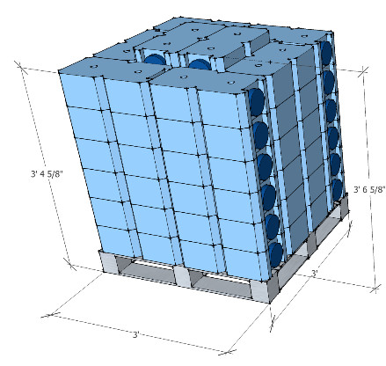
Detector Setup

Slide 3
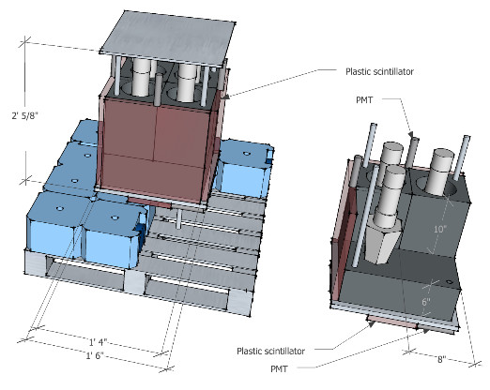
Detector Setup

Slide 4
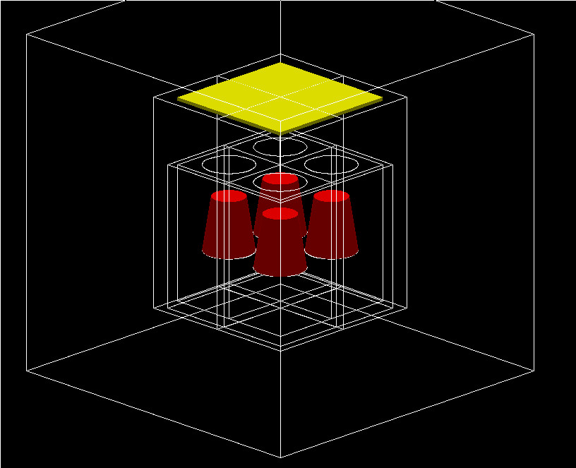
Detector Setup

Slide 5
Materials
Shielding in bricks: water (H2O)
Detector: lead (Pb)
Scintillator: EJ-301 (C6H4(CH3)2)
Shielding around lead: EJ-200 (C10H11)
Shielding over lead: Al7075 (alloy)

Slide 6
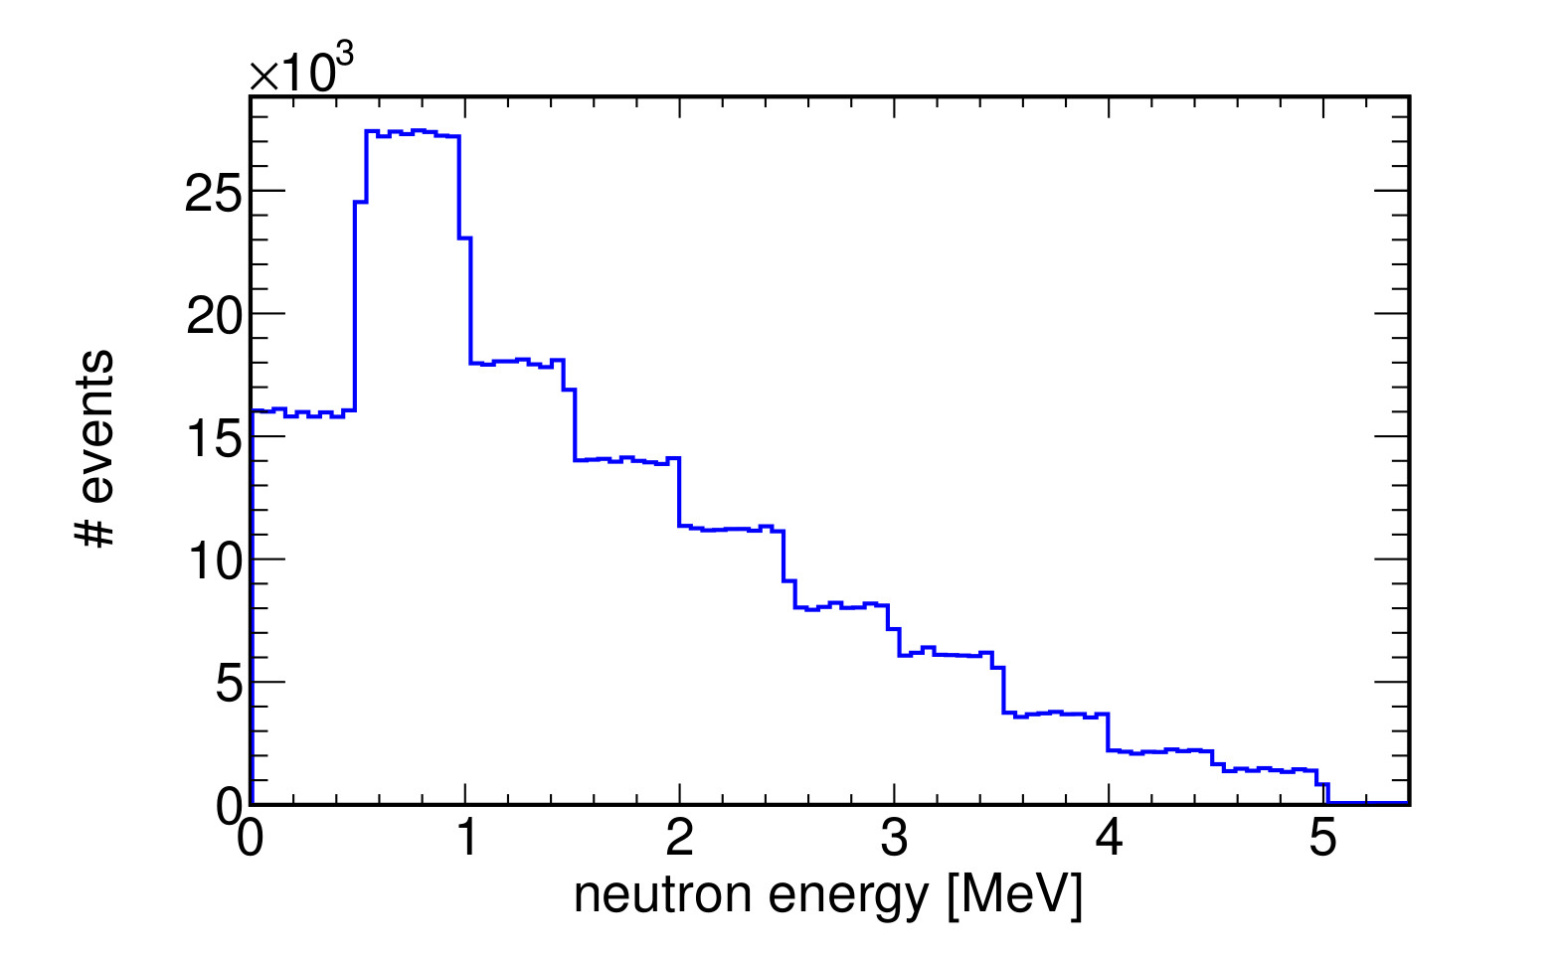
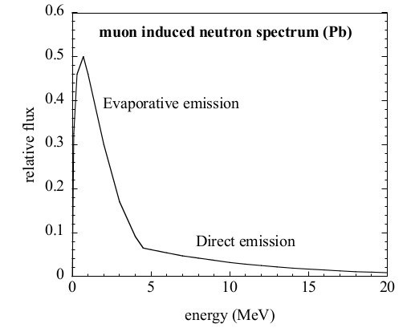
Energy Distribution

Slide 7
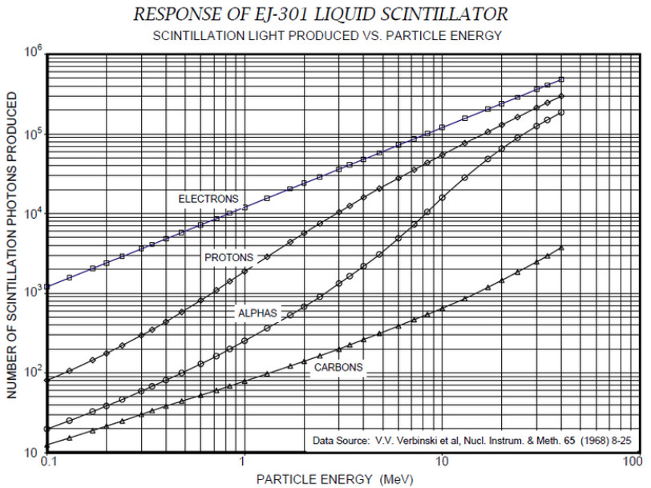
Energy Deposition

Slide 8
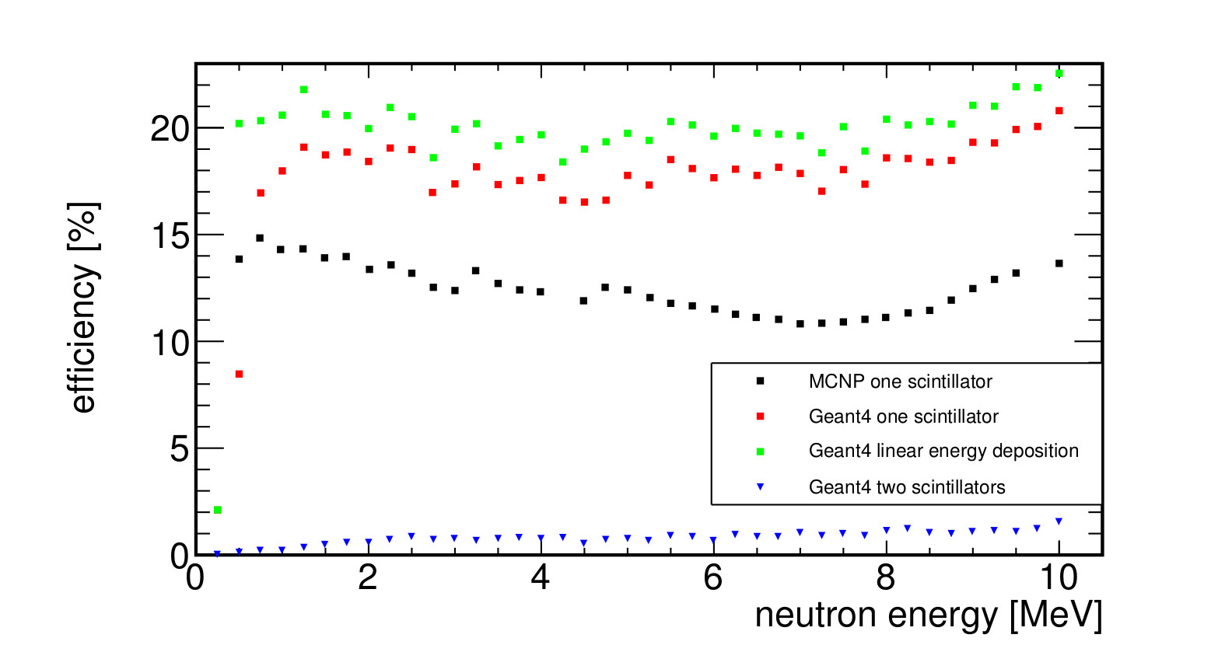
Efficiency

Slide 9
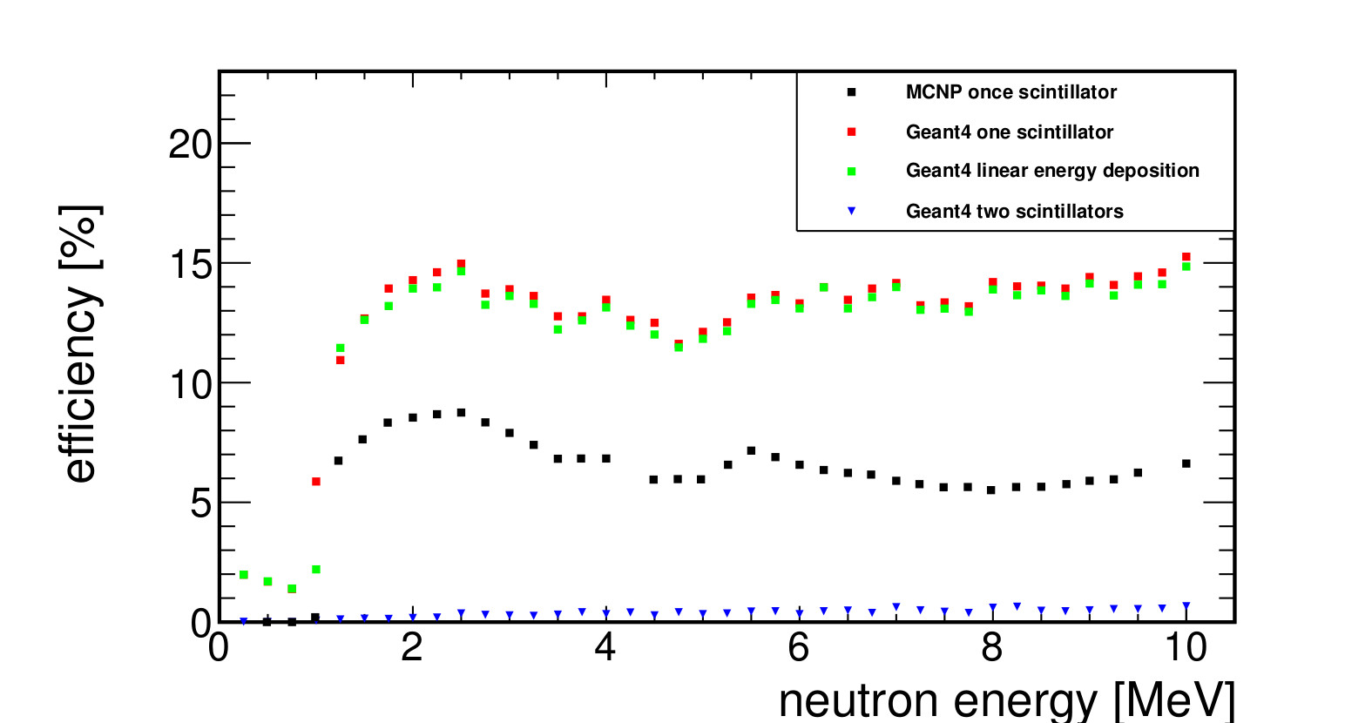
Efficiency

Slide 10
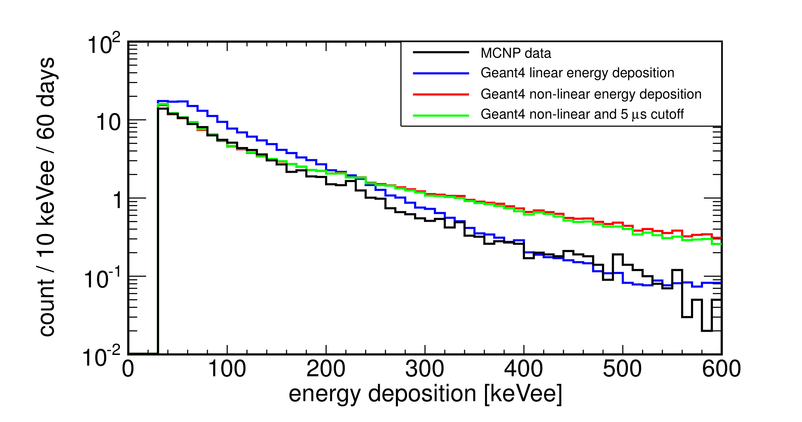
Energy Deposition
30 keVee threshold

Slide 11
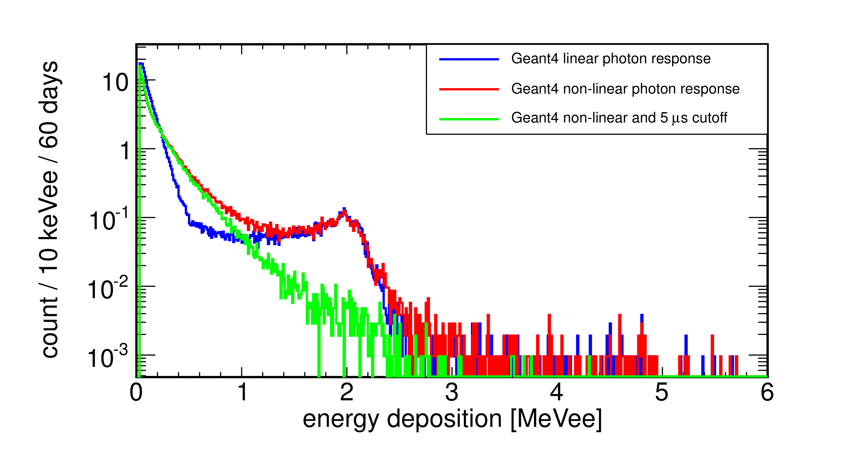
Energy Deposition
2.2 MeV peak: neutron capture hydrogen

Slide 12
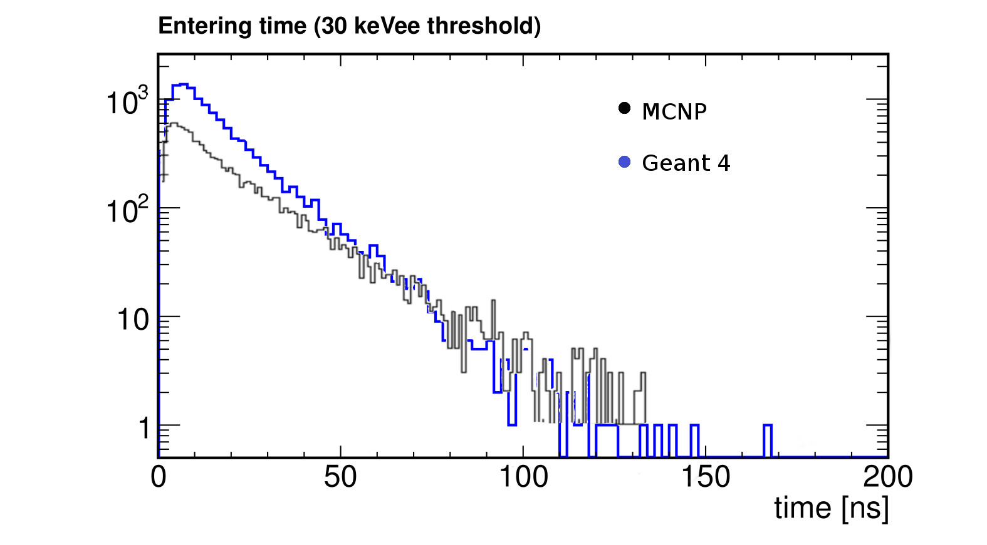
Timing

Slide 13
Comparison of CENNS detector results
created with Geant4 and MCNP
Sources:
“A Design Document for the Neutrino-Induced Neutron Pile Concept”
P. S. Barbeau, J. I. Collar, Y. Efremenko, D. Hornback,
J. Newby, D. Reyna, G. C. Rich, K. Scholberg
August 6, 2014
Scintillator data:
http://www.eljentechnology.com/
Jan Patrick Adam
10/04/2014

