Slide 1
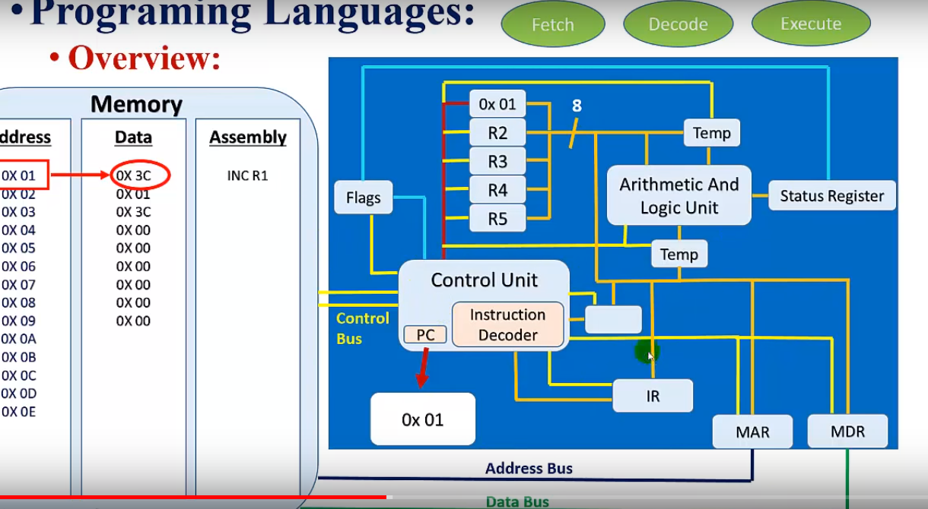

Slide 2
https://www.youtube.com/watch?v=XM4lGflQFvA
Fetch-Decode-Execute Cycle
https://www.youtube.com/watch?v=D9lIycpp__M&list=PLikkRSgdfjuqlPKfQkPm4FeB9QT8dPojw&index=7

Slide 3
Interfaces
Interface 2
-uart
-spI
-I2c
Interface1 -led -button -motors -lcd - Keypad -ADC -Timer -intrupt

Slide 4



Slide 5
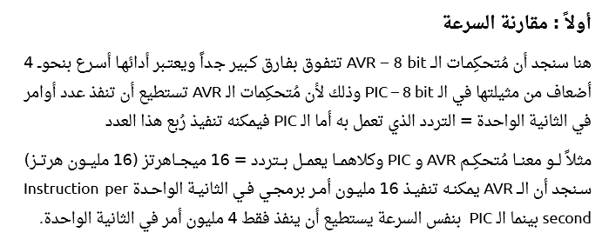


Slide 6


Slide 7
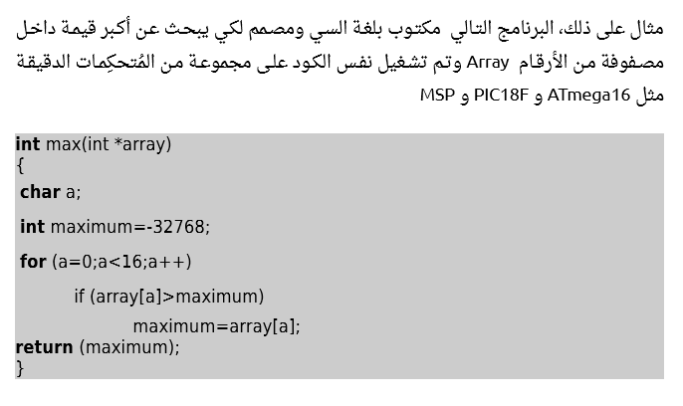

Slide 8
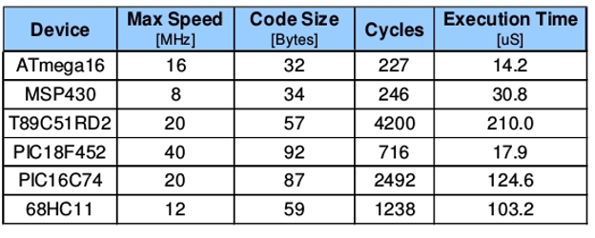

Slide 9



Slide 10



Slide 11
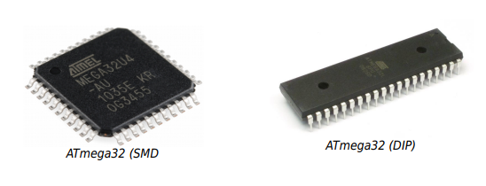
ATMEGA
surface-mount device
dual inline package

Slide 12
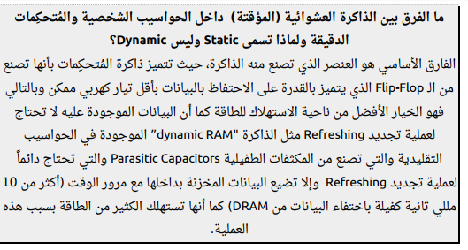

Slide 13
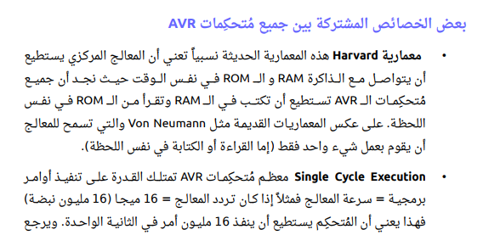

Slide 14
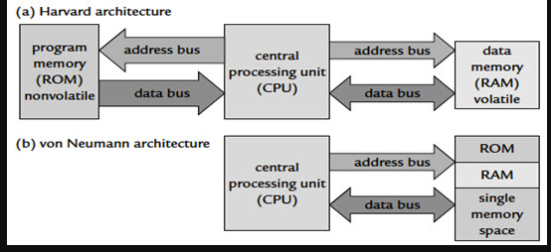

Slide 15
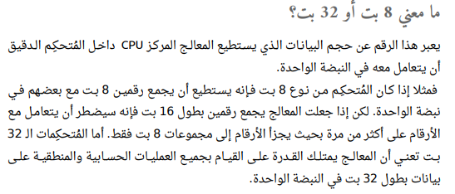

Slide 16
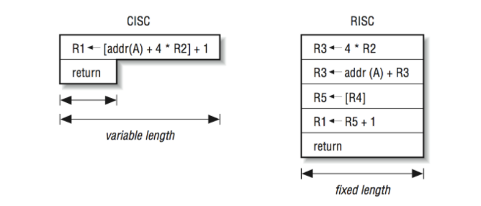

Slide 17
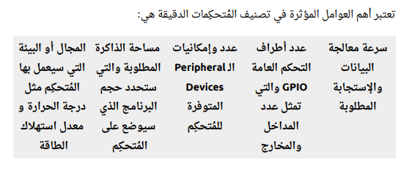

Slide 18
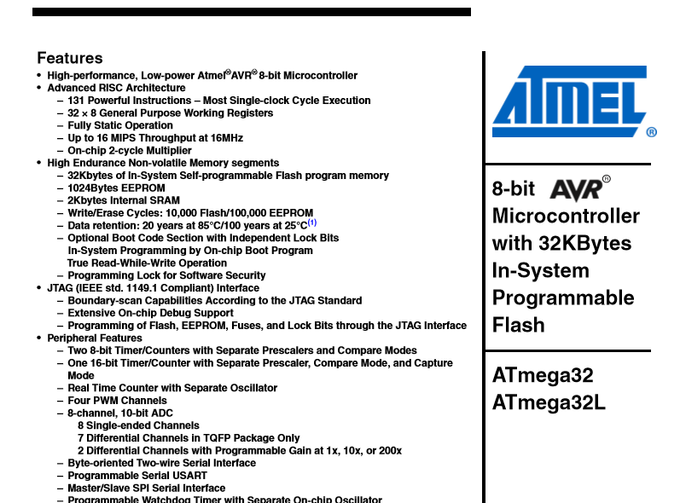

Slide 19




Slide 20
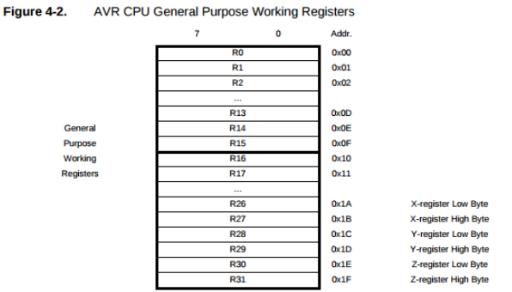

Slide 21


Slide 22


Slide 23
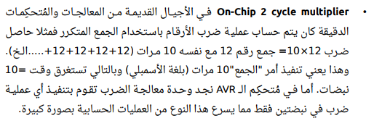

Slide 24



Slide 25



Slide 26



Slide 27
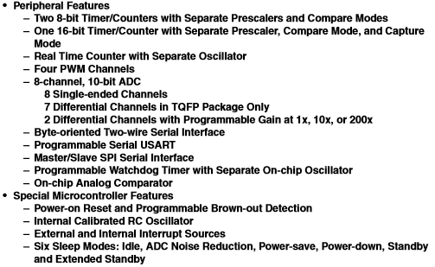

Slide 28
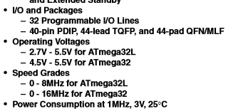

Slide 29
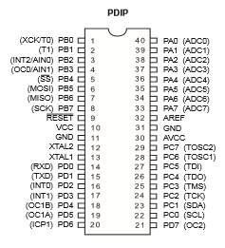
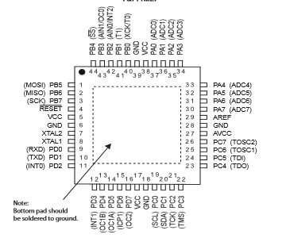

Slide 30
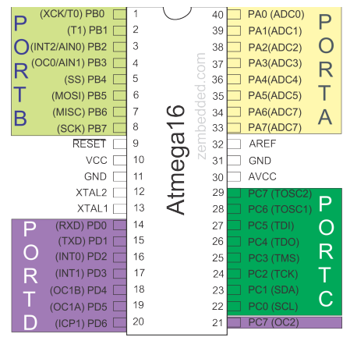

Slide 31




Slide 32
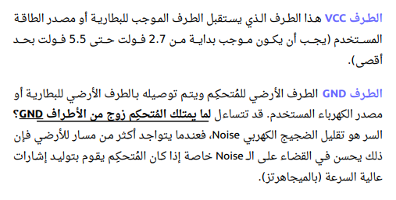

Slide 33
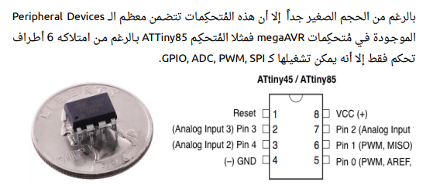

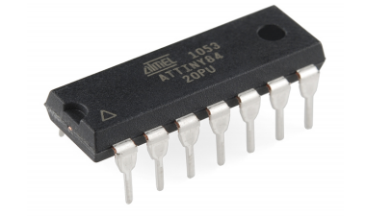

Slide 34
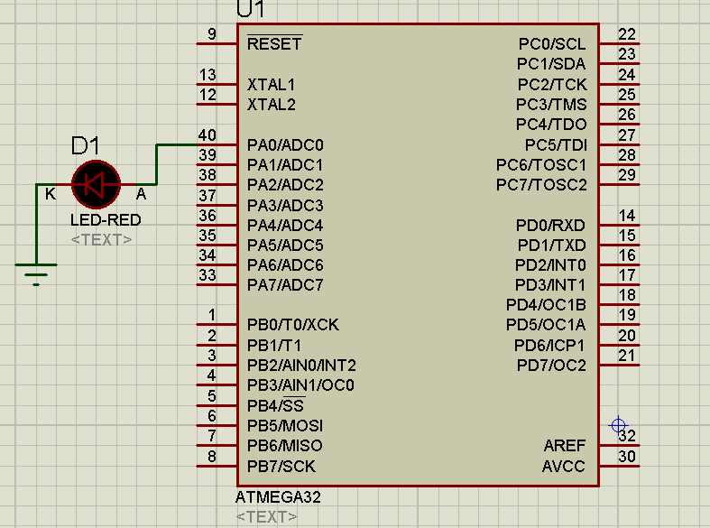
Example 1

Slide 35
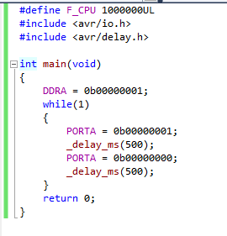


Slide 36
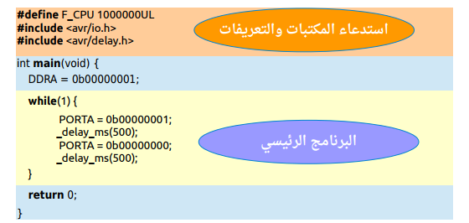

Slide 37

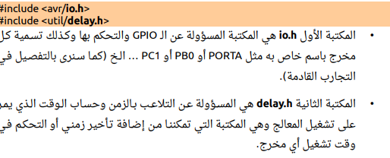

Slide 38
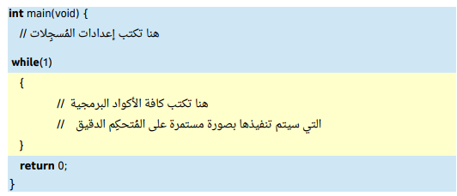

Slide 39
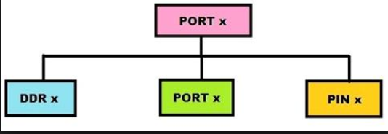


Slide 40
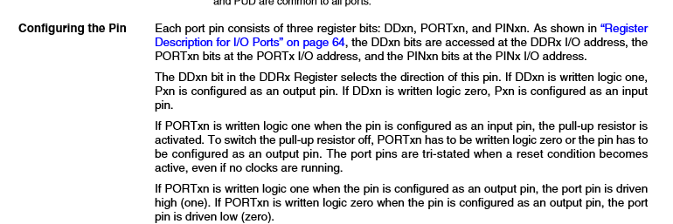

Slide 41
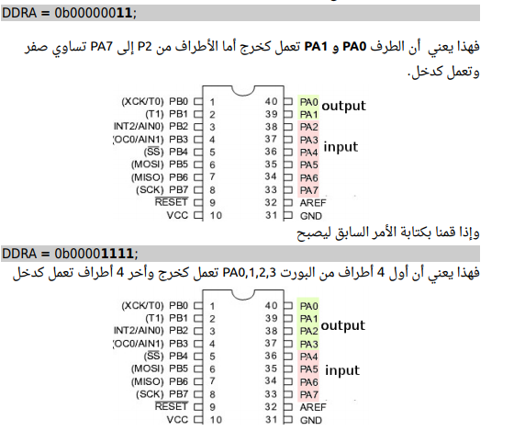


Slide 42
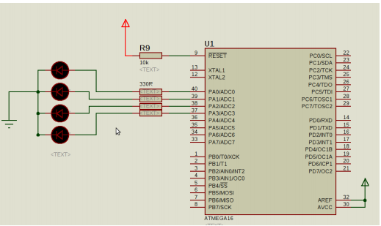

Example 2

Slide 43
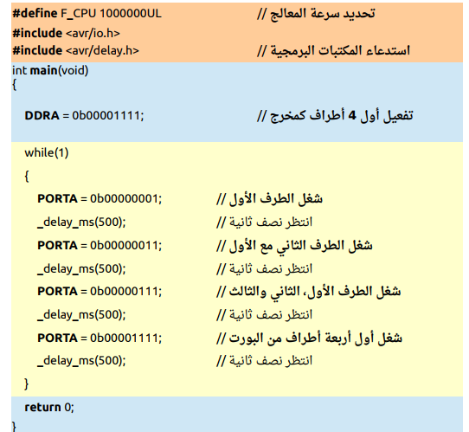

Slide 44
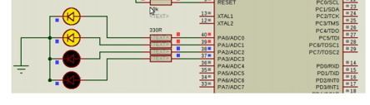
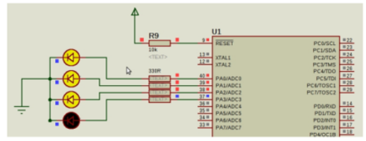
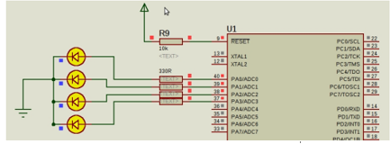

Slide 45

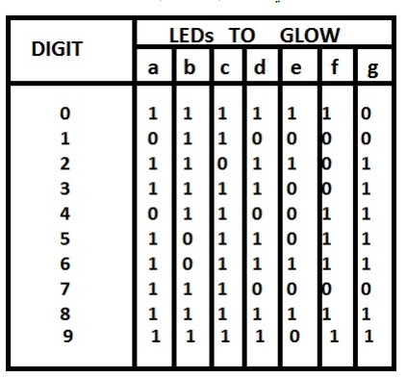
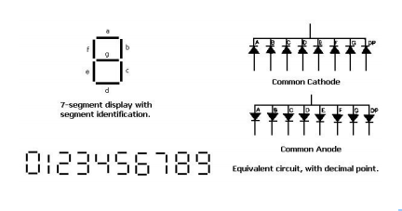

Slide 46
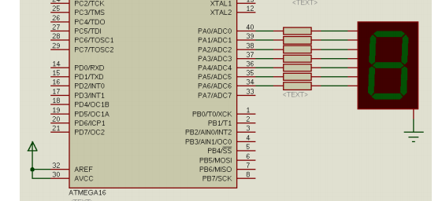

Slide 47
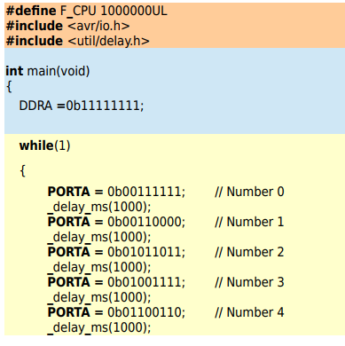
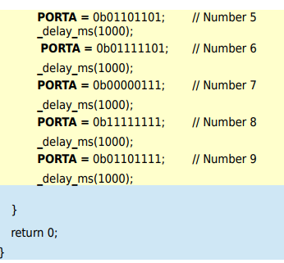

Slide 48
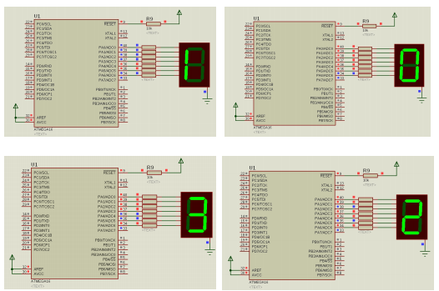

Slide 49
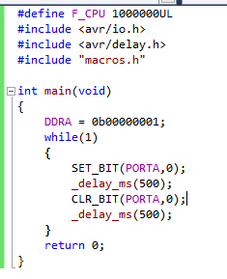
#define SET_BIT(reg,Index) Reg|=(1<<Index)
#define CLR_BIT(Reg,Index) Reg&=(~(1<<Index))
PORTA= xxxxxyxx
one = 000000001
Shift = 000000100
OR = xxxxxx1xx
PORTA= xxxxxyxx
one = 000000001
Shift ~= 111111011
and = xxxxxx0xx

Slide 50
