Slide 1



Politecnico di Torino
Emulating NXP S32K3X8EVB in QEMU & Porting FreeRTOS
CAOS Project Report
Group 18 – Bertolami Carmelo, Frigo Matteo, Simoncini Marco, Soldera Marco
February 18th, 2025
© CAOS Group 18 2024/2025, licensed under CC BY-NC 4.0 (view slide 2)

Slide 2
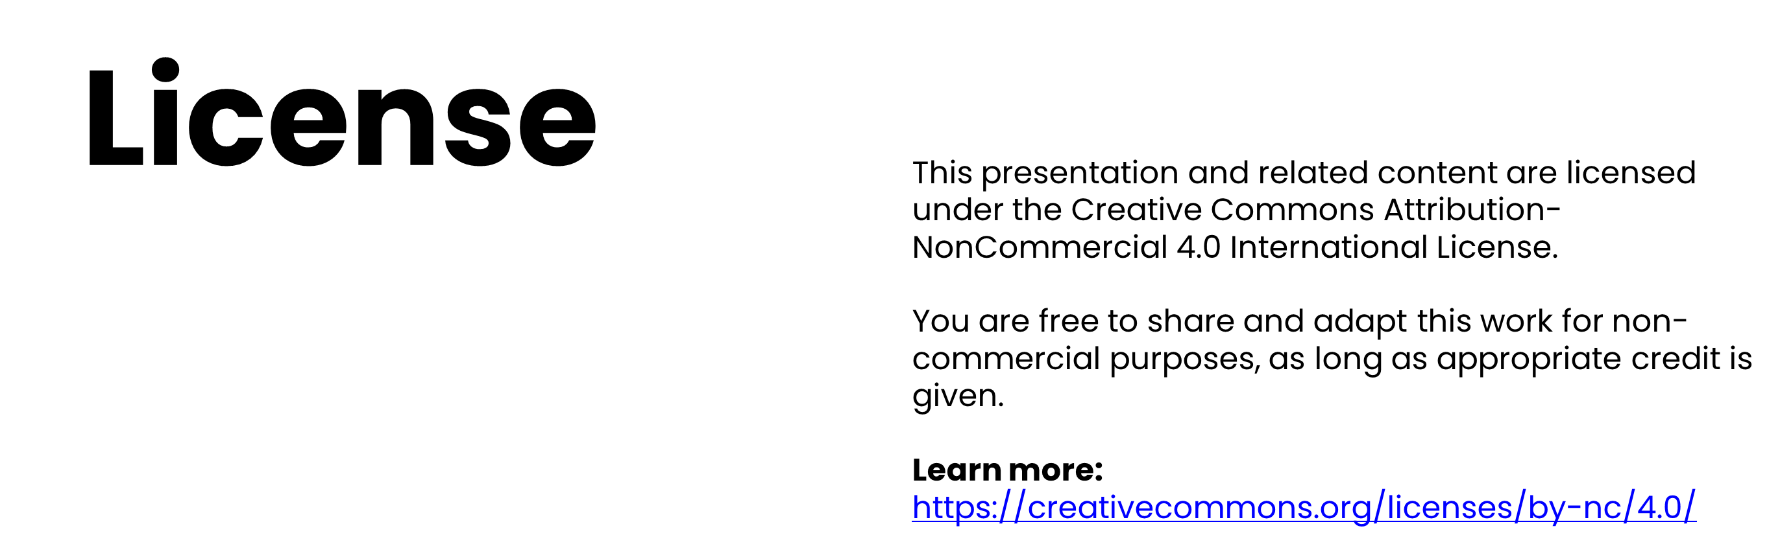
© CAOS Group 18 2024/2025, licensed under CC BY-NC 4.0 (view slide 2)

Slide 3
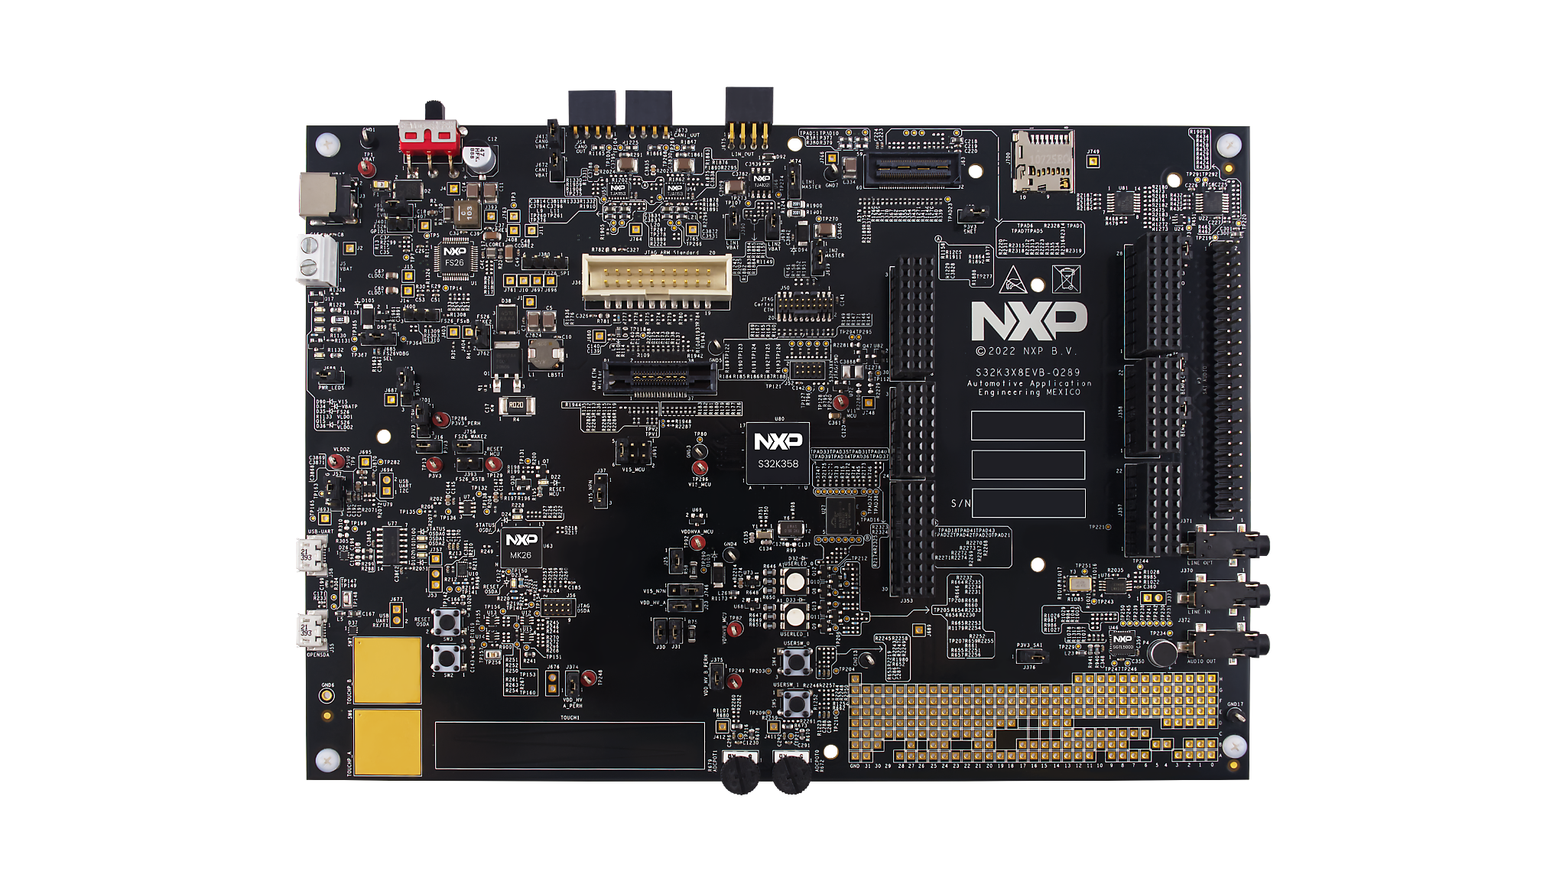
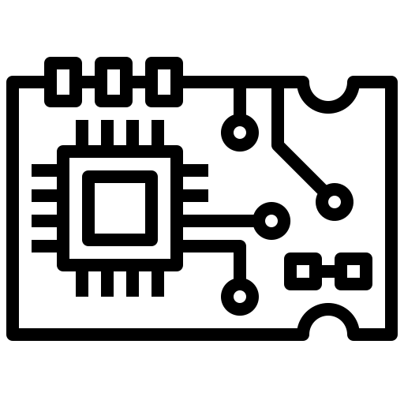


Introduction
Emulation S32K3X8EVB-Q289 in qemu
CONTROLLER AREA NETWOEK
Can implementation
RX TX
Uart Implementation
Porting freeRTOS
Develop an application
© CAOS Group 18 2024/2025, licensed under CC BY-NC 4.0 (view slide 2)

Slide 4
Board Details
ARM Cortex-M7 CPU 32-bit architecture
Maximum frequency: up to 320 MHz
SoC S32K358
Designed for low energy consumption
especially in automotive applications

Slide 5

QEMU Board
Emulation
Open-source emulator - Version: QEMU stable-8.2
Code Structure :
hw/arm/: Contains modules for ARM architectures and SoC management.
include/hw/: Header files and peripheral definitions.
target/arm/tcg/: CPU emulation, including Cortex-M7.
Modifications :
s32k358_soc.c - nxps32.c - Kconfig - Meson.build
© CAOS Group 18 2024/2025, licensed under CC BY-NC 4.0 (view slide 2)

Slide 6
QEMU UART
Emulation
Peripheral Emulation:
UART (Universal Asynchronous Receiver-Transmitter) facilitates serial communication.
Implemented a driver for the SoC-specific UART in hw/char/.
Supports transmission and reception of data.
REGISTERS:
DATA
CTRL
STAT
BAUD
© CAOS Group 18 2024/2025, licensed under CC BY-NC 4.0 (view slide 2)

Slide 7
CAN (Controller Area Network) is widely used in automotive applications.
QEMU CAN
Emulation
Implemented FlexCAN controller in hw/net/can/ to support data transmission.
Defines transmission and reception of frames.
REGISTERS:
DATA
MCR
IFLAG1
IMASK1
ESR1
CTRL1
© CAOS Group 18 2024/2025, licensed under CC BY-NC 4.0 (view slide 2)

Slide 8

FreeRTOS Porting
Compilation using NXP toolchain official IDE
Memory configuration replicated from the NXP linker file
CPU configuration (vector table setup in QEMU)
Boot header removal to enable proper startup
HardFault fix by temporarily disabling the MPU
© CAOS Group 18 2024/2025, licensed under CC BY-NC 4.0 (view slide 2)

Slide 9

Board & SoC Adaptation:
Based on Netduino 2 adjusted memory, peripherals, addresses.
Compilation & Configuration Issues:
Fixed Kconfig & meson.build for proper integration.
Understanding & Adapting QEMU's Structure
Main
Challenges
Peripheral Emulation:
UART: Adapted from Netduino 2.
CAN: No QEMU support for FlexCAN, built from scratch, complex bus synchronization.
FreeRTOS Porting:
Fixed memory mapping, boot_header, vector table.
MPU issues still unresolved needs further debugging.
© CAOS Group 18 2024/2025, licensed under CC BY-NC 4.0 (view slide 2)

Slide 10
Deeper Understanding of Hardware & Emulation :
Gained insights into hardware architecture and software implementation.
Conclusion
Register Mapping & Peripheral Emulation :
Accurate memory mapping was essential for reliable emulation.
Successfully implemented basic CAN and UART, overcoming protocol complexities.
FreeRTOS Porting Challenges :
Addressed memory configuration, vector table adjustments, and startup modifications.
Key Takeaways :
Improved expertise in QEMU emulation, peripheral integration, and debugging.
Valuable experience for future embedded systems development.
© CAOS Group 18 2024/2025, licensed under CC BY-NC 4.0 (view slide 2)

Slide 11

Thank You
Available for any question…
Group 18 – Bertolami Carmelo, Frigo Matteo, Simoncini Marco, Soldera Marco
© CAOS Group 18 2024/2025, licensed under CC BY-NC 4.0 (view slide 2)

