Slide 1
OpenGL Programming
Chunxu Xu
E-mail: xu-cx12@mails.tsinghua.edu.cn
Cellphone: 15120003845

Slide 2
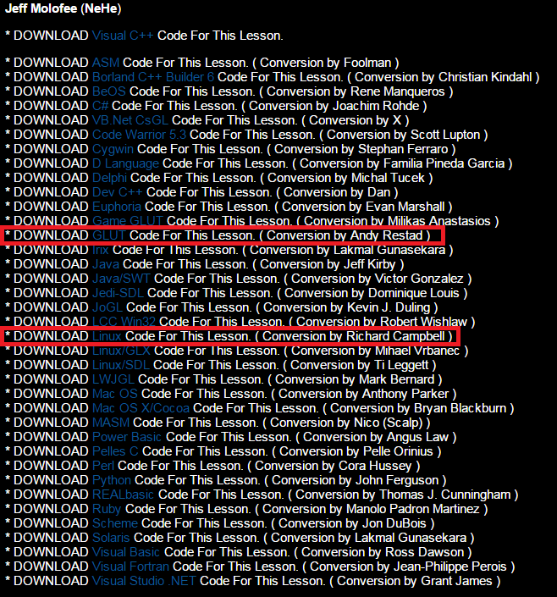
Tutorials
NeHe tutorials:
http://nehe.gamedev.net/
All the code used as exercises are available online

Slide 3
Process of each lesson
What will we do?
Show the effects we will achieve
Main techniques we need
Talk about the corresponding content in OpenGL
Exercise time & Some more (Optional)
Try to understand what we learn and do the exercises
Some extension

Slide 4
Week 2
What will we do?
Main techniques we need
Exercise time & Some more (Optional)

Slide 5
What will we do?
Build up an OpenGL window
Draw something
Color what you draw

Slide 6
Week 2
What will we do?
Main techniques we need
Exercise time & Some more (Optional)

Slide 7
Main techniques we need
Build up a window using OpenGL Utility Toolkit (GLUT)
Our first group of drawing/transformation functions

Slide 8
Using GLUT
Using GLUT
Create a window
Drawing part
Menus, buttons, etc
Keyboard/Mouse response

Slide 9
Using GLUT
Build an ordinary VS2010 console project
Include files
gl/glut.h
or gl/freeglut.h if you’re using FreeGLUT
No need to include gl.h explicitly

Slide 10
Using GLUT
Main structure of a basic program
Main function
Set properties of the window
Register the functions
Implement all the functions
Respond to resize the window size
Rendering
Responding to keyboard/mouse

Slide 11
Using GLUT
Main function
glutInit(&argc, argv)
glutInitDisplayMode(GLUT_DOUBLE | GLUT_RGBA | GLUT_DEPTH)
GLUT_DOUBLE — Double buffers
GLUT_RGBA — Color mode
GLUT_DEPTH — Depth buffer

Slide 12
Using GLUT
Main function
glutInitWindowSize(width, height)
glutInitWindowPosition(x_pos, y_pos)
Origin — left, top of the screen
glutCreateWindow(“The title”)
Return a handle of the window, maybe it’s useful somewhere

Slide 13
Using GLUT
Main function
glutDisplayFunc(your display function)
Register the rendering function
glutReshapeFunc(your reshape function)
Register the reshaping function
Called when the window’s size is changed
glutKeyboardFunc(your keyboard function)
Register the keyboard function

Slide 14
Using GLUT
Main function
glutMainLoop()
The main loop
Before the loop, some initialization is needed…

Slide 15
Using GLUT
Main function
glClearColor(color_r, color_g, color_b, alpha)
set the clear color
glClearDepth(default depth value)
0.0~1.0
usually set with the biggest value, i.e. 1.0

Slide 16
Using GLUT
Implement all the functions
your reshape function
myReshape(int width, int height)
View port
Set initial matrixes
ModelView Matrix
Projection Matrix
These settings are important
but may be hard to understand now…
just follow these in the first several lessons

Slide 17
Using GLUT
Implement all the functions
glViewport(GLint x, GLint y, GLsizei width, GLsizei height)
(x, y) — left, bottom of the viewport
width, height — literal meanings

Slide 18
Using GLUT
Implement all the functions
glMatrixMode(GL_PROJECTION)
glLoadIdentity()
Select the matrix we will operate
gluPerspective(GLdouble fovy, GLdouble aspect, GLdouble zNear, GLdouble zFar)
A figure will explain better…

Slide 19
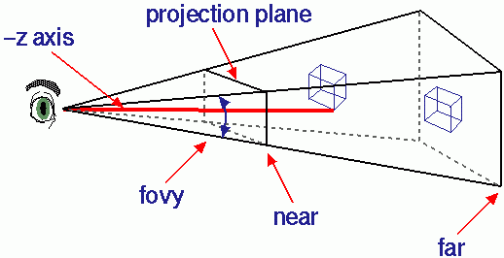
Using GLUT
Implement all the functions

Slide 20
Using GLUT
Implement all the functions
glMatrixMode(GL_MODELVIEW)
glLoadIdentity()
Model matrix
View matrix
Modification is done by
gluLookAt()
glTranslatef()
glRotatef()
glScalef()
…

Slide 21
Using GLUT
Implement all the functions
your display function
void myDisplay()
All the rendering work is done in this function

Slide 22
Using GLUT
Implement all the functions
glClear(GL_COLOR_BUFFER_BIT | GL_DEPTH_BUFFER_BIT)
Color Buffer, Depth Buffer
glutSwapBuffers()
Because we are using double buffers…
Try to uncomment this line and see what you will get
All the drawing, transformation should be added between these two functions

Slide 23
Using GLUT
Implement all the functions
glBegin(GLenum mode)
glEnd()
GLenum values
GL_TRIANGLES/GL_QUADS
GL_POINTS/GL_LINES
GL_LINE_STRIP
GL_TRIANGLE_STRIP
GL_POLYGON
……

Slide 24
Using GLUT
glVertex3f(GLfloat x, GLfloat y, GLfloat z)
(x, y, z)
For triangles/quads/polygons, you must follow a specific order of the vertices
CW
CCW
It is related to the normal of the vertex
CCW
Right-Hand principle
y
z
x

Slide 25
Using GLUT
glColor3f(GLfloat red, GLfloat green, GLfloat blue)
Each component ranges from 0.0~1.0
This call sets the color of a vertex
Effect lasts until another call of this function
Different colors on each vertex of a triangle
glShadeModel(GL_SMOOTH)
GL_FLAT — only use one color of the vertices

Slide 26
Using GLUT
Things seem to be done until here…
Try if you can see what you expected to draw
The answer is probably NO..
If you draw the object on the z=0 plane
Why?
Because we still don’t know which direction we’re looking into

Slide 27
Using GLUT
gluLookAt()
This function will set
“where your eyes will be”
“which direction you’re look into”
“which direction is UP for your head”
in the coordinate system in OpenGL
The default value will be set as
Eyes will be at origin
Look into –z axis
+y axis will be UP for you

Slide 28
Using GLUT
So how can you expect to see things IN your eyes? ☺
Of course, set gluLookAt() is a good choice…
Transformation is what we will talk about below…

Slide 29
Transformation functions
glTranslatef(GLfloat x, GLfloat y, GLfloat z)
Translate what you draw
If current position is (xc, yc, zc)
Then the transformed position is (xc+x, yc+y, zc+z)
Note
Transformation is set BEFORE you draw

Slide 30
Week 2
What will we do?
Main techniques we need
Exercise time & Some more (Optional)

Slide 31
Some more(Optional)…
Exercise time
Try draw a triangle and a quad in a window
Try to set the colors you want
Try to use glViewport() to draw in a specific area of the window
For instance, left-top region
Try to find out how to set the EYE using gluLookAt()
Different position/direction

