Slide 1
OpenGL Programming
Chunxu Xu
E-mail: xu-cx12@mails.tsinghua.edu.cn
Cellphone: 15120003845

Slide 2
Week 8
What will we do?
Main techniques we need
Exercise time & Some more (Optional)

Slide 3
What will we do?
Texture – Texture Coordinate Generation
example
Texture – Multi-Texturing
example
Bezier Patch
example
Line

Slide 4
Week 8
What will we do?
Main techniques we need
Exercise time & Some more (Optional)

Slide 5
Week 8
What will we do?
Main techniques we need
Texture Coordinate Generation
Multi-Texturing
Bezier Patch
Line
Exercise time & Some more (Optional)

Slide 6
Main techniques we need
Texture Coordinate Generation
Until now, the texture coordinates are assigned manually.
So what’s the function of texture coordinate generation?
Not just for convenient, but also some great effect.

Slide 7
Main techniques we need
Texture Coordinate Generation
Object Linear Texture
Eye Linear Texture
Sphere Texture
Cubemap Texture
All coordinate automatic generations need to enable the coordinate to generate
glEnable(GL_TEXTURE_GEN_S)
glEnable(GL_TEXTURE_GEN_T)
…

Slide 8
Main techniques we need
Texture Coordinate Generation
Object Linear Texture
Generated coordinates =
p1~p4
Plane parameter
x0, y0, z0, w0
Coordinates of a point
glTexGeni(GL_S, GL_TEXTURE_GEN_MODE, GL_OBJECT_LINEAR);
Assign the plane parameter
glTexGenfv(GL_S, GL_OBJECT_PLANE, zPlane);
……
Demo

Slide 9
Main techniques we need
Texture Coordinate Generation
Eye Linear Texture
Generated coordinates =
p1~p4
Plane parameter
x0, y0, z0, w0
Coordinates of a point RELATED TO EYES
glTexGeni(GL_S, GL_TEXTURE_GEN_MODE, GL_EYE_LINEAR);
Assign the plane parameter
glTexGenfv(GL_S, GL_EYE_PLANE, zPlane);
……
Demo

Slide 10
Main techniques we need
Texture Coordinate Generation
Sphere Texture
glTexGeni(GL_S, GL_TEXTURE_GEN_MODE, GL_SPHERE_MAP);
Coordinate Generation
Related to eyes
Demo

Slide 11
Main techniques we need
Texture Coordinate Generation
Cubemap Texture
Used for reflection
6 textures are treated as a whole cubemap texture
Loading just as a normal 2D texture
With target GL_TEXTURE_CUBE_MAP
SOIL also provide a convenient way to load cubemap
Parameter set as a whole texture

Slide 12
Main techniques we need
Texture Coordinate Generation
Cubemap Texture
Reflection
GL_REFLECTION_MAP
GL_NORMAL_MAP
glTexGeni(GL_S, GL_TEXTURE_GEN_MODE, GL_REFLECTION_MAP);
Remember
On some platform, cubemap is an extension.
Demo

Slide 13
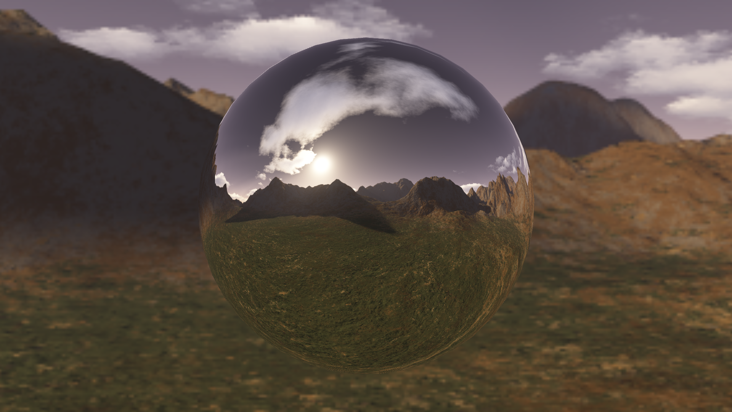
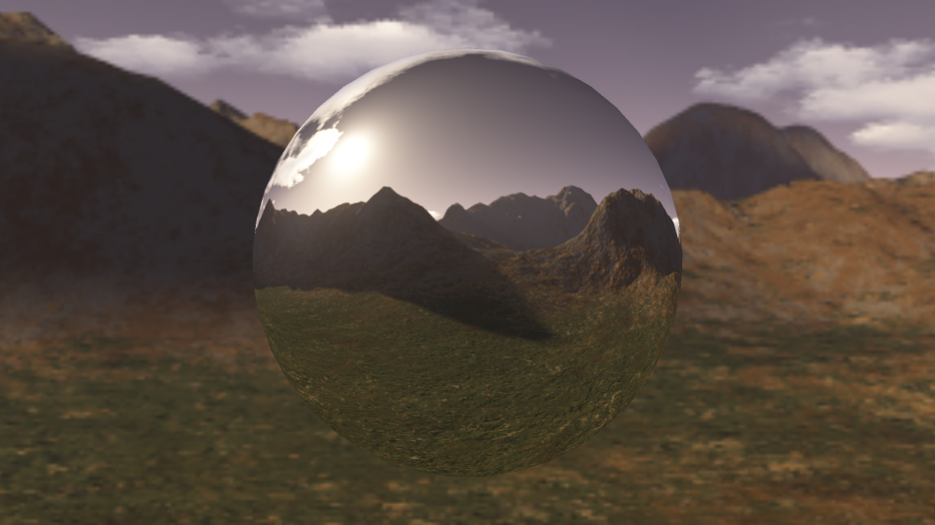
Main techniques we need
Texture Coordinate Generation
GL_REFLECTION_MAP v.s. GL_NORMAL_MAP

Slide 14
Week 8
What will we do?
Main techniques we need
Texture Coordinate Generation
Multi-Texturing
Bezier Patch
Line
Exercise time & Some more (Optional)

Slide 15
Main techniques we need
Multi-Texturing
Until now, we only use one texture for one face
, and we also see how to mix texture and color.
What if we want to mix multiple textures for one face?
Compare to blending

Slide 16
Main techniques we need
Multi-Texturing
Steps to use multiple texture
Load image as texture
Active the n-th texture
Enable target
Bind handle to target
……
Disable some texture
Active the texture
Disable it

Slide 17
Main techniques we need
Multi-Texturing
void glActiveTexture(GLenum texUnit)
texUnit
GL_TEXTURE0/1/2…
void glTexEnv{if}(GLenum target, GLenum pname, TYPE param)
target
GL_TEXTURE_ENV
pname
GL_TEXTURE_ENV_MODEL
param
GL_REPLACE/GL_DECAL/GL_MODULATE/GL_ADD…

Slide 18
Main techniques we need
Multi-Texturing
About texture coordinate…
void glMultiTexCoord{1234}{sifd}(GLenum texUnit, TYPE coords)
glTexCoord() only affect GL_TEXTURE0

Slide 19
Week 8
What will we do?
Main techniques we need
Texture Coordinate Generation
Multi-Texturing
Bezier Patch
Line
Exercise time & Some more (Optional)

Slide 20
Main techniques we need
Evaluator
Bezier curves/surfaces
A method to create smooth curves/surfaces.
OpenGL provides evaluator to calculate Bezier curves/surfaces.

Slide 21
Main techniques we need
Evaluator
Bezier curves/surfaces
Define a evaluator
void glMap2{fd}(GLenum target,
TYPE u1, TYPE u2, GLint ustride, GLint uorder,
TYPE v1, TYPE v2, GLint vstride, GLint vorder,
TYPE points)
target
GL_MAP2_VERTEX_3
GL_MAP2_TEXTURE_COORD_2
Using glEnable() to enable the targets.

Slide 22
Main techniques we need
Evaluator
Bezier curves/surfaces
u1, u2
min & max of u component
ustride
stride to “adjacent” u value
uorder
order of u-dimension
v-dimension is the same
points
control points or corresponding texture coordinates

Slide 23
Main techniques we need
Evaluator
Bezier curves/surfaces
Define a grid
void glMapGrid2{fd}(GLint nu, TYPE u1, TYPE u2, GLint nv, TYPE v1, TYPE v2)
nu
steps
u1, u2
evaluate range

Slide 24
Main techniques we need
Evaluator
Bezier curves/surfaces
Apply evaluator
void glEvalMesh2(GLenum mode, GLint i1, GLint i2, GLint j1, GLint j2)
mode
GL_POINT/GL_LINE/GL_FILL
i1, i2
calculation step range

Slide 25
Week 8
What will we do?
Main techniques we need
Texture Coordinate Generation
Multi-Texturing
Bezier Patch
Line
Exercise time & Some more (Optional)

Slide 26
Main techniques we need
Line
glBegin(GL_LINES)
glEnd()
GL_LINE_STRIP
GL_LINE_LOOP

Slide 27
Main techniques we need
Line
void glLineWidth(GLfloat width)
GLfloat sizes[2]
GLfloat step
glGetFloatv(GL_LINE_WIDTH_RANGE, sizes)
glGetFloatv(GL_LINE_WIDTH_GRANULARITY, &step)

Slide 28
Main techniques we need
Line
Anti-aliasing
glEnable(GL_POINT_SMOOTH)
glEnable(GL_LINE_SMOOTH)
glEnable(GL_POLYGON_SMOOTH)
Demo

Slide 29
Week 8
What will we do?
Main techniques we need
Exercise time & Some more (Optional)

Slide 30
Some more(Optional)…
Exercise time
Any of the examples is acceptable

