Slide 1
OpenGL Programming
Chunxu Xu
E-mail: xu-cx12@mails.tsinghua.edu.cn
Cellphone: 15120003845

Slide 2
Week 5
What will we do?
Main techniques we need
Exercise time & Some more (Optional)

Slide 3
What will we do?
Texture – Filter
example
Wandering
example
Texture Environment
example

Slide 4
Week 5
What will we do?
Main techniques we need
Exercise time & Some more (Optional)

Slide 5
Main techniques we need
Texture in OpenGL
Basic Steps
Generate texture handles
To distinguish from other textures
Read (image) data for each handle
Set texture parameters
To achieve different effects
Rendering related work

Slide 6
Main techniques we need
Texture in OpenGL
Set Parameters
void glTexParameters{f/i/fv/iv}(GLenum target, GLenum pname, GLfloat param)
Many parameters can be set through this function call.
We only introduce what we need.

Slide 7
Main techniques we need
Texture in OpenGL
Set Texture Parameters
Filtering
Most pixels probably don’t correspond to a single unit of the texture.
Filtering decides how to choose or mix the texture units to display each pixel
Filtering should be set for magnifying and minifying separately
pname
GL_TEXTURE_MAG_FILTER
GL_TEXTURE_MIN_FILTER

Slide 8
Main techniques we need
Texture in OpenGL
Set Texture Parameters
Filtering
param
For magnifying
GL_NEAREST/GL_LINEAR
For minifying
GL_NEAREST/GL_LINEAR
GL_NEAREST_MIPMAP_NEAREST
GL_NEAREST_MIPMAP_LINEAR
GL_LINEAR_MIPMAP_NEAREST
GL_LINEAR_MIPMAP_LINEAR

Slide 9
Main techniques we need
Texture in OpenGL
Set Texture Parameters
GL_NEAREST
Pick the nearest texture unit for each pixel
GL_LINEAR
Linear combination of corresponding texture units

Slide 10
Main techniques we need
Texture in OpenGL
Set Texture Parameters
Mipmap
Why we need mipmap?
Basic idea
Store different resolutions of textures

Slide 11
Main techniques we need
Texture in OpenGL
Set Texture Parameters
Mipmap
Come back to the level parameter of glTexImage2D()
We can use different glTexImage2D() calls with different level parameter
glTexImage2D(…, 0, …)
glTexImage2D(…, 1, …)
glTexImage2D(…, 2, …)

Slide 12
Main techniques we need
Texture in OpenGL
Set Texture Parameters
Mipmap
A much more easier way to read for mipmap filtering
int gluBuild2DMipmaps(GLenum target, GLint internalFormat, GLint width, GLint height, GLenum format, GLenum type, const void* data)

Slide 13
Main techniques we need
Texture in OpenGL
Set Texture Parameters
Wrapping
Texture coordinate
ranges in [0.0, 1.0]
What if it is out of bounder?
pname
GL_TEXTURE_WRAP_S
GL_TEXTURE_WRAP_T
GL_TEXTURE_WRAP_R
…

Slide 14
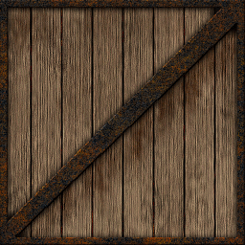
Main techniques we need
Texture in OpenGL
Set Texture Parameters
(0.0, 1.0)
(1.0, 1.0)
(0.0, 0.0)
(0.0, 1.0)

Slide 15
Main techniques we need
Texture in OpenGL
Set Texture Parameters
Wrapping
param
GL_REPEAT
start from 0 again…
GL_CLAMP_TO_EDGE
GL_CLAMP_TO_BORDER

Slide 16
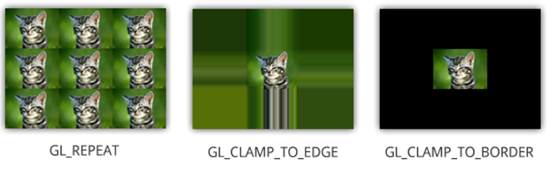
Main techniques we need
Texture in OpenGL
Set Texture Parameters
Wrapping
example

Slide 17
Main techniques we need
Texture in OpenGL
Set Environment
void glTexEnvfi (GLenum target, GLenum pname, GLint param)

Slide 18
Main techniques we need
Texture in OpenGL
Set Environment
Mix texture with colors
pname
GL_TEXTURE_ENV_COLOR
param
GL_MODULATE
GL_REPLACE
GL_DECAL
GL_ADD
example

Slide 19
Main techniques we need
Texture in OpenGL
Render
We need to assign texture coordinate to each vertex
glEnable(GL_TEXTURE_2D)
glBindTexture(GL_TEXTURE_2D, texturehandle);
{
glTexCoord2f(s_coord, t_coord);
glVertex3f(…);
}

Slide 20
Week 5
What will we do?
Main techniques we need
Exercise time & Some more (Optional)

Slide 21
Some more(Optional)…
Exercise time
Any of the examples is acceptable

