Slide 1
OpenGL Programming
Chunxu Xu
E-mail: xu-cx12@mails.tsinghua.edu.cn
Cellphone: 15120003845

Slide 2
Week 9
What will we do?
Main techniques we need
Exercise time & Some more (Optional)

Slide 3
What will we do?
Display List
example
Fonts & Extension
Using texture
Using GLUT
Extension
Fog Coordinate Extension
Volumetric Fog

Slide 4
Week 9
What will we do?
Main techniques we need
Exercise time & Some more (Optional)

Slide 5
Week 9
What will we do?
Main techniques we need
Display List
Font & Extension
Fog Coordinate Extension
Exercise time & Some more (Optional)

Slide 6
Main techniques we need
Display List
Purpose
Improve performance
Usage
Creating display list
Executing display list
Deleting display list

Slide 7
Main techniques we need
Display List
Creating display list
GLuint glGenLists(GLsizei range)
void glNewList(GLuint list, GLenum mode)
// Rendering code
…
void glEndList();

Slide 8
Main techniques we need
Display List
Executing display list
Execute a single display list
void glCallList(GLuint list)
Execute multiple display lists
void glListBase(GLuint base)
void glCallLists(GLsizei n, GLenum type, const GLvoid* list)

Slide 9
Main techniques we need
Display List
Deleting display list
For reusing indices allocated.
void glDeleteLists(GLuint list, GLsizei range)

Slide 10
Week 9
What will we do?
Main techniques we need
Display List
Font & Extension
Fog Coordinate Extension
Exercise time & Some more (Optional)

Slide 11
Main techniques we need
Font in OpenGL
NeHe’s font lesson 13-15
Cool effect, but Windows specific.
Our ways to create font in OpenGL
Texture
GLUT
……

Slide 12
Main techniques we need
Font in OpenGL
Using Texture
We are actually mapping texture on a square.
With display list, we can create a convenient function call to “type” character like this:
glPrintf(“Hello, world!”)

Slide 13
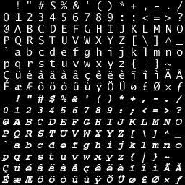
Main techniques we need
Font in OpenGL
Using Texture
The image
256 characters
256 display lists
Shift it to the position of the next character

Slide 14
Main techniques we need
Font in OpenGL
Using Texture
How can we achieve the most convenient way to TYPE, say using only the string like shown before?
Let’s go over the usage of multiple display lists…

Slide 15
Main techniques we need
Font in OpenGL
Using Texture
How can we achieve the most convenient way to TYPE, say using only the string like shown before?
Let’s go over the usage of multiple display lists…
We know the ascii value of ‘A’ is 65
And its sequence no. in the picture is 33 (count from 0)
So, we can set the list base to be originalBase-32
Then we can just use glCallLists(textLength, GL_UNSIGNED_BYTE, textString)

Slide 16
Main techniques we need
Font in OpenGL
Using GLUT
Bitmap fonts
void glutBitmapCharacter(void* font, int character)
font
GLUT_BITMAP_8_BY_13
GLUT_BITMAP_TIMES_ROMAN_10
GLUT_BITMAP_HELVETICA_10
character
ASCII of the character you want to type

Slide 17
Main techniques we need
Font in OpenGL
Using GLUT
Bitmap fonts
Remember
glutBitmapCharacter() is implemented by glBitmap(), which is a pixel operation function.
If you want to transform the character, you can use
void glRasterPos{234}{sifd}(TYPE x, TYPE y, TYPE z, TYPE w)

Slide 18
Main techniques we need
Font in OpenGL
Using GLUT
Stroke fonts
void glutStrokeCharacter(void* font, int character)
It’s actually rendering a character with lines.
The original size is very large!
Try to use glScalef() to make it smaller to be seen

Slide 19
Main techniques we need
Version Info.
Query the OpenGL implementation company/version/renderer identifier
const GLubyte* glGetString(GLenum name)
name
GL_VENDOR
GL_RENDERER
GL_VERSION

Slide 20
Main techniques we need
Extension
The newest OpenGL version is 4.3
However…
The ones installed in our machine, especially Windows machine, are probably very low…
All the new things still exists,
in the form of extensions

Slide 21
Main techniques we need
Extension
For version under 3.0
const GLubyte* glGetString(GL_EXTENSIONS)
For version over 3.0
const GLubyte* glGetStringi(GLenum target, GLuint index)
index
[0, GL_NUM_EXTENSIONS)

Slide 22
Main techniques we need
Extension
To achieve the effect shown above, we use scissor test
void glScissor(GLuint x, GLuint y, GLsizei width, GLsizei height)
x, y
left, bottom position
width, height
w.r.t window size
glEnable(GL_SCISSOR_TEST)

Slide 23
Week 9
What will we do?
Main techniques we need
Display List
Font & Extension
Fog Coordinate Extension
Exercise time & Some more (Optional)

Slide 24
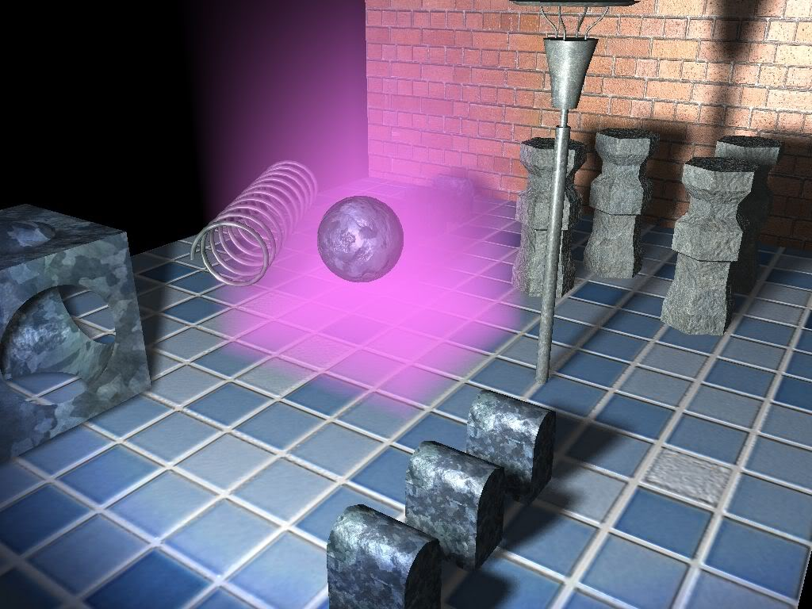
Main techniques we need
Fog Coordinate Extension
Default fog setting
The fog density is calculated by the distance to eyes.
Volumetric Fog
Fog around the object.

Slide 25
Main techniques we need
Fog Coordinate Extension
glFogi(GL_FOG_COORDINATE_SOURCE, GL_FOG_COORDINATE)
To switch it back, make the 2nd parameter GL_FRAGMENT_DEPTH
void glFogCoord{fd}(TYPE z)
Use it for each vertex (like texture)
glFogCoordf(1.0f)
glVertex3f(x, y, z)

Slide 26
Main techniques we need
Fog Coordinate Extension
Unfortunately, we have to use it as an Extension in Windows
#include “GLEXT.h”
PFNGLFOGCOORDFEXTPROC glFogCoordfEXT = NULL;
//
glFogCoordfEXT = (PFNGLFOGCOORDFEXTPROC) wglGetProcAddress("glFogCoordfEXT");

Slide 27
Week 9
What will we do?
Main techniques we need
Exercise time & Some more (Optional)

Slide 28
Some more(Optional)…
Exercise time
Any of the examples is acceptable
While using GLUT bitmap fonts, try to translate to the border of the window
If you’re using orthogonal projection;
If you’re using perspective projection.

