Slide 1
OpenGL Programming
Chunxu Xu
E-mail: xu-cx12@mails.tsinghua.edu.cn
Cellphone: 15120003845

Slide 2
Week 12
What will we do?
Main techniques we need
Exercise time & Some more (Optional)

Slide 3
What will we do?
Load a heightmap
example
Trackball
example
Cel-Shading
example

Slide 4
Week 12
What will we do?
Main techniques we need
Exercise time & Some more (Optional)

Slide 5
Week 12
What will we do?
Main techniques we need
Load a heightmap
Trackball
Cel-Shading
Exercise time & Some more (Optional)

Slide 6

Main techniques we need
Load a heightmap
A heightmap contains height information

Slide 7
Main techniques we need
Load a heightmap
How to load an image into memory as pure data but not as texture?
Resolve the image file yourself.
SOIL library
unsigned char* SOIL_load_image(
const char *filename,
int* width, int* height, int* channels,
int force_channels)

Slide 8
Main techniques we need
Load a heightmap
In this gray scale image, every pixel contains exactly one byte
, which you can treat as an integer to represent the height value.
Alternatively, you can construct a model explicitly.
triangulation, for example.

Slide 9
Main techniques we need
Load a heightmap
You can construct a data structure to store you model
Since this height map is not so small (256 by 256)
On one side, you may need an efficient data structure
On the other side, sampling may improve efficiency.

Slide 10
Week 12
What will we do?
Main techniques we need
Load a heightmap
Trackball
Cel-Shading
Exercise time & Some more (Optional)

Slide 11
Main techniques we need
Trackball
Rotate an object freely.
Many design principles, but here we adopt the following:
Rotate around the center of the object itself;
Use a ball to simulate the rotation.

Slide 12
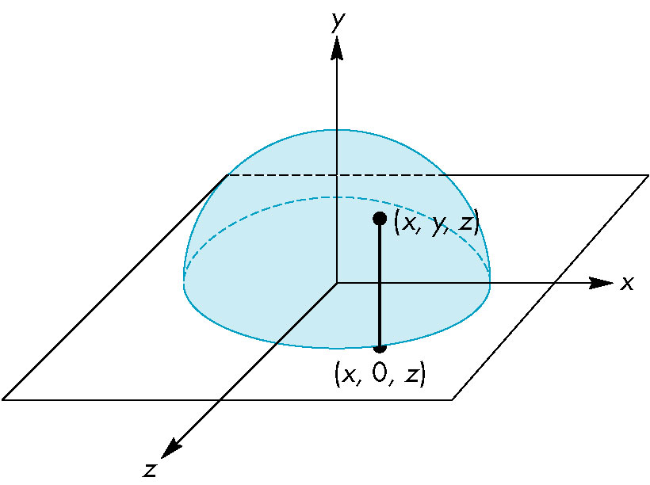
Main techniques we need
Trackball
The trackball model

Slide 13
Week 12
What will we do?
Main techniques we need
Load a heightmap
Trackball
Cel-Shading
Exercise time & Some more (Optional)

Slide 14
Main techniques we need
Cel-Shading
A method to create a cartoon-like effect
Simulate lighting effect with 1-D texture
Here is a link to give a brief explanation
http://www.konlabs.com/articles_data/cel_shading/

Slide 15
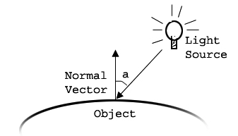
Main techniques we need
Cel-Shading
Lighting equation

Slide 16

Main techniques we need
Cel-Shading
Texture content

Slide 17
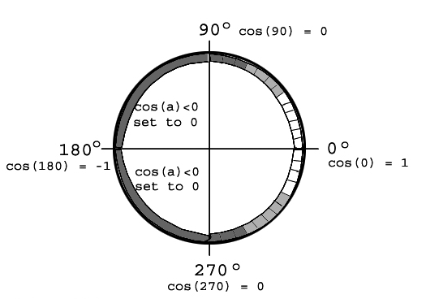
Main techniques we need
Cel-Shading
Texture content

Slide 18
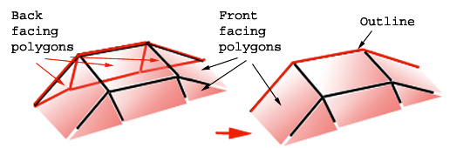
Main techniques we need
Cel-Shading
Outline

Slide 19
Week 12
What will we do?
Main techniques we need
Exercise time & Some more (Optional)

Slide 20
Some more(Optional)…
Exercise time
Any of the examples is acceptable

