Slide 1

Employment Analysis of Veterans
By: Sun han

Slide 2
Introduction
Objective: To analyze employment trends among veterans based on education achieved
Scope: Comparison of employment from veterans with GED, high school diploma, and higher education levels
Hypothesis: Does a veteran with a higher education level equate to higher employment opportunities?

Slide 3
Data source: United States Census Bureau
Veterans Employment Outcomes (VEO)
https://lehd.ces.census.gov/data/veo_experimental.html

Slide 4
Variables * Variable names have been replaced with the descriptions of the variables
Education - Level of education attained by the veterans.
Count of Employed Veterans in Year 1 - Number of veterans employed after one year.
Count of Employed Veterans in Year 5 - Number of veterans employed after five years.
Count of Employed Veterans in Year 10 - Number of veterans employed after 10 years.
Count of Nonemployed Veterans in Year 1 - Number of veterans not employed after 1 year.
Count of Nonemployed Veterans in Year 5 - Number of veterans not employed after 5 years.
Count of Nonemployed Veterans in Year 10 - Number of veterans not employed after 10 years.

Slide 5
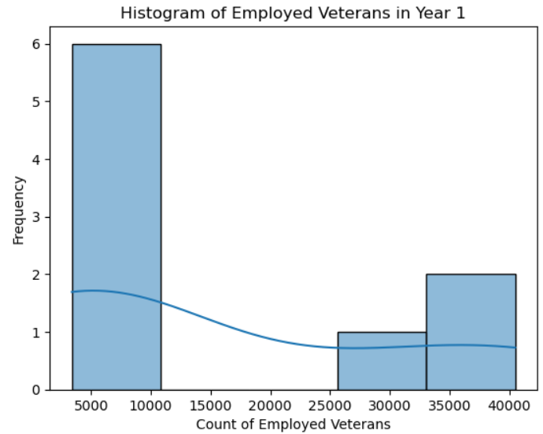
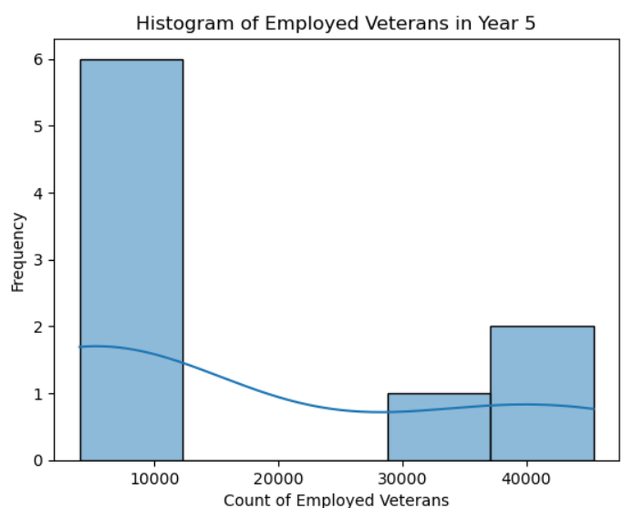
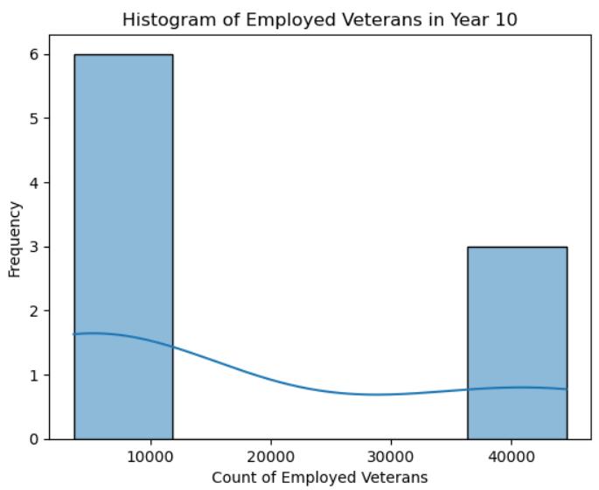
Histograms of Variables for Employed Veterans
There are no outliers in the plots. The higher frequency around the 5000-10000 range is due to the higher population of veterans with High School diplomas.

Slide 6
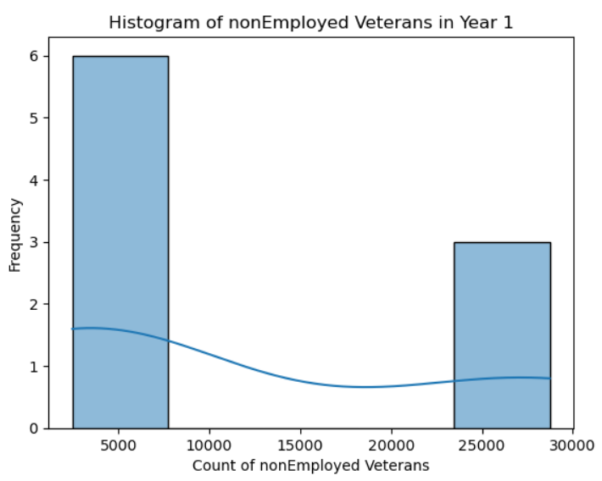
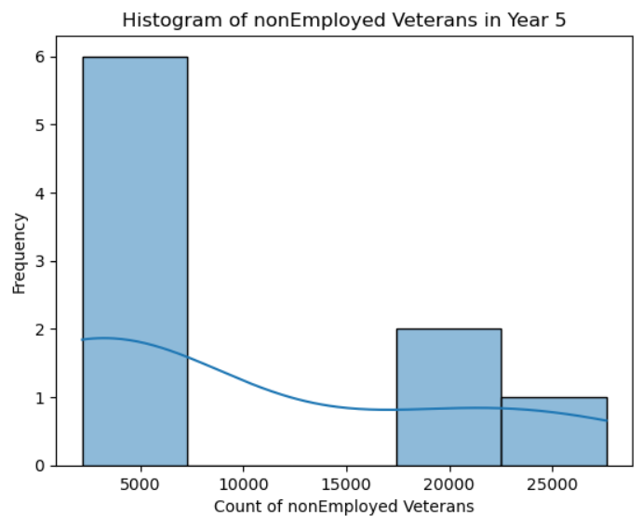
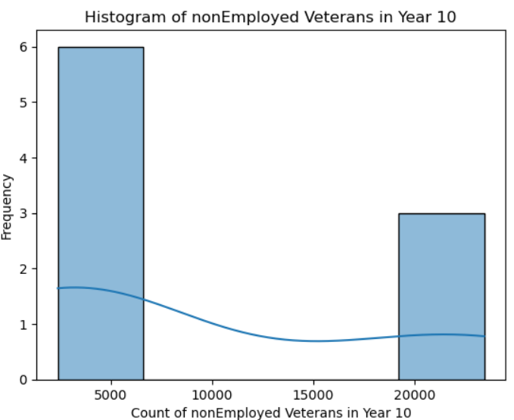
Histograms of Variables for NonEmployed Veterans
There are no outliers in the plots. The higher frequency around the 5000 range is due to the higher population of veterans with High School diplomas.

Slide 7



Employed Veterans: Mean, Mode, Spread, and Tails
Count of employed veterans year 1.
Count of employed veterans year 5.
Count of employed veterans year 10
Employed veterans year 1 shows mean of 15361 and right skewed.
Employed veterans year 5 shows mean of 17046 and right skewed.
Employed veterans year 10 shows mean of 17241 and right skewed.

Slide 8



NonEmployed Veterans: Mean, Mode, Spread, and Tails
Count of nonemployed veterans year 1
NonEmployed veterans year 1 shows mean of 11448 and right skewed.
Count of nonemployed veterans year 5.
NonEmployed veterans year 5 shows mean of 9646 and right skewed.
Count of nonemployed veterans year 10.
NonEmployed veterans year 10 shows mean of 9345 and right skewed.

Slide 9
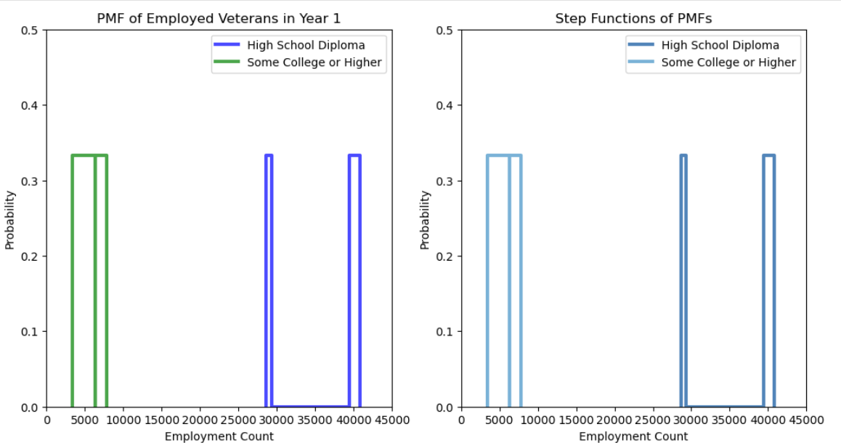
PMF Comparison
High school graduates have a higher employment count compared to college graduates
This can be contributed to the size of population with high school graduates compared to college graduates.
Veterans with college degrees have a more consistent employment count

Slide 10
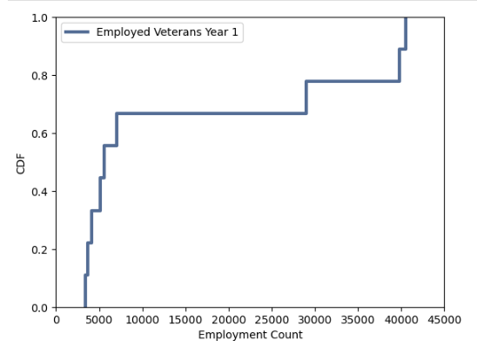
CDF Analysis
There is a significant jump around 30,000 to 40,000. This represents a higher concentration of employment counts at this level.

Slide 11
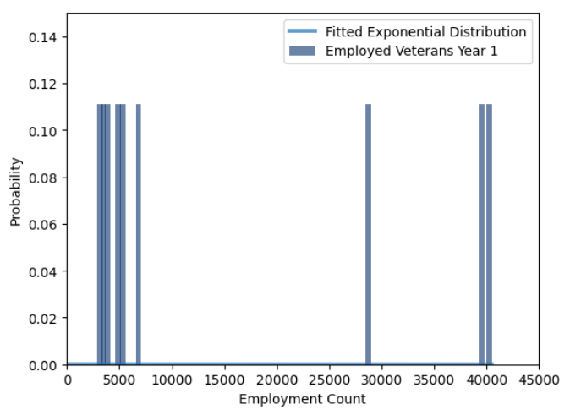
Analytical Distribution
There are gaps between the actual employment counts
and the fitted exponential distribution indicating that
the employment data does not perfectly follow an
exponential distribution.
These deviations could be due to various factors
such as job markets, availability of jobs,
or specific employment programs targeting veterans.

Slide 12
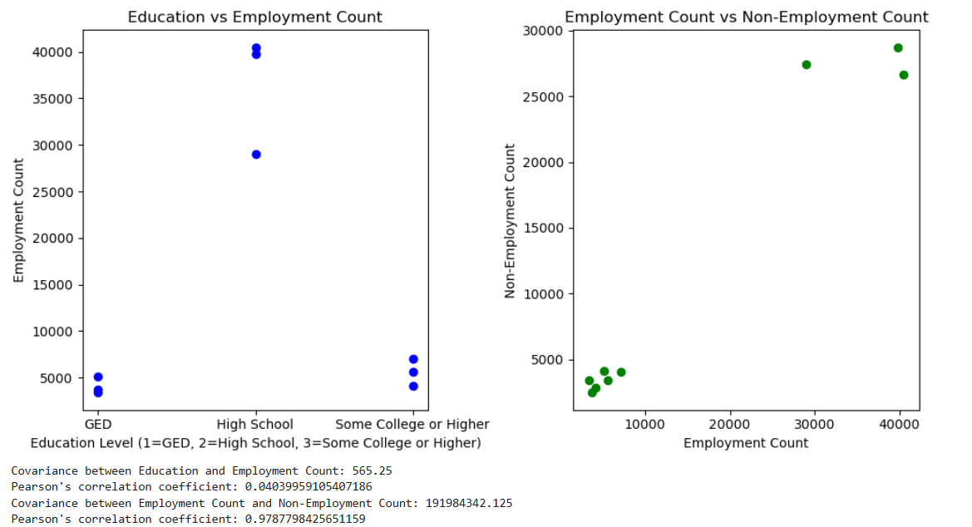
Scatter Plots and Correlation

Slide 13
Summary of Scatter Plots
Education Vs Employment
The data points show the employment counts for veterans based on their education level.
The points are scattered across the three education levels, with no clear clustering around specific employment counts.
A positive covariance indicates a direct relationship between education level and employment count. However, the value is relatively low, suggesting a weak relationship.
This very low positive correlation coefficient indicates a very weak linear relationship between education level and employment count. Essentially, education level has a minimal impact on employment count within this dataset.
Employed Vs Non-Employed
The data points illustrate the relationship between employment count and non-employment count for veterans.
There is a noticeable linear pattern, with points forming a line along the plot.
A high positive covariance indicates a strong direct relationship between employment count and non-employment count.
This very high positive correlation coefficient suggests a strong linear relationship between employment count and non-employment count. As the employment count increases, the non-employment count also increases significantly.

Slide 14

Hypothesis Testing
The test indicates that the education level (high school diploma versus some college or higher)
has a significant impact on the employment counts of veterans in the first year.

Slide 15
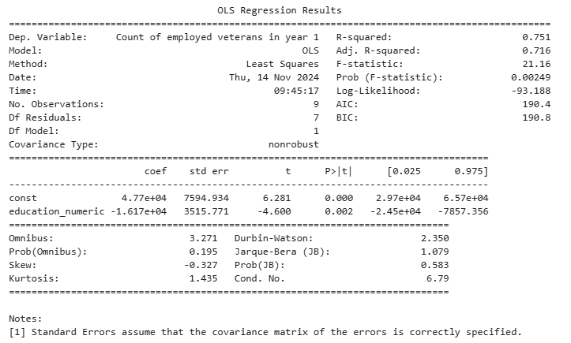
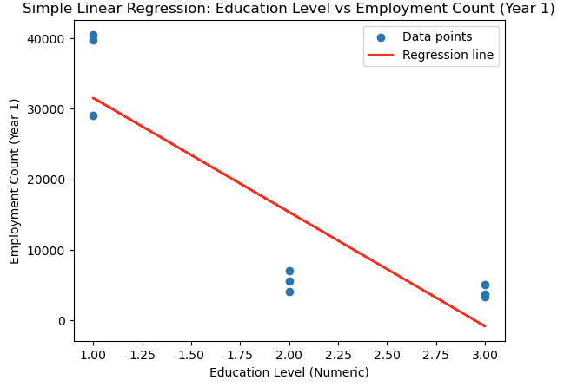
Regression Analysis
The results show an inverse relationship between education level and employment count.

Slide 16
Conclusion
The findings suggest that veterans with higher education levels have a lower but more consistent employment counts
These findings show that a more targeted employment program is needed to support veterans with higher level education.

