Slide 1

Quantifying graphene molecules’ electronic properties using their structural properties
Julien Leuenberger

Slide 2
Table of content
What we know
Pairing theorem
Graphical model
Definitions
From Hamiltonian matrices to adjacency matrices
Perfect matchings & pairing theorem
Permanent: definition and properties
Main results & discussion

Slide 3
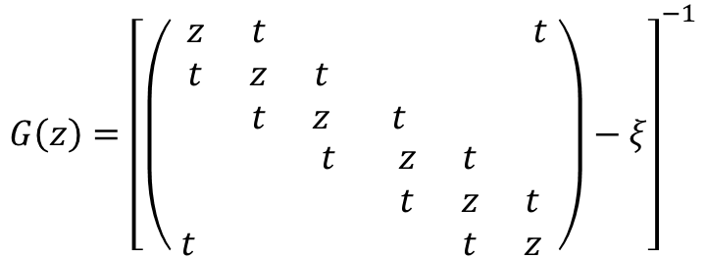
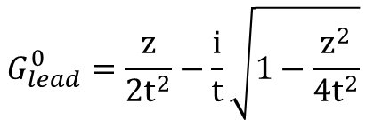
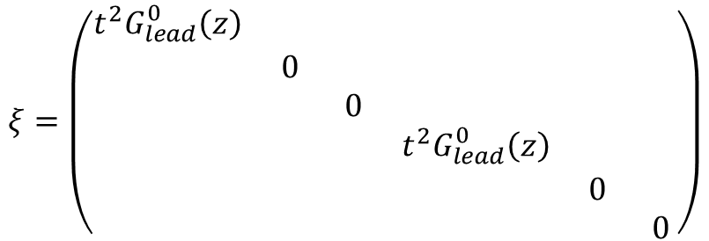
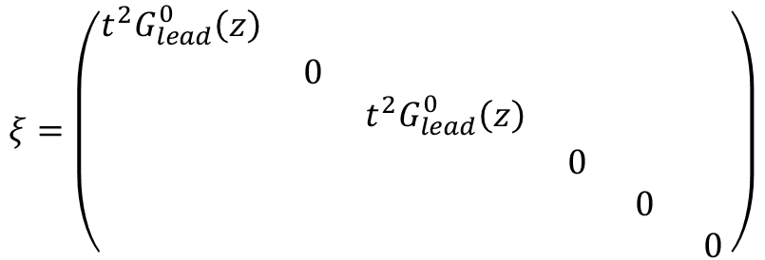
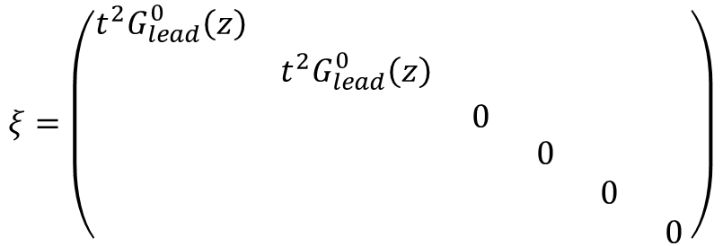
Hamiltonian & adjacency matrices
$${G\left(z\right)=\left[\left(\begin{matrix}\begin{matrix}z & t & \\ t & z & t \\ & t & z\end{matrix} & \begin{matrix} & & t \\ & & \\ t & & \end{matrix} \\ \begin{matrix} & & t \\ & & \\ t & & \end{matrix} & \begin{matrix}z & t & \\ t & z & t \\ & t & z\end{matrix}\end{matrix}\right)−ξ\right]}^{−1}$$
$$ξ=\left(\begin{matrix}\begin{matrix}t^{2}G_{lead}^{0}\left(z\right) & & \\ & t^{2}G_{lead}^{0}\left(z\right) & \\ & & 0\end{matrix} & \begin{matrix} & & \\ & & \\ & & \end{matrix} \\ \begin{matrix} & & \\ & & \\ & & \end{matrix} & \begin{matrix}0 & & \\ & 0 & \\ & & 0\end{matrix}\end{matrix}\right)$$
2
3
1
4
6
5
$$ξ=\left(\begin{matrix}\begin{matrix}t^{2}G_{lead}^{0}\left(z\right) & & \\ & 0 & \\ & & t^{2}G_{lead}^{0}\left(z\right)\end{matrix} & \begin{matrix} & & \\ & & \\ & & \end{matrix} \\ \begin{matrix} & & \\ & & \\ & & \end{matrix} & \begin{matrix}0 & & \\ & 0 & \\ & & 0\end{matrix}\end{matrix}\right)$$
2
3
1
4
6
5
$$ξ=\left(\begin{matrix}\begin{matrix}t^{2}G_{lead}^{0}\left(z\right) & & \\ & 0 & \\ & & 0\end{matrix} & \begin{matrix} & & \\ & & \\ & & \end{matrix} \\ \begin{matrix} & & \\ & & \\ & & \end{matrix} & \begin{matrix}t^{2}G_{lead}^{0}\left(z\right) & & \\ & 0 & \\ & & 0\end{matrix}\end{matrix}\right)$$
2
3
$$G_{lead}^{0}=\frac{z}{2t^{2}}−\frac{i}{t}\sqrt{1−\frac{z^{2}}{4t^{2}}}$$
1
4
6
5

Slide 4

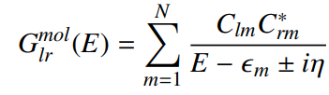
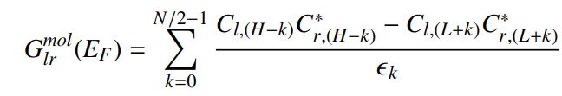
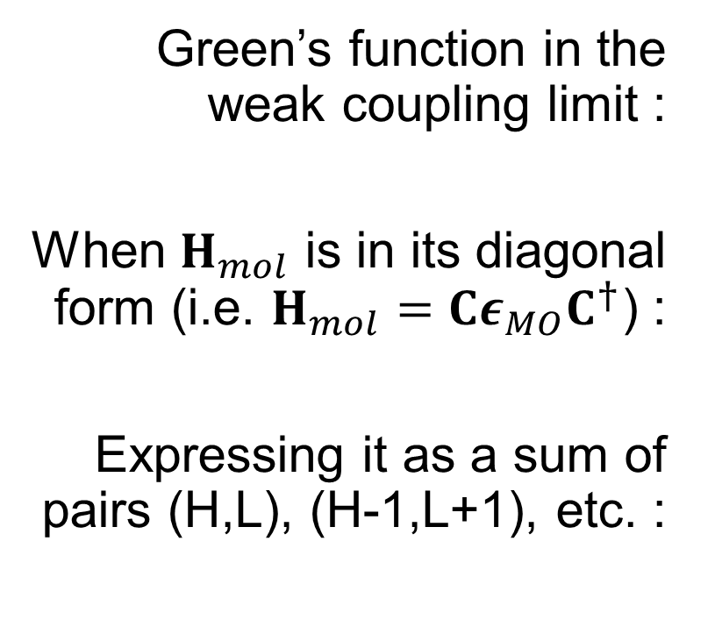
Pairing theorem
X. Zhao, V. Geskin, R. Stadler, The Journal of chemical physics 146 (2016)
Green’s function in the weak coupling limit :
When $H_{mol}$ is in its diagonal form (i.e. $H_{mol}=Cε_{MO}C^{†}$) :
Expressing it as a sum of pairs (H,L), (H-1,L+1), etc. :

Slide 5
Pairing theorem
X. Zhao, V. Geskin, R. Stadler, The Journal of chemical physics 146 (2016)
Depending on which atoms the leads are connected to, there might be constructive or destructive quantum interferences.

Slide 6
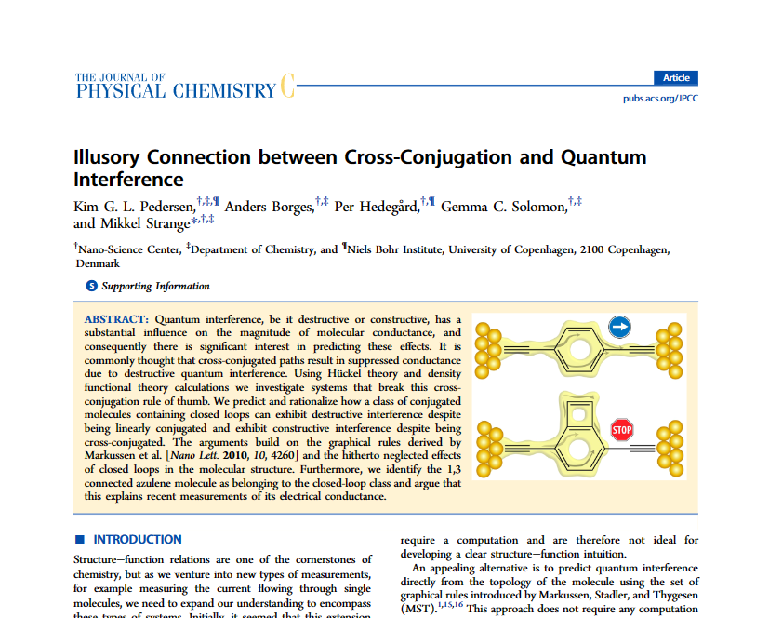

Slide 7
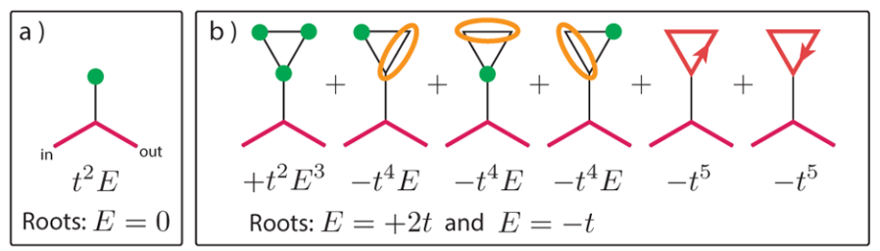
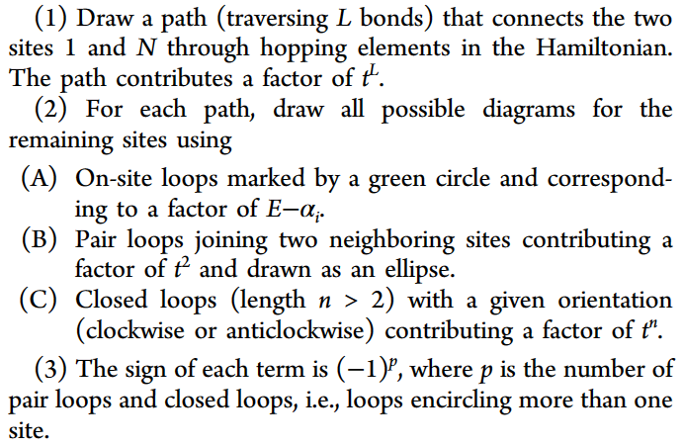
Graphical rules
K. G. L. Pedersen et al., The Journal o fphysical
chemistry 26919 (2015)

Slide 8
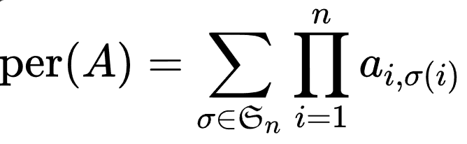
Permanent: definition
The permanent has an interesting relation with bipartite graphs.

Slide 9
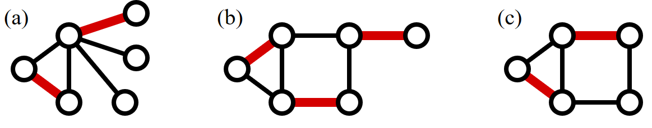
Perfect matching: definition
A graph is “perfectly matching” when there exist a subset of edges where each vertex is adjacent to exactly one of those edges.
FIG 1. There is a perfect matching in graph (b) only. Source: Wikipedia

Slide 10
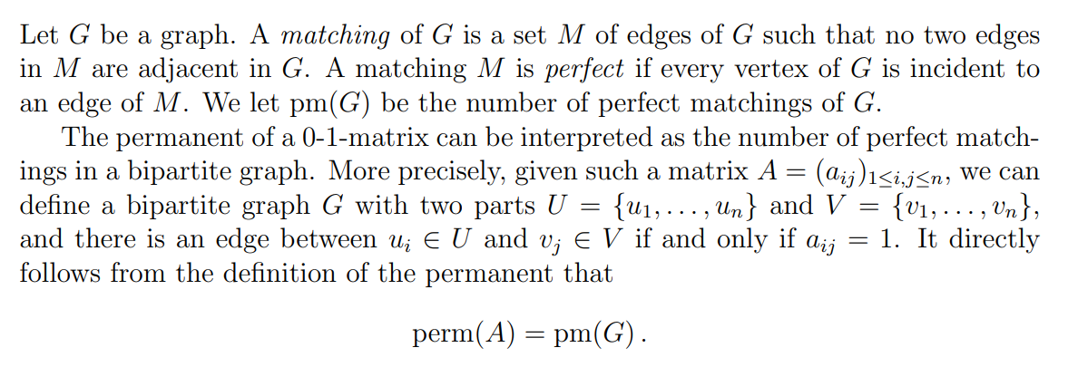
Permanent and perfect matchings
Source: Sereni J.-S., M. Loebl, Univerzita Karlova

Slide 11
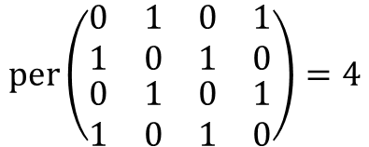
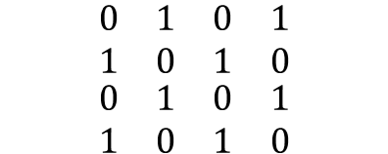
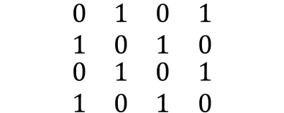
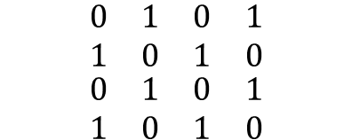
Permanent and perfect matchings
1
2
1
2
1
2
1
2
4
3
4
3
4
3
4
3
$$per\left(\begin{matrix}\begin{matrix}0 & 1 \\ 1 & 0\end{matrix} & \begin{matrix}0 & 1 \\ 1 & 0\end{matrix} \\ \begin{matrix}0 & 1 \\ 1 & 0\end{matrix} & \begin{matrix}0 & 1 \\ 1 & 0\end{matrix}\end{matrix}\right)=4$$
$$\begin{matrix}\begin{matrix}0 & 1 \\ 1 & 0\end{matrix} & \begin{matrix}0 & 1 \\ 1 & 0\end{matrix} \\ \begin{matrix}0 & 1 \\ 1 & 0\end{matrix} & \begin{matrix}0 & 1 \\ 1 & 0\end{matrix}\end{matrix}$$
$$\begin{matrix}\begin{matrix}0 & 1 \\ 1 & 0\end{matrix} & \begin{matrix}0 & 1 \\ 1 & 0\end{matrix} \\ \begin{matrix}0 & 1 \\ 1 & 0\end{matrix} & \begin{matrix}0 & 1 \\ 1 & 0\end{matrix}\end{matrix}$$
$$\begin{matrix}\begin{matrix}0 & 1 \\ 1 & 0\end{matrix} & \begin{matrix}0 & 1 \\ 1 & 0\end{matrix} \\ \begin{matrix}0 & 1 \\ 1 & 0\end{matrix} & \begin{matrix}0 & 1 \\ 1 & 0\end{matrix}\end{matrix}$$
$$\begin{matrix}\begin{matrix}0 & 1 \\ 1 & 0\end{matrix} & \begin{matrix}0 & 1 \\ 1 & 0\end{matrix} \\ \begin{matrix}0 & 1 \\ 1 & 0\end{matrix} & \begin{matrix}0 & 1 \\ 1 & 0\end{matrix}\end{matrix}$$

Slide 12
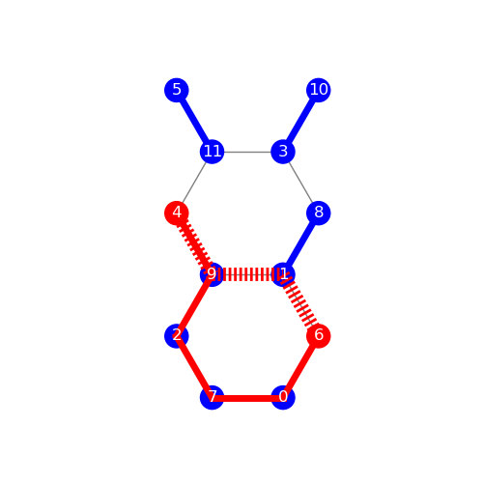
An example
Sites connected to electrodes are in red
The shortest (or one of the shortest) path(s) is the red dashed line
The red path leads to a perfect matching, represented by the blue pairs.
Conductance ~1 G₀.
(according to TB)
Notes:
junction_15419728
Similaire à 16745024

Slide 13
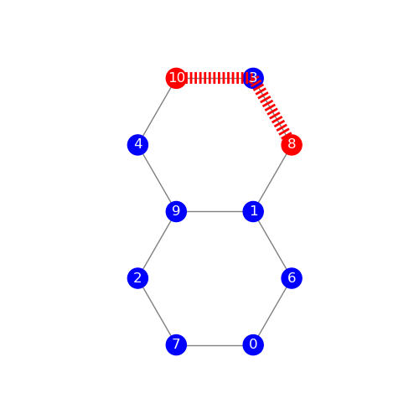
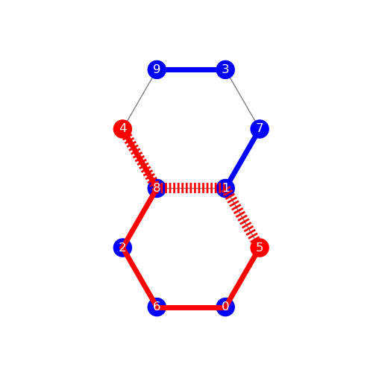
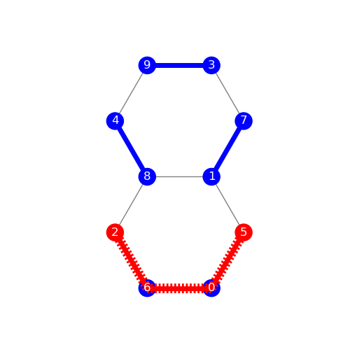
More examples
Cond. = 10⁻²⁰ G₀
Cond. = 0,36 G₀
Cond. = 0,85 G₀
Per = 0 for all paths
Per = 0 or 1
Per = 0, 1, 4
Notes:
Left : 52937495
Middle :
Right :

Slide 14
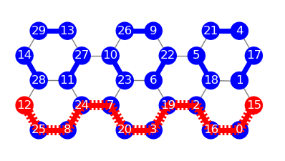
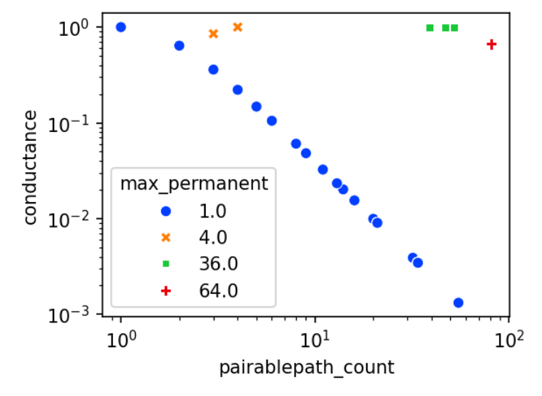
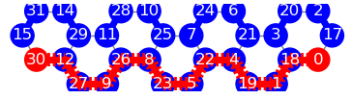
Interpretations
Cond. = 0,67 G₀
For a given path, the existence of perfect matchings indicate the existence of (an)other path(s) which will be in phase with the first one.
Thus, a high permanent indicate a large number of cooperating paths.
Proof of concept
Cond. = 0,003 G₀
Notes:
First point: if per > 0, a given path can be deformed into another path such that it arrives with the same phase that the first one.

Slide 15
The permanent as a new tool
The permanent might be a new way of classifying molecules conductance.

