Slide 1

Electron dynamics in graphene junctions
Permanent-based junction characterization

Slide 2
Table of content
Definitions
From Hamiltonian matrices to adjacency matrices
Perfect matchings & pairing theorem
Permanent: definition and properties
Main results & discussion

Slide 3
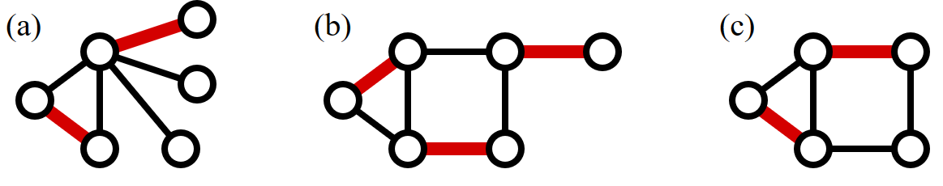
Perfect matching: definition
A graph is “perfectly matching” when there exist a subset of edges where each vertex is adjacent to exactly one of those edges.
FIG 1. There is a perfect matching in graph (b) only. Source: Wikipedia

Slide 4
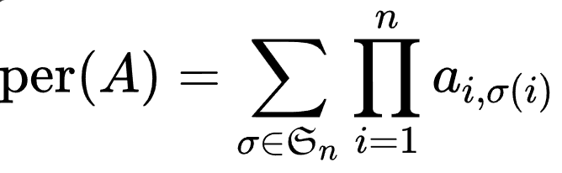
Permanent: definition

Slide 5
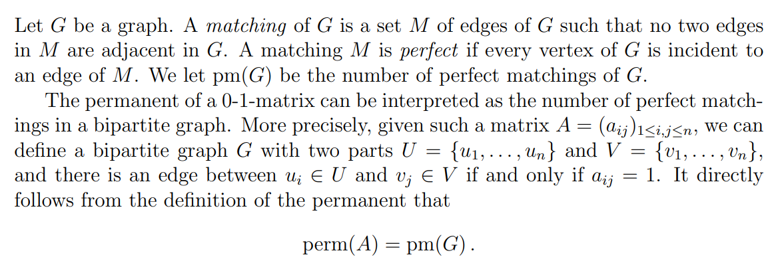
Permanent and perfect matchings
Source: Sereni J.-S., M. Loebl, Univerzita Karlova

Slide 6
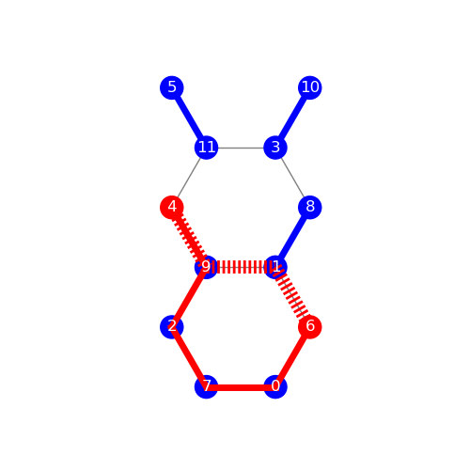
An example
Sites connected to electrodes are in red
The shortest (or one of the shortest) path(s) is the red dashed line
The red path leads to a perfect matching, represented by the blue pairs.
Conductance ~1 G₀.
(according to TB)
Notes:
junction_15419728
Similaire à 16745024

Slide 7
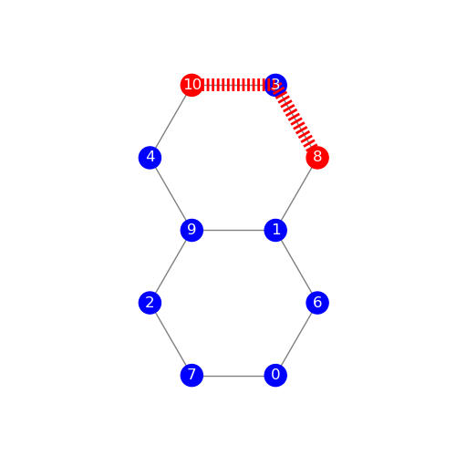
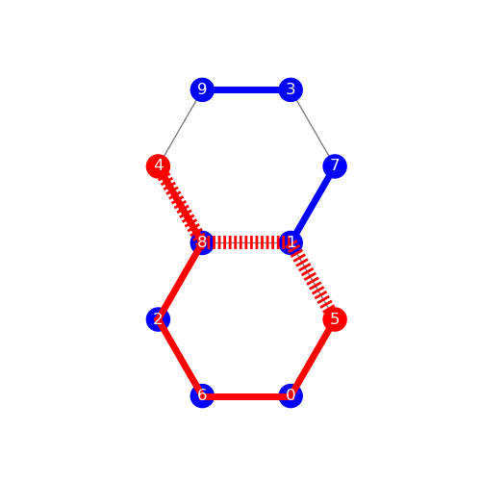
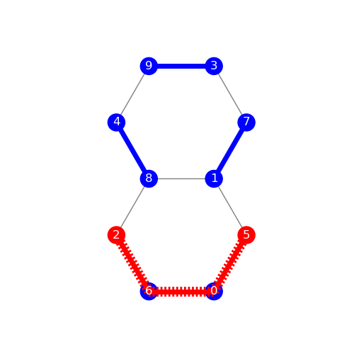
More examples
Cond. = 10⁻²⁰ G₀
Cond. = 0,36 G₀
Cond. = 0,85 G₀
Per = 0 for all paths
Per = 0 or 1
Per = 0, 1, 4
Notes:
Left : 52937495
Middle :
Right :

Slide 8
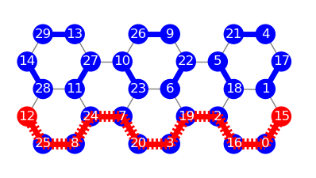
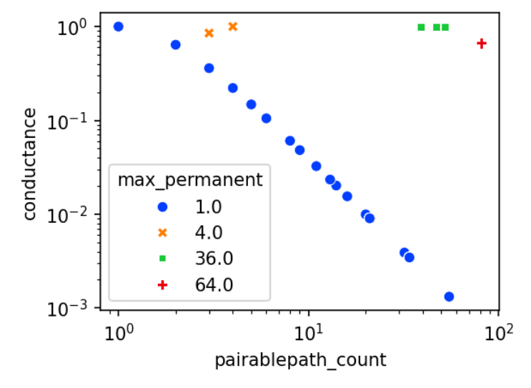
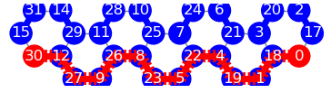
Interpretations
Cond. = 0,67 G₀
For a given path, the existence of perfect matchings indicate the existence of (an)other path(s) which will be in phase with the first one.
Thus, a high permanent indicate a large number of cooperating paths.
Proof of concept
Cond. = 0,003 G₀

