Slide 1
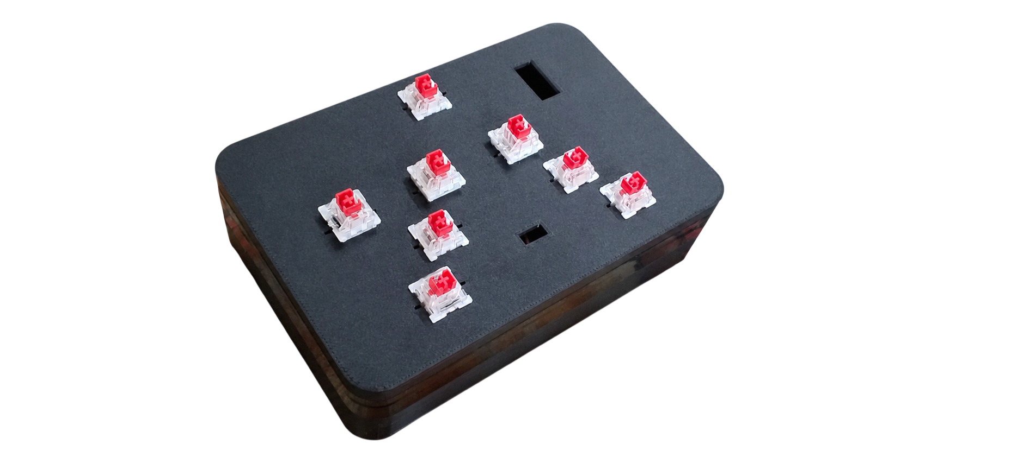
Braille Bridge

Slide 2
Braille Bridge
A Low-Cost Bilingual Braille Writing System

Slide 3
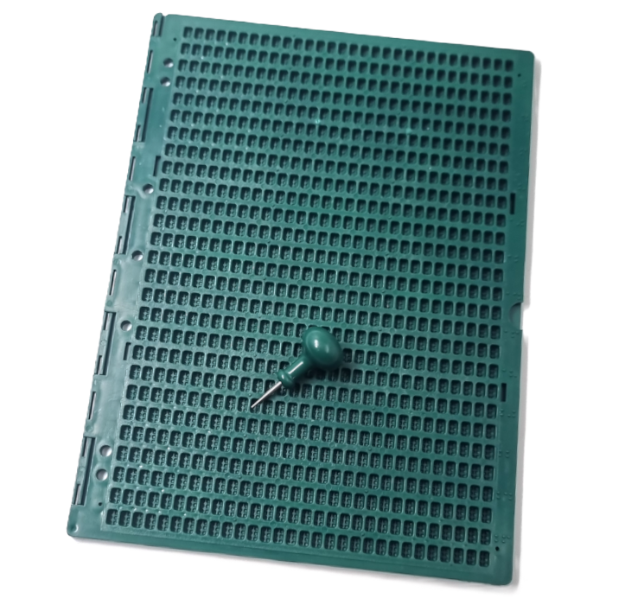
Braille Bridge
Slate & Stylus
A Low-Cost Bilingual Braille Writing System
Minor Writing
Too Manual
Too Complex
Risk of Lost Parts
Not Convenient

Slide 4
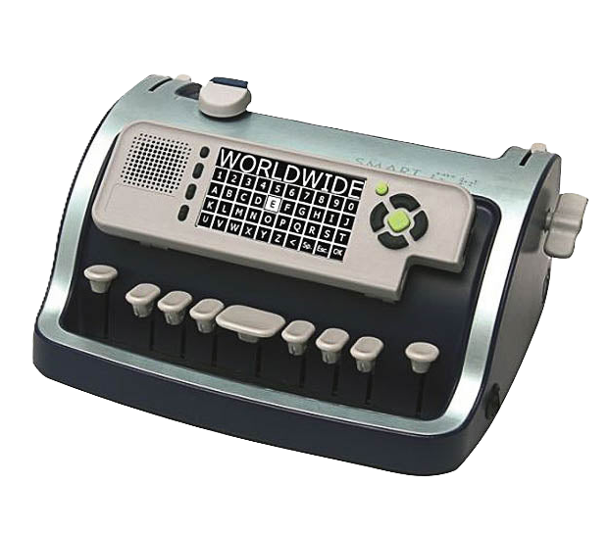
A Low-Cost Bilingual Braille Writing System
Braille Bridge
Perkins Braille
Slate & Stylus
Minor Writing
Too Manual
Too Complex
Risk of Lost Parts
Not Convenient
Minor Writing
Too Manual
Too Complex
Risk of Lost Parts
Not Convenient

Slide 5
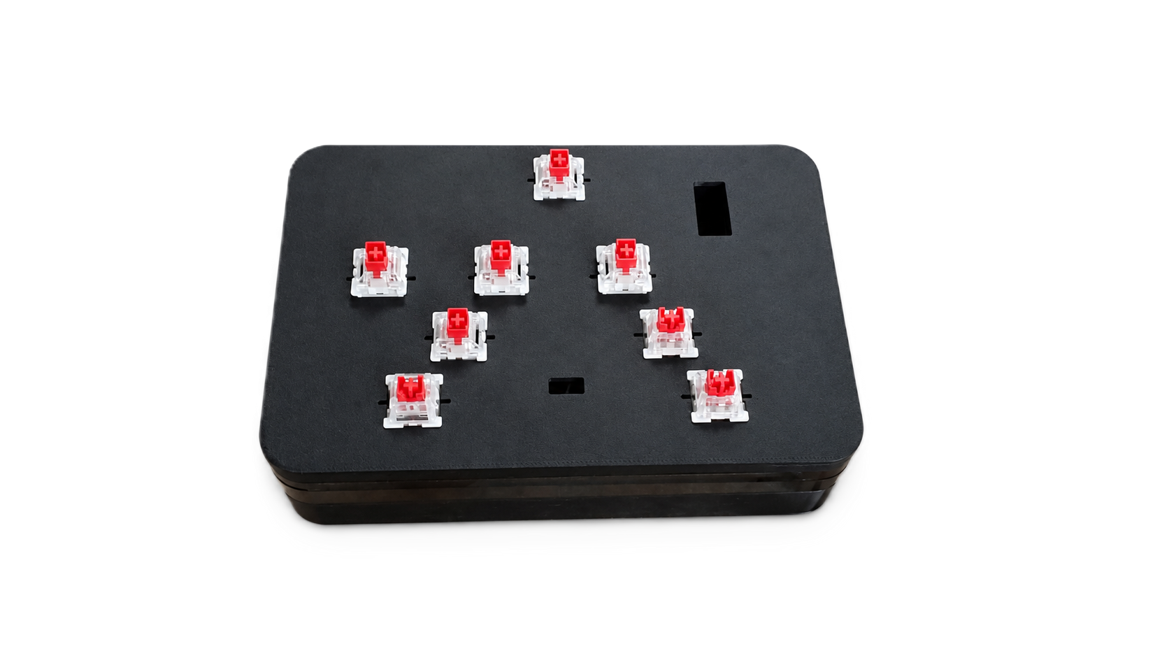
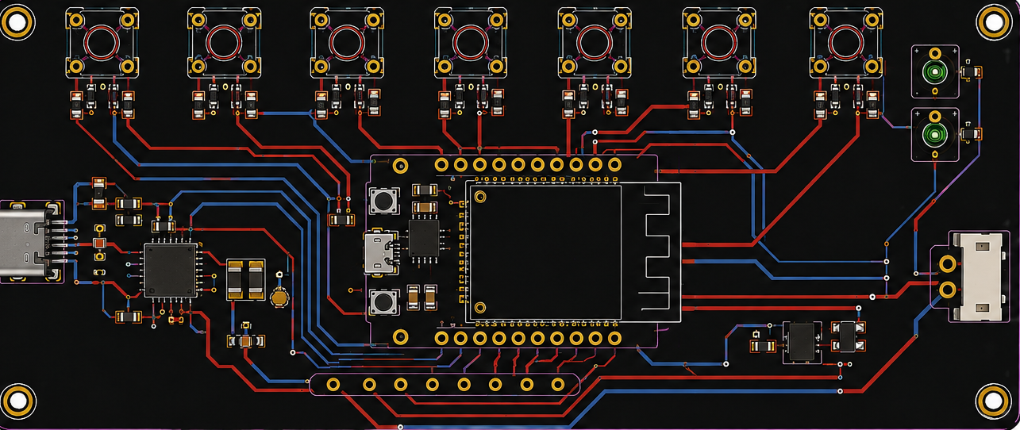
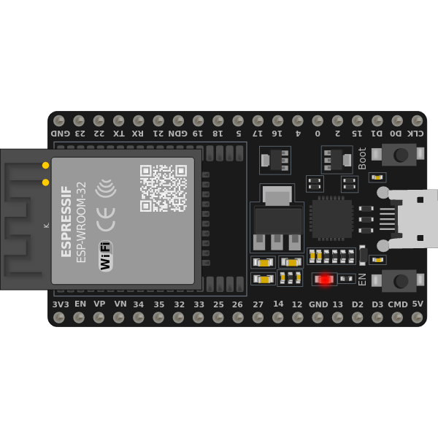
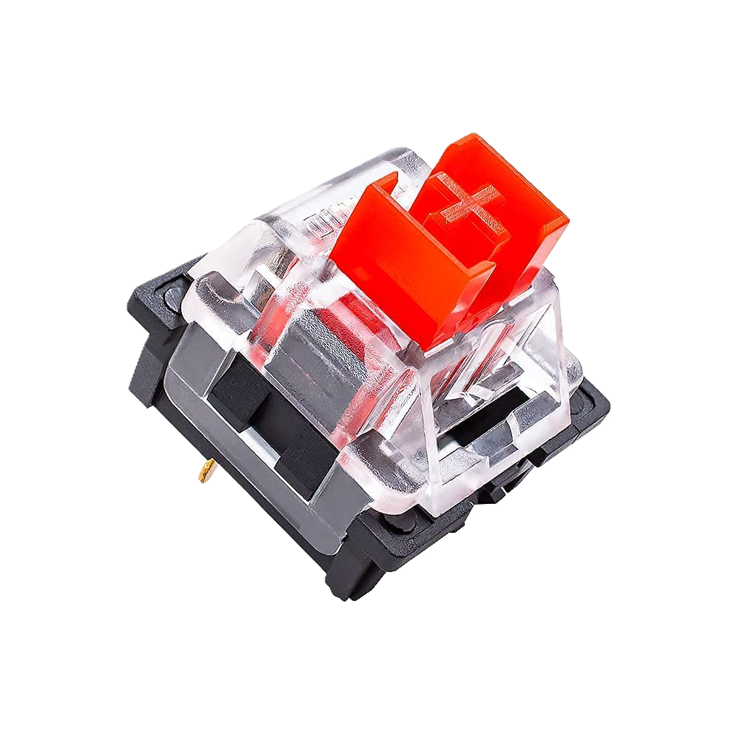
A Low-Cost Bilingual Braille Writing System
Slate & Stylus
Braille Bridge
Custom 3d
Printed Shell
with Ergonomic
Design Made for
Flexibility
& Scalability
PCB Support
Requires Braille paper to produce its normal output.
Produces tactile Braille rather than directly providing digital text in the standard model.
Teachers who do not know Braille cannot directly read the embossed output.
Perkins Braille
Converts Braille input into readable digital English and Bangla.
Real-time Teacher Software allows teachers to see student output without knowing Braille.
No paper required for digital classroom work.
Bluetooth connectivity allows it to work with computers, phones, and other compatible devices.
Too Bulky
Very Heavy
Finger Fatigue
Loud Noise
700-800 USD!
x8 Tactile Switches
6 Keys to Type + Shift and Space Key
Minor Writing
Too Manual
Too Complex
Risk of Lost Parts
Not Convenient

Slide 6
A Low-Cost Bilingual Braille Writing System
Slate & Stylus
Braille Bridge
PCB Support
Custom 3d
Printed Shell
with Ergonomic
Design Made for
Flexibility
& Scalability
PCB Support
Perkins Braille
The Solution
Converts Braille input into readable digital English and Bangla.
Real-time Teacher Software allows teachers to see student output without knowing Braille.
No paper required for digital classroom work.
Bluetooth connectivity allows it to work with computers, phones, and other compatible devices.
Requires Braille paper to produce its normal output.
Produces tactile Braille rather than directly providing digital text in the standard model.
Teachers who do not know Braille cannot directly read the embossed output.
x8 Tactile Switches
6 Keys to Type + Shift and Space Key
Too Bulky
Very Heavy
Finger Fatigue
Loud Noise
700-800 USD!
Minor Writing
Too Manual
Too Complex
Risk of Lost Parts
Not Convenient

Slide 7

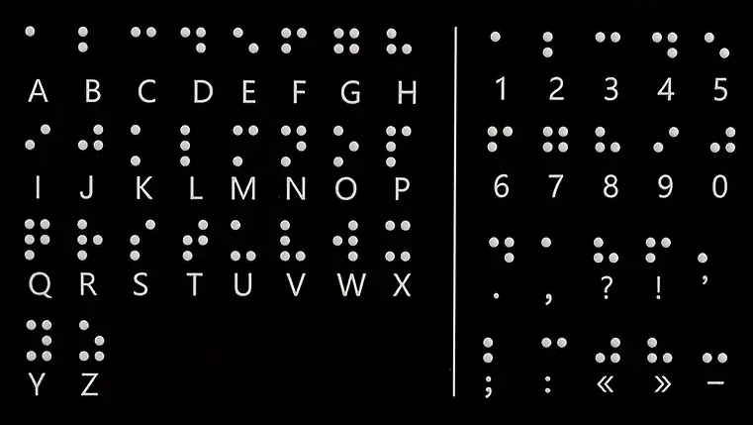
C
H
O
R
D
I
N
G
Braille Bridge
Perkins Braille
Custom 3d
Printed Shell
with Ergonomic
Design Made for
Flexibility
& Scalability
PCB Support
Too Bulky
Very Heavy
Finger Fatigue
Loud Noise
700-800 USD!
ESP-32
x8 Tactile Switches
6 Keys to Type + Shift and Space Key
S
Y
S
T
E
M

Slide 8
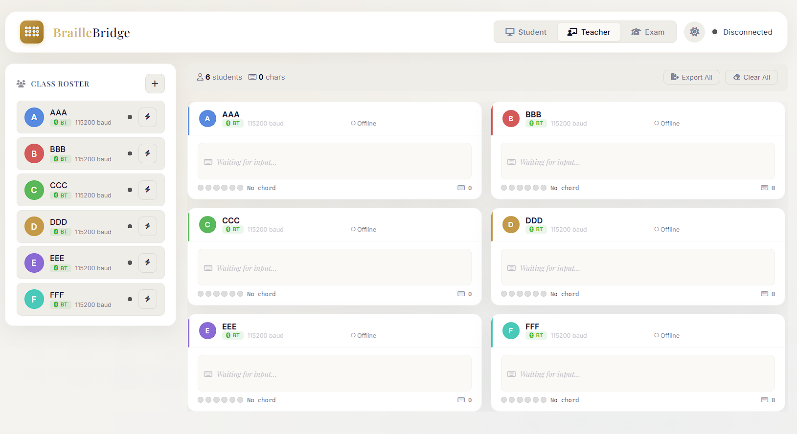
A Purpose-Built Teacher Software
Braille Bridge
What’s Chording?
C
H
O
R
D
I
N
G
S
Y
S
T
E
M
Custom 3d
Printed Shell
with Ergonomic
Design Made for
Flexibility
& Scalability
Chording is a typing method where you press multiple keys at the same time to produce one character or command. Instead of pressing one key for each letter, different combinations of keys represent different characters. In BrailleBridge, the six keys represent the six dots of a Braille cell, so pressing dot 1 produces A, while pressing dots 1+2 together produces B, and dots 1+4 produces C. This lets a blind user type using the same dot combinations they already use in Braille, rather than learning a completely different keyboard layout.
PCB Support
ESP-32
x8 Tactile Switches
6 Keys to Type + Shift and Space Key

Slide 9
Braille Bridge
A Purpose-Built Teacher Software
What’s Chording?
Chording is a typing method where you press multiple keys at the same time to produce one character or command. Instead of pressing one key for each letter, different combinations of keys represent different characters. In BrailleBridge, the six keys represent the six dots of a Braille cell, so pressing dot 1 produces A, while pressing dots 1+2 together produces B, and dots 1+4 produces C. This lets a blind user type using the same dot combinations they already use in Braille, rather than learning a completely different keyboard layout.
Custom 3d
Printed Shell
with Ergonomic
Design Made for
Flexibility
& Scalability
PCB Support
ESP-32
x8 Tactile Switches
6 Keys to Type + Shift and Space Key

Slide 10
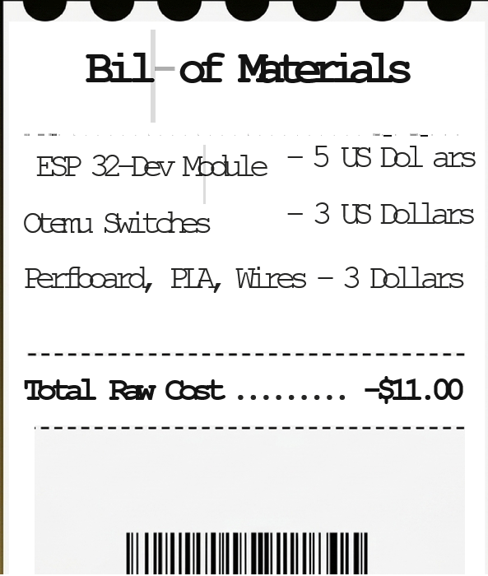
C
H
O
R
D
I
N
G
Braille Bridge
A Purpose-Built Teacher Software
BrailleBridge does not replace Braille. It protects Braille as the student's natural writing method while removing the barrier between Braille input and teacher-readable output.
S
Y
S
T
E
M

Slide 11
Braille Bridge
BrailleBridge does not replace Braille. It protects Braille as the student's natural writing method while removing the barrier between Braille input and teacher-readable output.

