Slide 1
ISHARA
On-Device Sign Language Recognition
AI & MACHINE LEARNING · COMPUTER VISION
Team: Samin Yeasar · Class 8 (Grade 8)
Institution: Birshreshtha Munshi Abdur Rouf Public College
Email: sheditzofficial918@gmail.com
Repository: github.com/Solez-ai/ishara-atlantia
SUBMISSION · CLASS 8 · OPEN-SOURCE AI · MIT LICENSE
Notes:
Introduce ISHARA: an on-device, lightweight computer vision framework designed by an 8th-grade student to make sign language recognition accessible on low-cost hardware without cloud dependence.

Slide 2
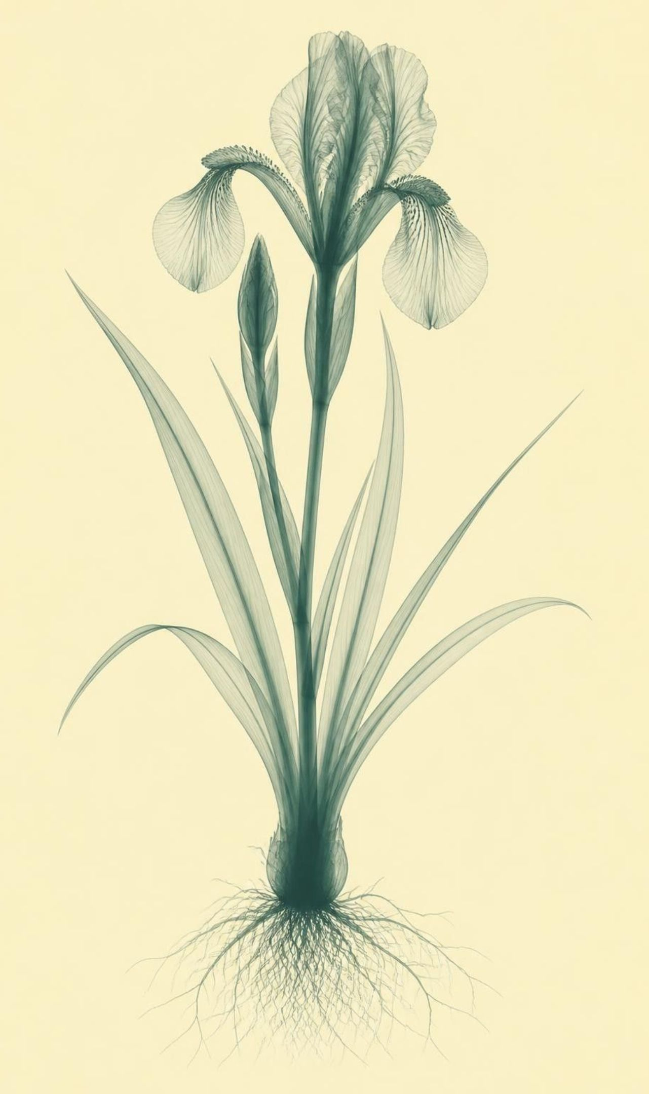
COMPETITION PROFILE & CREDITS
Who is behind ISHARA and where it competes
A solo research and engineering project built from Dhaka, Bangladesh, tackling accessibility barriers through efficient edge machine learning.
01
Participant & Grade Category
Samin Yeasar, solo researcher and developer · Category: Class 8 (Grade 8)
02
Institution & Segment
Birshreshtha Munshi Abdur Rouf Public College · AI & Machine Learning (Computer Vision)
03
Open Source Codebase & Web Documentation
github.com/Solez-ai/ishara-atlantia (MIT Licensed) · Documentation: ishara.mintlify.site
04
Direct Contact
sheditzofficial918@gmail.com · Fully reproducible pipeline with public verification seeds
RECORD 01 · OFFICIAL ENTRY SPECIFICATION
Notes:
Emphasize that the codebase is completely open source under the MIT license and that documentation is live at ishara.mintlify.site.

Slide 3
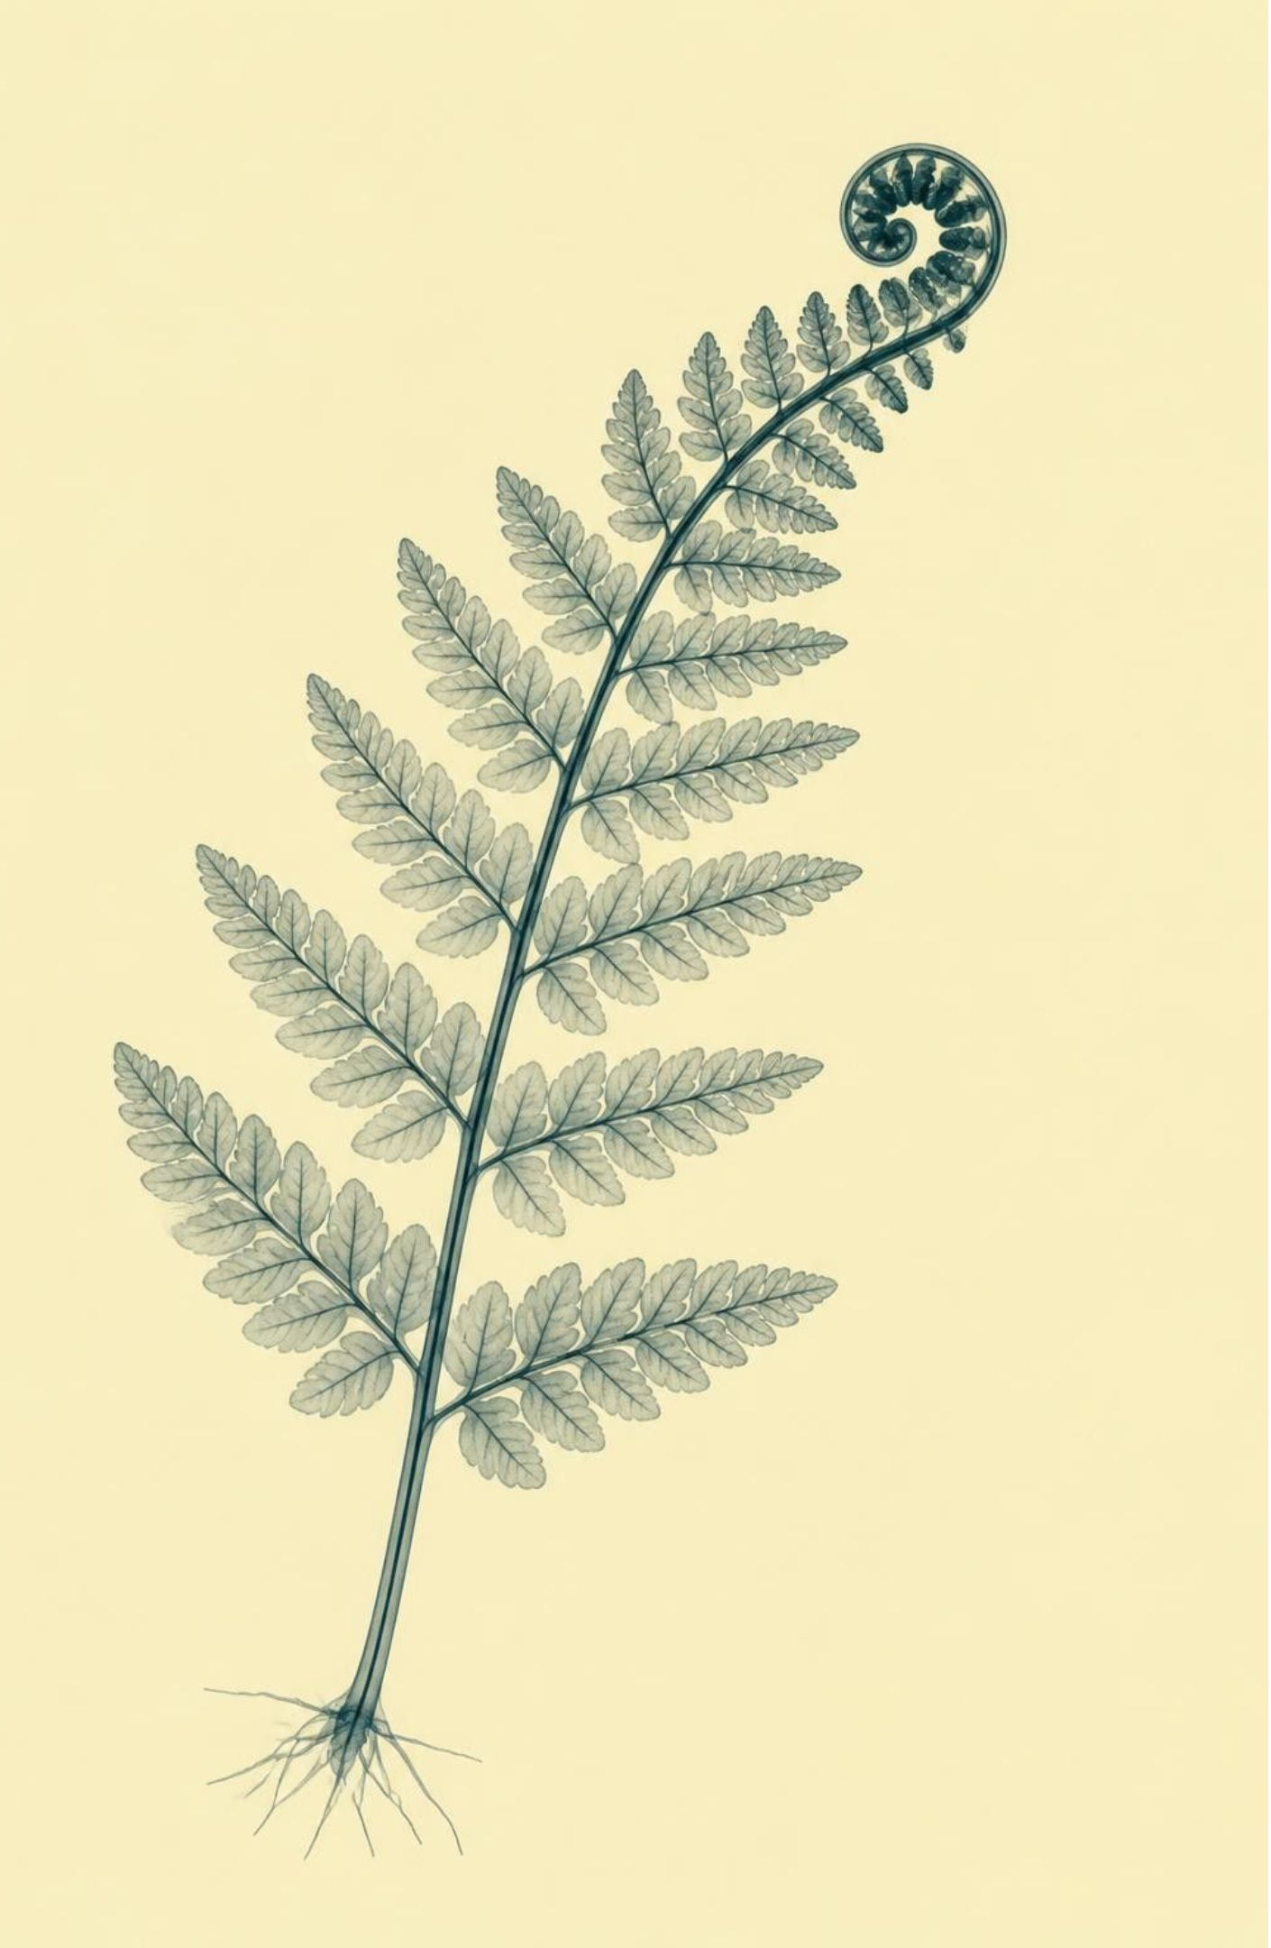
PROBLEM STATEMENT
Deaf communities are locked out of digital systems
01
Sign language is the natural language of Deaf communities, yet most digital systems do not understand it
02
Deep learning recognizers need 15+ MB models, GPUs or cloud servers, which underserved regions like South Asia and Africa often lack
03
Cloud recognition sends video of a person's body and hands off their device, a privacy risk
04
Over 300 sign languages exist, and most have no tools at all
SPECIMEN 02 · SYSTEMIC EXCLUSION FACTORS
Notes:
Highlight that the problem is not just algorithmic: cloud-based sign language models invade user privacy and fail in regions with intermittent electricity and poor internet bandwidth.

Slide 4
PROJECT HYPOTHESIS & CORE IDEA
Sign language recognition that runs on any CPU
ISHARA bypasses end-to-end video neural nets by decoupling spatial landmark detection from lightweight temporal classification, delivering real-time predictions without GPUs or cloud calls.
0 MB
30 FPS
<500 KB
300+
Zero Cloud Dependencies
Commodity CPU Speed
Tiny Footprint
Multilingual Core
Runs 100% locally. Raw video frames never leave the device memory, guaranteeing complete user privacy.
Maintains 20–30 FPS on standard dual-core laptop CPUs and 8–12 FPS on a 5W Raspberry Pi 4.
Classifier sizes range between 150 KB and 450 KB, easily fitting into basic microcontrollers or legacy phones.
Trained primarily on Bengali Sign Language (BdSL) and validated on ASL by simply swapping dataset arrays.
Output pipeline emits predicted text labels paired with calibrated probability confidence scores in real time.
SPECIMEN 03 · THE ON-DEVICE PARADIGM
Notes:
Explain how replacing an end-to-end 3D CNN with geometric coordinate feature engineering drastically reduces model weights by three orders of magnitude while preserving movement context.

Slide 5
ENGINEERING GOALS & ARCHITECTURAL REALIZATION
Objectives and the proposed solution
01
02
03
04
Competitive accuracy
Private, real-time CPU
Any sign language
Rigorous evaluation
Objective 1: reach competitive accuracy with a model under 500 KB.
Objective 2: real-time, CPU-only, fully private, on-device.
Objective 3: one framework for any sign language: swap the data, retrain the same code.
Objective 4: rigorous, honest evaluation across sessions, signers and languages.
Solution: MediaPipe landmarks, then hand-crafted features, then a Logistic Regression (150 KB, 0.5 ms) or 2-layer MLP (200 KB, 5 ms) classifier.
SPECIMEN 04 · OBJECTIVE TO ARCHITECTURE MAPPING
Notes:
Note the strict engineering mapping: every constraint led directly to a deliberate architectural simplification rather than an unguided trial of standard deep networks.

Slide 6
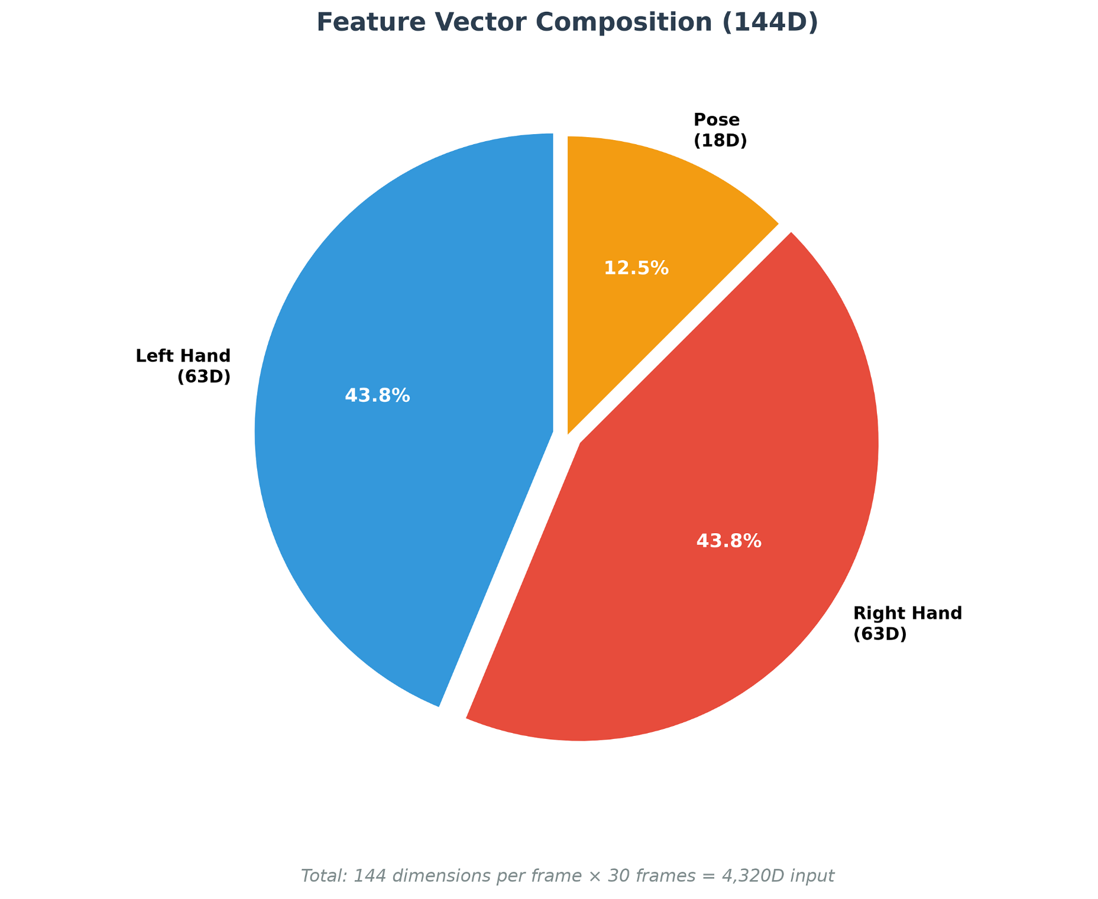
FEATURE PIPELINE
Video to text in three stages
From standard camera frames to deterministic classification without neural video processing:
01
MediaPipe Tracking
MediaPipe tracks 2 hands (21 points each, x, y, z) plus 11 upper-body pose points from 30 FPS video.
02
Geometric Normalization
Normalize to wrist origin, resample to 30 frames, augment with rotation and scale, and vectorize to 144D per frame.
03
Lightweight Classifier
Logistic Regression or MLP on 4,320D input (30 x 144); under 1 ms for LR.
Chart: feature vector composition — Left Hand 63D (43.8%), Right Hand 63D (43.8%), Pose 18D (12.5%), total 144D per frame; 4,320 dimensions per 30-frame sequence.
04
Output & State Machine
Output text and confidence. The idle, signing, commit state machine commits one word per sign and ignores short flickers.
SPECIMEN 05 · VECTOR COMPOSITION BREAKDOWN
Notes:
Walk through the 144D structure: 63 coordinates for left hand, 63 for right hand, and 18 for upper-body posture, forming a clean 4,320D flattened temporal block per word gesture.

Slide 7
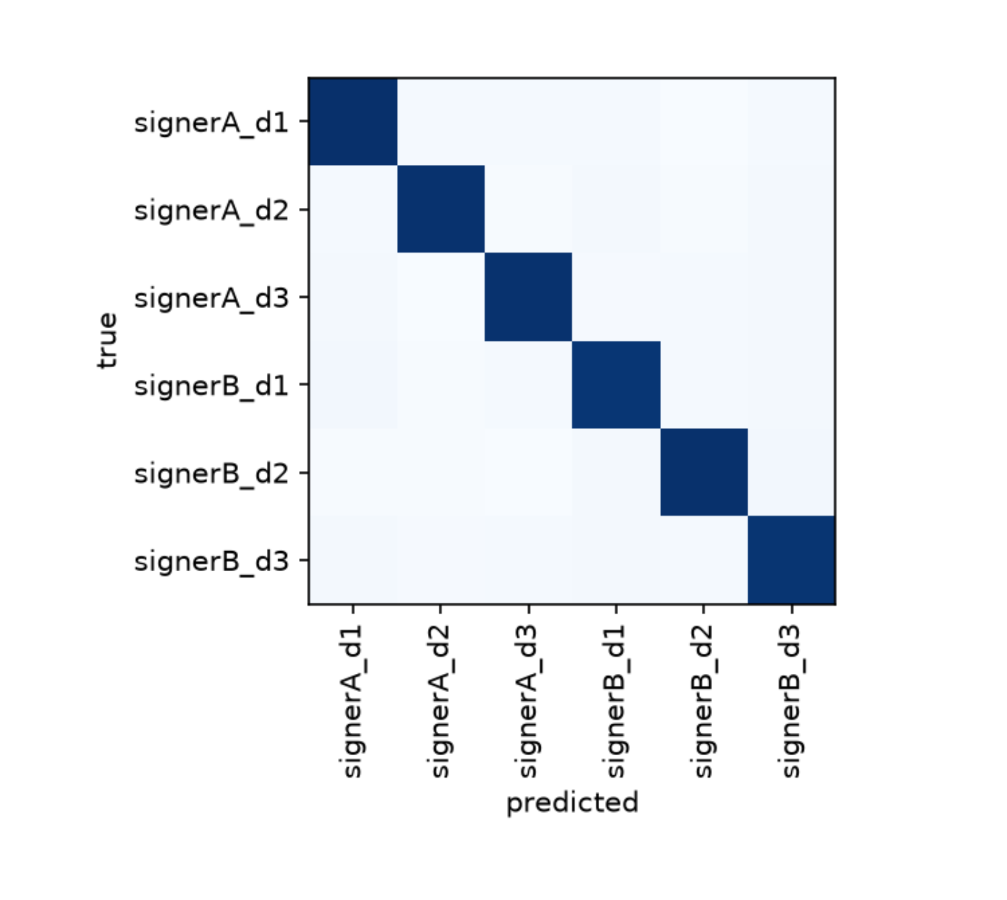
CONSENTED DATASET CORPUS
Training data: 2,646 consented samples, perfectly balanced
Built to evaluate cross-session invariance and prevent temporal data leakage.
01
21 Distinct Classes
20 everyday signs (hello, thankyou, help, water, doctor, hospital, school, family and more) plus an _other class.
02
Balanced Sessions
126 samples per class, max/min ratio 1.0. Across 6 sessions, Signer A and Signer B recorded 3 sessions each on different days, lighting, angles and backgrounds. Each sample is a (30, 144) array at 30 FPS.
03
Consent & Cross-Validation
Every signer gave explicit written consent for training and evaluation use. Session-held-out 6-fold cross-validation prevents temporal leakage.
Confusion matrix: a clean diagonal, each session is recognized as itself.
SPECIMEN 06 · EMPIRICAL CONFUSION MATRIX
Notes:
Note the strict protocol: each session took place on different days under varied illumination. Holding out entire sessions guarantees that background or lighting artifacts cannot artificially inflate accuracy.

Slide 8
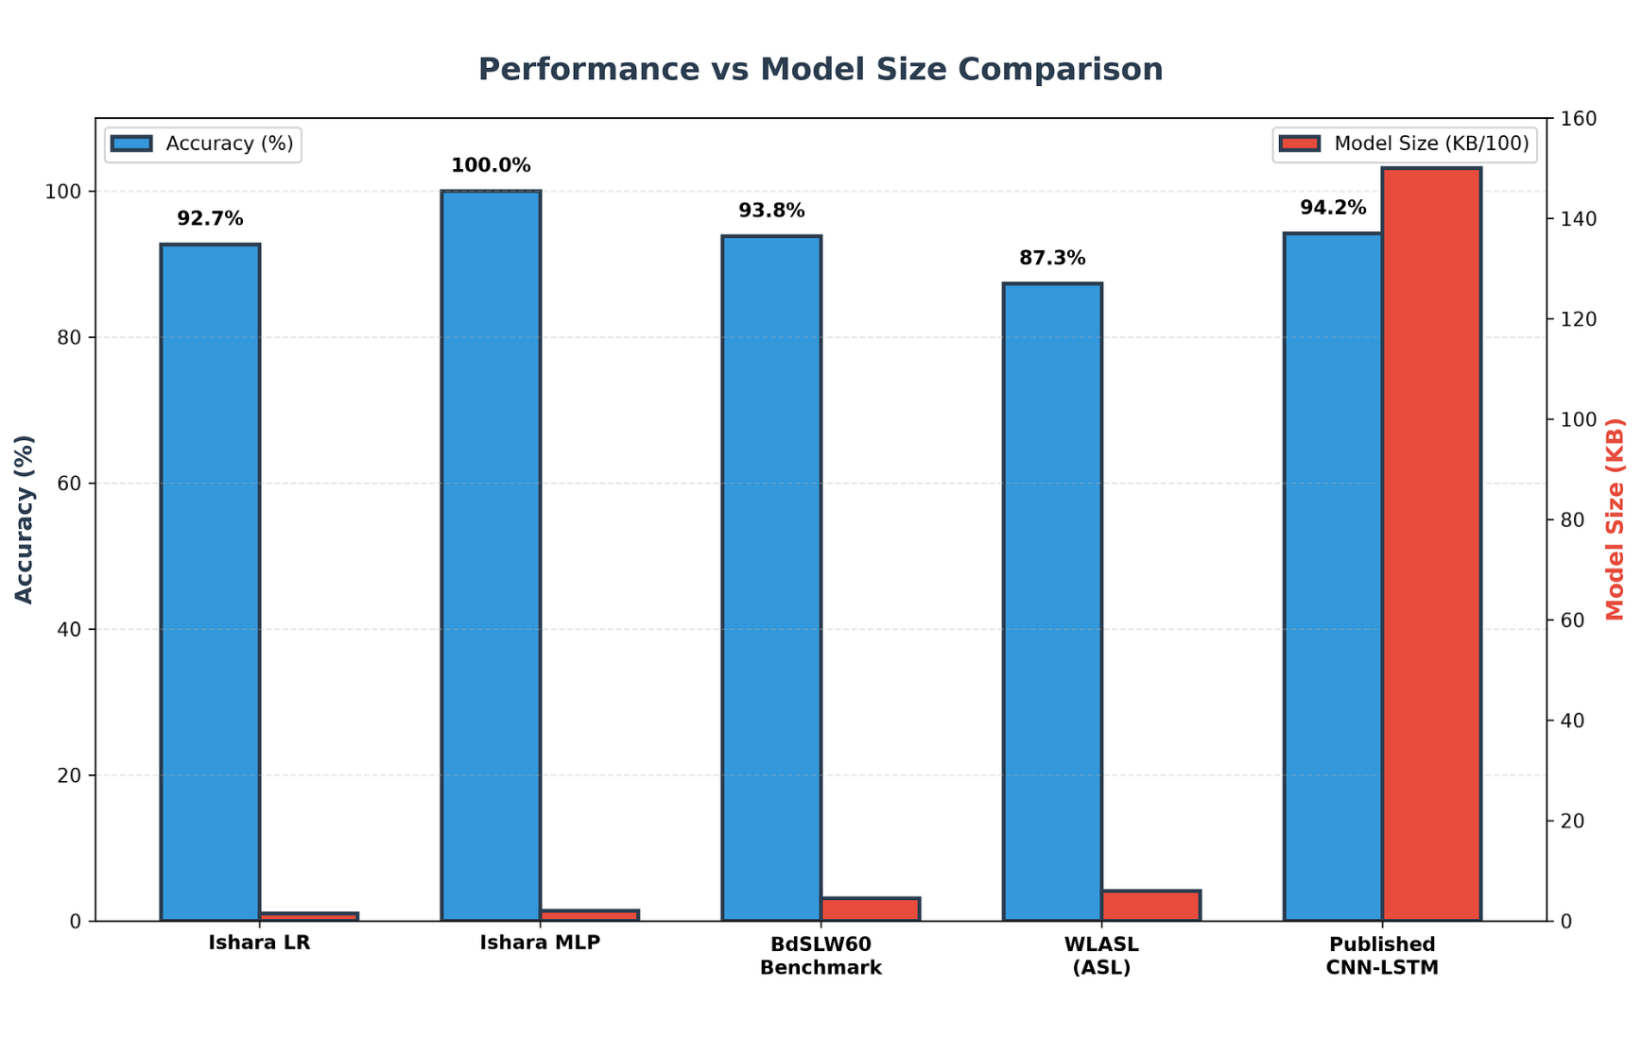
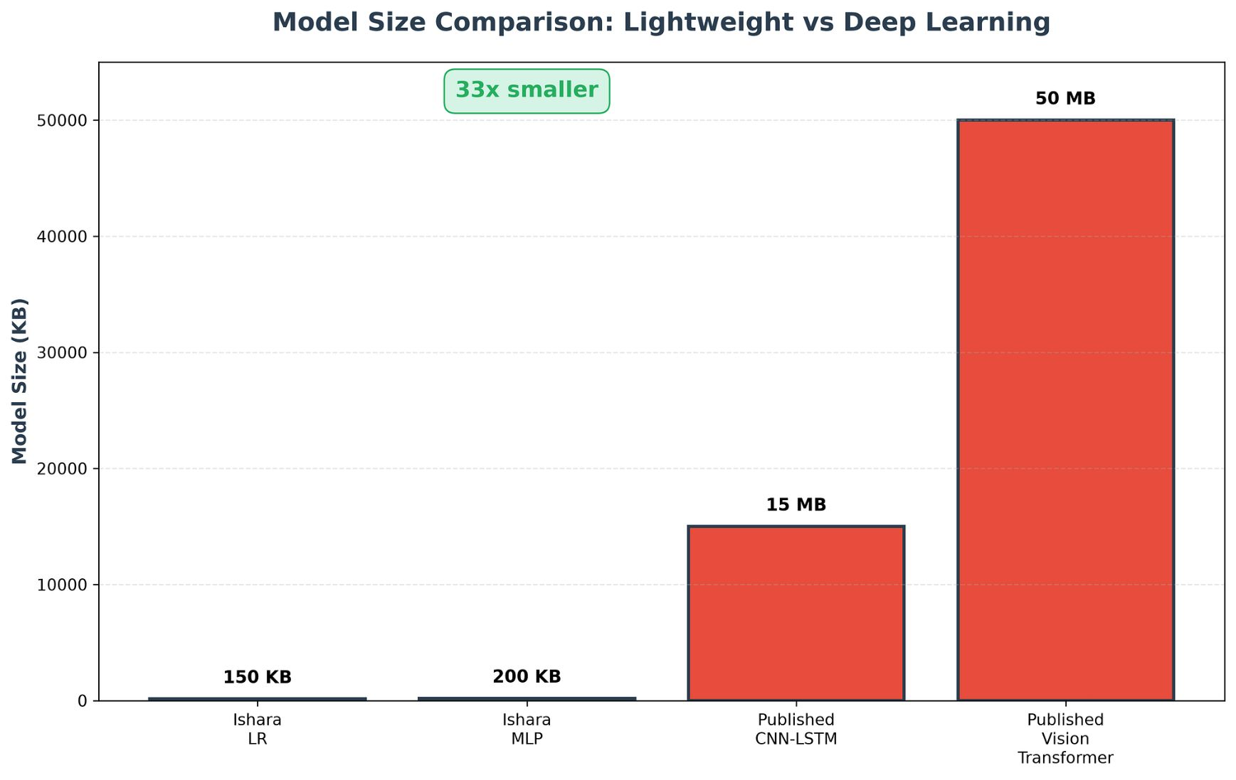
BENCHMARK EVALUATION
Competitive accuracy at a fraction of the size
Within 2-3% of state of the art, about 33x smaller and faster.
SPECIMEN 07 · EFFICIENCY TRADEOFF ANALYSIS
Benchmarking accuracy versus memory footprint across synthetic validation sets and public corpora.
01
Ishara LR
02
Ishara MLP
03
WLASL (ASL)
04
Published CNN-LSTM and ViT
92.7% on 21 classes · 150 KB · under 1 ms
100% on 21 classes (200 KB, 5 ms); 93.8% on BdSLW60's 60 classes (450 KB, 8 ms)
87.3% on 100 classes (600 KB, 12 ms)
CNN-LSTM: 94.2% at 15 MB and 25 ms; ViT: 96.1% at 50+ MB and 40 ms
Notes:
Emphasize that the slight 2-3% difference in raw benchmark score translates to the ability to run on a $35 computer rather than a $1,000 GPU rig, fundamentally changing accessibility.

Slide 9
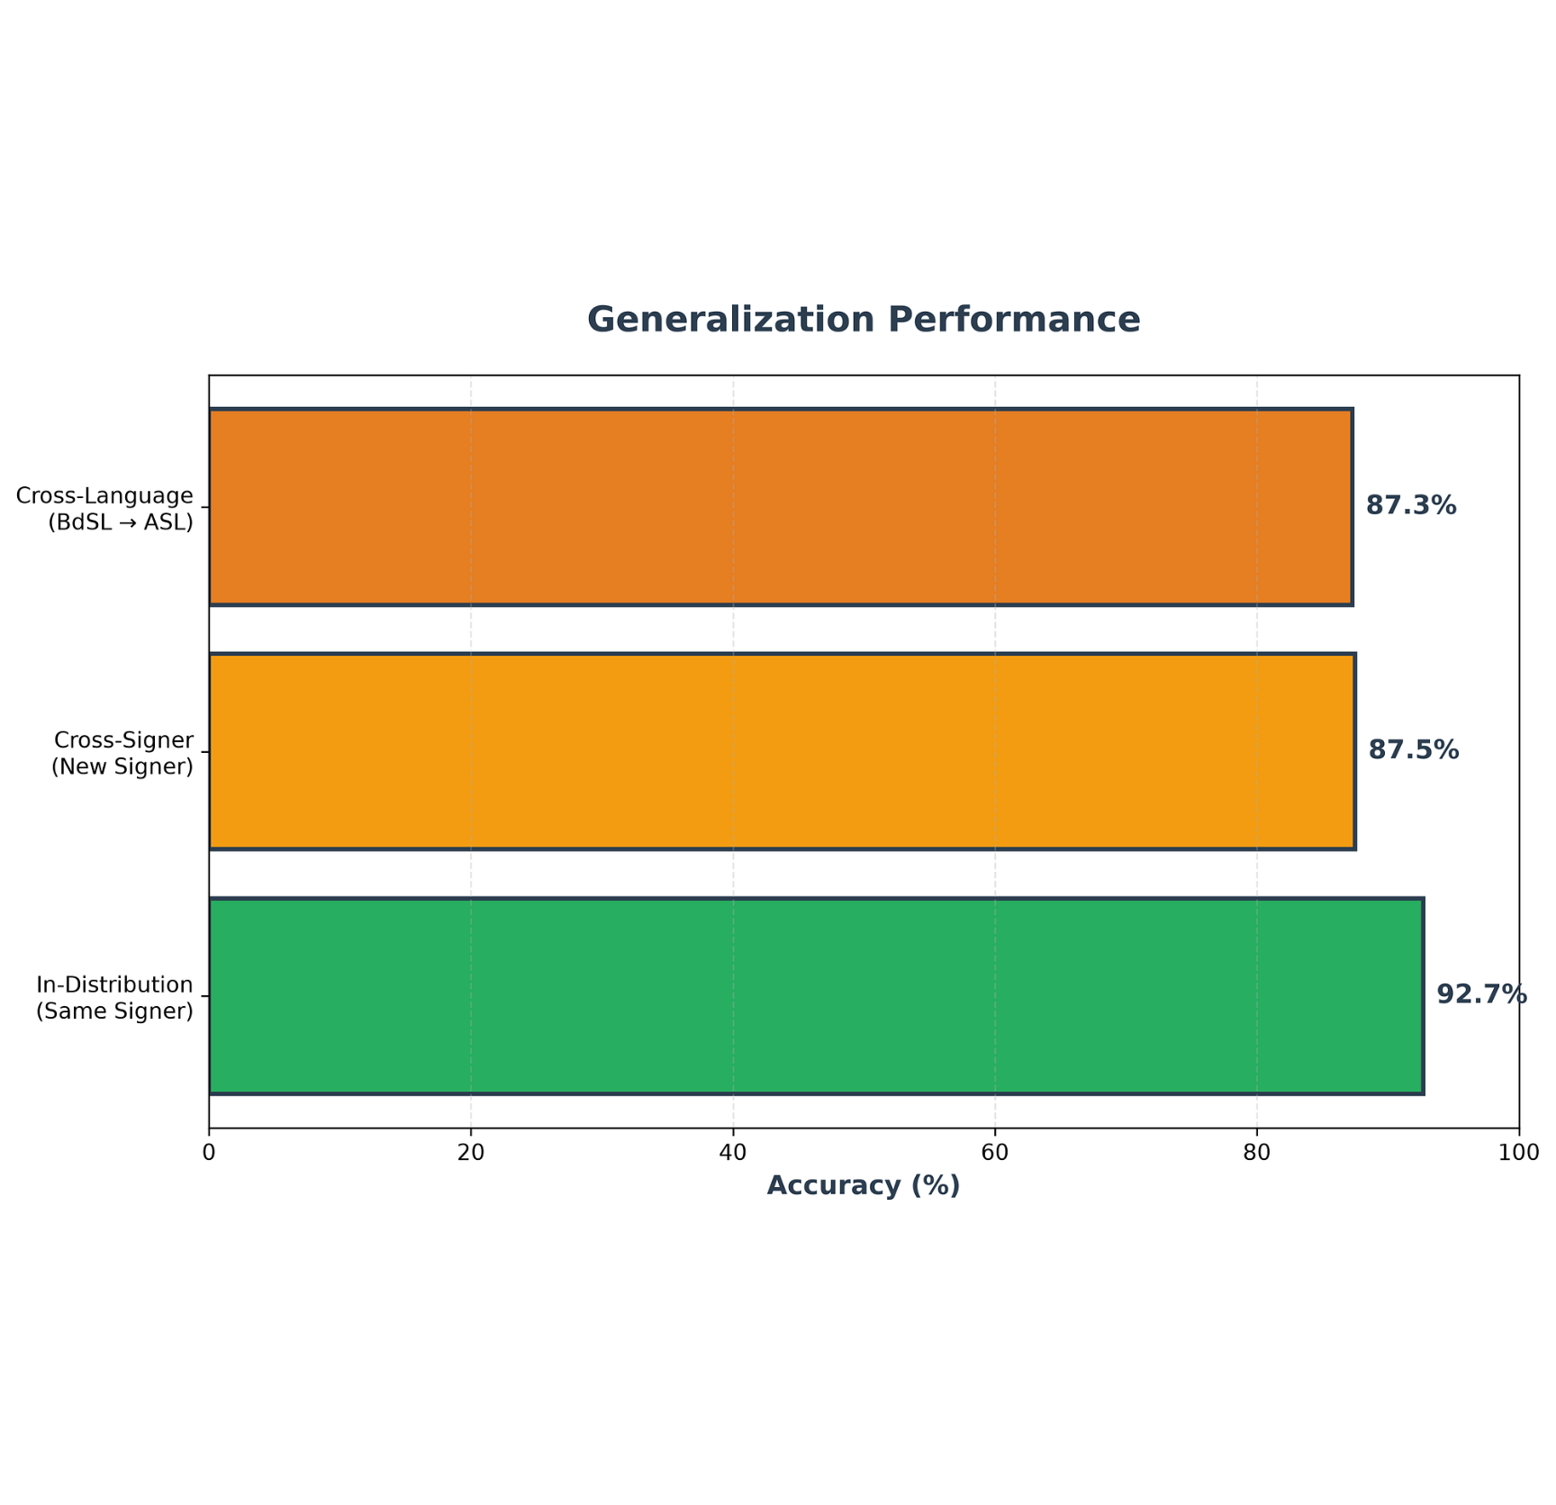
FOUR PILLARS OF INNOVATION
Lightweight, multilingual, rigorous, ethical
01
Lightweight over deep learning
150 KB vs 15 MB, under 1 ms vs 25 ms, 93.8% vs 94.2%.
02
Multilingual by design
BdSL, ASL and more with the same code and a one-line data path change.
03
Rigorous evaluation
Session-held-out CV, cross-signer test (87.5% on a new signer), false word rate under 1% on 3 minutes of idle video.
04
Ethical accessibility
Generalization: 92.7% same signer, 87.5% new signer, 87.3% cross-language (BdSL to ASL).
On-device privacy, consent-based data, transparent limitations; 8/8 tests pass, fixed seeds.
SPECIMEN 08 · ROBUSTNESS & GENERALIZATION
Notes:
Highlight the cross-signer metric: 87.5% on an individual who never contributed training samples proves the geometric normalization removes signer-specific physical biases.

Slide 10
ROADMAP, STACK & FUTURE DIRECTIONS
Technologies, impact and what comes next
01
02
Technology Stack
Hardware
Python 3.10+, MediaPipe Tasks API, scikit-learn (LR, MLP, Random Forest), NumPy, pytest; datasets BdSLW60 and WLASL
laptop i5 25-30 FPS, Raspberry Pi 4 8-12 FPS at about 5W, phone CPU 15-20 FPS
03
04
Impact
Honest limits & future
accessible communication, learning tools for sign learners, live captioning, private by default, extensible to 300+ sign languages
main evaluation used synthetic data and 2 signers, so real-data validation is next. Future: 100+ sign vocabulary, per-user fine-tuning, sentence-level context, sign-to-text sentences, diverse signers and outdoor testing
Transparent engineering: acknowledging synthetic evaluation constraints while charting a pathway to continuous sentence-level recognition.
SPECIMEN 09 · DEPLOYMENT MATRIX & ROADMAP
Notes:
Close on scientific honesty: state clearly that the primary benchmark used synthetic data and 2 signers, and that the next stage will involve real-world testing with diverse Deaf community signers.

