Slide 1
BEHAVIOURAL ANALYSIS OF WATER CONSUMPTION
USING IOT-BASED SMART RETROFIT METER

Slide 2
INDEX
SI.No CONTEXT
ABSTRACT
INTRODUCTION
EXPERIMENTAL SETUP
DEPLOYMENT SETUP
DATA PROCESSING
RESULT AND ANALYSIS
ALGORITHMS
FUTURE WORK

Slide 3

1. ABSTRACT
WATER CONSERVATION AND EFFICIENT RESOURCE MANAGEMENT
are critical challenges in modern urban and institutional settings.
This paper presents an IoT-BASED SMART RETROFIT SYSTEM designed to
MONITOR AND ANALYSE WATER CONSUMPTION PATTERNS in real time.
By integrating DEEP LEARNING AND COMPUTER VISION,
analog water meters are converted into SMART METERS without requiring infrastructure overhaul.
The system captures HIGH-RESOLUTION IMAGES, processes them using a
ResNet-18 DIGIT RECOGNITION MODEL, and transmits data to the CLOUD FOR ANALYSIS.
The study focuses on BEHAVIOURAL ANALYSIS OF WATER USAGE across different campus zones, revealing consumption trends influenced by ACADEMIC SCHEDULES, HOLIDAYS, AND DAILY ROUTINES.
The proposed method achieves HIGH ACCURACY, COST-EFFECTIVENESS, AND SCALABILITY, making it a viable solution for SMART WATER MANAGEMENT in EDUCATIONAL INSTITUTIONS, URBAN ENVIRONMENTS, AND INDUSTRIES.

Slide 4
2. INTRODUCTION
Importance of water consumption monitoring
Role of IoT in water management
Motivation for retrofitting analog meters with smart IoT solutions
2.1. OBJECTIVES OF THE STUDY
Analyze water supply behaviour in an educational campus
Implement IoT-based retrofit smart meters
Utilize deep learning for digit detection
Refine data using advanced processing techniques
Evaluate water consumption patterns on a weekly and monthly basis
2.2. LITERATURE REVIEW
Discussion on existing water consumption monitoring systems
Limitations of traditional water meters
Advances in deep learning for digit detection

Slide 5
3. EXPERIMENTAL SETUP
3.1. HARDWARE COMPONENTS
RASPBERRY PI 3B+: The core processing unit responsible for controlling the smart meter and executing deep learning algorithms.
PiCAM (RASPBERRY PI CAMERA MODULE): Captures high-resolution images of the analog water meter readings for digit recognition.
LED RING LIGHTING: Ensures clear image capture even in LOW-LIGHT AND NIGHT-TIME CONDITIONS to enhance accuracy.
POWER SUPPLY: The entire setup is powered via AC ADAPTERS WITH BATTERY BACKUP to prevent data loss during outages.

Slide 6
3.2. SOFTWARE COMPONENTS
DEEP LEARNING-BASED DIGIT RECOGNITION (ResNet-18 MODEL): Utilized to extract and identify numerical values from meter images with high accuracy.
IMAGE PREPROCESSING USING OPENCV: Image enhancement techniques such as NOISE REDUCTION, CONTRAST ADJUSTMENT, AND EDGE DETECTION for better digit recognition.
DATA TRANSMISSION TO CLOUD: The detected values are securely transmitted to a CLOUD SERVER FOR REAL-TIME MONITORING AND STORAGE.

Slide 7
3.3. DEPLOYMENT STRATEGY
FOUR SMART METERS STRATEGICALLY INSTALLED at different locations on campus, ensuring diverse data collection.
LOCATIONS COVERED:
STUDENT HOSTELS: Areas with high occupancy and FLUCTUATING WATER CONSUMPTION PATTERNS.
FACULTY QUARTERS: Provides a baseline comparison with MORE STABLE WATER USAGE.
DATA COLLECTION DURATION: Over FOUR MONTHS, resulting in approximately 550,000 DATA POINTS.
REAL-TIME MONITORING ENABLED through IoT integration, allowing administrators to analyze consumption patterns remotely.

Slide 8
3.4. SIGNIFICANCE OF EXPERIMENTAL SETUP
ENSURES HIGH-PRECISION DATA COLLECTION AND ANALYSIS.
COMBINES IoT, CLOUD COMPUTING, AND MACHINE LEARNING for an intelligent, automated solution.
ALLOWS SCALABILITY FOR LARGER DEPLOYMENTS IN URBAN AND INDUSTRIAL SETTINGS.
HELPS IN LEAK DETECTION, RESOURCE OPTIMIZATION, AND SMART DECISION-MAKING FOR SUSTAINABLE WATER MANAGEMENT.

Slide 9
4. DEPLOYMENT SETUP
4.1. OVERVIEW OF DEPLOYMENT
STRATEGIC INSTALLATION OF IoT-BASED SMART METERS across the IIIT-Hyderabad campus to analyze WATER CONSUMPTION PATTERNS.
FOCUS AREAS:
STUDENT HOSTELS – High occupancy with DYNAMIC AND VARIABLE WATER USAGE.
FACULTY & STAFF QUARTERS – More STABLE AND PREDICTABLE WATER CONSUMPTION.
GOAL: To capture REAL-TIME, HIGH-RESOLUTION DATA for detailed behavioural analysis of water usage.

Slide 10
4.2. HARDWARE DEPLOYMENT
FOUR SMART RETROFIT METERS INSTALLED at critical points in the water supply network.
INTEGRATED SENSORS FOR IMAGE CAPTURE:
RASPBERRY PI 3B+ – Controls the IoT system and processes meter readings.
PiCAM MODULE – Captures high-quality images of the analog meter dials.
LED RING LIGHTING – Ensures clear image capture in LOW-LIGHT CONDITIONS.
BATTERY BACKUP SYSTEM – Prevents data loss during POWER OUTAGES.

Slide 11
4.3. SOFTWARE DEPLOYMENT
DEEP LEARNING-BASED DIGIT RECOGNITION using ResNet-18 MODEL.
DATA PREPROCESSING WITH OPENCV to improve IMAGE CLARITY, EDGE DETECTION, AND NOISE REDUCTION.
CLOUD-BASED DATA TRANSMISSION for REAL-TIME MONITORING AND ANALYSIS.
DYNAMIC ERROR CORRECTION USING HAMMING DISTANCE ALGORITHM to refine inaccurate readings.

Slide 12
4.4. DATA COLLECTION STRATEGY
550,000 DATA POINTS COLLECTED over FOUR MONTHS.
HIGH-FREQUENCY DATA RECORDING:
1-MINUTE INTERVAL SAMPLING for capturing DETAILED WATER USAGE TRENDS.
CROSS-VERIFICATION WITH COMMERCIAL DIGITAL METERS for accuracy validation.

Slide 13
4.5. SIGNIFICANCE OF DEPLOYMENT SETUP
ENSURES HIGH-PRECISION WATER USAGE MONITORING without replacing existing infrastructure.
SCALABLE AND COST-EFFECTIVE SOLUTION for smart water management in URBAN & INSTITUTIONAL SETTINGS.
ENABLES BEHAVIOURAL ANALYSIS to optimize RESOURCE DISTRIBUTION AND LEAKAGE DETECTION.
PROVIDES DATA-DRIVEN INSIGHTS for sustainable water consumption and policy formulation.

Slide 14
5. DATA PROCESSING
5.1. OVERVIEW OF DATA PROCESSING
EFFICIENT DATA PROCESSING ENSURES ACCURACY IN WATER CONSUMPTION ANALYSIS.
MULTI-STAGE DATA HANDLING PIPELINE designed to CAPTURE, TRANSMIT, REFINE, AND STORE DATA.
AUTOMATED ERROR DETECTION AND CORRECTION applied to minimize inaccuracies in readings.

Slide 15
5.2. DATA COLLECTION METHODOLOGY
DATA ACQUISITION FROM SMART METERS:
IMAGES CAPTURED AT 1-MINUTE INTERVALS using the PiCAM MODULE.
REAL-TIME DATA STREAMING TO CLOUD STORAGE for further analysis.
TOTAL OF 550,000 DATA POINTS COLLECTED over a span of FOUR MONTHS.

Slide 16
5.3. ERROR ANALYSIS & CHALLENGES
CHALLENGES IN DATA COLLECTION:
POWER OUTAGES & NETWORK ISSUES causing MISSING DATA.
ENVIRONMENTAL FACTORS (RAIN, DUST, SCRATCHES) affecting IMAGE CLARITY.
HUMAN INTERVENTION leading to accidental misalignment of devices.
COMMON ERRORS IDENTIFIED:
BLURRED IMAGES reducing digit recognition accuracy.
PARTIAL OBSTRUCTIONS leading to incomplete readings.
SUDDEN SPIKES IN VALUES indicating potential METER MISREADINGS OR LEAKAGES.

Slide 17
5.4. DATA REFINEMENT & ERROR CORRECTION
ADVANCED REFINEMENT ALGORITHM IMPLEMENTED:
HAMMING DISTANCE-BASED TECHNIQUE to filter out inaccurate readings.
COMPARISON OF CONSECUTIVE READINGS to detect anomalies.
IMAGE PREPROCESSING USING OPENCV for NOISE REDUCTION, EDGE DETECTION, AND CONTRAST ENHANCEMENT.
CROSS-VALIDATION MECHANISM:
COMPARISON WITH COMMERCIAL DIGITAL METERS to ensure accuracy.
OUTLIER DETECTION METHODS to discard extreme fluctuations in data.

Slide 18
5.5. FINAL DATA PROCESSING RESULTS
SIGNIFICANT IMPROVEMENT IN DATA QUALITY & ACCURACY.
ROOT MEAN SQUARE ERROR (RMSE) REDUCED FROM 8.6 TO 0.24.
MEAN ABSOLUTE ERROR (MAE) REDUCED FROM 0.67 TO 0.02.
ENSURED RELIABLE WATER CONSUMPTION DATA FOR BEHAVIORAL ANALYSIS.
5.6. SIGNIFICANCE OF DATA PROCESSING PIPELINE
ENABLES HIGH-PRECISION WATER MONITORING AND TREND ANALYSIS.
ENSURES CONSISTENT AND ACCURATE DATA FOR SMART WATER MANAGEMENT.
SCALABLE & ADAPTABLE FOR DEPLOYMENT IN OTHER SMART CITIES & INSTITUTIONS.
FACILITATES INFORMED DECISION-MAKING FOR WATER CONSERVATION AND SUSTAINABLE USAGE.

Slide 19
6. RESULT AND ANALYSIS
6.1. OVERVIEW OF RESULTS
COMPREHENSIVE ANALYSIS OF WATER USAGE PATTERNS BASED ON SMART METER DATA.
DEEP INSIGHTS INTO CONSUMPTION TRENDS ACROSS DIFFERENT CAMPUS ZONES.
COMPARISON OF WATER USAGE BETWEEN STUDENT HOSTELS AND FACULTY QUARTERS.
IDENTIFICATION OF KEY FACTORS INFLUENCING WATER DEMAND.

Slide 20
6.2. WATER CONSUMPTION TRENDS
HOSTEL BLOCKS EXPERIENCE SIGNIFICANTLY HIGHER WATER USAGE compared to faculty quarters.
PEAK CONSUMPTION PERIODS IDENTIFIED DURING MORNINGS AND EVENINGS.
REDUCED WATER CONSUMPTION OBSERVED DURING HOLIDAY PERIODS AND EXAMS.
FACULTY AND STAFF QUARTERS SHOW MORE STABLE AND PREDICTABLE USAGE PATTERNS.
6.3. TIME SERIES ANALYSIS
GRAPHICAL REPRESENTATION OF WATER SUPPLY DATA OVER 4 MONTHS.
TRENDS INDICATE REGULAR SUPPLY CYCLES AND BEHAVIORAL VARIATIONS.
WATER CONSUMPTION STEADILY INCREASES DURING HIGH-OCCUPANCY PERIODS.
WEEKLY AND MONTHLY ANALYSIS REVEALS CONSISTENT USAGE PATTERNS.

Slide 21
6.4. COMPARISON WITH DIGITAL METERS
SMART RETROFIT METERS SHOW ACCURATE READINGS COMPARABLE TO DIGITAL METERS.
DIFFERENCE IN READINGS MINIMAL WHEN ROUNDED TO ONE DECIMAL PLACE.
SMART METERS PROVIDE A COST-EFFECTIVE SOLUTION FOR WATER MONITORING.
6.5. DATA ACCURACY AND ERROR REDUCTION
SIGNIFICANT IMPROVEMENT IN DATA RELIABILITY DUE TO ERROR CORRECTION ALGORITHMS.
ROOT MEAN SQUARE ERROR (RMSE) REDUCED FROM 8.6 TO 0.24.
MEAN ABSOLUTE ERROR (MAE) REDUCED FROM 0.67 TO 0.02.
IMPLEMENTATION OF HAMMING DISTANCE ALGORITHM ENSURES HIGH-PRECISION READINGS.

Slide 22
6.6. BEHAVIOURAL INSIGHTS AND CONSUMPTION PATTERNS
STUDENT HABITS SIGNIFICANTLY IMPACT WATER USAGE TRENDS.
CAMPUS HOLIDAYS AND EXAM PERIODS RESULT IN SHARP DECLINE IN WATER CONSUMPTION.
FACULTY QUARTERS SHOW CONSISTENT CONSUMPTION WITH MINIMAL VARIATION.
HIGH WATER USAGE IN HOSTELS DUE TO SHARED FACILITIES SUCH AS MESS AND BATHROOMS.
6.7. IMPACT AND SIGNIFICANCE OF RESULTS
ENABLES SMART DECISION-MAKING FOR OPTIMIZED WATER RESOURCE DISTRIBUTION.
HELPS IN IDENTIFYING LEAKAGES AND EXCESSIVE CONSUMPTION AREAS.
SUPPORTS FUTURE EXPANSION OF SMART WATER MANAGEMENT SYSTEMS.
PROVIDES A SCALABLE MODEL FOR URBAN AND INDUSTRIAL WATER MONITORING.

Slide 23
7. ALGORITHM
7.1. DEEP LEARNING (RES NET - 18)
Definition:
ResNet-18 (Residual Network with 18 layers) is a deep convolutional neural network designed to tackle vanishing gradient problems using shortcut connections (skip connections). It is widely used for image classification and object detection tasks.
Why Use ResNet-18 in the Paper?
The research required a computationally efficient deep learning model capable of recognizing digits from water meter images.
ResNet-18 balances accuracy and computational efficiency, making it suitable for deployment on edge devices like Raspberry Pi.
Transfer learning was applied, where a pre-trained ResNet-18 model (trained on ImageNet) was fine-tuned for digit recognition.

Slide 24
Architecture of ResNet-18
ResNet-18 consists of:
Conv Layers: Extract features from input images.
Batch Normalization & ReLU Activation: Improve training efficiency and add non-linearity.
Residual Blocks (Skip Connections): Help prevent the vanishing gradient issue, allowing deeper networks to be trained efficiently.
Fully Connected Layer: Final classification of digits (0-9 in this case).

Slide 25
HIGH LEVEL ARCHITECTURE DIAGRAM OF RESNET-18
Input Image (Water Meter)
│
Conv1 (7x7, 64 filters, stride=2) → BatchNorm → ReLU → MaxPool (3x3)
│
ResBlock (64 filters) → ResBlock (64 filters)
│
ResBlock (128 filters) → ResBlock (128 filters)
│
ResBlock (256 filters) → ResBlock (256 filters)
│
ResBlock (512 filters) → ResBlock (512 filters)
│
AvgPool → Fully Connected Layer (10 neurons for digit classification)
│
Output (Detected Digits)

Slide 26
ALGORITHMIC PIPELINE
The figure in the paper illustrates the digit recognition pipeline using ResNet-18:
Image Capturing: IoT-based cameras take images of the water meter.
Preprocessing:
Extracting the Region of Interest (RoI) (digits on the meter).
Resizing to 224x224 pixels to match ResNet-18 input requirements.
Normalization (zero mean, unit variance).
Digit Segmentation: Using OpenCV to extract individual digits.
Deep Learning Recognition: The fine-tuned ResNet-18 model classifies the digits.
Post-processing: Corrects errors using Hamming Distance and MSE for duplicate detection.
Data Transmission: The refined digit values are sent to the cloud for further analysis.

Slide 27
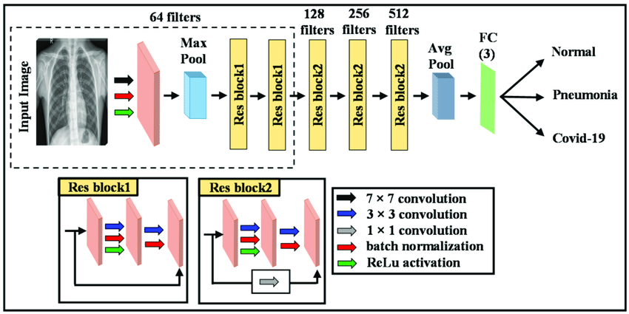
ARCHITECTURAL DIAGRAM OF RESNET-18

Slide 28
7.2. HAMMING DISTANCE ALGORITHM
The Hamming Distance is a metric used to measure the difference between two strings of equal length. It counts the number of positions where the corresponding characters (or digits) differ.
For example, the Hamming distance between: "10110" and "10011" is 2 (since two positions differ).
Use for this paper?
The digit recognition model sometimes produces errors due to: - Blurry images - Environmental conditions (rain, dust, insects, smudges) - Lighting issues - Camera misalignment
These errors cause incorrect digit detection, which leads to inaccurate water meter readings. To fix this, a Hamming Distance-based correction algorithm is used.

Slide 29
WORK
The algorithm detects and corrects errors in the digit recognition
STEP
ACTION
Step 1
Step 2
Step 3
Step 4
Step 5
Compute expected range R=10×TD
Compare detected value with all possible values in the range
Calculate the Hamming Distance for each comparison
Choose the value with the smallest Hamming Distance
Replace incorrect reading with the closest match

Slide 30
Step 1: Define an Acceptable Range of Values
Since a water meter reading increases gradually over time, the algorithm sets a valid range (R) for expected values.
The range is defined as: R=10×TD
where:
10 is the maximum expected digit change per minute.
T_D is the time difference (in minutes) between two readings.
Example: If the last detected value was 23325.5 kL and T_D = 1 min, the new reading should be between 23325.5 and 23335.5 kL.

Slide 31
Step 2: Compare the Detected Value with Expected Values
The detected meter value is compared against all possible values within R.
The Hamming Distance is calculated for each comparison.
The value with the least Hamming Distance (fewest differing digits) is chosen as the corrected reading.
Example:
If the previous correct reading was 23325.5 kL and T_D = 2 min, the next reading should be within:
23325.5≤Next Reading≤23345.5
Thus, the expected range is 23325.5 to 23345.5 kL.

Slide 32
Step 3: Correct the Error
If a digit is detected incorrectly, the algorithm replaces it with the closest match.
Example:
Previous reading: 23325.5 kL
Detected reading: 23125.9 kL (Error in digit 3 → 1)
Expected range: 23325.5 - 23335.5 kL
Hamming distance between 23125.9 and expected values:
23125.9 vs. 23325.9 → Hamming Distance = 1
23125.9 vs. 23329.9 → Hamming Distance = 2
Since 23325.9 has the smallest Hamming Distance, it is chosen as the corrected value.

Slide 33
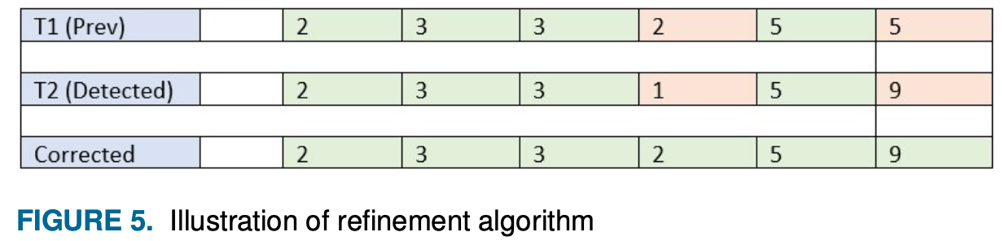
Step 4: Example from the Paper
The following illustration from Figure 5 in the paper shows how the algorithm works:
The previous value at T1 was 233255 kL.
The new detected value at T2 is 233251 kL.
The algorithm calculates the Hamming Distance between the detected value and expected values.
Since 233259 kL has the smallest difference (Hamming Distance = 1), the incorrect reading is corrected.

Slide 34
Step 5: Replace Incorrect Reading with the Closest Match
The algorithm finalizes the correction by replacing the incorrect meter reading with the closest valid value.
It selects the value with the smallest Hamming Distance from the expected range.
This ensures the least deviation from the actual reading.
The corrected value is stored as the new reference for future readings.
This prevents error accumulation over time.
The final corrected meter reading is outputted for further analysis.
This step ensures data accuracy by eliminating errors caused by environmental factors, sensor issues, or image distortions.

Slide 35
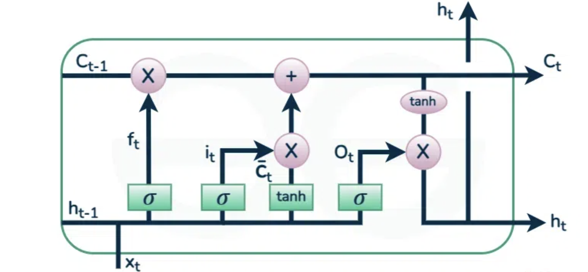
7.3 LONG SHORT-TERM MEMORY
Long Short-Term Memory (LSTM) networks are a specialized type of Recurrent Neural Network (RNN) designed to address the vanishing gradient problem and capture long-term dependencies in sequential data. Introduced by Hochreiter and Schmidhuber in 1997, LSTMs excel at processing time series, text, speech, and other sequential inputs.

Slide 36
Core Structure
LSTM cells contain three regulatory gates and two states:
Forget gate: Determines what information to discard from the cell state using a sigmoid function (outputs 0-1)
Input gate: Updates the cell state by combining a sigmoid-activated filter and tanh-activated candidate values
Output gate: Controls what information from the cell state becomes the hidden state output
Cell state: Maintains long-term memory across sequences
Hidden state: Handles short-term memory and immediate outputs
This architecture allows LSTMs to selectively retain or discard information, enabling effective learning of patterns in data with long temporal gaps

Slide 37
Key Applications
Natural Language Processing (NLP):
- Machine translation (e.g., Google's Neural Machine Translation reduced errors by 60%)
- Text generation and sentiment analysis
- Speech recognition (used in Google Voice, Amazon Alexa, and Apple Siri)
Time Series Analysis:
- Stock market forecasting
- Weather prediction
- Industrial process monitoring
Computer Vision:
- Video activity recognition
- Image captioning

Slide 38
Specialized Domains:
- Polymer property prediction (mechanical strength, degradation rates)
- Robot control and game AI (e.g., DeepMind's StarCraft II AI)
- Medical pathway prediction
Notable Implementations:
- Google (2015): Cut speech recognition errors by 49% using LSTM with Connectionist Temporal Classification
- Facebook (2017): Processed 4.5 billion daily translations via LSTM
- OpenAI(2018): Used LSTM-powered agents to defeat humans in Dota 2
LSTMs overcome traditional RNN limitations through their gated architecture, making them indispensable for tasks requiring context preservation over extended sequences[3][4]. While newer architectures like Transformers have emerged, LSTMs remain widely used for their balance of performance and computational efficiency in sequential data processing[7][9].

Slide 39
8. FUTURE WORK
The paper suggests several potential directions for future research to enhance the accuracy, efficiency, and scalability of the proposed IoT-based water consumption monitoring system. These include:
Optimizing Water Motor Operations: Investigating the operational aspects of water pumps to assess efficiency, maintenance needs, and energy consumption, ensuring optimal water distribution.
Improving Water Storage Solutions: Developing strategies to reduce water stagnation, particularly for drinking water, to enhance water quality and sustainability.
Expanding Deployment to Larger Areas: Scaling the system to multiple buildings, cities, or industries to analyze diverse water consumption behaviors.
Enhancing Machine Learning Models: Implementing more advanced deep learning models or hybrid AI techniques to improve digit recognition accuracy in various environmental conditions.

Slide 40
Real-time Leak Detection and Anomaly Identification: Integrating AI-driven leak detection mechanisms to identify water losses and inefficiencies in the supply system.
Integration with Smart City Infrastructure: Connecting the system with municipal water management platforms for large-scale monitoring and decision-making.
Incorporating Predictive Analytics: Using time-series forecasting models (like LSTM or ARIMA) to predict future water demand patterns, enabling proactive resource management.
User Behavior Analysis and Feedback System: Developing an interactive dashboard that provides real-time insights and recommendations to users for sustainable water usage.

Slide 41
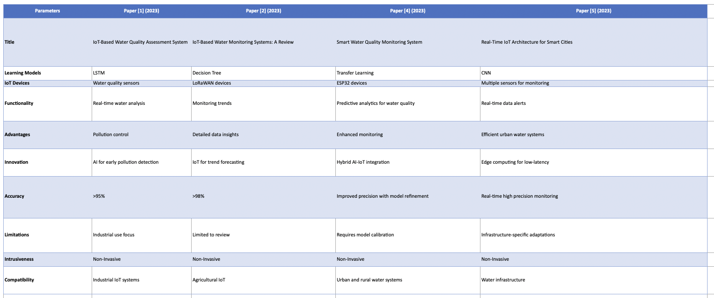
COMPARISON BETWEEN DIFFERENT MODELS USED

