Slide 1
User Task 1: Add a
new payment detail
within a group and
make the payment
Persona: Alex Singh who has a
very busy schedule
and wants to get jobs
done fast. They have
less time due to their
software job, them
attending many
technology events
and participating in
outdoor activities
John Baker, a fellow
flatmate, who is
cautious and takes
their time looking at
finer details.

Slide 2
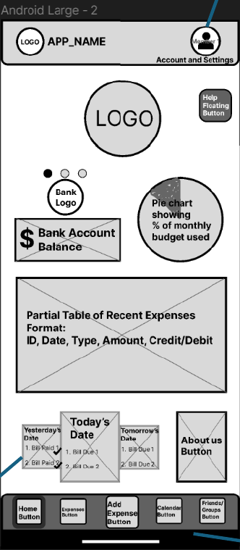

Slide 3
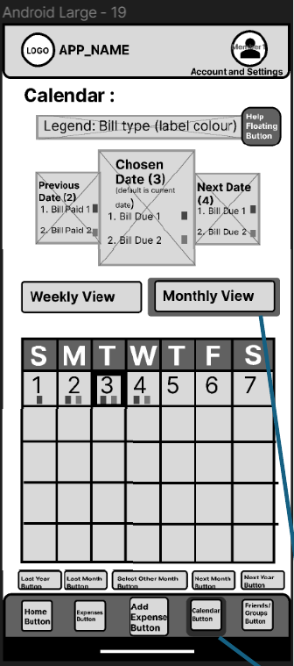

Slide 4
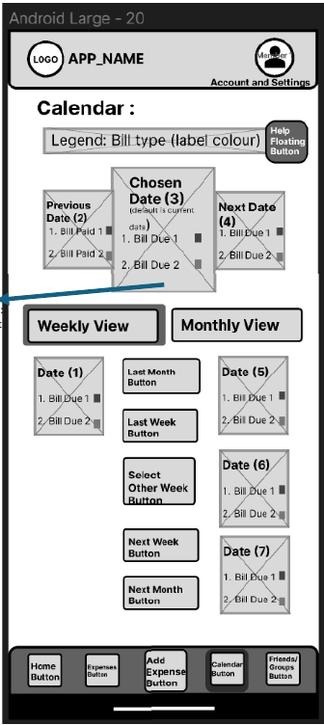

Slide 5
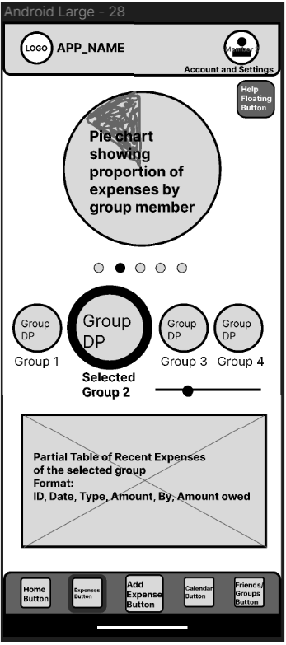

Slide 6
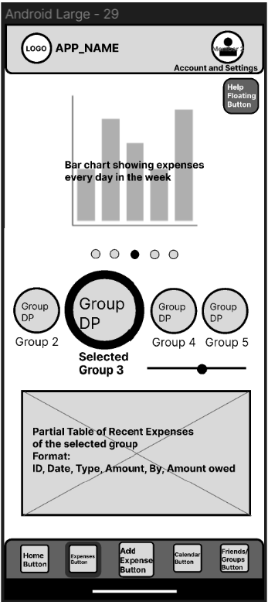

Slide 7
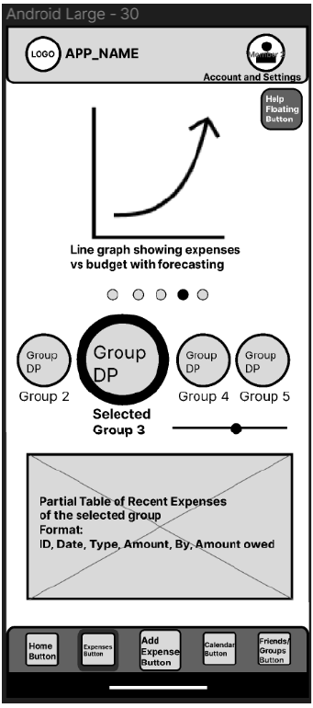

Slide 8
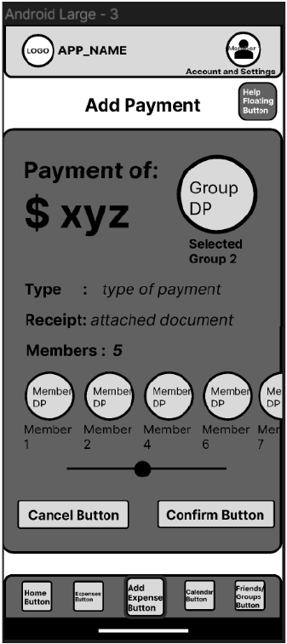

Slide 9
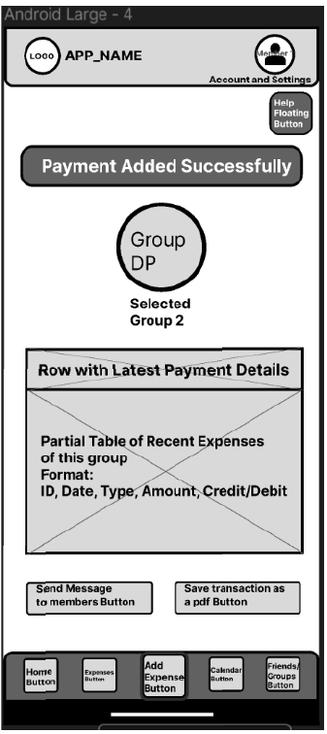

Slide 10
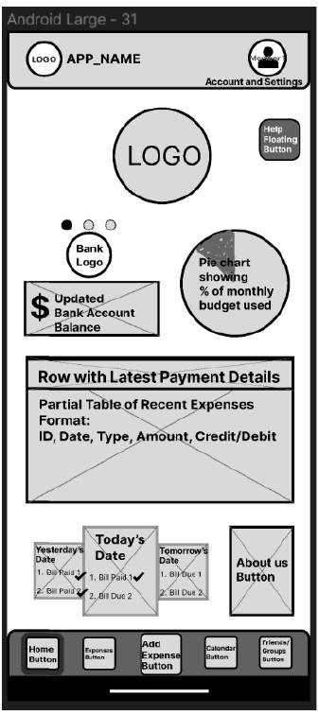

Slide 11
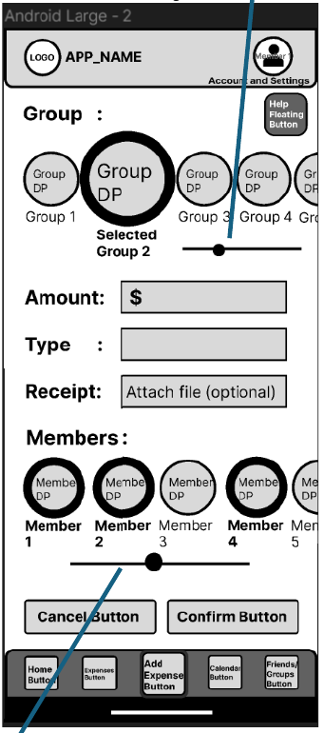

Slide 12
User Task 2: Edit a
payment’s details in which Alex Singh (flatmate) added John
Baker as a member by accident, since they were in hurry to add the payment due to their busy
schedule.

Slide 13
Personas:
• Alex Singh who has a very busy schedule and wants to get jobs done fast. They have less time due to their software job, them attending many technology events and participating in outdoor activities
• John Baker, a fellow flatmate, who is cautious and takes their time looking at finer details. They realize that they have been added as a payee by mistake since they were out of town during the time and did not need to pay for the bill. The mistake could be because Alex was in a hurry due to their busy schedule. John contacts Alex to remind him to change the payment details. Alex changes these details.

Slide 14
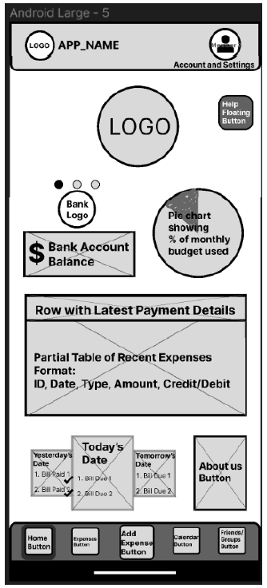

Slide 15
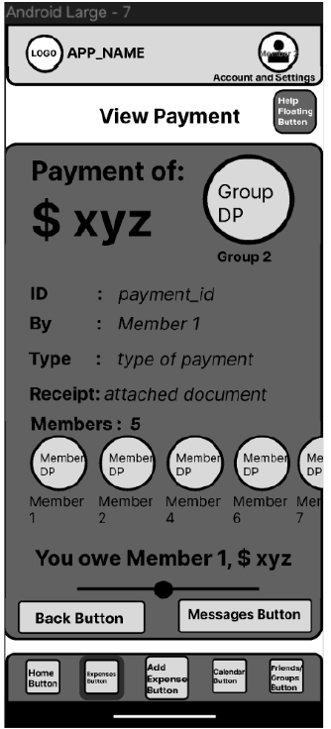

Slide 16
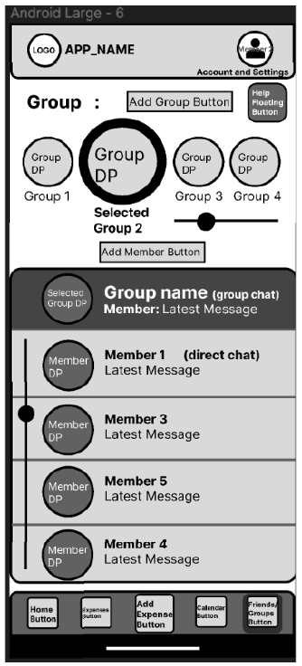

Slide 17
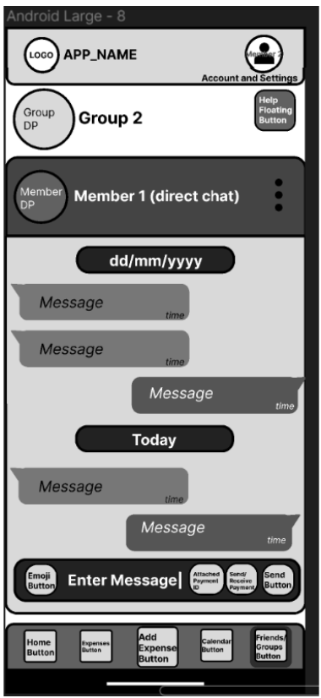

Slide 18
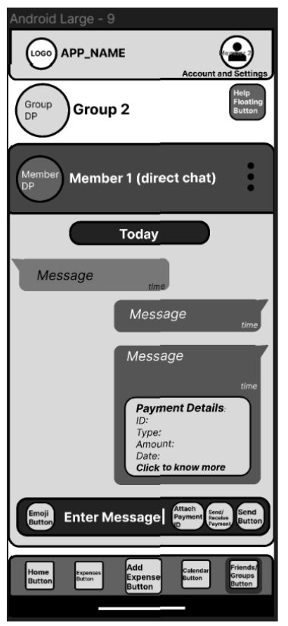

Slide 19
User Task 2: Alex Singh’s Perspective

Slide 20
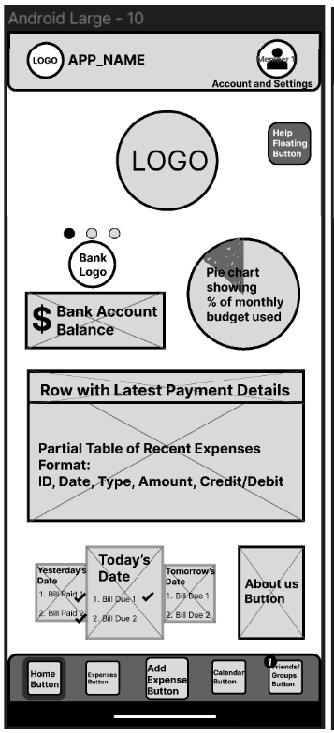

Slide 21
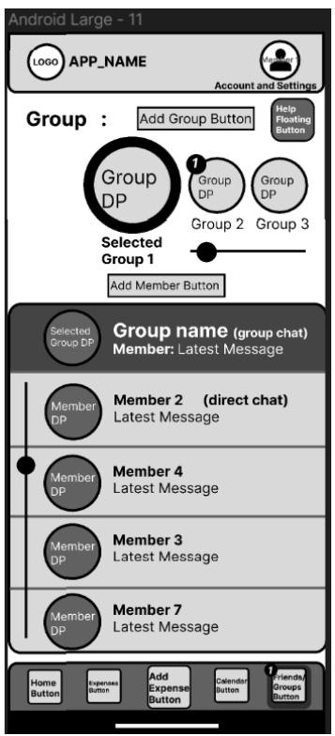

Slide 22
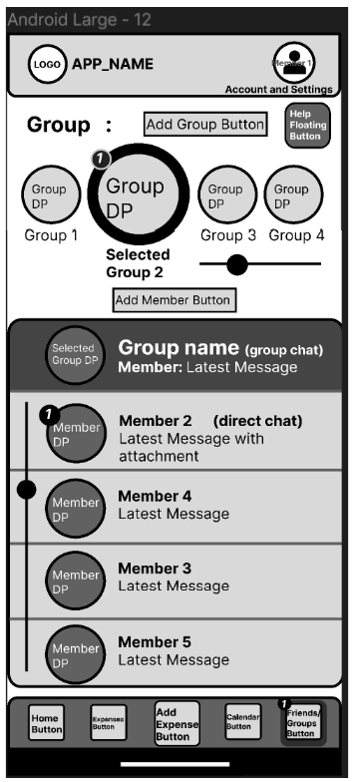

Slide 23
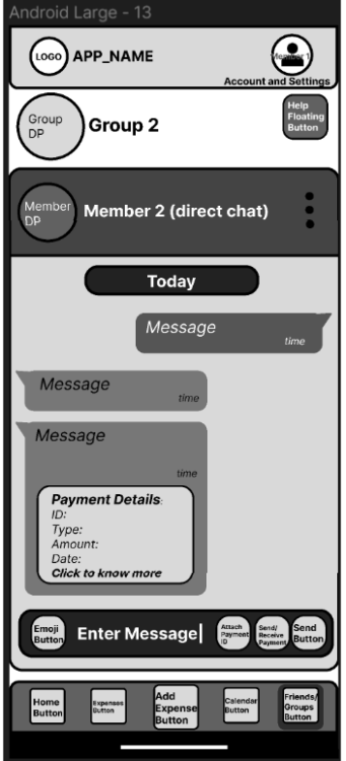

Slide 24
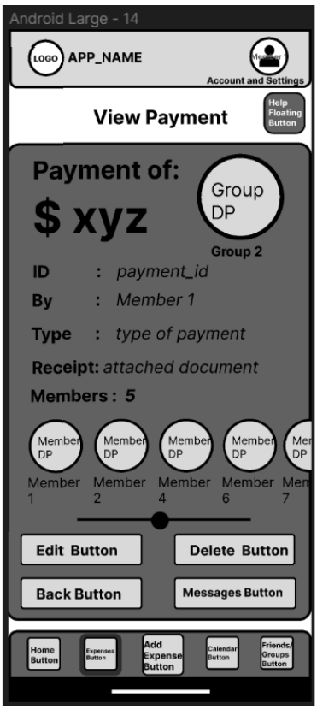

Slide 25
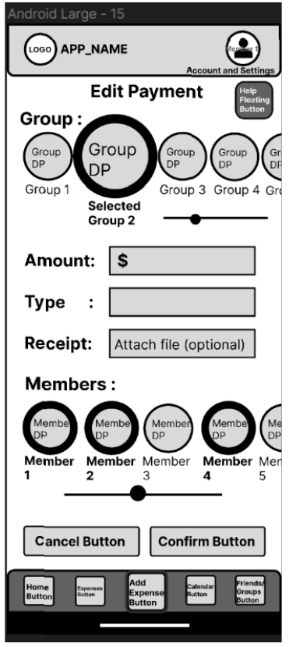

Slide 26
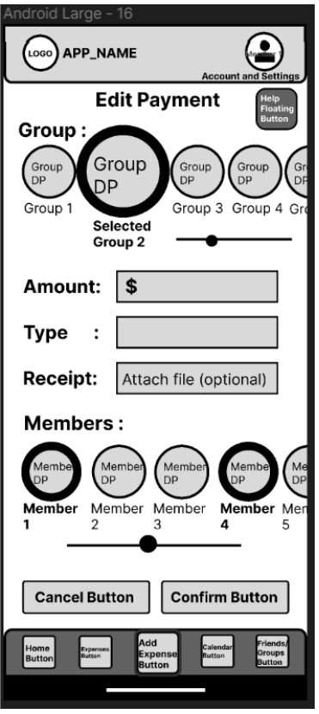

Slide 27
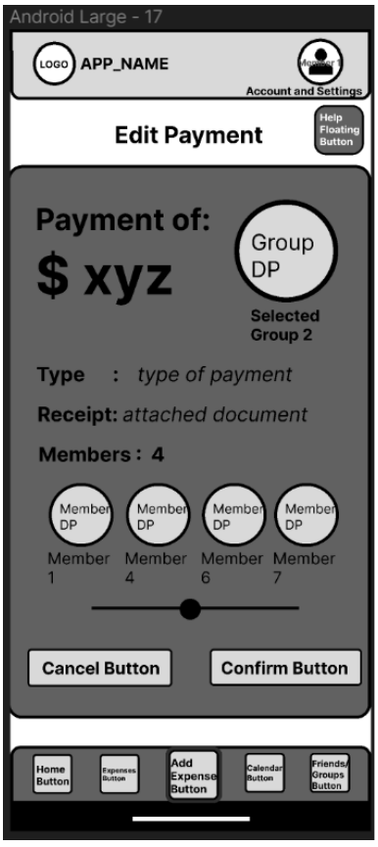

Slide 28
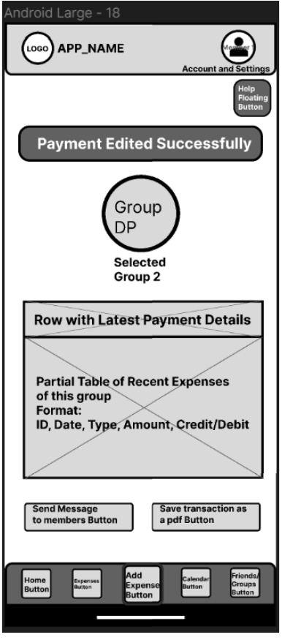

Slide 29
User Task 3: Remind a group of tenants to pay an overdue bill and add a late penalty to it.
Persona: Trevor Smith, a flat owner, who expects their tenants to pay bills like rent regularly. They always like tenants to be prompt in paying their bills and is strict on penalties.

Slide 30
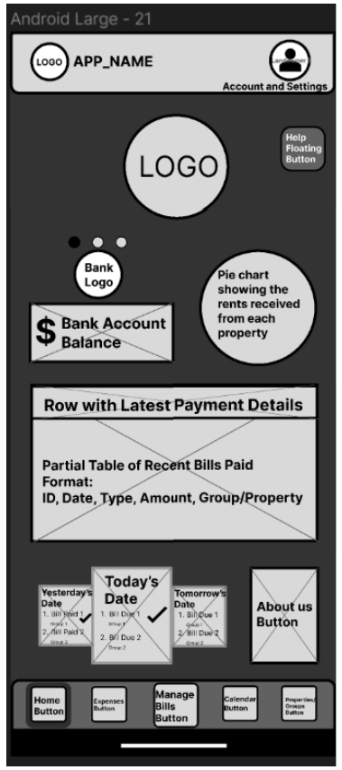

Slide 31
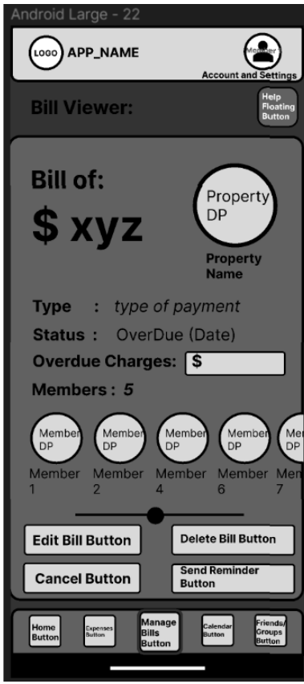

Slide 32
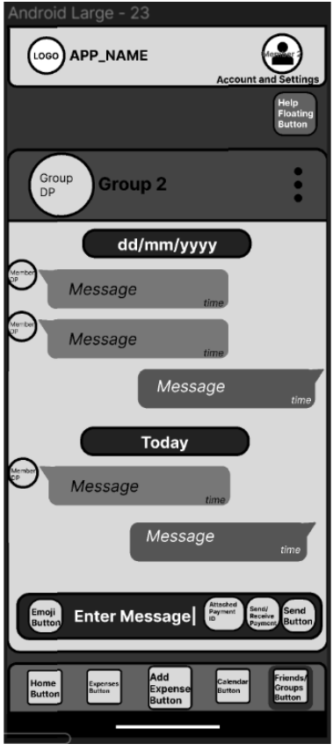

Slide 33
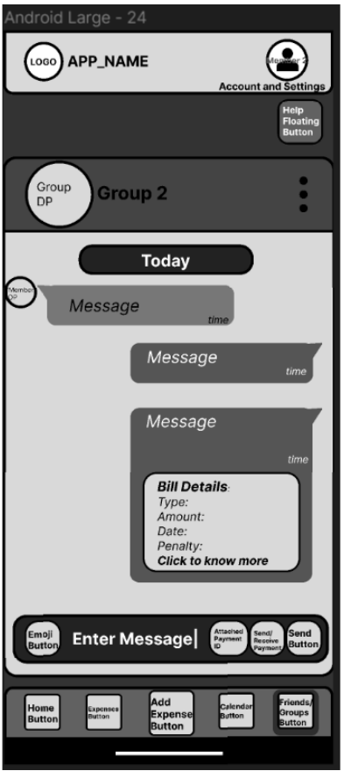

Slide 34
