Slide 1
Cognitive Walkthrough

Slide 2
Wireframe 1
User Task: Look at Expenses (weekly and stats)

Slide 3
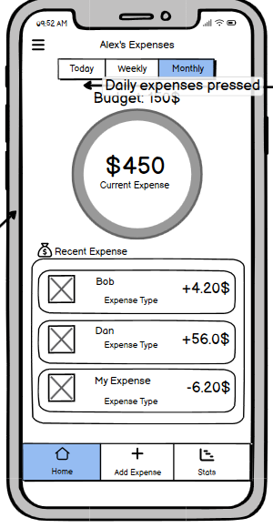
Action: Look at the Weekly expenses

Slide 4
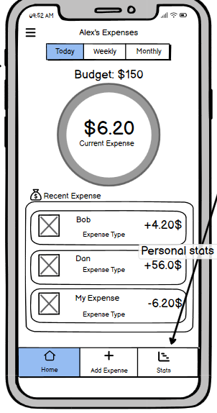
Action: Look at the stats page

Slide 5
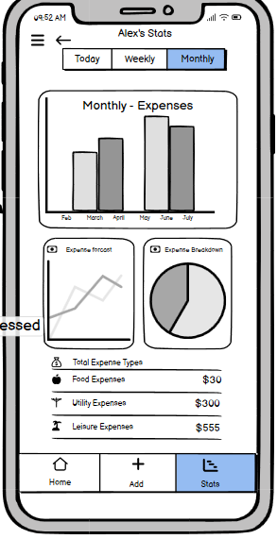
Look at the stats of their expense

Slide 6
Wireframe 2
User Task: Add new expense

Slide 7
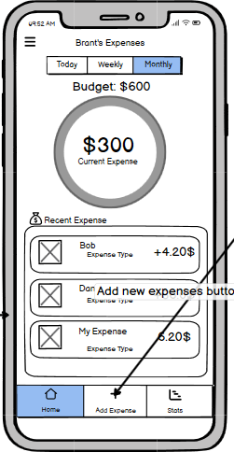
Action: Add new expense

Slide 8
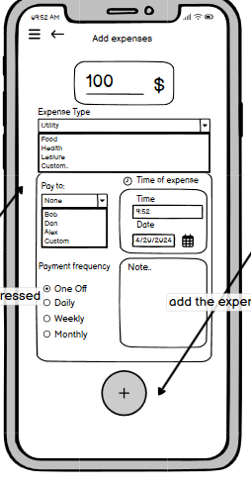
Action: fill in relevant details about expense

Slide 9
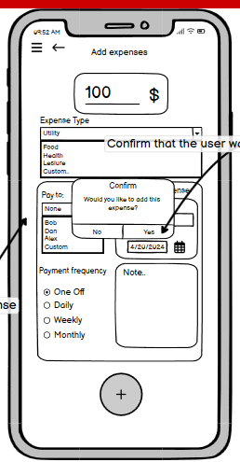
Action: Confirm Expense

Slide 10
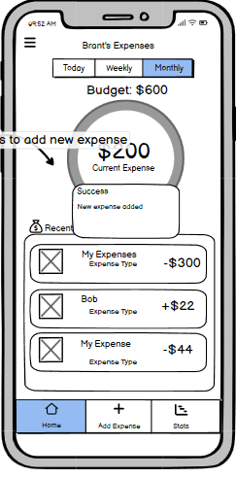
Action: See expense added

Slide 11
Wireframe 3
User Task: Add new flatmate

Slide 12
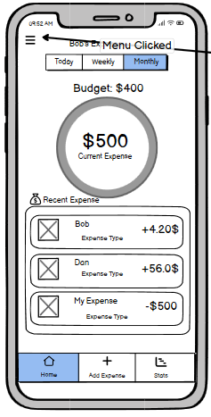
Action: Go to the Menu page

Slide 13
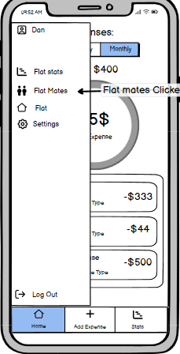
Action: Navigate the flatmates page

Slide 14
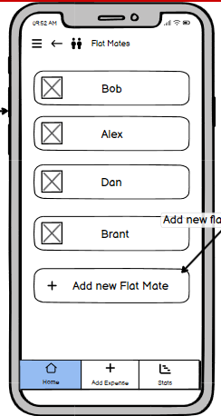
Action: add new flatmate

Slide 15
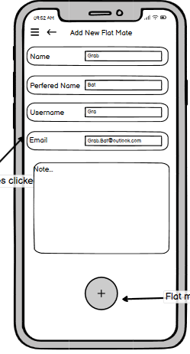
Action: Add in relevant details about flatmates

Slide 16
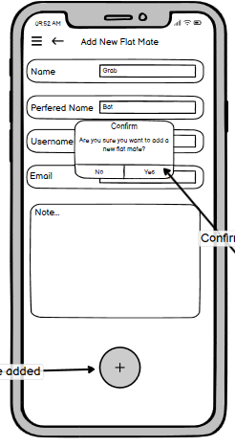
Action: confirm flatmate

Slide 17
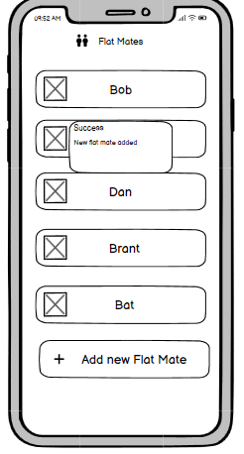
Action: add in detail

