Slide 1
Task One: Switch Flat and Check Expenses Persona: Abby Jones

Slide 2
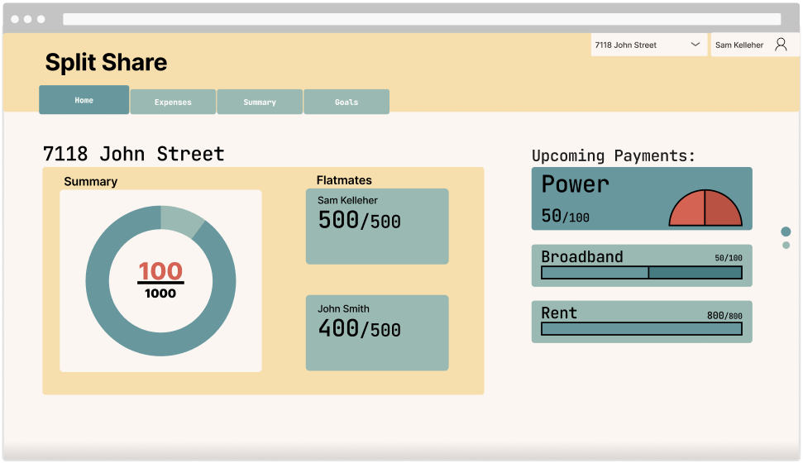
Frame 1.1, Change Flat

Slide 3
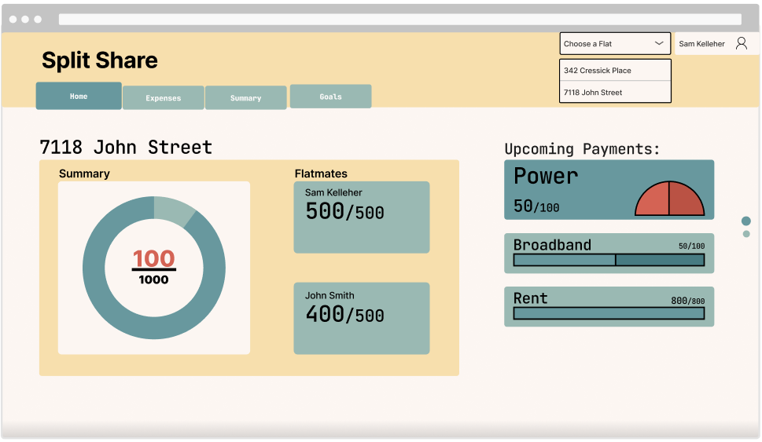
Frame 1.2, Select New Flat

Slide 4
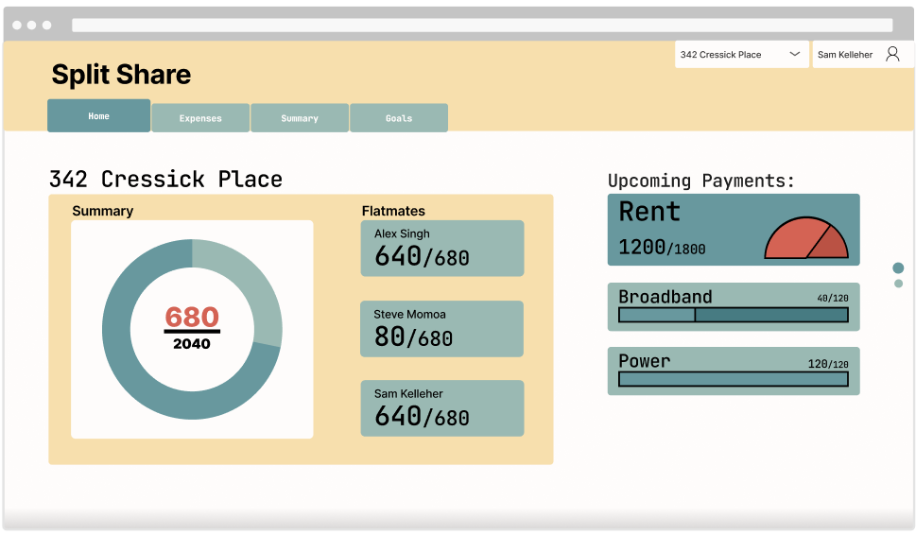
Frame 1.3, View Payments, Get more detail on Broadband

Slide 5
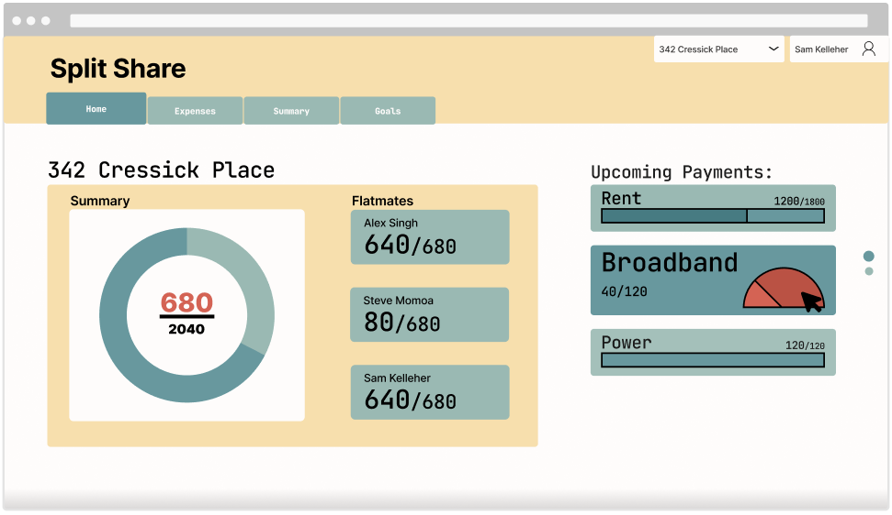
Frame 1.4, View Broadband

Slide 6
Task Two: Adding and Expense Persona: Bob Dylan

Slide 7
Frame 1.3, Navigate to Expenses

Slide 8
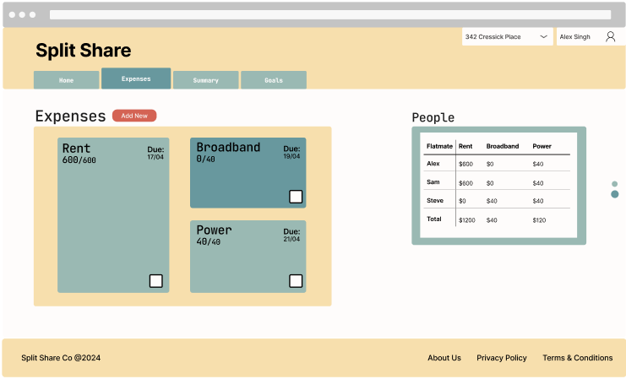
Frame 2.1, Create new Expense

Slide 9
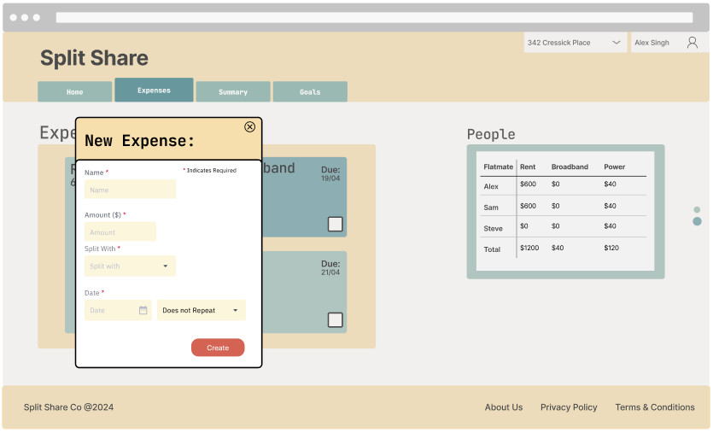
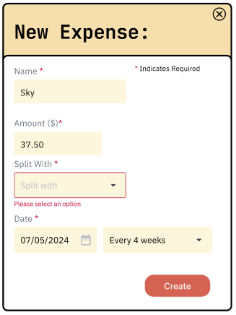
Frame 2.2.1 & 2.2.2, Fill out Form

Slide 10
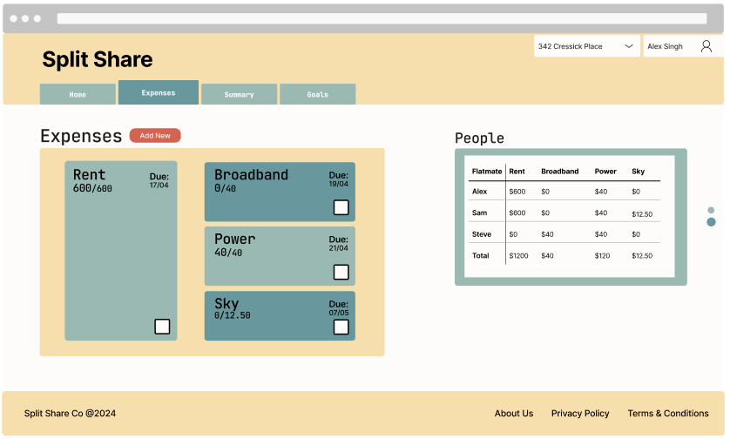
Frame 2.3, View New Expense

Slide 11
Task Three: Notify Flatmate of Expense Persona: John Baker

Slide 12
Frame 2.1, Open up Expense

Slide 13
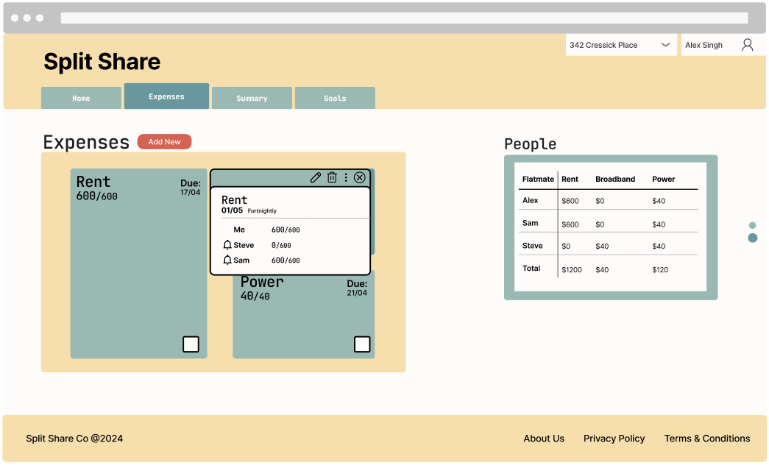
Frame 3.1, Notify Flatmate

Slide 14
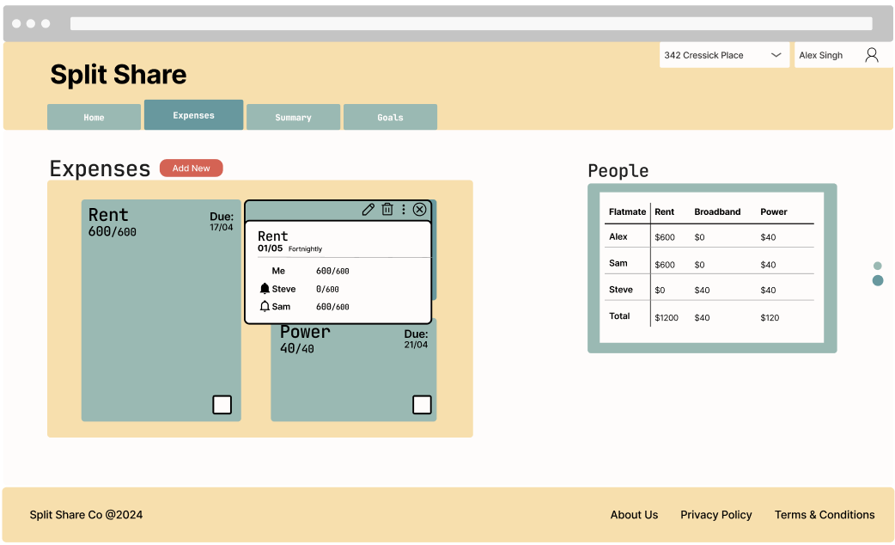
Frame 3.2, After Notifying

