Slide 1
Task 1:
Add a Split Payment
Persona:
John Baker

Slide 2
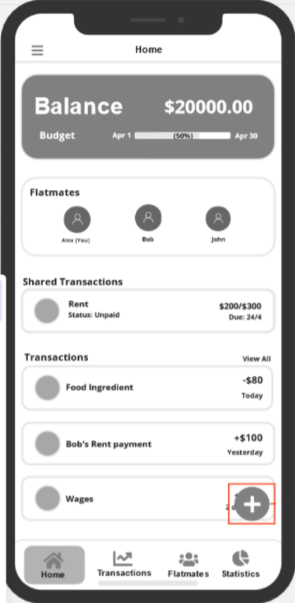



Slide 3
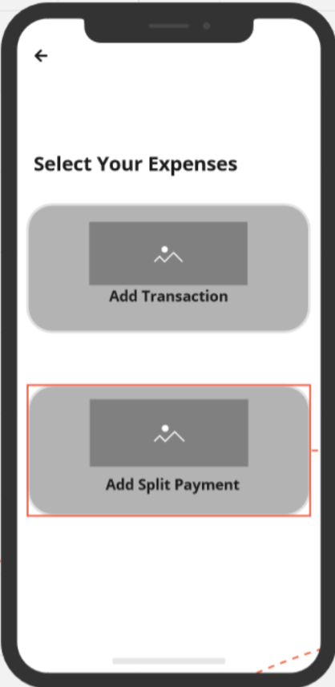




Slide 4
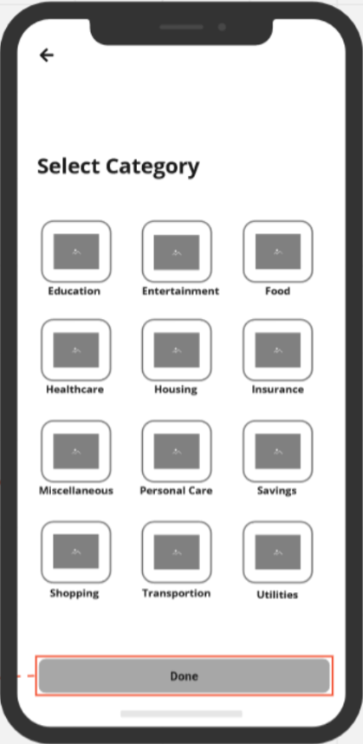

Slide 5
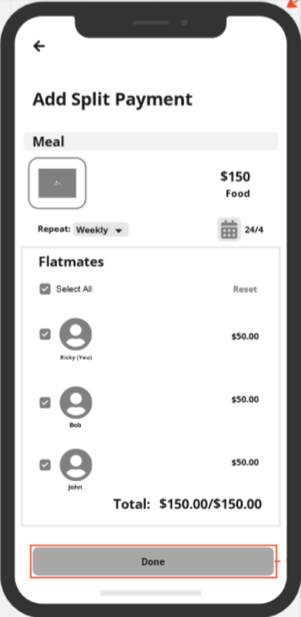

Slide 6
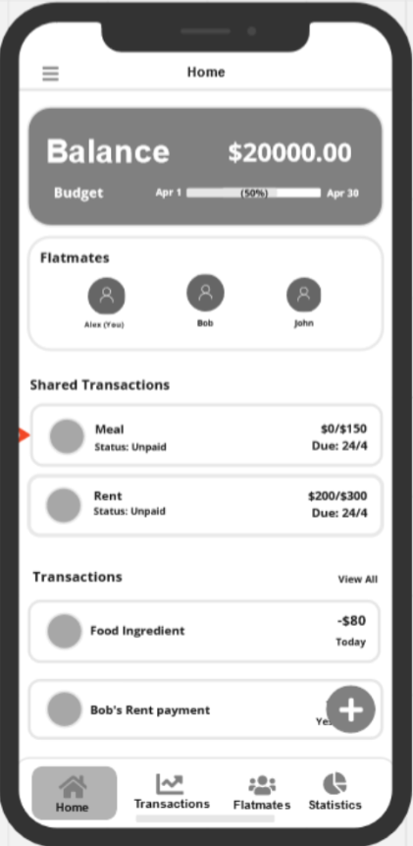

Slide 7
Task 2:
Settle a payment to flatmates
Persona:
Alex Singh

Slide 8
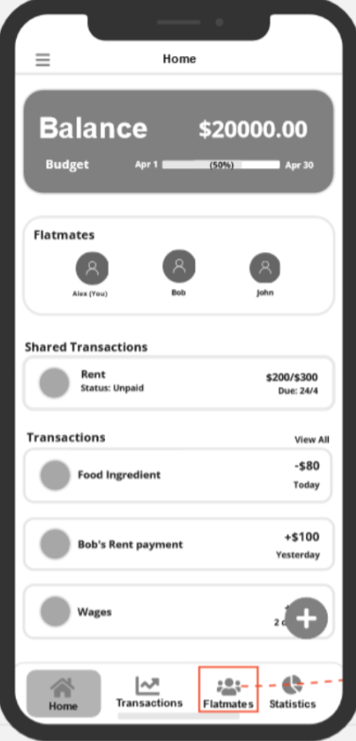


Slide 9
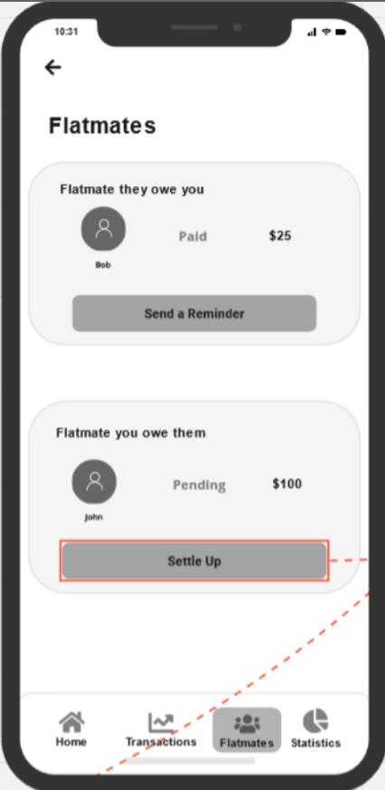







Slide 10
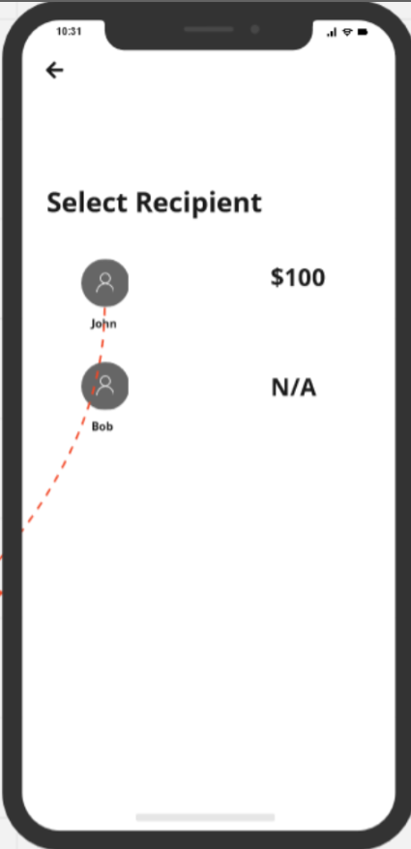


Slide 11
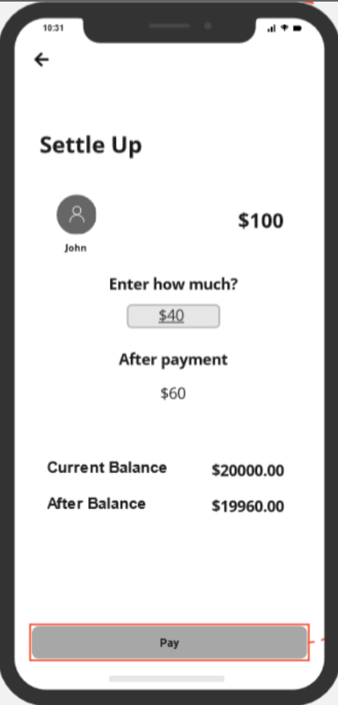




Slide 12
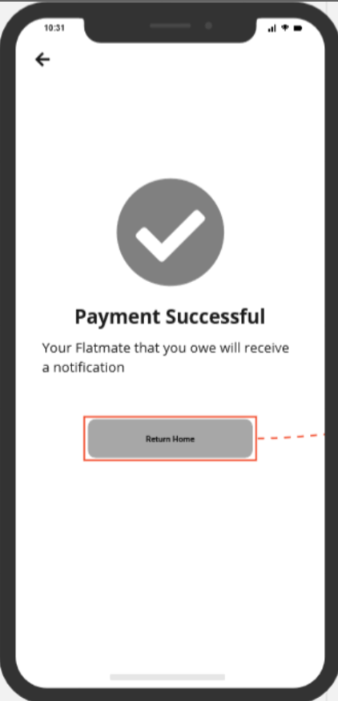



Slide 13
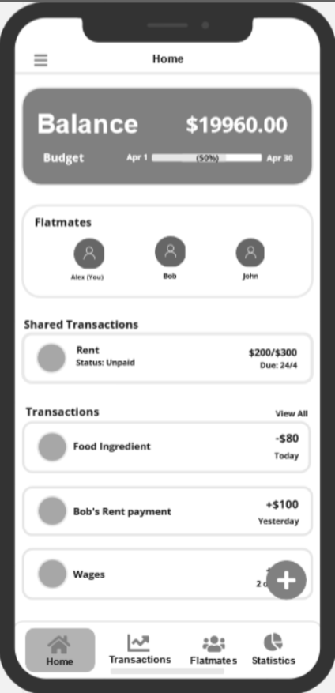

Slide 14
Task 3:
View a Breakdown of Expense in maximum detail
Persona:
Abby Jones

Slide 15
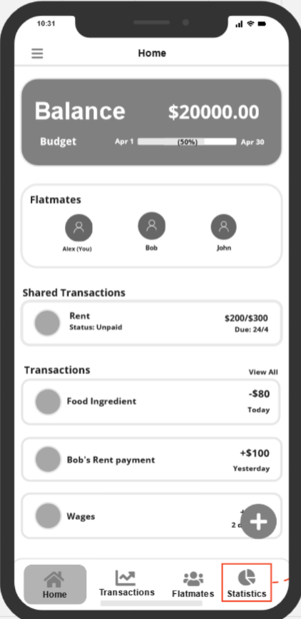


Slide 16
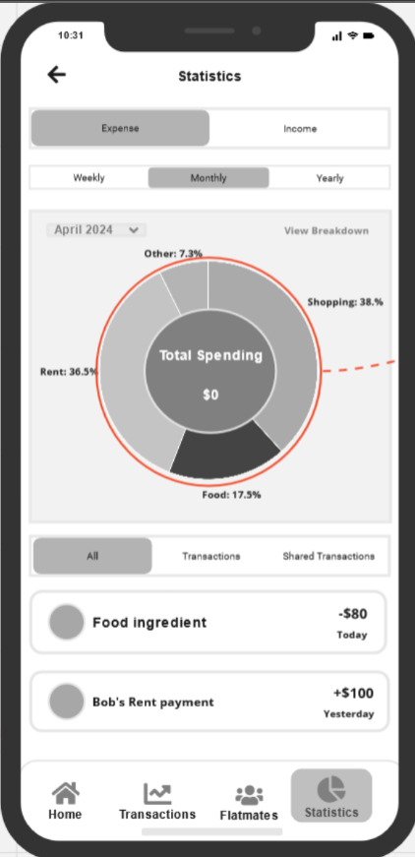







Slide 17
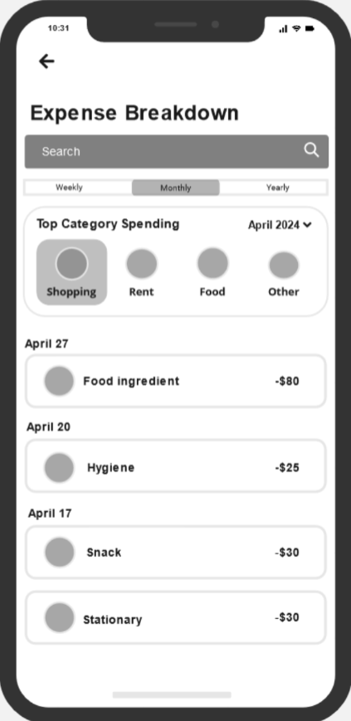

Slide 18
Thank you for taking part in this Cognitive Walkthrough Experience….

