Slide 1
Cognitive Presentation (Mazen)
Persona for all: Alex Singh

Slide 2
User Task: Creating a new expense entry for today’s Exotic Butters he bought Persona: Alex Singh

Slide 3
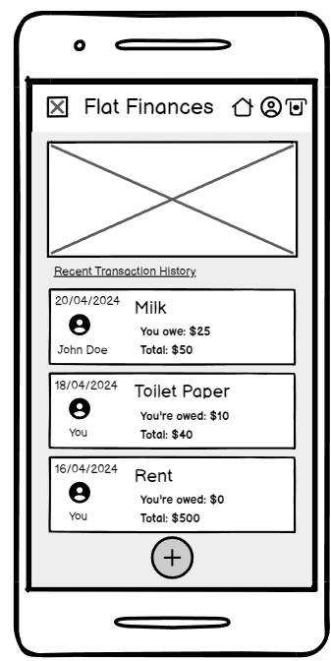
Subtask: Add a new expense Persona: Alex Singh

Slide 4
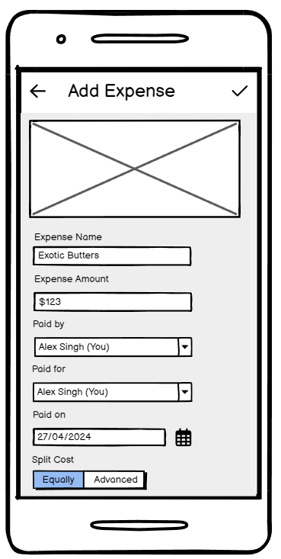
Subtask: Fill out details and confirm expense Persona: Alex Singh

Slide 5
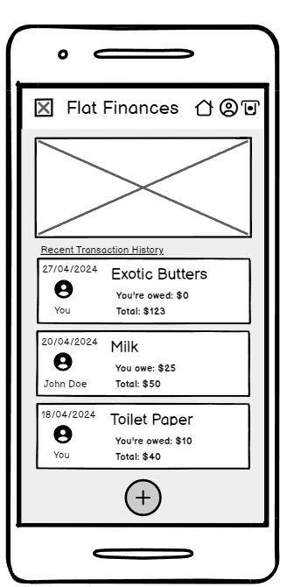
Subtask: Confirm existence of new expense Persona: Alex Singh

Slide 6
User Task: Viewing the history of all expenses for last month (March 2024) Persona: Bob Dylan

Slide 7
Subtask: View expense history Persona: Bob Dylan

Slide 8
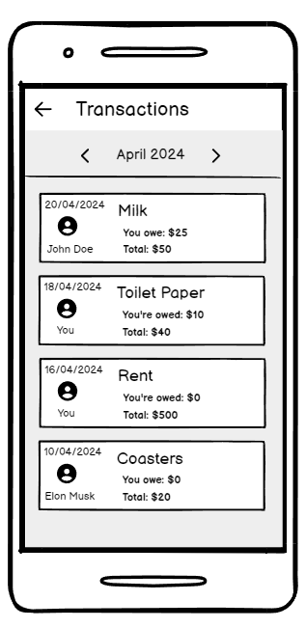
Subtask: Switch to March expense history Persona: Bob Dylan

Slide 9
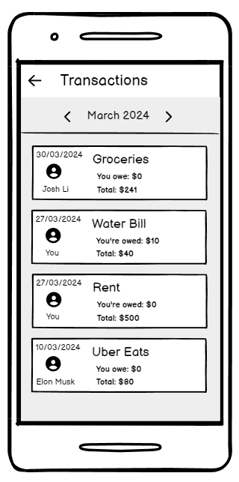
Subtask: Confirm existence of March expense history Persona: Bob Dylan

Slide 10
User Task: Adding a new flatmate to the app by giving them a unique join link Persona: Abby Jones

Slide 11
Subtask: Go to flat settings Persona: Abby Jones

Slide 12
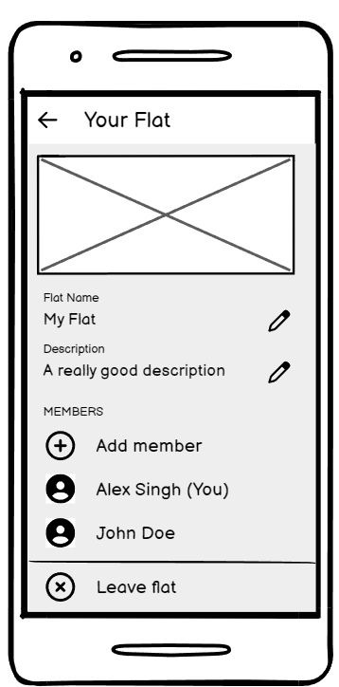
Subtask: Add member Persona: Abby Jones

Slide 13
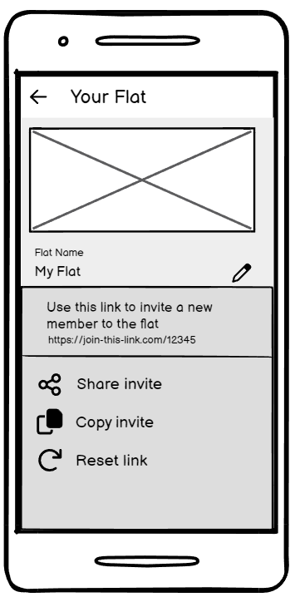
Subtask: Choose an option to add the member Persona: Abby Jones

Slide 14
Subtask: Do nothing, you’re done Persona: Abby Jones

