Slide 1
Task One: Switch Flat and Check Expenses

Slide 2
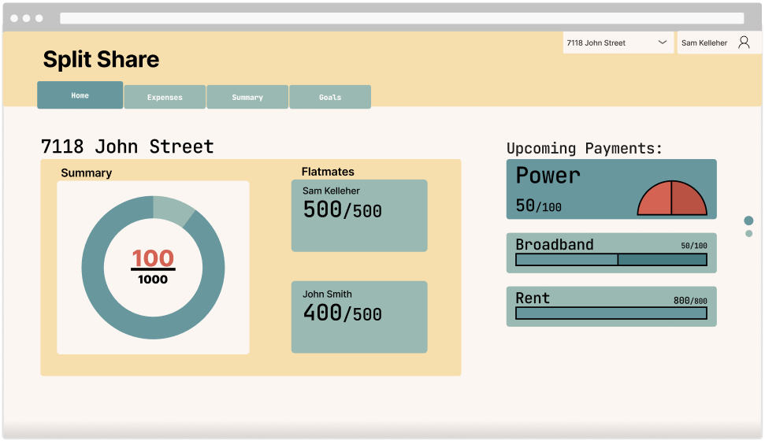
Frame 1.1

Slide 3
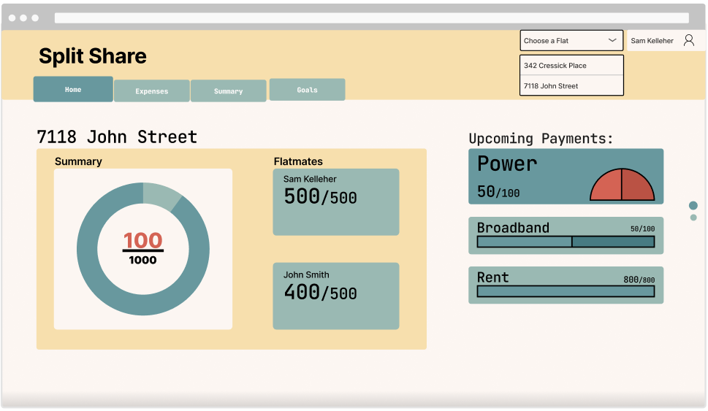
Frame 1.2

Slide 4
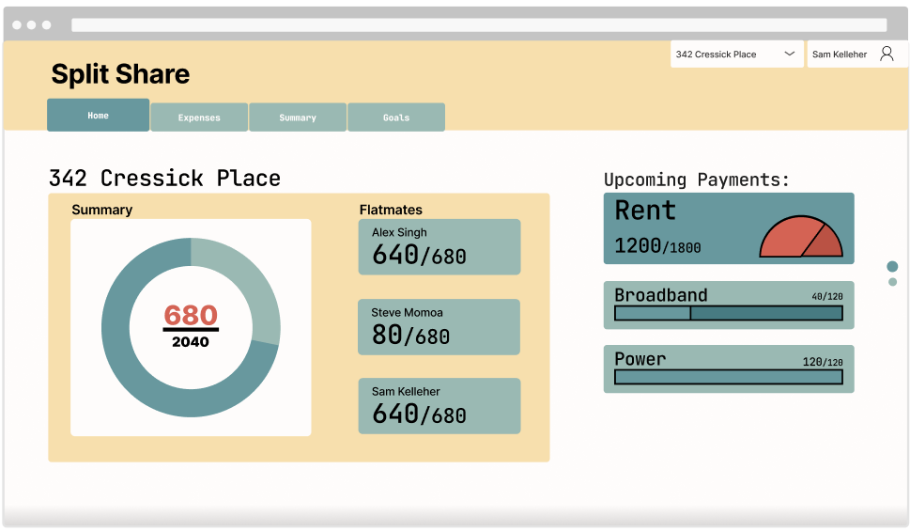
Frame 1.3

Slide 5
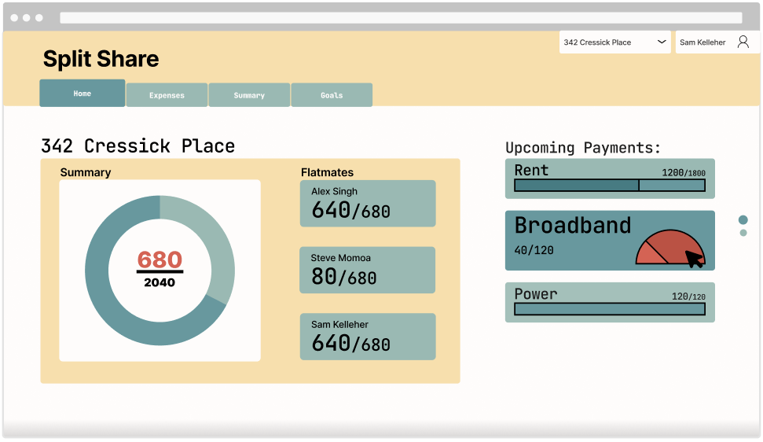
Frame 1.4

Slide 6
Task Two: Adding and Expense

Slide 7
Frame 1.3

Slide 8
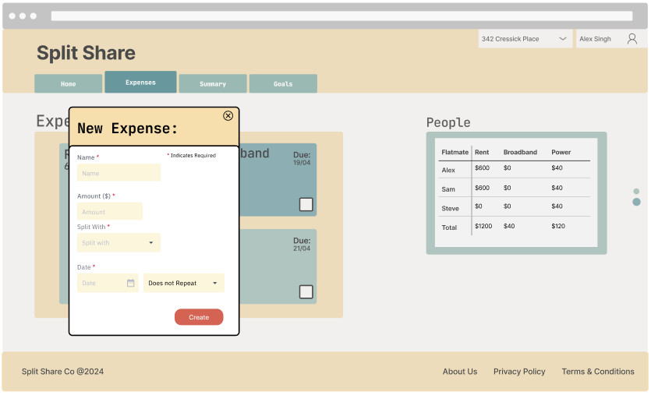
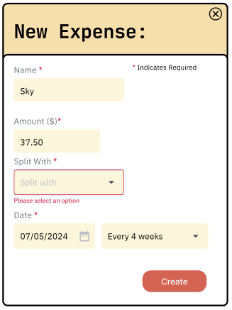
Frame 2.2.1 & 2.2.2

Slide 9
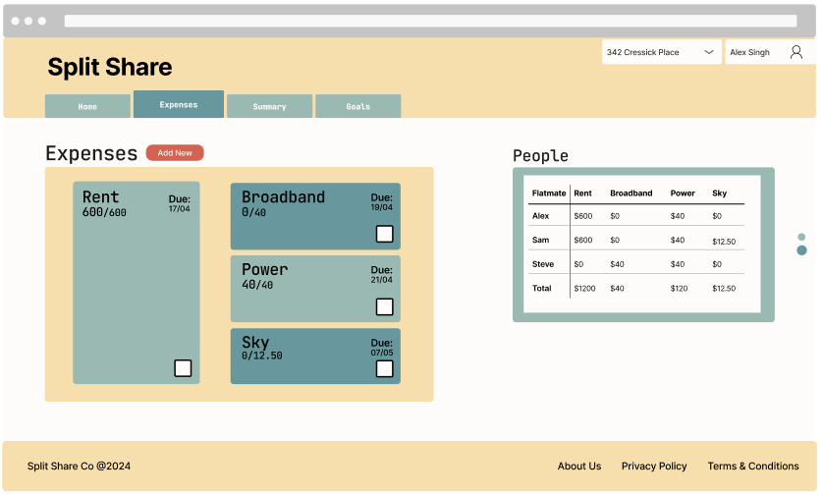
Frame 2.3

Slide 10
Task Three: Notify Flatmate of Expense

Slide 11
Frame 2.1

Slide 12
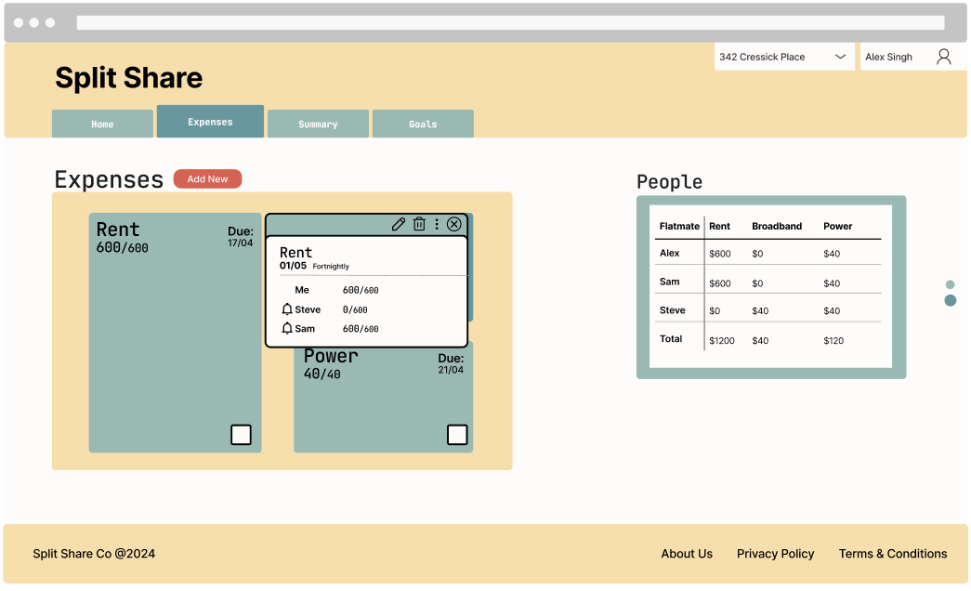
Frame 3.1

Slide 13
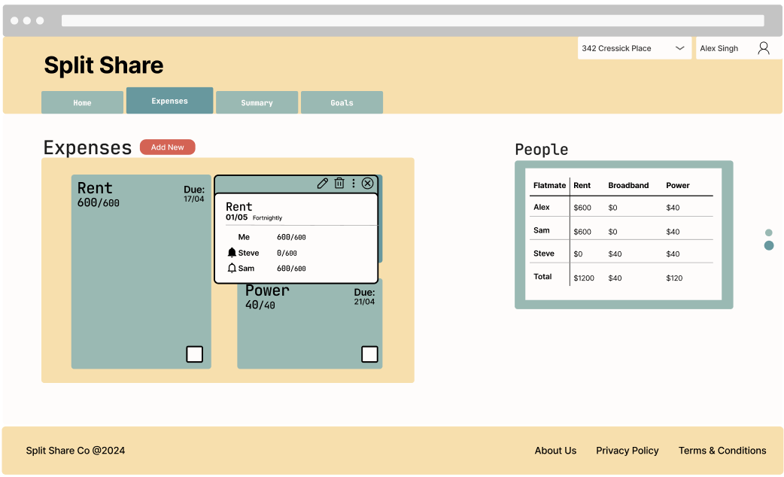
Frame 3.2

