Slide 1
User Task 1: Add a
new payment detail
within a group and
make the payment
Persona: Alex Singh

Slide 2
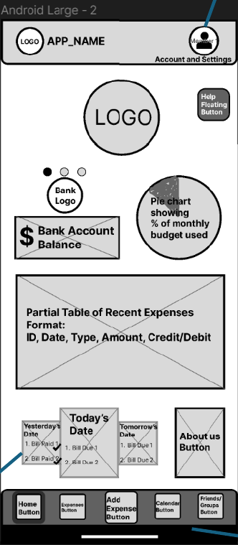

Slide 3
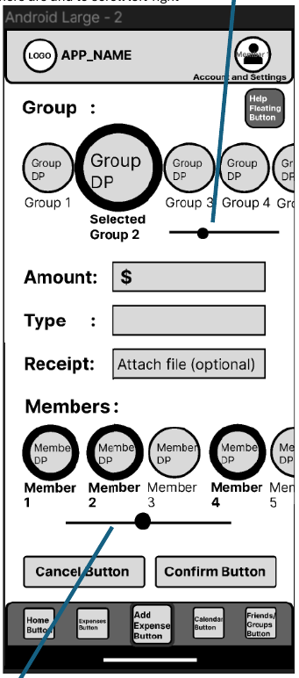

Slide 4
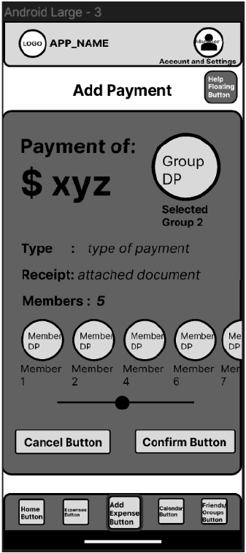

Slide 5
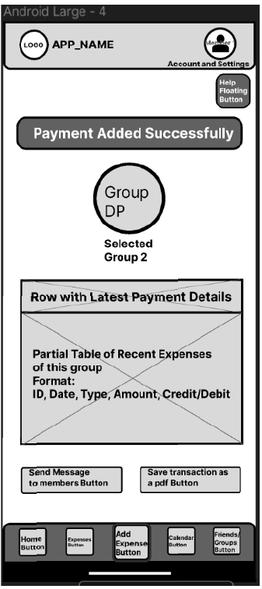

Slide 6
User Task 2: Inform Alex that he made a wrong payment
Personas: Abby Jones

Slide 7
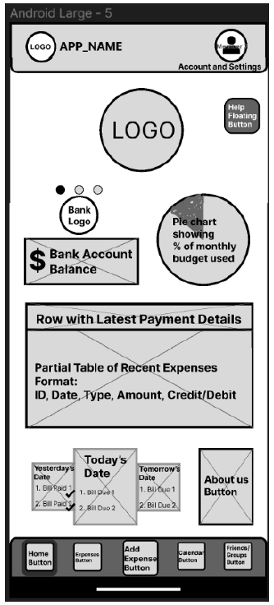

Slide 8
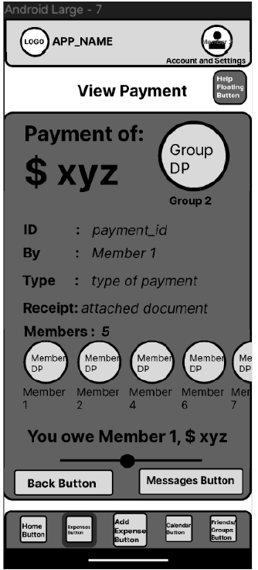

Slide 9
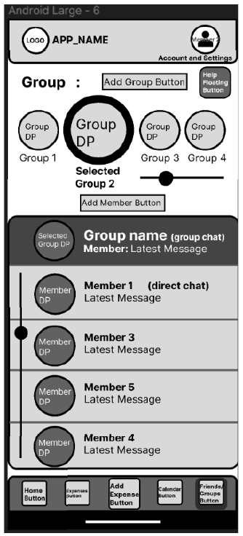

Slide 10
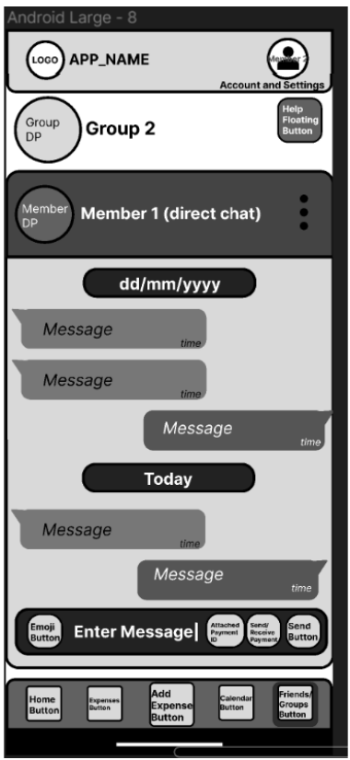

Slide 11
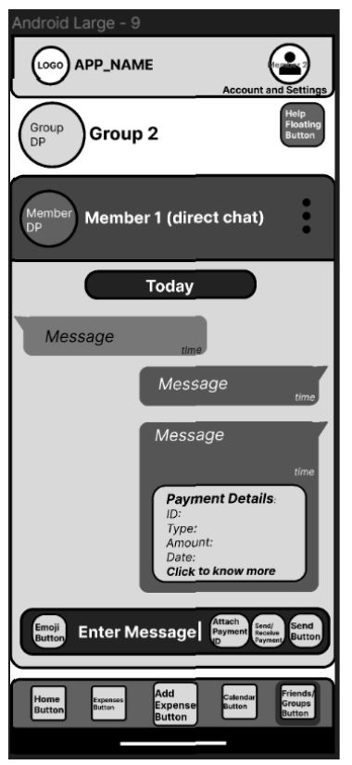

Slide 12
User Task 3: Remind a group of tenants to pay an overdue bill and add a late penalty to it.
Persona: Debby Smith

Slide 13
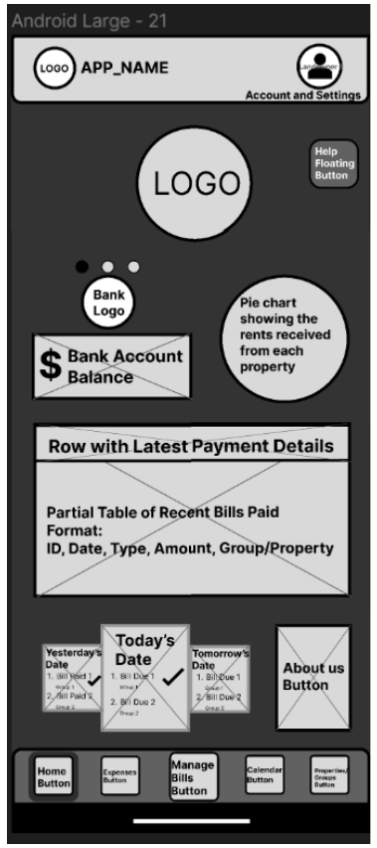

Slide 14
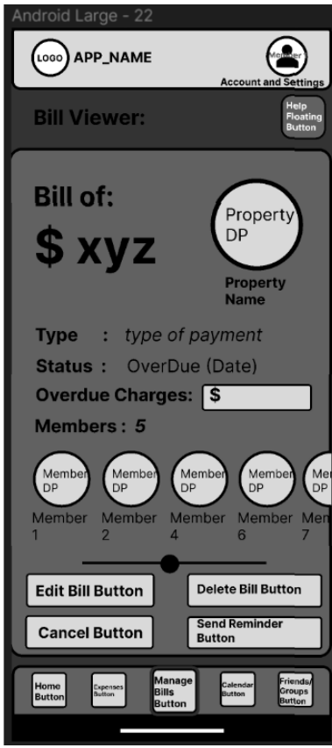

Slide 15
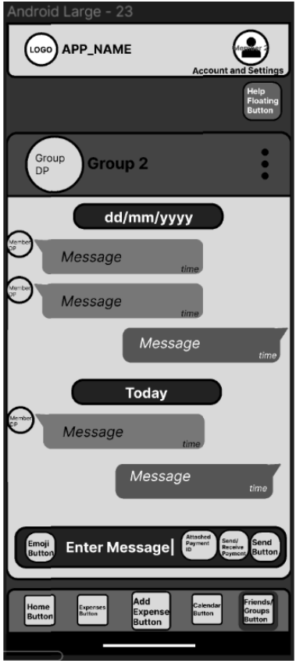

Slide 16
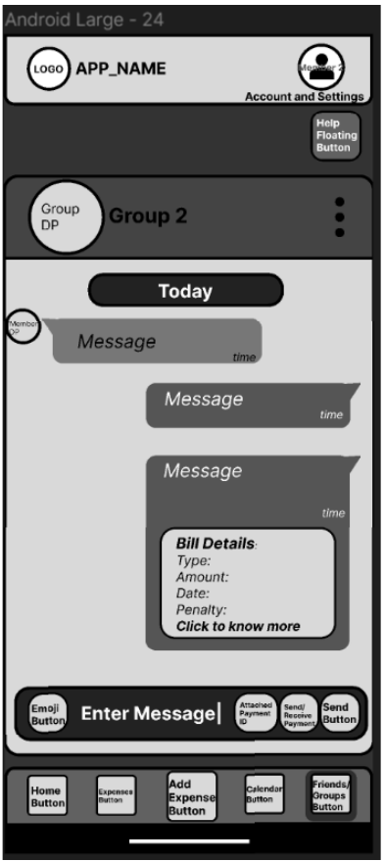

Slide 17
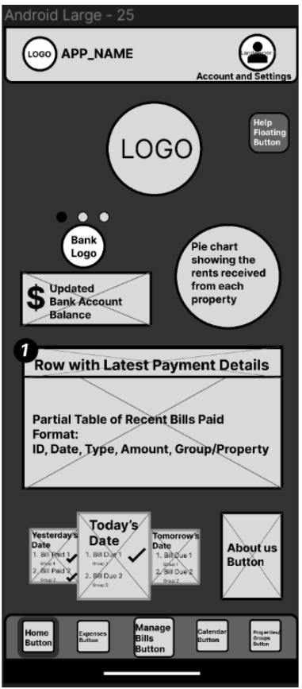

Slide 18
Special User Task: Understand how a
particular feature in the
app works (get help) to
finish a task OR to gain
extra knowledge on
Budgeting by watching a video
Persona: John Bake

Slide 19
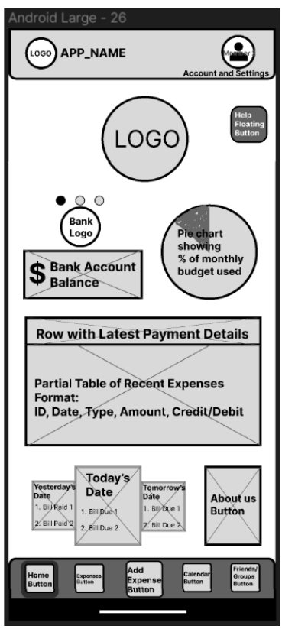

Slide 20
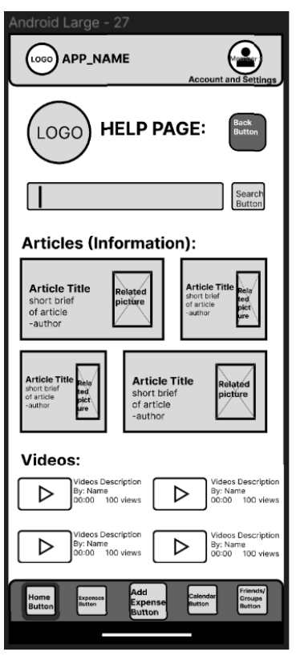

Slide 21
