Slide 1
Task 1:
Add a Split Payment
Persona:
Trevor Smith - a non-tech savvy roommate in their 30s. Takes their time looking at finer details but may not understand them at first glance.

Slide 2
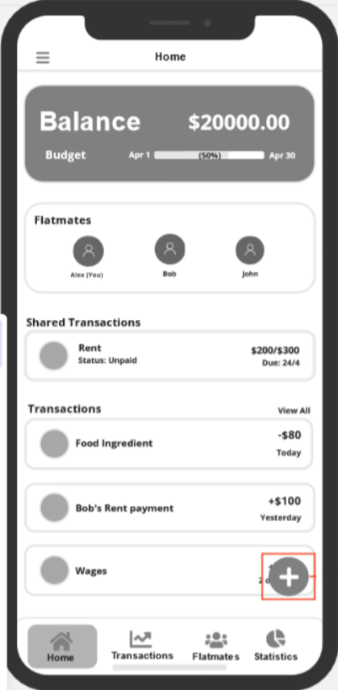



Slide 3
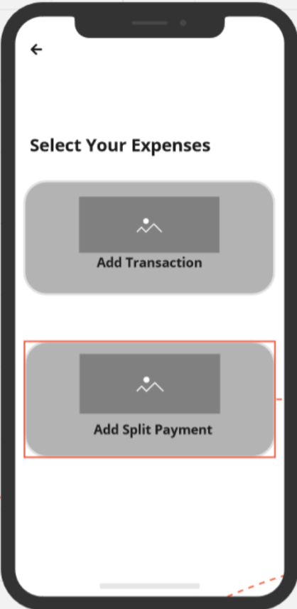




Slide 4
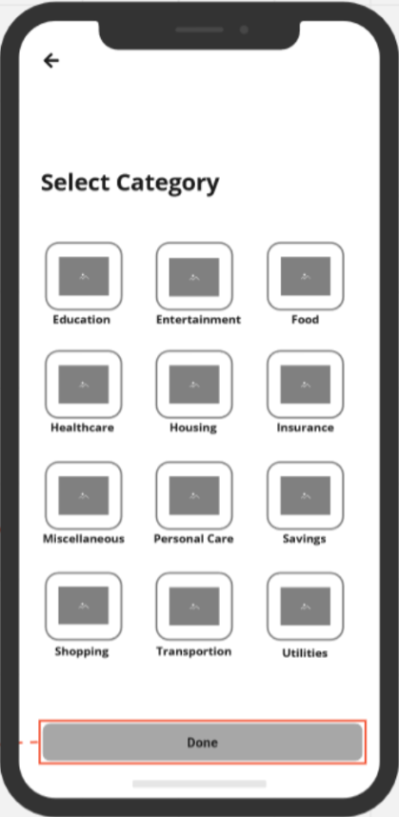

Slide 5
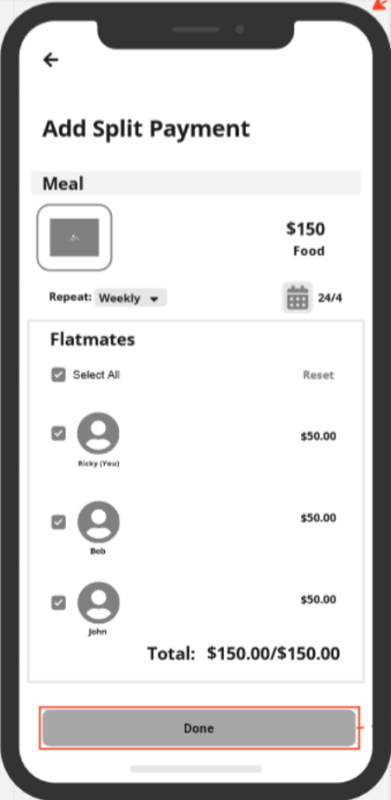

Slide 6
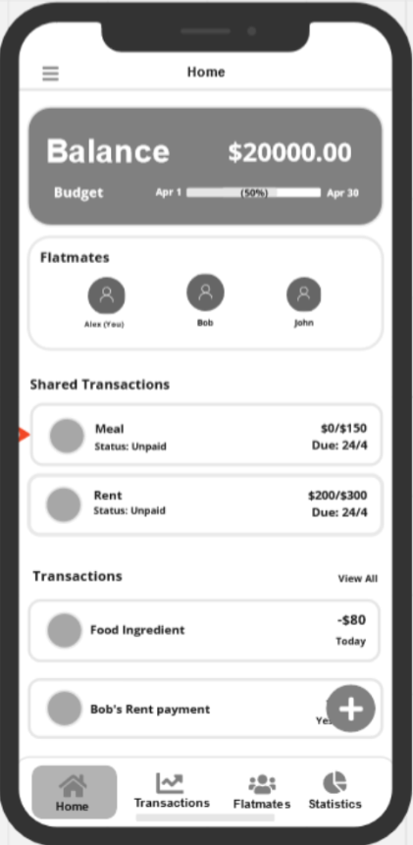

Slide 7
Task 2:
Settle a payment to flatmates
Persona:
Alex Singh, who is a software engineer in his 20s, but is very busy with many events and their job

Slide 8
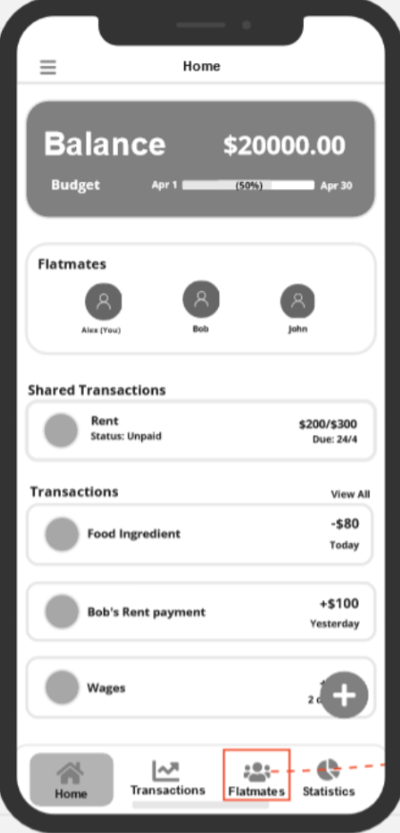


Slide 9
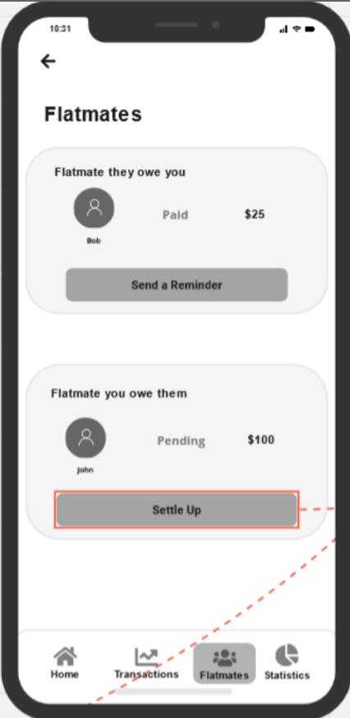







Slide 10
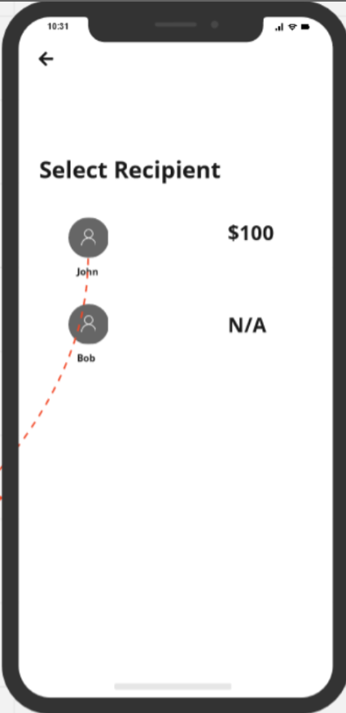


Slide 11
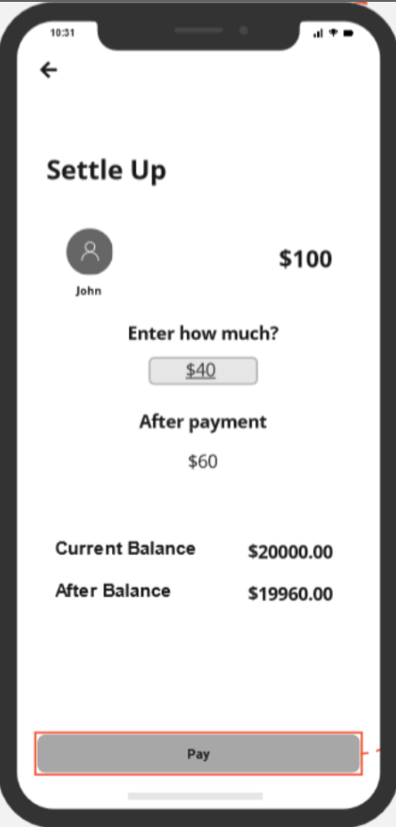




Slide 12
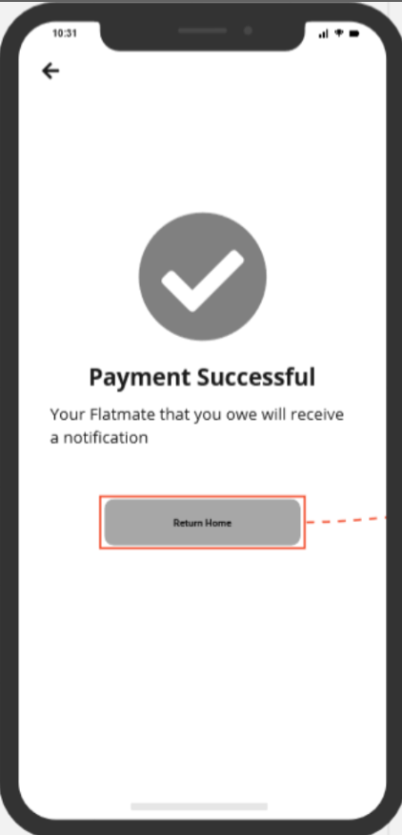



Slide 13
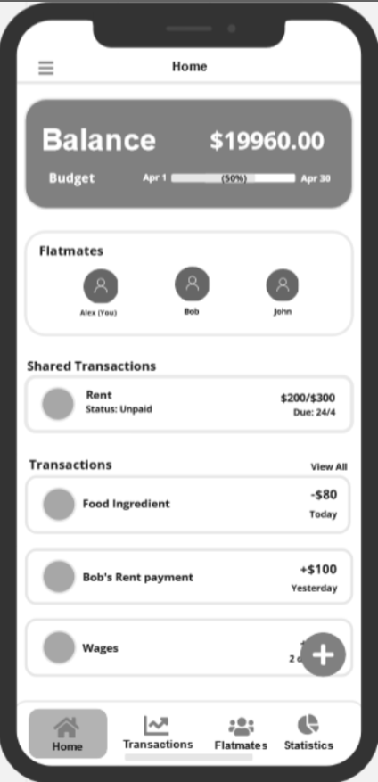

Slide 14
Task 3:
View a Breakdown of Expense in maximum detail
Persona:
Toby Baker, a roommate in their 20s with long-sighted vision. They cannot see tiny text on the phone up close.

Slide 15
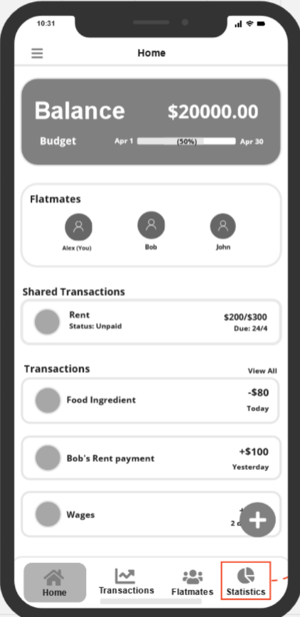


Slide 16
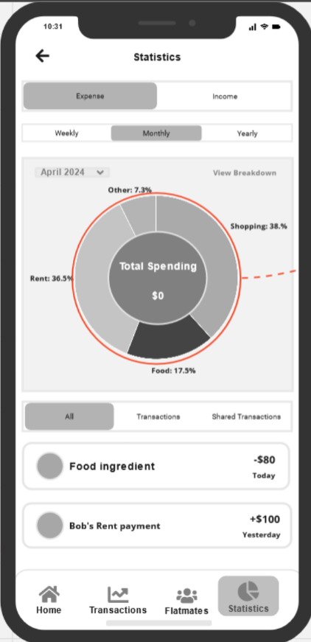







Slide 17
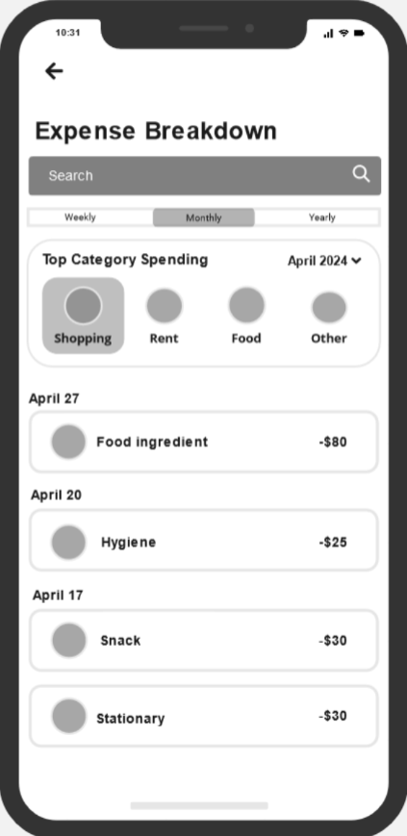

Slide 18
Thank you for taking part in this Cognitive Walkthrough Experience….

