Slide 1
Critical Design Review
Team: Flux Capacitors
Calvin Nelson
Ryan Kachline

Slide 2
Programmable Timing Delay box
Our project is a ignition timing delay box designed for cars with variable reluctor ignition triggering systems.
We have chosen to accomplish the task with an Atmel ATMEGA328P micro controller.
What makes our solution better than industry products is:
It is modular – It will work on an engine of any number of cylinders up to 8, as long as it has a variable reluctor trigger.
It is programmable – Most solutions only provide a static delay, with an enable line. Our solution provides any delay requested and allows timing changes in response to analog or digital sensors.

Slide 3
Specifications
The device will:
Apply an ignition delay with a minimum step value of 0.5 degrees for a maximum operating speed of 6000 revolutions per minute for up to an 8 cylinder 4 stroke engine.
The device will have a maximum timing delay of 30 degrees.
Use an Arduino Uno, and involve the design and implementation of a printed circuit board.
Be able to function in an automobile using automobile power supply (car battery).

Slide 4
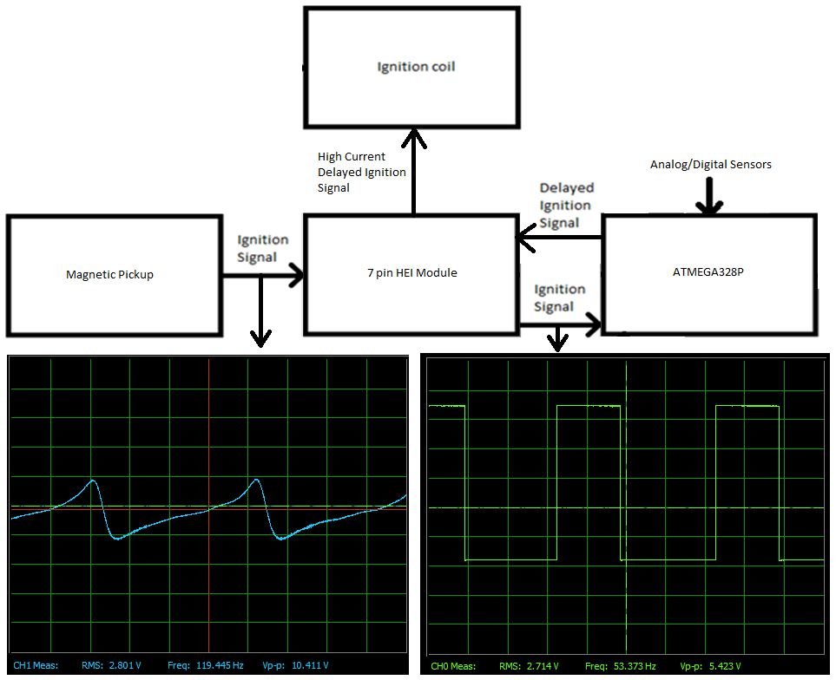
Block Diagram

Slide 5
Code Algorithm

Slide 6
Code Algorithm – Straddling

Slide 7
Code Algorithm – Not Straddling

Slide 8
Design Details – Code working
f = 30 Hz, Delay = 10 degrees

Slide 9
Design Details – PCB

Slide 10
Tasks to be completed
Build PCB
Test
Make case
Tradeoffs
The Arduino has a tiny amount of jitter in the timing delay. The jitter amounts to a maximum of 6.2 microseconds. We have chosen to ignore this, because the worst case error is 0.223 degrees. If we wanted to have more accuracy we could use an FPGA.

Slide 11
Statement of Work
Calvin Nelson
Coding
Testing
Ryan Kachline
PCB Design
We chose to divide it up like so, because Calvin has more familiarity with the function of the ignition system.

Slide 12
Summary
We are designing an automotive programmable ignition timing delay box.
We are progressing smoothly, and we are on track to completing on time.

Slide 13
Questions?

