Slide 1
Critical Design Review
Team: Flux Capacitors
Calvin Nelson
Ryan Kachline

Slide 2
Programmable Timing Delay box
Our project is a ignition timing delay box designed for cars with variable reluctor ignition triggering systems.
We have chosen to accomplish the task with an Atmel ATMEGA328P micro controller.
What makes our solution better than industry products is:
It is modular – It will work on an engine of any number of cylinders up to 8, as long as it has a variable reluctor trigger.
It is programmable – Most solutions only provide a static delay, with an enable line. Our solution provides any delay requested and allows timing changes in response to analog or digital sensors.

Slide 3
Specifications
The device will:
Apply an ignition delay with a minimum step value of 0.5 degrees for a maximum operating speed of 6000 revolutions per minute for up to an 8 cylinder 4 stroke engine.
The device will have a maximum timing delay of 30 degrees.
Use an Arduino Uno, and involve the design and implementation of a printed circuit board.
Be able to function in an automobile using automobile power supply (car battery).

Slide 4
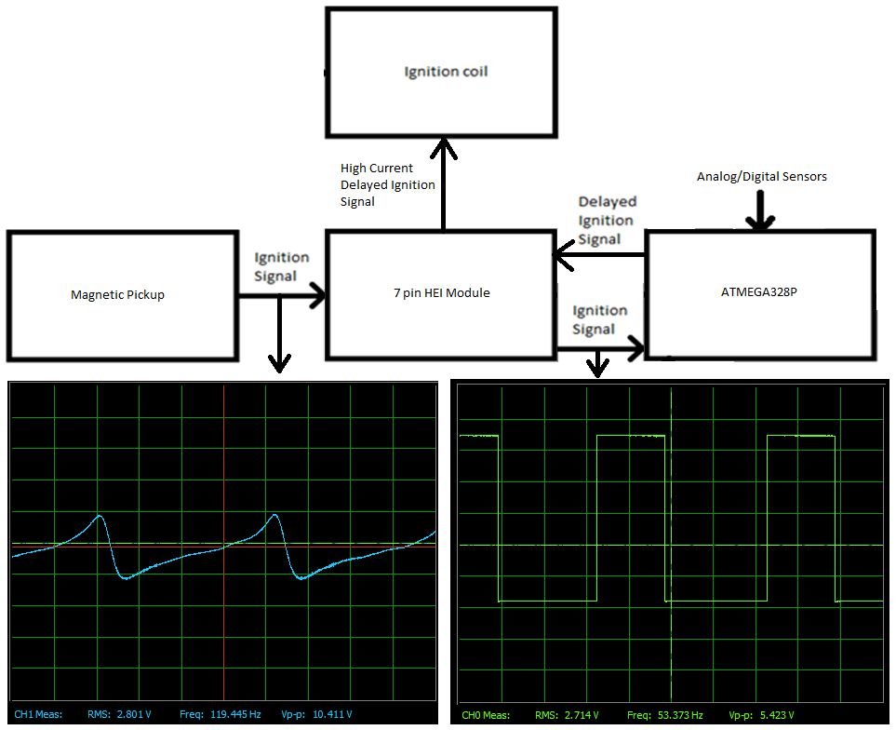
Block Diagram

Slide 5
Code Algorithm
1. Check manifold pressure
2. Get RPM
Lookup Requested Delay
Wait for negative edge on ignition signal line.

Slide 6
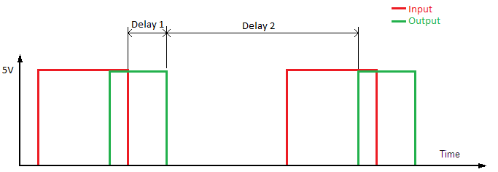
Code Algorithm – Straddling
In order to charge the coil and discharge at the proper time, the code must predict when the coil needs to begin charging for the next cycle before it has any information on when the next cycle is beginning. Engine speed changes slowly in relation to RPM, so this yields very accurate results.
Continuing the Algorithm
Calculate each of the delays
Execute the first delay
Bring output low
Execute second delay
Bring output high
Repeat

Slide 7
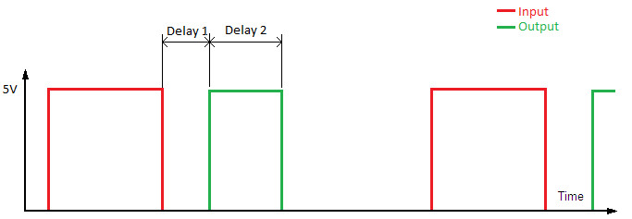
Code Algorithm – Not Straddling
In this branch, the code has all of the information, therefore
Delay 1 = Ignition Delay – Coil Charge Time
Delay 2 = Coil Charge Time
Continuing the algorithm
Calculate each of the delays
Execute the first delay
Bring output high
Execute second delay
Bring output low
Repeat

Slide 8
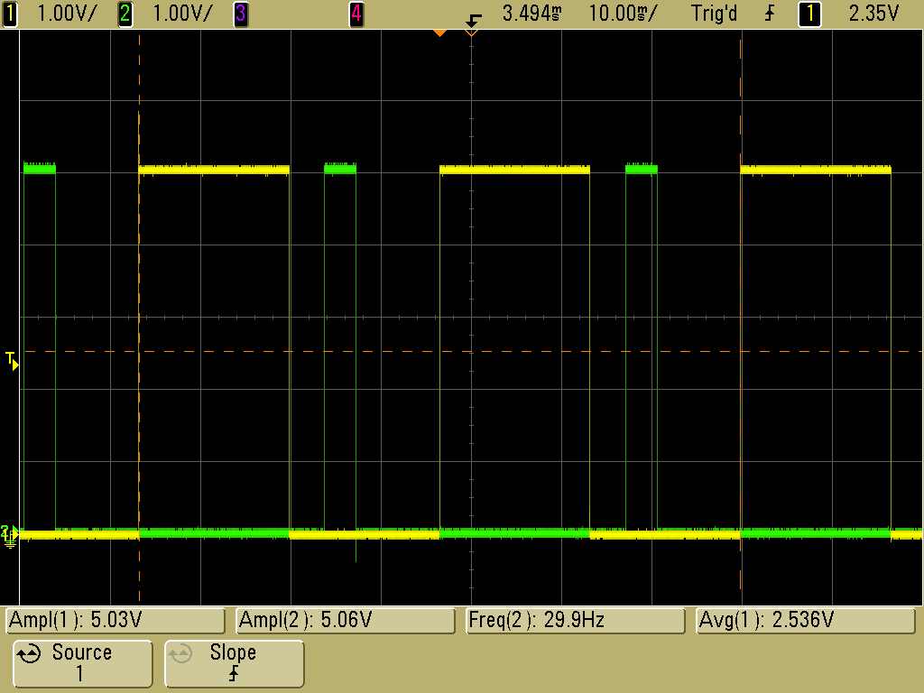
Design Details – Code working
f = 30 Hz, Delay = 10 degrees

Slide 9
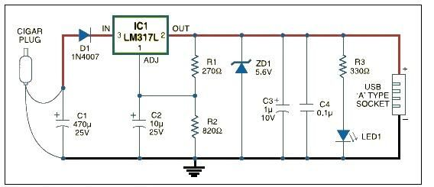
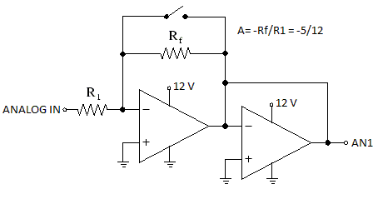
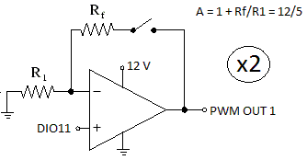
Design Details – PCB

Slide 10
Tasks to be completed
Finish PCB layout in ultiboard
Build PCB
Test
Make case
Tradeoffs
The Arduino has a tiny amount of jitter in the timing delay. The jitter amounts to a maximum of 6.2 microseconds. We have chosen to ignore this, because the worst case error is 0.223 degrees. If we wanted to have more accuracy we could use an FPGA.

Slide 11
Statement of Work
Calvin Nelson
Coding
Testing
Ryan Kachline
PCB Design
We chose to divide it up like so, because Calvin has more familiarity with the function of the ignition system.
Schedule
We plan to have the device tested and working over spring break.
Once we have verified functionality, we will begin integrating the manifold pressure, and other analog/digital sensors.
We will then begin case design.

Slide 12
Summary
We are designing an automotive programmable ignition timing delay box.
We are progressing smoothly, and we are on track to completing on time.

Slide 13
Questions?

