Slide 1
Design Plan Flux Capacitors
Ryan Kachline, Calvin Nelson

Slide 2
1. Problem Statement
On an older car lacking an electronically triggered ignition, all of the ignition timing alterations are done mechanically. We would like to invent a device that would allow the ignition timing to be further modified in response to up to 6 analog electrical sensors. An electronically controlled system would be better, because it would allow reference to more systems to base ignition timing changes on.
This is useful, in cases when you install power adders, such as a supercharger(s), turbocharger(s), and/or nitrous oxide to a car. In these cases, the thermal expansion rate of the combustion charge is increased. At low RPM when the engine does not feel the effects of a power adder, you want the ignition timing to act like a stock car. Alternatively, at higher RPM and/or when the power adder becomes active, you want the ignition timing to take into account this increased rate of thermal expansion.
One of the most useful applications for this is the implementation of knock sensors. Knock is when the ignition timing happens early enough that the maximum force applied by the combustion charge happens before the piston reaches the top of its compression stroke. This can be extremely harmful to an engine, and prevention of it is paramount. Factoring this into timing alterations can prevent catastrophic failure. Obviously, this is valuable.

Slide 3
2. Proposed Solution
This device is meant to be installed in series with the conventional mechanically triggered ignition system. The device will use the mechanical trigger, and information from analog sensors to alter the phase. Once installed the user will be able to configure up to 6 analog sensors to alter the timing as they choose.
The device will:
Apply an ignition delay with a minimum step value of 0.5 degrees for a maximum operating speed of 6000 revolutions per minute.
The device will have a maximum timing retard of 30 degrees.
Use an Arduino Uno, and involve the design and implementation of a printed circuit board.
Be able to function in an automobile using automobile power supply (car battery).

Slide 4
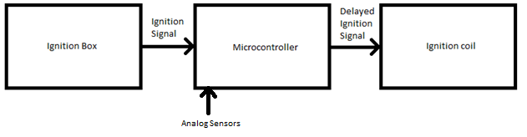
3a. Design Approach
The device will follow the following algorithm:
1. Check push button state
2. Perform calculation for requested delay.
3. Wait for ignition event.
4. Delay for requested number of degrees.
5. Send ignition signal.
6. Repeat.

Slide 5
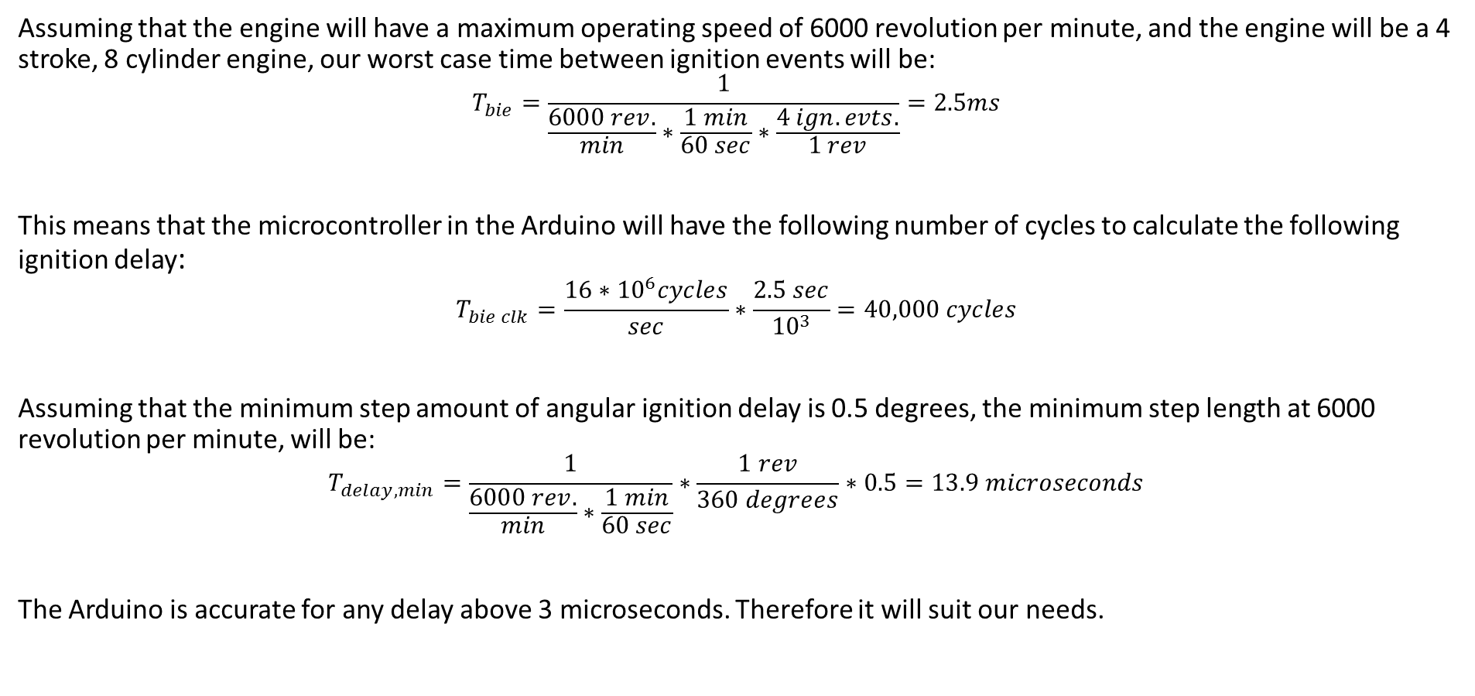
3b. Technical Details
Assuming that the engine will have a maximum operating speed of 6000 revolution per minute, and the engine will be a 4 stroke, 8 cylinder engine, our worst case time between ignition events will be:
$$T_{bie}=\frac{1}{\frac{6000 rev.}{min}∗\frac{1 min}{60 sec}∗\frac{4 ign. evts.}{1 rev}}=2.5ms$$
This means that the microcontroller in the Arduino will have the following number of cycles to calculate the following ignition delay:
$$T_{bie clk}=\frac{16∗{10}^{6}cycles}{sec}∗\frac{2.5 sec}{{10}^{3}}=40,000 cycles$$
Assuming that the minimum step amount of angular ignition delay is 0.5 degrees, the minimum step length at 6000 revolution per minute, will be:
$$T_{delay, min}=\frac{1}{\frac{6000 rev.}{min}∗\frac{1 min}{60 sec}}∗\frac{1 rev}{360 degrees}∗0.5=13.9 microseconds$$
The Arduino is accurate for any delay above 3 microseconds. Therefore it will suit our needs.

Slide 6
3b. Technical Details (cont.)
In our first design, we will have a push button which will trigger a static ignition delay. As we add stretch goals, the number of signals being processed increases. This could be an issue, because we will quickly reach the extent of the Arduino Uno.
Another issue that could arise is the cleanliness of the ignition signal. To remedy this, we will attempt to design a filter that will be implemented on the PCB. This inherently will add delay. This can be fixed by factoring this delay into the ignition timing delay equation.

Slide 7
3c. Manpower
Calvin Nelson – Gathering data from vehicle, testing, writing/editing reports
Ryan Kachline – PCB/power filter Design, writing/editing reports
Shared Responsibilities – Design, Troubleshooting, Assembly, Packaging Design

Slide 8
3d. Schedule
EE 403W Flux Capacitors, Ignition Timing Delay Box (ITDB) Spring 2016 Schedule
Week | Monday Lab 2:30PM- 4:25PM 301 EEW | Wednesday Lab 2:30PM- 4:25PM 301 EEW | Notes
2/1/2016 | Acquire Microcontroller, Probe Ignition signal on Car
2/8/2016 | Design/Testing
2/15/2016 | Have Working Push button Delay
2/22/2016 | Design Power filter/PCB Design, Milestone Report
2/29/2016 | PCB Design/Gerber File
3/7/2016 | Spring Break | Spring Break | Spring Break

Slide 9
Schedule (cont.)
3/14/2016 | Assembly
3/21/2016 | Packaging Design
3/28/2016 | Stretch Goals
4/4/2016 | Stretch Goals, Milestone Report
4/11/2016 | Stretch Goals
4/18/2016 | Stretch Goals
4/25/2016 | Stretch Goals, Final Review

Slide 10
3e. Cost Estimate
Item | Unit Price | Quantity | Price
Engineering Hours | $ 160.00 | 70 | $ 11,200.00
Arduino Uno | $ 24.95 | 1 | $ 24.95
PCB | $ 60.00 | 1 | $ 60.00
PCB components | $ 20.00 | 1 | $ 20.00
Packaging | $ 10.00 | 1 | $ 10.00
 |  | total | $ 11,314.95

Slide 11
References – Calvin Nelson
Over 15 years of experience working on race cars.
Experience with: Microcontrollers, FPGAs, PCB fabrication
Experience with multitude of programming languages: C, C++, Java, G-code, P-Basic

Slide 12
References – Ryan Kachline
Experience building and troubleshooting circuits on breadboard.
Designed and built dc power supply
Proficiency in C++
Strong interest in DIY projects
R/C car hobbyist

