Slide 1
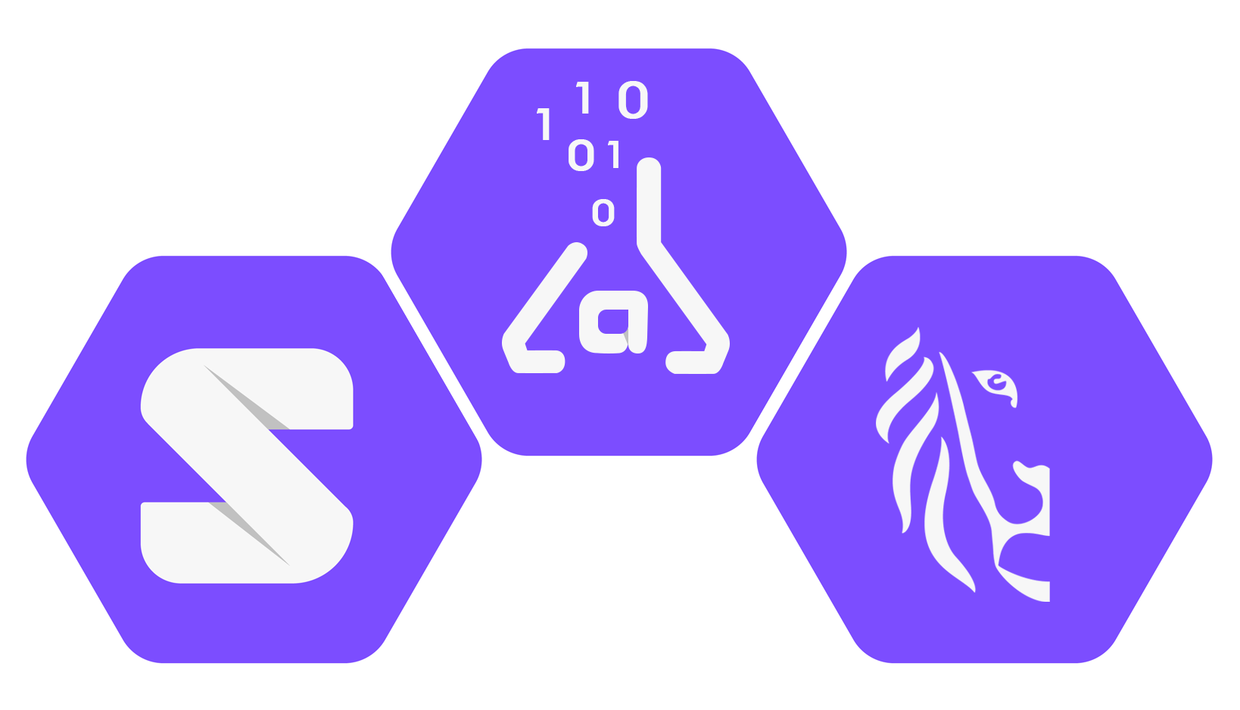
Solid `SDK`
Thomas Dupont
Concept & plans
Notes:
From the start of SolidLab, one of the work packages was marked as the SDK.
It has taken a while before we were able to start with this, because it was still vague as to what this package would entail.
This morning you have already heard about the ways in which we are planning to change the underlaying architecture of the CSS, because we want to prove that this is the way forward for the Solid spec.
Now that this route has been chosen, it is easier to define an SDK and what it could mean.
The first question that we needed to ask ourselves though, was what exactly we are trying to solve with this SDK?

Slide 2
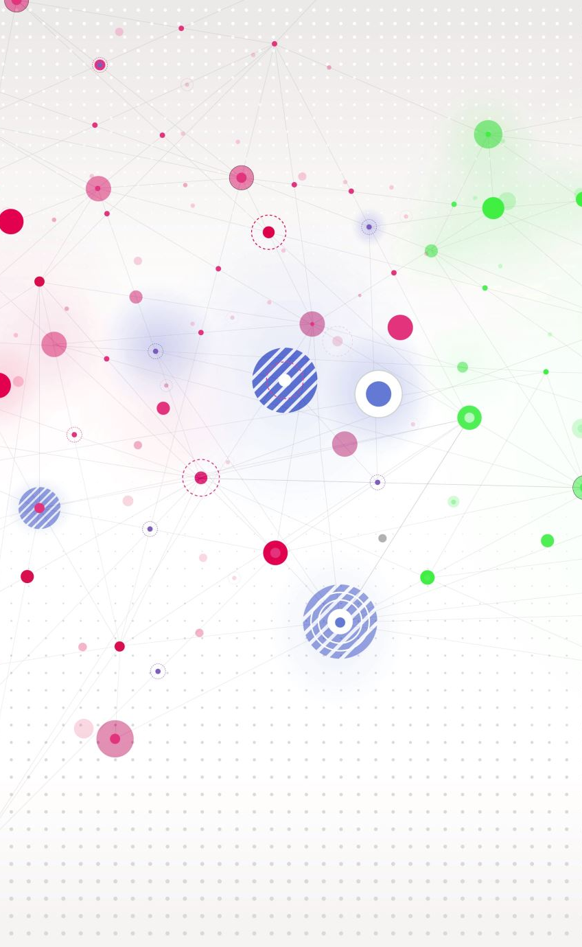

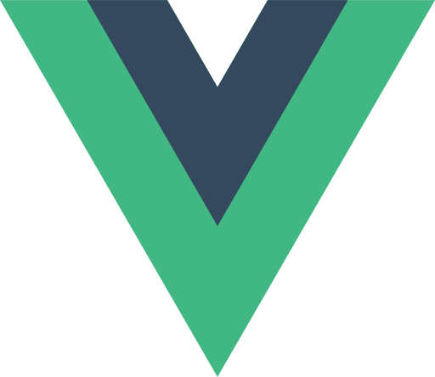


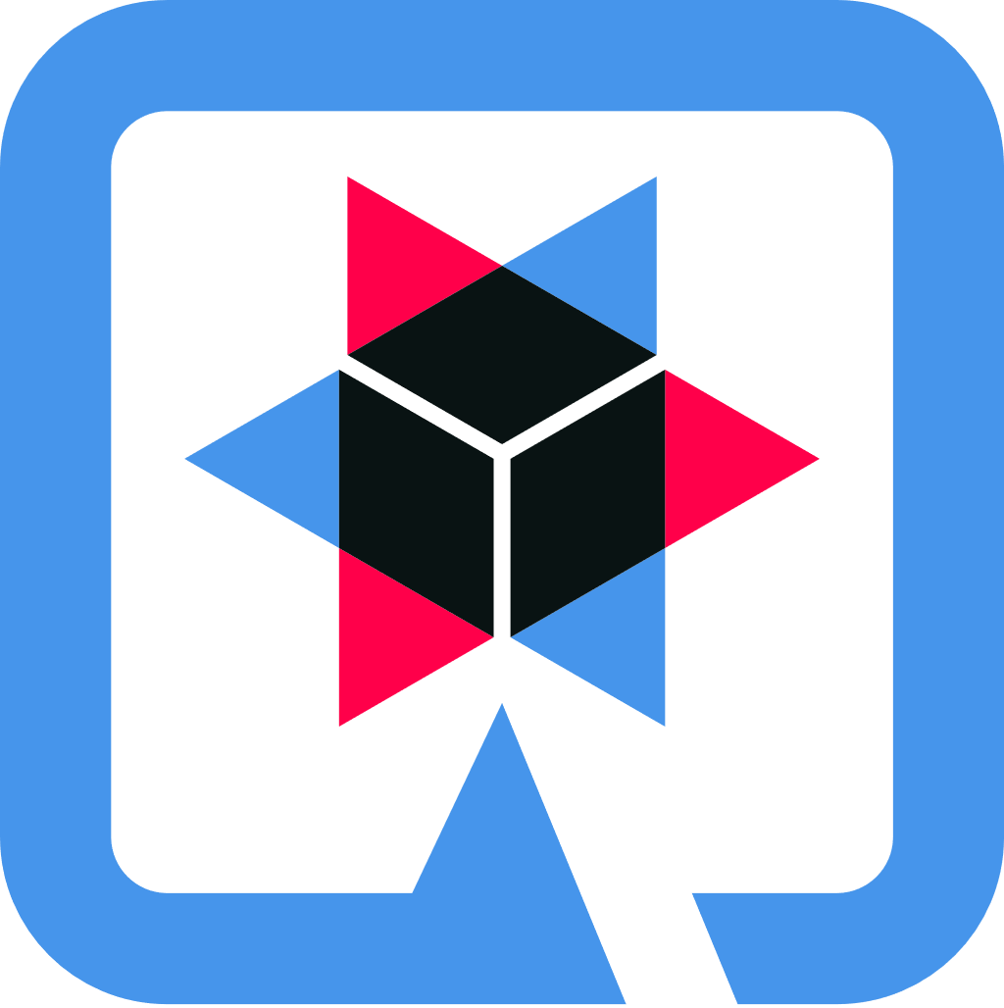
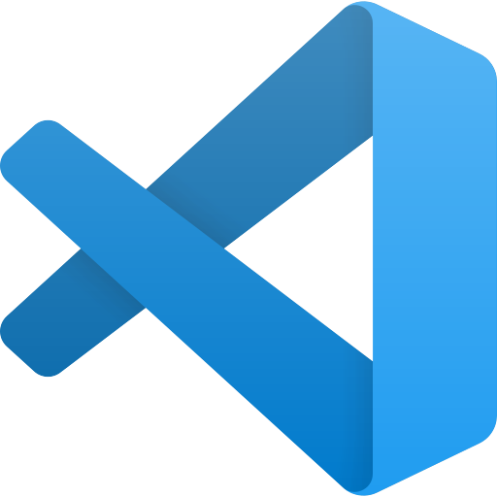
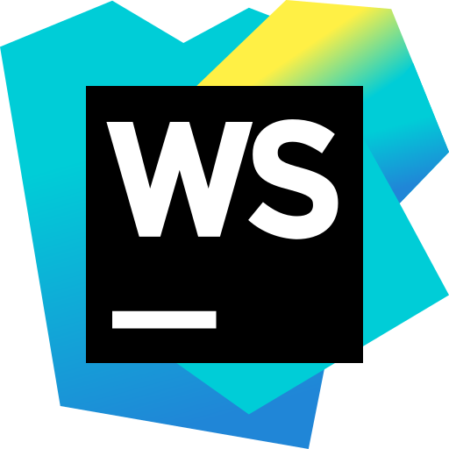
What are we trying to fix?
Linked data world ⬄ (solid) app developers
Make it enjoyable to develop solid applications
Don’t enforce, but offer abstractions
Pave the way towards a solid app eco-system
Notes:
So what are we trying to solve?
There have (apparently) been efforts to bridge the gap between the linked data world and app developer world before, however they have not been very successful.
These attempts were to simplify linked data interaction towards developer, but this has 2 problems: it conveys the message that ‘regular’ developer will not understand this complicated stuff and along with complexity you loose a lot of the power of linked data and linked data querying along the way.
So we are trying to attract more solid application developers with the SDK and we want to make sure we offer an enjoyable development experience.
Do this by tapping into the way other frameworks (successfully) embrace developers. [go over logos]
On top of that, we can offer abstractions over linked data, but try to do this by not dumbing down, and not enforcing it. If a developer knowns and wants access to the raw libraries and tools, they can.
With our design of this SDK, we should work towards a future vision for a solid application eco-system.

Slide 3
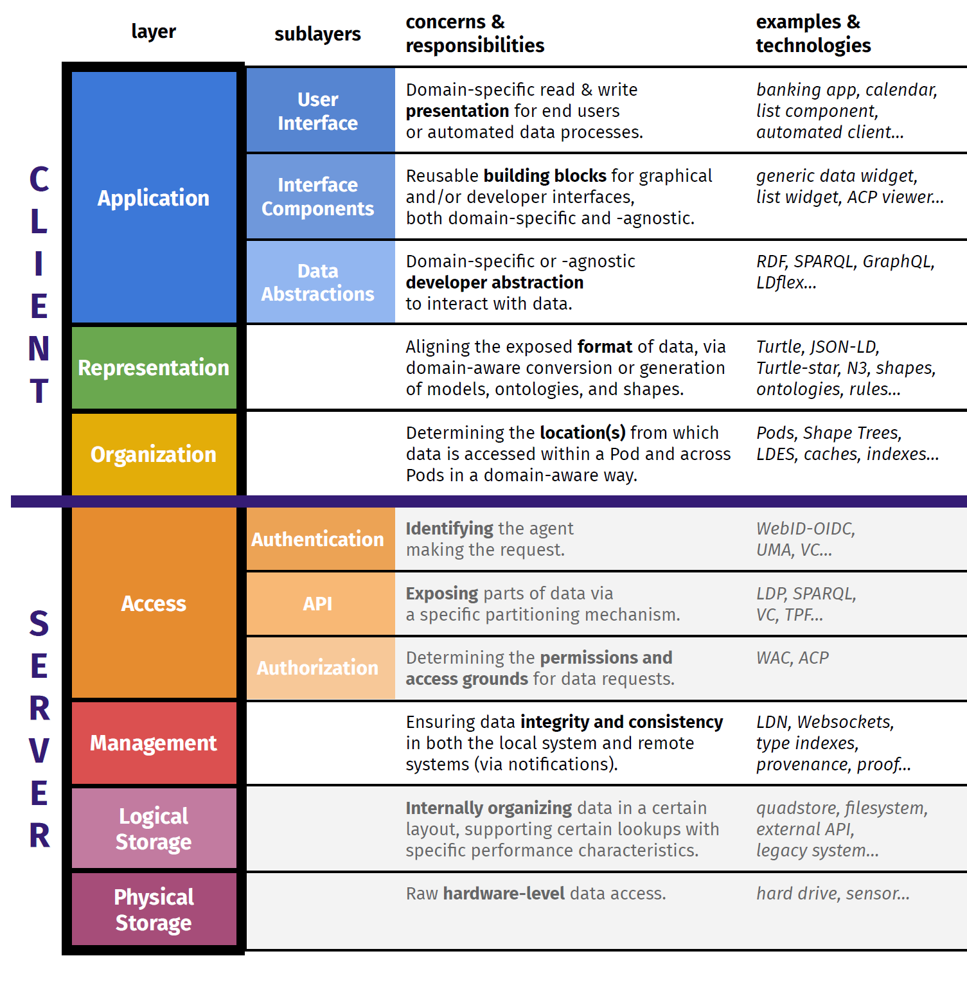
Situate
SDK
CSS
Notes:
Some of you might have seen this image before. It is a view on the solid stack, as a layered architecture, not unlike the original OSI stack.
I just wanted to show this, to situate the SDK in this stack.
The CSS (or Community Solid Server) takes up the part above the logical and physical storage, just below the boundary between client and server.
The SDK starts on that boundary and goes all the way up to the Application sublayer Data abstractions. It then includes the representation layer and the organization layer.
So this simply means that the SDK can take responsibility for what needs to be done on those layers.

Slide 4
Early concept
Bootstrap Solid application development
Tooling support for a Solid eco-system
Middleware shifts responsibility away from developer
Prepare for declarative data requests
Support existing and upcoming frameworks
Notes:
In the following slides we will try to share our early concept and ideas for the SDK.
Tooling to help bootstrapping solid application development
Tooling to support a Solid application development eco-system
Middleware layer that provides the abstractions of the linked data world
Be sure to prepare for a future with declarative solid applications
Try to leverage existing frameworks and their developer followers

Slide 5

1. Bootstrap Solid app development
Goal: enjoyable experience for solid development
Create a project bootstrapping tool
Automatically setup basic work directory structure
Creates proper config files
Installs required libraries
Can start a CSS server for local development
…
Notes:
We want more developers to jump on the bandwagon when it comes to solid application development.
What we believe is needed here, is a more enjoyable experience from the get go.
Internally we stopped saying SDK and called it SDX (for Solid Development Experience), as a way to show that it is more than an sdk, but also the tooling around it.
Tooling to setup a simple starting example. This could be in the form of – beware just an example – some cli tool `sdx init` that asks some simple questions, like:
What query engine do you want to use?
What APIs does the pod you contact speak?
Do you want to set up a CSS with your own local pod?
Etc..
This then sets up a basic file structure with all necessary pieces and installs the proper libraries with npm.
After this you have a working example and are good to go and start expanding it to your own application.
This is just an initial thought and will certainly be iterated on.

Slide 6
user@example:~$ sdx init
? What is the name of your project? My New Project ? What Query Engines would you like to include? [1] Engine A; [2] Engine B; [3] Engine C? {numbered list or ‘all’} all ? … Initialising your workspace… Installing libraries …
… Done! Your workspace is available at ~/my-new-project/
user@example:~$ tree my-new-project my-new-project
├── .appmanifest
├── .sdxconfig
├── package.json
├── dist/
├── shapes/
└── src/
├── index.html
├── index.ts
└── styles.scss
Notes:
This is an example of how this could look.
ANIMATED! (press shift+F5)

Slide 7
2. Tooling support for a Solid eco-system
For solid apps: Data is key!
Shapes define how the data looks
Imagine an online repository for versioned Shapes (~ npmjs.org)
And tooling along with it: sdx install solid-shapes/Contact
Installs Shape in your app
Updates app manifest
Tooling support like intelliSense is possible now
Notes:
Another look into the future here: shapes.
Linked data applications are created using Shapes.
Since we believe that in solid application, data is key. Shapes are very important here. They can be seen as the `types` of the data.
A typical problem is that there are no real good ways to find a common type to reuse (e.g. A Contact for a phonebook application). The result is that everyone creates a slightly different Contact type, and those applications will have a hard time transferring data later in the future.
An idea we have for the sdk is having an online repository that hosts Shapes, think of this as analogue to npmjs.org for libraries. You could search the most popular Contact shapes (e.g. 15M downloads versus 1k downloads) and pick the most used one. Then simply use the sdx tooling to install it (e.g. sdx install solid-shapes/Contact) . This would install the type locally in your dev environment.
This has some benefits. The sdx can edit the application manifest for the developer with the new Shapes. Now that we know the shape of your data, we can leverage this in popular IDEs (e.g. intelliSense).
Again: just a concept now, but this is what we are thinking about.

Slide 8

3. Middleware shifts responsibility
Abstract which query engine or API to use
Middleware knows available query engines/APIs
Given a request, middleware chooses best engine/API
But: still expose APIs for (expert) developers
Notes:
Must have:
When we’ve said that we want to bridge the gap between linked data world and developers, we must be sure not to do this by simplifying. It both conveys the wrong message (as though developer wouldn’t get it otherwise), and it hides to much of the expressiveness of the query engines and apis.
The idea is that the sdk would install a middleware layer that abstracts the decision of which query engine to use or api to target. However if a developer still wants to decide on his/her own, that functionality is still exposed. It transfer responsibility for deciding the best course of action to the middleware on a per-request basis.
This also lays the foundation for the next point…

Slide 9

4. Prepare for declarative data requests
Ideal future: declarative application
Write your data requests declaratively (reads & writes)
The sdx optimizes by picking best tool for the job…
…on a per-request basis
Notes:
The dream scenario is that solid application development could one day use pure declarative requests.
A developer would then simply describe what the query is supposed to do, instead of how to do it. This would then be more than enough information for the middleware layer to decide on the best course of actions for the given request.
(This vision however is still far off.)

Slide 10

5. Support existing & upcoming frameworks
Support an easy way to access and update data…
… backed by the middleware layer
Integration with existing and upcoming frameworks (react, angular, vue, etc)
Ability to use favorite framework for solid development
Notes:
We are not looking to re-invent popular development frameworks. Instead we should look at providing what is needed, to integrate easily with those frameworks. One such thing is proper integration with framework’s two-way data binding. If we focus on this, frameworks like react, angular, vue etc could be complementary to solid development, and that would be a huge plus to having more developer uptake.

Slide 11

End notes
Check existing Solid tooling and try to integrate/consolidate instead of compete.
Still in conceptualization phase: everything may still change!
We will lead a public tender, to see how and where the industry can help us.
Notes:
Some important things to watch out for.
We don’t want to necessarily disturb any efforts that have already gone into this space.
If any organizations, companies or individuals have already contributed efforts towards theses goals, we will investigate and see how we can consolidate and integrate rather than compete.

Slide 12
Thank you for your attention

Slide 13
Solid Development eXperience (SDX)
Early prototype

Slide 14
SDX goals
Lower the entry barrier for developers
SOLID application development should be enjoyable
Fill in gaps in toolchain for developers
Provide SDK abstraction layer in front of linked data world (RDF, POD(s))

Slide 15
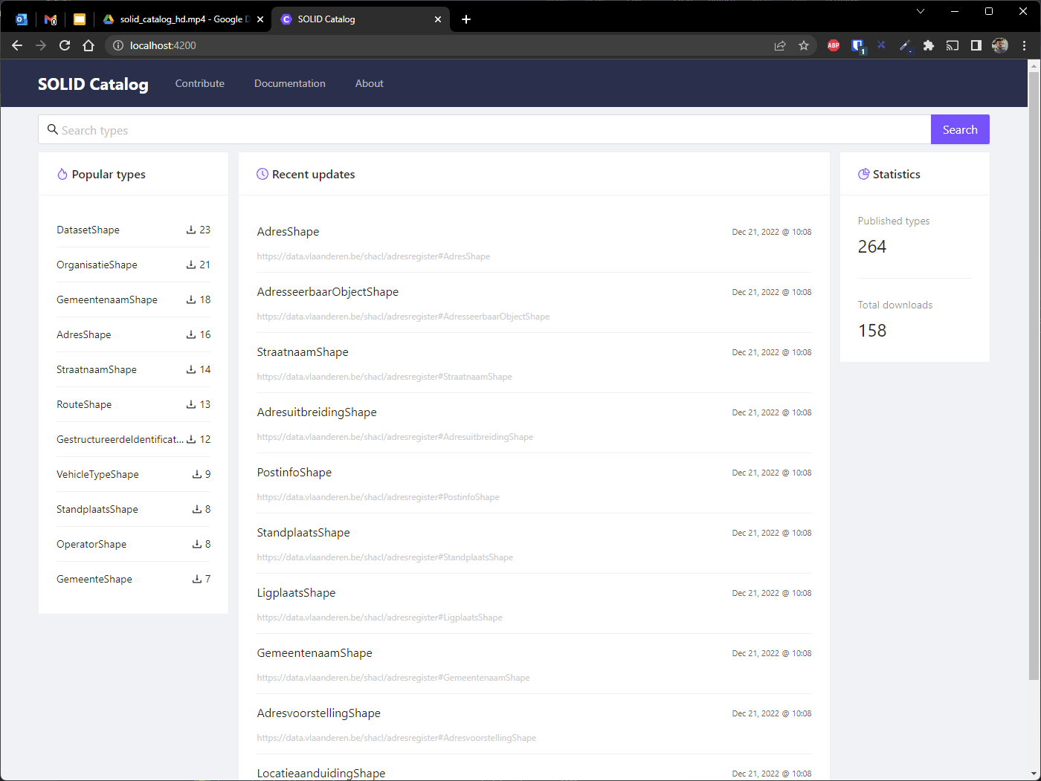
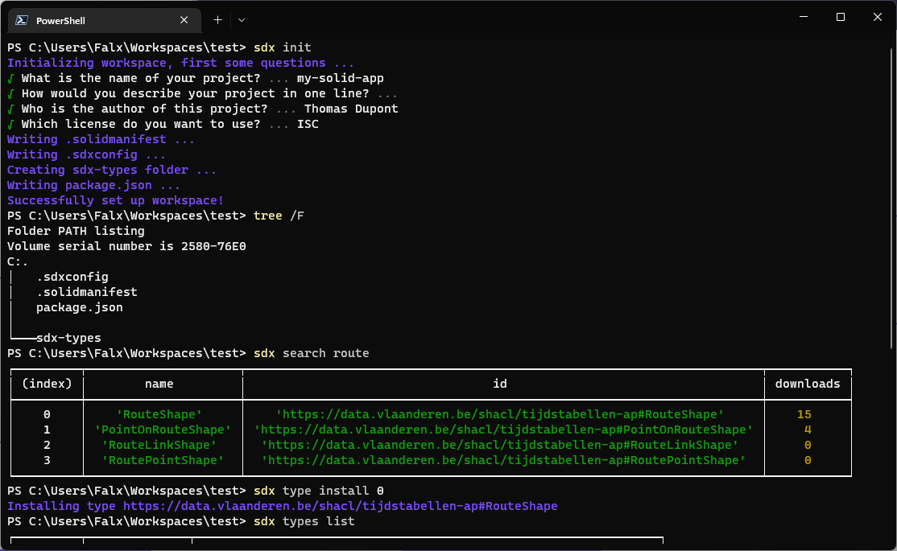

SDX overview
Catalog
Repository
Repository
Repository
Pod
Pod
Pod
Catalog
SDX sdk
SDX cli
local workspace
SDX cli

Slide 16

SDX demos

Slide 17
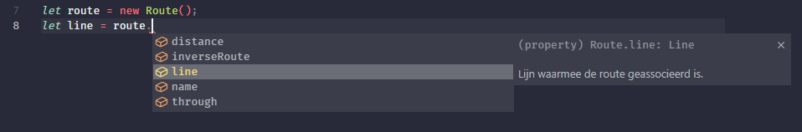
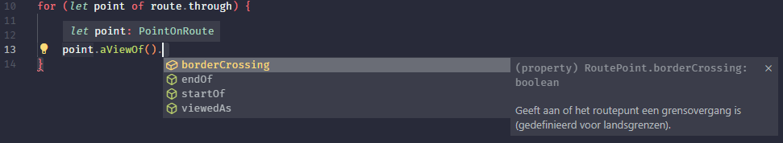
SDX next steps

