Slide 1

Tise Olayinka
Paxman Interview

Slide 2
Front-end & Back-end Strategy
Company - Paxman
Network Connection
Connection between app, cloud, company
Cloud server set up to temporarily store client’s device data, containing:
No patient data
Sensor readings
System settings/configuration
Monitoring
Maintenance
Performance updates OTA
Device data can be optimised by R&D using machine learning algorithms
Updated configurations are sent OTA to the desired device
Client/User
Intranet
Each Paxman device will be connected to the local network, to be controlled by the app
Application
Monitoring of multiple devices on site
Remote control and scheduling of operations

Slide 3
Solution Design
Cooling System
Cap
Microcontroller
4.7K Ω
Sensors
DS18B20
Intranet
Network Connection
Cloud Server
Client App
I/O Display
Firewall
Wi-Fi Connection
Current System
Cyber Security
Touch Screen
Monitoring
Managing Multiple Devices
Sensor Data
Remote Connection
Monitoring
Maintenance
OTA Updates
R&D
Paxman
Updated System
Company

Slide 4
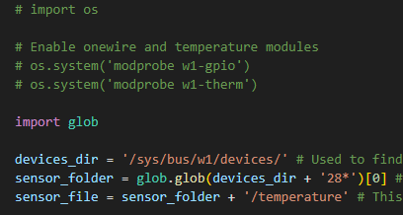
Technical Development
Code
Client/User
Raspberry Pi Connection
Each Paxman device will be connected to the local network, to be controlled by the app
Sensor Connection
Monitoring of multiple devices on site
Processing
fgh
Interface processing
gfhj

Slide 5
Schematics and Demo
Microcontroller
Raspberry Pi 3B+
GPIO4
GND
3V3
Cam 2
4.7k Ω
GND
VCC
Data
Sensor
Online
DS18B20
Console Interface

