Slide 1

An Introduction to different job profiles in Information Technology

Slide 2

Introduction to Information Technology as an industry
Branches of Information Technology
Software
Development
Application/Web Developer
Application Analyst/Architect
Data Analyst/Scientist/Engineer
Software Tester
Contents
Operations
Database Administrator
Network Engineer
Security Engineer
Cloud Engineer
DevOps
DevOps Engineer

Slide 3

IT as an Industry
Information technology sector is a business sector that works with computation and digital media.
It provides services and support to various IT products, software, applications and websites, maintenance, support for hardware devices, consulting etc.

Slide 4
Branches of IT
The IT industry and its functions can be divided into two major branches:
Software
Hardware
Any job profile in the field of Information Technology would fall under either of the two branches.
In this presentation, we are focusing on major job profiles in the software industry.

Slide 5
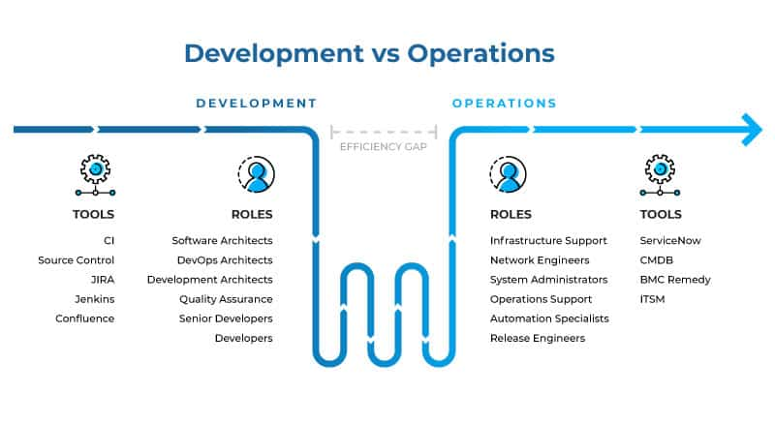
Software
It revolves around the entire lifecycle of an application/software/website. From conception to development to production to maintenance.
The entire software Industry can be divided into two, based on it’s functions:
Development
Operations

Slide 6
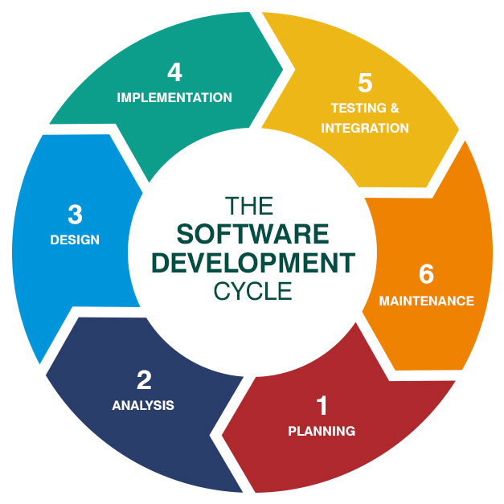
Software Development
Development of a software is a life cycle which consists of 6 major steps.
The major job profiles in development are as follows:
Application/web developer
Application Analyst/architect
Data Analyst/Scientist
Software Tester

Slide 7
Application/Web Developer
An application developer is someone who translates software requirements into workable programming code and maintain and develop programs for business.
A developer usually works within a specific development field such as mobile phone applications, accounting software, office suites or graphics software, and will have in-depth knowledge of at least one computer language.
An application developer might write applications, or apps, for either:
A particular system, such as Windows or Android
Across numerous platforms, including computers and mobile devices.
A web developer on the other hand will create reliable and high-performing applications and services, which can be accessed over the internet.

Slide 8
Responsibilities of an Application Developer
As an applications developer, you'll need to:
Establish a detailed program specification through discussion with clients.
Clarify the actions the program is intended to perform.
Write the program - to do this you'll break down program specification into its simplest elements and translate this logic into a programming language.
Work as part of a team - which may be established purely for a particular project to write a specific section of the program.
Test sample data-sets to check that output from the program works as intended.
Install the program into production, once testing is complete.
Devise possible solutions to anticipated problems.
React to problems and correct the program as necessary.
Evaluate and increase the program's effectiveness.
Adapt the program to new requirements, as necessary.
Conduct user acceptance testing, to ensure the program can be used easily, quickly and accurately.
Write detailed documentation for the operation of the program by users and computer operators.
Consult manuals, periodicals and technical reports to learn new ways to develop programs and maintain existing skills and knowledge.
Update, repair, modify and develop existing software and generic applications.

Slide 9
Responsibilities of a Web Developer
As a web developer, you'll need to:
Write code in one or more programming or scripting languages, such as PHP or JavaScript.
Fix bugs in existing projects.
Test new features thoroughly to ensure they perform the correct task in all cases.
Build and test Application Program Interfaces (APIs) for applications to exchange data.
Research, incorporate and contribute to Open Source projects.
Meet designers, developers and project staff for progress updates.
Gather requirements from clients and users.
Learn and test new technologies, frameworks and languages.
Stay up to date with new trends and advancements in web development.
Build and maintain databases.
Carry out code refactoring and optimization of existing code.
Document code, so other developers can understand and contribute to it.

Slide 10
Application Architect
Application architects are responsible for the administration, monitoring and maintenance of software infrastructures and applications.
An architect oversees best practices and processes needed for a business to function and succeed are running smoothly, acting as a technical point of contact to fix application and systems issues - usually on an immediate basis.
The job title requires to work within various IT departments alongside application developers and software engineers and involved in tasks such as:
Training and support of staff in using applications
Analysis and diagnosis of application errors
Problem resolution in both the long and short term
Design and development of existing and new applications
Road testing and implementation of new applications.

Slide 11
Responsibilities of an Architect
As an application architect, you'll need to:
Identify organizational need for new applications.
Prepare technical specification as a roadmap for software.
Provide instructions and training to staff when necessary.
Monitor, record and respond to requests for support.
Analyze error trends aimed at reducing or minimizing down time.
Communicate messages regarding systems issues to users promptly.
Liaise with software suppliers to fulfill the requirements of the organization.
Schedule regular tests to enhance the current systems and applications.
Identify functionality changes.
Maintain documentation of key databases and linked applications.
Prepare and manage sprints and ensure all requirements are properly met.
Attend regular internal and external meetings to provide updates on the progress of your task and to present to users the application solutions you are proposing.

Slide 12
Data Analyst/Scientist
A data analyst is a professional who retrieves and gathers data, organizes it and uses it to reach meaningful conclusions.
A data scientist on the other hand, is a professional responsible for collecting, analyzing and interpreting extremely large amounts of data and is able to perform predictive analysis based on past patterns.

Slide 13
Responsibilities of a Data Analyst
As a data analyst, you'll need to:
Develop records management processes and policies.
Identify areas to increase efficiency and automation of processes.
Set up and maintain automated data processes.
Identify, evaluate and implement external services and tools to support data validation and cleansing.
Produce and track key performance indicators.
Develop and support reporting processes.
Monitor and audit data quality.
Gather, understand and document detailed business requirements using appropriate tools and techniques.
Design and carry out surveys and analyze survey data.
Prepare reports for internal and external audiences using business analytics reporting tools.
Create data dashboards, graphs and visualizations.
Provide sector and competitor benchmarking.
Mine and analyze large datasets, draw valid inferences and present them successfully to management using a reporting tool.

Slide 14
Responsibilities of a Data Scientist
As a data scientist, you'll need to:
Work closely with your business to identify issues and use data to propose solutions for effective decision making
Build algorithms and design experiments to merge, manage, interrogate and extract data to supply tailored reports to colleagues, customers or the wider organization
Use machine learning tools and statistical techniques to produce solutions to problems
Test data mining models to select the most appropriate ones for use on a project
Assess the effectiveness of data sources and data-gathering techniques and improve data collection methods
Conduct research from which you'll develop prototypes and proof of concepts
Stay up-to-date about new technologies, libraries and using algorithms to solve problems.

Slide 15
Software Tester
A software tester is a professional who conducts automated and manual tests to ensure the software created by developers is fit for purpose and any bugs or issues are removed within a product before it gets deployed to everyday users.
A tester should be knowledgeable in various types of functional testing like:
Unit Testing
Integration Testing
System Testing
Regression Testing
Beta/Acceptance Testing
And non-functional testing like:
Performance Testing
Load Testing
Stress Testing
Security Testing
Compatibility Testing
Usability Testing
Compliance Testing

Slide 16
Responsibilities of a Tester
As a software tester, you'll need to:
Carry out stress testing, performance testing, functional testing and scalability testing.
Write and execute test scripts.
Run manual and automated tests.
Test in different environments including web and mobile.
Write bug reports.
Review documentation.
Provide quality assurance.
Provide objective feedback to software development project teams.
Troubleshoot and problem solve.
Design tests to mitigate risk.
Present findings to software development and business user teams.

Slide 17
Software Operations
Software/IT operations include administrative processes with support for hardware and software.
Important roles of the IT operations team include tech management, quality assurance, infrastructure management and confirmation that finished products meet all the customer's needs and expectations.
The major job profiles in operations are as follows:
Database Administrator
Network Engineer
Security Engineer
Cloud Engineer

Slide 18
Database Administrator
A database admin is a professional who maintains the performance, integrity and security of a database.
A DBA will ensure that:
Data remains consistent across the database.
Data is clearly defined.
Users access data concurrently, in a form that suits their needs.
There is provision for data security and recovery control (ensuring all data is retrievable in an emergency).

Slide 19
Responsibilities of a DBA
As a database administrator, you'll need to:
Establish the needs of users and monitor user access and security.
Monitor performance and manage parameters in order to provide fast responses to front-end users.
Map out the conceptual design for a planned database.
Install and test new versions of the database management system (DBMS).
Maintain data standards, including adherence to the Data Protection Act.
Write database documentation, including data standards, procedures and definitions for the data dictionary (metadata).
Control access permissions and privileges.
Manage and test back-up and recovery plans.
Ensure that storage and archiving procedures are functioning correctly.
Carry out capacity planning.
Work closely with IT project managers, database programmers and multimedia programmers.

Slide 20
Network Engineer
A network Engineer is a professional responsible for setting up, developing and maintaining computer networks within an organization or between organizations.
Ensures the integrity of high availability network infrastructure to provide maximum performance for your users including networks like voice and firewall.

Slide 21
Responsibilities of a Network Engineer
As a network engineer, you'll need to:
Establish the networking environment by designing system configuration, directing system installation and defining, documenting and enforcing system standards.
Maximize network performance by monitoring performance, troubleshooting network problems and outages, scheduling upgrades and collaborating with network architects on network optimization.
Undertake data network fault investigations in local and wide area environments using information from multiple sources.
Secure network systems by establishing and enforcing policies, and defining and monitoring access.
Support and administer firewall environments in line with IT security policy.
Report network operational status by gathering and prioritizing information and managing projects.
Upgrade data network equipment to the latest stable firmware releases.
Configure routing and switching equipment, hosted IP voice services and firewalls.
Provide remote support to on-site engineers and end users/customers during installation.
Provide remote troubleshooting and fault finding if issues occur upon initial installation.
Undertake capacity management and audit of IP addressing and hosted devices within data centers.

Slide 22
Cyber Security Engineer
A cyber security engineer is a professional responsible for protecting the IT infrastructure (including networks, hardware and software) from a range of criminal activity.
Monitor networks and systems, detect security threats ('events'), analyze and assess alarms, and report on threats, intrusion attempts and false alarms, either resolving them or escalating them, depending on the severity.

Slide 23
Responsibilities of a Cyber Security Engineer
As a cyber security Engineer, you'll need to:
Keep up to date with the latest security and technology developments.
Research/evaluate emerging cyber security threats and ways to manage them.
Plan for disaster recovery and create contingency plans in the event of any security breaches.
Monitor for attacks, intrusions and unusual, unauthorized or illegal activity.
Use advanced analytic tools to determine emerging threat patterns and vulnerabilities.
Engage in 'ethical hacking', for example, simulating security breaches.
Identify potential weaknesses and implement measures, such as firewalls and encryption.
Investigate security alerts and provide incident response.
Monitor identity and access management, including monitoring for abuse of permissions by authorized system users.
Maintain an information security risk register and assist with internal and external audits relating to information security.
Monitor and respond to 'phishing' emails and 'pharming' activity.

Slide 24
Cloud Engineer
Cloud engineers are responsible for performing the technical duties associated with cloud computing. This can involve anything from designing cloud software and systems to implementing and maintaining them.
Implement cloud-applications, migrate existing on-premise applications to the cloud, and debug cloud stacks.

Slide 25
Responsibilities of a Cloud Engineer
As a cloud Engineer, you'll need to:
Collaborate with engineering and development teams to evaluate and identify optimal cloud solutions.
Modify and improve existing systems.
Educate teams on the implementation of new cloud technologies and initiatives.
Design, develop, and deploy modular cloud-based systems.
Develop and maintain cloud solutions in accordance with best practices.
Ensure efficient functioning of data storage and processing functions in accordance with company security policies and best practices in cloud security.
Identify, analyze, and resolve infrastructure vulnerabilities and application deployment issues.
Regularly review existing systems and making recommendations for improvements.
Interact with clients, providing cloud support, and making recommendations based on client needs.

Slide 26
DevOps
DevOps is a set of practices/cross-functional combination that combines software development (Dev) and IT operations (Ops).
It aims to shorten the development life cycle and all the IT operations related to a software by continuously and automatically integrating updates and changes through the process called continuous integration (CI) and continuous deployment (CD).

Slide 27
DevOps Engineer
DevOps Engineers are professionals who work with developers and the IT staff to oversee the code releases.
They build, test and maintain the infrastructure and tools to allow for the speedy development and release of software.

Slide 28
Responsibilities of a DevOps Engineer
Build and set up new development tools and infrastructure.
Work on ways to automate and improve development and release processes.
Test and examine code written by others and analyzing results.
Ensure that systems are safe and secure against cybersecurity threats.
Identify technical problems and developing software updates and ‘fixes’.
Work with software developers and software engineers to ensure that development follows established processes and works as intended.
Plan out projects and being involved in project management decisions.

Slide 29


