Slide 1
Chess engine on python using PyGame Team No. 03 1. Ashwin Ravi – 3122 21 5001 014 2. Makesh Vaibhav A.G. – 3122 21 5001 048 3. Naren Srinivasan – 3122 21 5001 057
Artificial Intelligence Assignment
III Year CSE “A” Section
SSN College of Engineering

Slide 2
Problem Statement
Aim:- To develop a Python Chess Engine with Pygame, focusing on creating an immersive platform with a visually engaging interface for chess enthusiasts by implementing a sophisticated AI opponent using the negamax algorithm, alpha-beta pruning, and a transposition table for challenging and strategic gameplay thereby providing a seamless and enjoyable experience for players of all levels.
Input:- Movement of a white chess piece
Output:- Movement of a black chess piece by the computer to counter the white chess piece moves.
Techniques used:- Alpha beta pruning, Negamax algorithm
Objectives:-
To create a visually engaging interface to facilitate an immersive and strategic gaming experience for chess enthusiasts.
To enhance the engine's decision-making capabilities by evaluating potential moves, considering diverse outcomes, and incorporating a transposition table for efficiency using alpha beta pruning and Negamax algorithm.
To make an aesthetically pleasing side menu and to ensure a seamless and enjoyable gaming experience, inviting players of all levels to participate in the timeless game of chess.

Slide 3
Literature Study
Motivation:- Developing a Python Chess Engine with Pygame is motivated by a passion for chess, a commitment to enhancing the chess community, and the educational goal of advancing Python and game development skills through creating an immersive and visually engaging digital chess platform with a challenging AI opponent.
Real time Applications
Educational Tool
Algorithmic Development and Testing
AI Training and Benchmarking
Entertainment and Recreation
Algorithm Visualization
Game Development Learning
Open-Source Contribution
Source / Reference links of the chosen problem:-
python - Chess using pygame - Code Review Stack Exchange
https://youtube.com/playlist?list=PLBwF487qi8MGU81nDGaeNE1EnNEPYWKY_&feature=shared

Slide 4
Design
ALPHA-BETA PRUNING
1. Initialization:
The findBestMove function initializes the next_move variable and shuffles the list of valid moves. It then calls the findMoveNegaMaxAlphaBeta function.
2. NegaMax with Alpha-Beta Pruning:
The findMoveNegaMaxAlphaBeta function is a recursive implementation of the NegaMax algorithm with Alpha-Beta Pruning.
3.Base Case - Depth Limit:
If the depth limit is reached (depth == 0), the function returns the evaluated score of the current game state multiplied by the turn_multiplier.
4. Move Ordering (TODO):
There is a placeholder for move ordering, marked as //TODO. Move ordering can be implemented later for more efficient pruning.

Slide 5
Design
5. Alpha-Beta Pruning Loop:
The function maintains an alpha and beta value to prune branches that won't affect the final decision.
The alpha value represents the best value found so far for the maximizing player along the path to the root.
The beta value represents the best value found so far for the minimizing player along the path to the root.
The max_score variable is used to track the best score.
6. Iteration Through Valid Moves:
The function iterates through the provided list of valid moves.
For each move, it makes the move on the game state, retrieves the next set of valid moves, and recursively calls itself.
7. Score Calculation:
The score for the current move is calculated as the negation of the score returned from the recursive call.
If the calculated score is higher than the maximum score (max_score), it updates max_score and, if at the initial depth, updates the next_move variable.

Slide 6
Design
8. Undo Move:
After exploring a move, the function undoes the move on the game state to backtrack for further exploration.
9. Update Alpha and Beta:
If the max_score is greater than the current alpha value, alpha is updated to be the same as max_score.
If alpha is greater than or equal to beta, the loop breaks, as further exploration is unnecessary.
10. Return Maximum Score:
The function returns the max_score, representing the optimal score for the current game state.

Slide 7
Design
NEGAMAX ALGORITHM
1. Initialization:
The findBestMove function is the entry point. It initializes the next_move variable, shuffles the list of valid moves, and calls the findMoveNegaMaxAlphaBeta function.
2. NegaMax Recursive Function:
The findMoveNegaMaxAlphaBeta function is a recursive implementation of the NegaMax algorithm.
It evaluates the current game state and explores possible moves up to a certain depth in the game tree.
3. Base Case - Depth Limit:
If the depth limit is reached (depth == 0), the function returns the evaluation score of the current game state multiplied by the turn_multiplier.
The turn_multiplier is 1 for white's turn and -1 for black's turn.
4. Move Ordering (TODO):
The comment indicates a placeholder for move ordering, a technique to prioritize certain moves for more efficient pruning. This step is marked for future implementation.

Slide 8
Design
5. Iteration Through Valid Moves:
The function iterates through the provided list of valid moves.
For each move, it makes the move on the game state, retrieves the next set of valid moves, and recursively calls itself.
6. Score Calculation:
The score for the current move is calculated as the negation of the score returned from the recursive call.
If the calculated score is higher than the maximum score (max_score), it updates max_score and, if at the initial depth, updates the next_move variable.
7. Undo Move:
After exploring a move, the function undoes the move on the game state to backtrack for further exploration.
8. Alpha-Beta Pruning:
Alpha-Beta Pruning is applied to optimize the search. It maintains alpha and beta values to prune branches that won't affect the final decision.
If the max_score is greater than the current alpha value, alpha is updated.
If alpha is greater than or equal to beta, the loop breaks, as further exploration is unnecessary.

Slide 9
Design
9. Final Move Selection:
The next_move variable stores the best move found at the initial depth.
The function returns the max_score, representing the optimal score for the current game state.

Slide 10
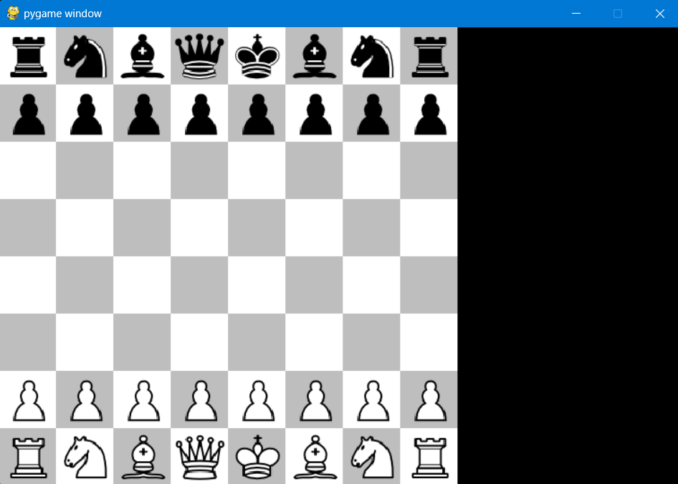
Results
Initial state

Slide 11
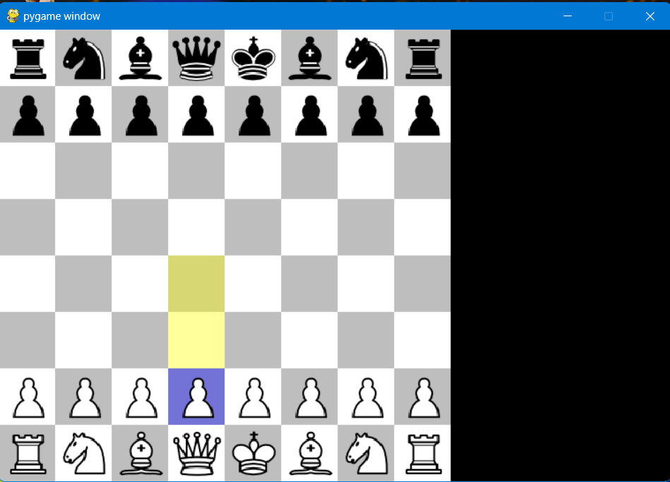
Results
Valid moves

Slide 12
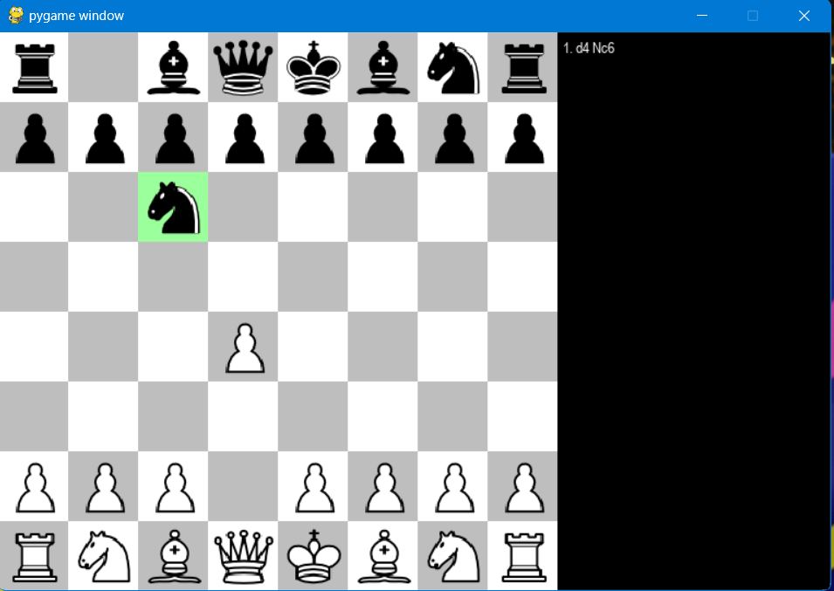
Results
User move made and AI move as well

Slide 13
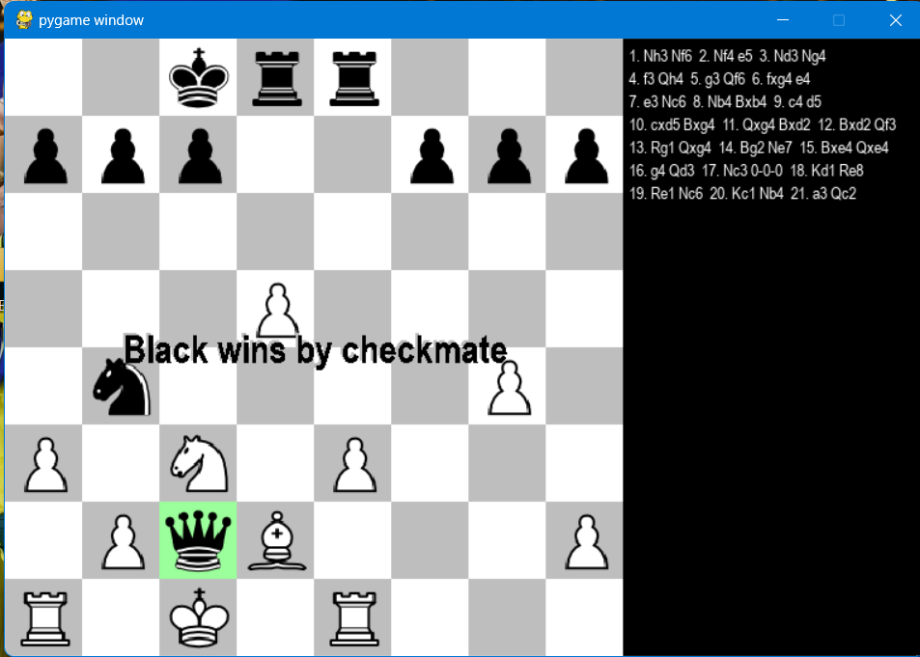
Results
AI wins

Slide 14
Inference & Future work
Inference:-
Hands-on experience in implementing AI algorithms for chess
Building an visually pleasing UI with Pygame engine.
Understanding of negamax algorithm applications in real-world games.
Understanding how alpha-beta pruning reducing the time complexity upon the increase of depth of search tree.
Further refinement of AI algorithms or exploration of machine learning techniques could lead to an even more challenging and adaptive computer opponent.

Slide 15
Inference & Future work
Future work:-
Exploring the integration of machine learning techniques, enabling the AI to dynamically learn and refine its strategies through gameplay data has to be a prioity. Additionally, enhancing the AI's ability to handle diverse scenarios and unexpected player moves could contribute to a more robust and challenging opponent. Continuous development and refinement of the chess engine's AI, potentially incorporating advanced algorithms, could elevate the gaming experience by providing players with a more adaptive, intelligent, and enjoyable chess-playing companion.

