Slide 1

TITLE: ESSENTIAL MEDICAL NEEDS
TEAM MEMBERS:
B. KIRAN KUMAR REDDY→17MIS1019
S. SUKESH KUMAR→17MIS1039

Slide 2
Introduction:
Now a days medicines are playing an important role in human life. Medicines preventing disease and injury and relieving pain and avoiding premature death and pursuing a peaceful death.
people who are living in the society needs the medicines , in developed areas people having knowledge about buying medicines and consult the specialists, but in developing areas 50% of the people don’t have a knowledge about which medicines they have to use and which type of specialists they have to consult.
Now a days medicines scam is also done. So, people are not getting the good quality of medicines from medical shops.
For all the above reasons we are providing a website having different modules to consult doctor , to order quality medicines, and delivery of medicines in less time with less effort and quality of medicines by using scheduling and least cost distance algorithms

Slide 3
Problem Statement-Societal Issue
Social issue:
people who are living in the society needs the medicines , in developed areas people having knowledge about buying medicines and consult the specialists, but in developing areas 50% of the people don’t have a knowledge about which medicines they have to use and which type of specialists they have to consult.
Now a days medicines scam is also done. So, people are not getting the good quality of medicines from medical shops.
→Our intension is to lessen this sort of social issue through our web application.
Keywords:
medicines, website, doctors, patients, pharmacies, scheduling algorithms- kruskal’s & dijkstra’s distance algorithms, database

Slide 4
Objective:
We are providing a web application for doctors, patients and pharmacies also. From this, a patient can discuss about his disease with doctor. Patient can get the prescription from the doctors , if he wants medicines from the same website , he can order those medicines from pharmacies which we provided in the website. The pharmacy members get the list from the patient orders and they can deliver medicines based on the patient’s ordered date and priority. By that pharmacy members can deliver the medicines with in less time to every patient located in different locations. For this we have been used scheduling algorithms (FIFO,PRIORITY) to sort the orders list and also used least cost distance algorithms (KRUSHKALS,DIJKSTRAS) to deliver the orders in less time.

Slide 5
Requirements:
SOFTWARE:
→ COLAB
→ XAMPP
→Languages: HTML,CSS,JAVASCRIPT,PHP,PYTHON
HARDWARE:
→WINDOWS 10
→ 4GB RAM / 8GB RAM

Slide 6
LITERATURE SURVEY:
S.NO | TITLE AND AUTHOR | YEAR AND PUBLICATION | TECHNIQUES | LIMITATIONS
1. | Medical Emergency and Healthcare Model Shihaa,Hameed, Vladimir Miho, Wajdi AlKhateeb, Aisha Hassan | International Conference on Computer and Communication Engineering (ICCCE 2010) | Enhancemet with SMS and MMS Facilities | It can offer: SMS, MMS, live audio and video coverage of emergency situations, location-based access to emergency situation, wide area coverage, and provides flexibility for the user.

Slide 7
S.NO | TITLE AND AUTHOR | YEAR AND PUBLICATION | TECHNIQUES | LIMITATION
2. | The medical project management system Dridi, Ahmed; Tissaoui, Anis; Sassi, Salma | Global Summit on Computer & Information Technology (GSCIT) 2015 | ontological components and an XML data exchange format | A semantic middleware for a unified representation of medical records
3. | Virtual Medical Care: How Are Our Patients Using Online Health Information? Heather A. Liszka; Terrence E. Steyer; William J. Hueston | Journal of community health (2006) | Online Health-seeking using internet and online health information | USING ONLINE HEALTH INFORMATION

Slide 8
S.NO | TITLE AND AUTHOR | YEAR AND PUBLICATION | TECHNIQUES | LIMITATIONS
4. | Healthcare provider-patient online consultation and compliance program Fotsch, E., DelGuidice, D., & Yuan, L. | (2004). U.S. Patent | messages includes medical advice or medical information | includes one or more messages to be transmitted to the user when a condition associated with the corresponding message is satisfied

Slide 9
s.no | Title and authors | Year and publication | techniques | limitations
5. | Seeking health information online: does limited healthcare access matter? Neeraj Bhandari, Yunfeng Shi, Kyoungrae Jung | 19 June 2014 Journal of the American Medical Informatics Association | Internet, Online Health Information Seeking, Health Care Access, Health Information Systems, Consumer Health Information | Brief Communication is done in internet
6. | Online health care Fayezah Anjum , Abu Saleh Mohammed Shoaib ,Abdullah Ibne Hossain , Mohammad Monirujjaman Khan | 2018 Computing and Communication Workshop and Conference (CCWC) | using Codeigniter, a PHP framework. The database has been designed using mySQL and XAMPP as the server. | The doctors can view their patient's data and issue prescriptions through the appointments as per the patients cases

Slide 10
s.No | Title and authors | Year and publication | Techniques | limitations
7. | Big Health Application System based on Health Internet of Things and Big Data Ma, Y., Wang, Y., Yang, J., Miao, Y., & Li, W | IEEE Access, 5, 7885-7897 2016 | Blending the latest information technology into the healthcare system will greatly mitigate the problems based on the health Internet of Things and big data | the big health care system’s architecture, technology challenges and several typical large health applications
8. | M-health : A complete healthcare solution Rohan V. Vaidya Darshan K. Trivedi | 2017 International Conference on Computing Methodologies and Communication (ICCMC) | Android application | A smart phone equipped with a internet connection.

Slide 11
s.No | Title and authors | Year and publication | Techniques | limitations
9. | Mobile based healthcare management using artificial intelligence Amiya Kumar Tripathy Rebeck Carvalho Keshav Pawaskar Suraj Yadav Vijay Yadav | 2015 International Conference on Technologies for Sustainable Development (ICTSD) | The system will consist of video conferencing to connect remotely with the Doctor. | The Doc-Bot which was developed earlier is now being transferred to mobile platform and will be further advanced for diagnosis of common diseases
10. | All Time Medicine and Health Device Pruthvesh Desai , Biswamoy Pattnaik , Sreya Dey , T.S. Aditya ,Karthik Rajaraman ,M. Aarthy | 2019 5th International Conference on Advanced Computing & Communication Systems (ICACCS) | the prototype of the All Time Medicine and Health device for the use of every person in need of drugs or medical assistance | ATMAH comprises of an automatic medicine vending machine to dispense drugs as per a doctor's prescription.

Slide 12
Proposed methodologies:
Modules list:
Website modules are home page, signup , registration, login, profile, service modules (patient, doctor, pharmacies), clinic, log out, database.
Backend performing modules are scheduling algorithms (FIFO, PRIORITY), and distance based least cost algorithms (KRUSHKAL’S, DIJKSTRA’S).

Slide 13
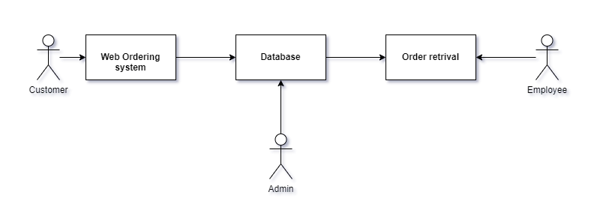
Architectural diagram:

Slide 14
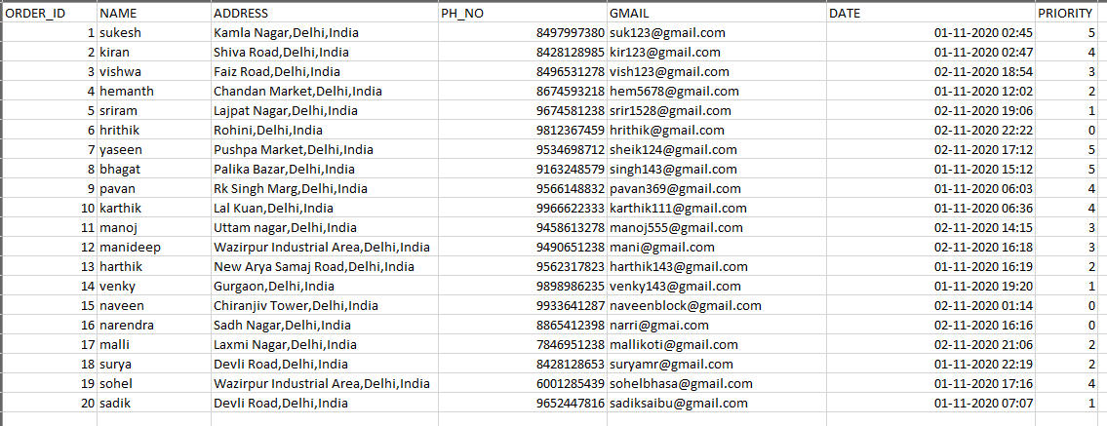
Dataset - Source Link
https://github.com/Sollety/Tarp

Slide 15
Algorithms Used
SCHEDULING ALGORITHMS:
→FIFO (FIRST IN FIRST OUT)
→PRIORITY BASED
LEAST COST DISTANCE ALGORITHMS:
→Kruskal
→Dijkstras

Slide 16
FIFO:
First in, first out (FIFO), otherwise called first come, first served (FCFS), is the least complex planning calculation. FIFO essentially lines measures in the request that they show up in the prepared line. This is regularly utilized for an assignment line, for instance as represented in this segment.
→Since setting switches just happen upon measure end, and no redesign of the cycle line is required, booking overhead is negligible.
→Throughput can be low, in light of the fact that long cycles can be holding the CPU, making the short cycles hang tight for quite a while (known as the caravan impact).
→No starvation, in light of the fact that each cycle persuades opportunity to be executed after a distinct time.
→ Turnaround time, holding up time and reaction time rely upon the request for their appearance and can be high for similar reasons above.
→ No prioritization happens, along these lines this framework experiences difficulty fulfilling measure time constraints.
→The absence of prioritization implies that as long as each cycle inevitably finishes, there is no starvation. In a climate where a few cycles probably won't finish, there can be starvation.
→ It depends on lining.

Slide 17
PRIORITY BASED:
If there should arise an occurrence of need booking the need isn't constantly set as the backwards of the CPU burst time, rather it very well may be inside or remotely set, however yes the planning is done based on need of the cycle where the cycle which is most pressing is handled first, trailed by the ones with lesser need all together. Cycles with same need are executed in FCFS way.
→Priority booking is a non-preemptive calculation and one of the most widely recognized planning calculations in bunch frameworks.
→Each measure is relegated a need. Cycle with most noteworthy need is to be taken first, etc.
→Processes with same need are executed on first start things out served premise.
→Priority can be chosen dependent on time necessities or some other asset necessity.

Slide 18
KRUSKAL’S ALGORITHM:
Kruskal's calculation finds a base spreading over woods of an undirected edge-weighted diagram. On the off chance that the diagram is associated, it finds a base crossing tree. (A base crossing tree of an associated chart is a subset of the edges that frames a tree that incorporates each vertex, where the aggregate of the loads of the apparent multitude of edges in the tree is limited. For a detached diagram, a base spreading over woodland is made out of a base crossing tree for each associated part.) It is an insatiable calculation in chart hypothesis as in each progression it includes the following most reduced weight edge that won't shape a cycle to the base traversing backwoods.
→The following are the means for discovering MST utilizing Kruskal's calculation
1. Sort all the edges in non-diminishing request of their weight.
2. Pick the littlest edge. Check on the off chance that it shapes a cycle with the traversing tree framed up until now. On the off chance that cycle isn't framed, incorporate this edge. Else, dispose of it.
3. Rehash step#2 until there are (V-1) edges in the spreading over tree.

Slide 19
DIJKSTRAS ALGORITHM:
Dijkstra's calculation (or Dijkstra's Shortest Path First calculation, SPF calculation) is a calculation for finding the most limited ways between hubs in a chart, which may speak to, for instance, street organizations. It was brought about by PC researcher Edsger W. Dijkstra in 1956 and distributed three years after the fact.
Dijkstra's unique calculation found the most brief way between two given hubs, yet a more normal variation fixes a solitary hub as the "source" hub and finds most brief ways from the source to all different hubs in the diagram, creating a most limited way tree.
The Dijkstra calculation utilizes marks that are positive numbers or genuine numbers, which are completely requested. It tends to be summed up to utilize any names that are halfway arranged, gave the ensuing marks (a resulting name is delivered while crossing an edge) are monotonically non-diminishing. This speculation is known as the conventional Dijkstra most brief way calculation.

Slide 20
Experiments and results:
We developed different modules as all are included in website to get all the inputs and perform the scheduling and least distance (cost) algorithms.
Modules are home page, signup , registration, login, profile, service modules (patient, doctor, pharmacies), clinic, log out, database.
Next we can perform the scheduling algorithms based on the exported csv file of ordered medicines.
For delivery we have used GEOPY to find out the order location with latitude and longitude .
And also we used NETWORKX to perform the distance between the locations , and also implementing the KRUSHKALS and DIJKSTRAS algorithms to find out the least distance between the each and every location mentioned in the orders list
The result will be the directions that the delivery boy should follow to deliver the products or medicines with less effort and in less time.

Slide 21
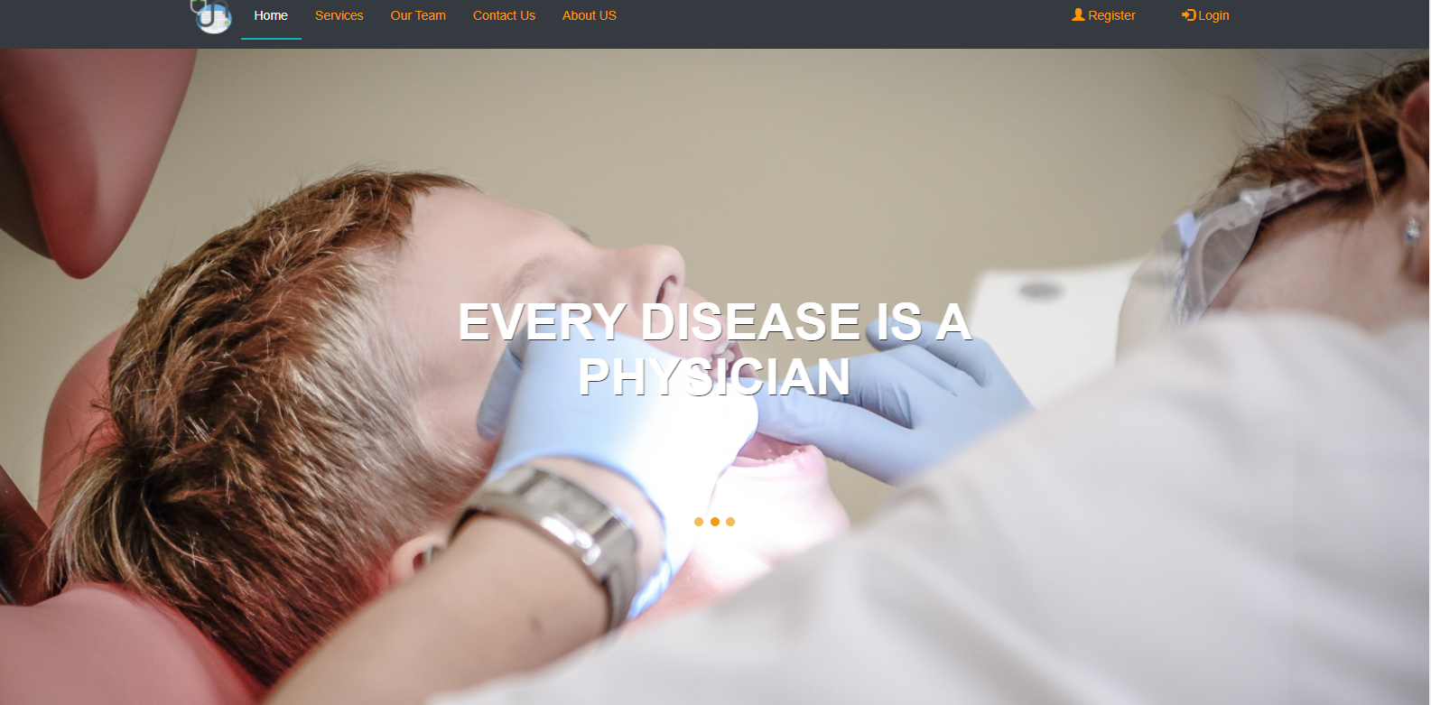
Screenshots of entire output:

Slide 22
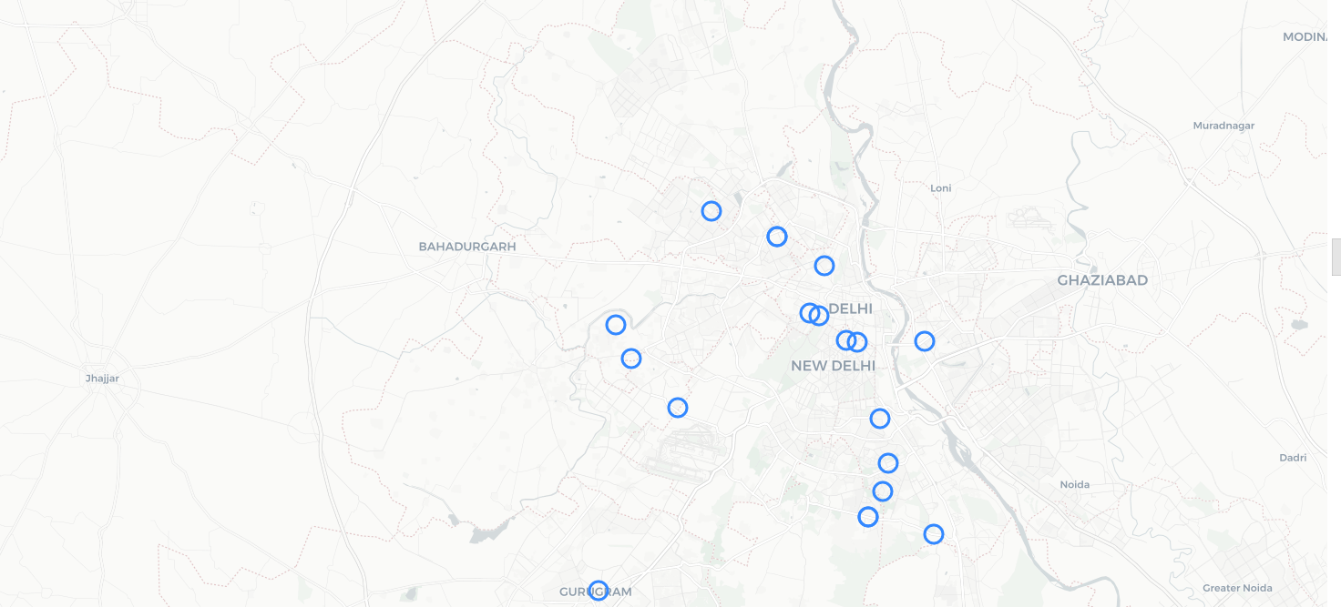

Slide 23
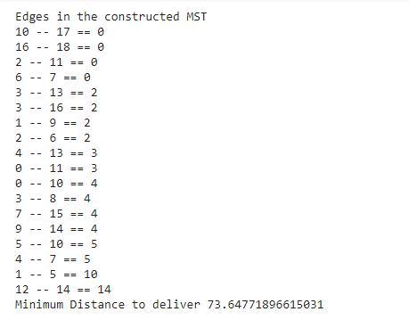

Slide 24
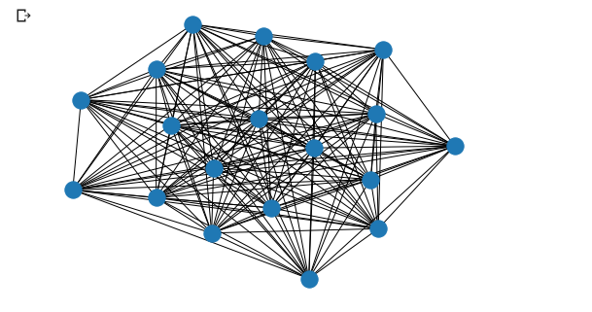

Slide 25
Conclusion:
From this project we can conclude that using FIFO and priority scheduling algorithms are used to deliver the medicines on first ordered one and priority based. Kruskal’s and Dijkstra’s algorithms are used to deliver the medicines with least cost on distance. The medicines will be delivered accordingly based on the customer choice. The delivery of the products will be faster with less effort and in less time.
Anyone can solve their medical problems or diseases in this website whether it is minor or major.
And also anyone can order the medicines from our website and we can deliver to any locations.
This project resolve the social issue to deliver the medicines in less time with less effort.

Slide 26
Individual contribution:
SUKESH→17MIS1039
signup , login, service modules (doctor, pharmacies), log out, database.
FIFO scheduling, KRUSHKAL’S least cost distance.
KIRAN→17MIS1019
home page, profile, service modules (patient ,clinic).
PRIORITY scheduling, DIJKSTRA’S least cost distance.

Slide 27
REFERENCES: (APA format)
1) Hameed, S. A., Miho, V., AlKhateeb, W., & Hassan, A. (2010, May). Medical emergency and healthcare model: Enhancemet with SMS and MMS facilities. In International Conference on Computer and Communication Engineering (ICCCE'10) (pp. 1-6). IEEE.
2) Dridi, A., Tissaoui, A., & Sassi, S. (2015, June). The medical project management (MPM) system. In 2015 Global Summit on Computer & Information Technology (GSCIT) (pp. 1-6). IEEE.

Slide 28
REFERENCES
3) Liszka, H. A., Steyer, T. E., & Hueston, W. J. (2006). Virtual medical care: how are our patients using online health information?. Journal of community health, 31(5), 368-378.
4) Fotsch, E., DelGuidice, D., & Yuan, L. (2004). U.S. Patent Application No. 10/641,982.
5) Journal of the American Medical Informatics Association, Volume 21, Issue 6, November 2014, Pages 1113–1117, https://doi.org/10.1136/amiajnl-2013-002350

Slide 29
References:
6) F. Anjum, A. S. M. Shoaib, A. I. Hossain and M. M. Khan, "Online health care," 2018 IEEE 8th Annual Computing and Communication Workshop and Conference (CCWC), Las Vegas, NV, 2018, pp. 580-583, doi: 10.1109/CCWC.2018.8301617
7) Ma, Y., Wang, Y., Yang, J., Miao, Y., & Li, W. (2016). Big health application system based on health internet of things and big data. IEEE Access, 5, 7885-7897.
8) R. V. Vaidya and D. K. Trivedi, "M-health : A complete healthcare solution," 2017 International Conference on Computing Methodologies and Communication (ICCMC), Erode, 2017, pp. 556-561, doi: 10.1109/ICCMC.2017.8282527.

Slide 30
References:
9) A. K. Tripathy, R. Carvalho, K. Pawaskar, S. Yadav and V. Yadav, "Mobile based healthcare management using artificial intelligence," 2015 International Conference on Technologies for Sustainable Development (ICTSD), Mumbai, 2015, pp. 1-6, doi: 10.1109/ICTSD.2015.7095895.
10) P. Desai, B. Pattnaik, S. Dey, T. S. Aditya, K. Rajaraman and M. Aarthy, "All Time Medicine and Health Device," 2019 5th International Conference on Advanced Computing & Communication Systems (ICACCS), Coimbatore, India, 2019, pp. 5-9, doi: 10.1109/ICACCS.2019.8728306.

Slide 31


