Slide 1
PROJECT TITLE: ESSENTIAL MEDICAL NEEDS
TEAM MEMBERS:
B. KIRAN KUMAR REDDY→17MIS1019
S. SUKESH KUMAR →17MIS1039
COURSE TITLE: TECHNICAL ANSWERS TO REAL TIME PROBLEMS
COURSE CODE: SWE3999
FACULTY: Bhuvaneswari Anbalagan

Slide 2
ABSTRACT:
Drugs (Medicines) are synthetic substances or mixes used to fix, stop, or forestall malady; ease manifestations; or help in the finding of sicknesses. Advances in meds have empowered specialists to fix numerous illnesses and spare lives.
In Urban zones some can be purchased over the counter at drug stores or different stores. Others require a specialist's solution. Some are accessible just in medical clinics. They realize which sort of medications and whose specialist's remedy is smarter to take for their concern.
Be that as it may, in Rural zones half of individuals don't know which and when the drugs they need to take and who is the better specialist for their issues. They don't get the great quality prescriptions for their concern on time because of absence of transport office or some other.
Consequently we are demonstrating a site for fundamental medicals needs with planning calculations and least cost separation calculations to make it successfully and effectively to determine the patient's questions and conveying the drugs moreover.

Slide 3
ABSTRACT CONT..
For ex: An individual is experiencing with malignant growth 2 years. He is having prescriptions with him. Be that as it may, toward the fruition of his meds, he doesn't have the foggiest idea where those drugs can purchase for his next 2 years plan.
Around then he or his family members can arrange those medicals in our site or, in all likelihood they can transfer the medicine list as per their primary care physician's recommendation, in light of that we can give the prescriptions month to month or week by week. They can get it quickly inside 2 days. On the off chance that the stock isn't there having a place with client needs. Around then we can give other choice to counsel a specialist identified with client issues and they propose some elective prescriptions for impermanent use and after the stock is accessible we can remind them to get those drugs.

Slide 4
Social Issue and Keywords:
Social issue:
Individuals are enduring with absence of getting the uncommon prescriptions in less and productive time for both significant illnesses like malignancy and so forth, and minor maladies too.
→Our intension is to lessen this sort of social issue through our web application.
Keywords: medicines, website, doctors, patients, pharmacies, scheduling algorithms- kruska’s & dijkstra’s distance algorithms, database

Slide 5
REQUIREMENTS
SOFTWARE:
→ COLAB
→ XAMPP
→Languages: HTML,CSS,JAVASCRIPT,PHP,PYTHON
HARDWARE:
→WINDOWS 10
→ 4GB RAM / 8GB RAM

Slide 6
USED ALGORITHMS:
SCHEDULING ALGORITHMS
→FIFO (FIRST IN FIRST OUT)
→PRIORITY BASED
LEAST COST DISTANCE ALGORITHMS:
→Kruskal
→Dijkstras

Slide 7
FIFO
First in, first out (FIFO), otherwise called first come, first served (FCFS), is the least complex planning calculation. FIFO essentially lines measures in the request that they show up in the prepared line. This is regularly utilized for an assignment line, for instance as represented in this segment.
→Since setting switches just happen upon measure end, and no redesign of the cycle line is required, booking overhead is negligible.
→Throughput can be low, in light of the fact that long cycles can be holding the CPU, making the short cycles hang tight for quite a while (known as the caravan impact).
→No starvation, in light of the fact that each cycle persuades opportunity to be executed after a distinct time.
→ Turnaround time, holding up time and reaction time rely upon the request for their appearance and can be high for similar reasons above.
→ No prioritization happens, along these lines this framework experiences difficulty fulfilling measure time constraints.
→The absence of prioritization implies that as long as each cycle inevitably finishes, there is no starvation. In a climate where a few cycles probably won't finish, there can be starvation.
→ It depends on lining.

Slide 8
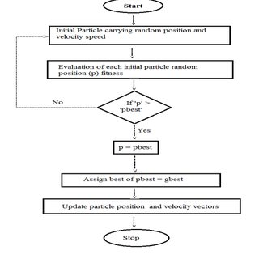
FIFO-FLOWCHART:

Slide 9
PRIORITY BASED
If there should arise an occurrence of need booking the need isn't constantly set as the backwards of the CPU burst time, rather it very well may be inside or remotely set, however yes the planning is done based on need of the cycle where the cycle which is most pressing is handled first, trailed by the ones with lesser need all together. Cycles with same need are executed in FCFS way.
→Priority booking is a non-preemptive calculation and one of the most widely recognized planning calculations in bunch frameworks.
→Each measure is relegated a need. Cycle with most noteworthy need is to be executed first, etc.
→Processes with same need are executed on first start things out served premise.
→Priority can be chosen dependent on memory prerequisites, time necessities or some other asset necessity.

Slide 10
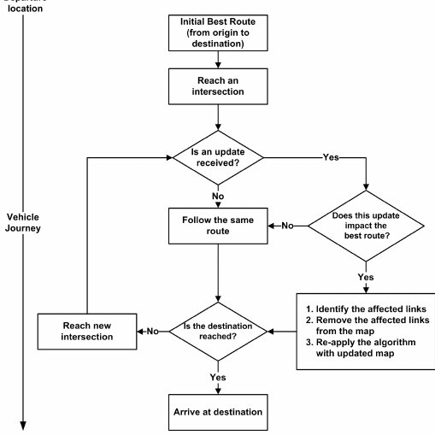
PRIORITY BASED—FLOWCHART:

Slide 11
KRUSKAL’S ALGORITHM:
Kruskal's calculation finds a base spreading over woods of an undirected edge-weighted diagram. On the off chance that the diagram is associated, it finds a base crossing tree. (A base crossing tree of an associated chart is a subset of the edges that frames a tree that incorporates each vertex, where the aggregate of the loads of the apparent multitude of edges in the tree is limited. For a detached diagram, a base spreading over woodland is made out of a base crossing tree for each associated part.) It is an insatiable calculation in chart hypothesis as in each progression it includes the following most reduced weight edge that won't shape a cycle to the base traversing backwoods.
→The following are the means for discovering MST utilizing Kruskal's calculation
1. Sort all the edges in non-diminishing request of their weight.
2. Pick the littlest edge. Check on the off chance that it shapes a cycle with the traversing tree framed up until now. On the off chance that cycle isn't framed, incorporate this edge. Else, dispose of it.
3. Rehash step#2 until there are (V-1) edges in the spreading over tree.

Slide 12
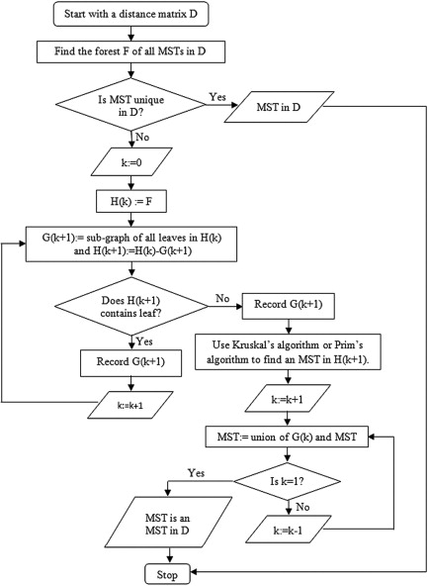
KRUSKAL--FLOWCHART

Slide 13
DIJKSTRAS ALGORITHM:
Dijkstra's calculation (or Dijkstra's Shortest Path First calculation, SPF calculation) is a calculation for finding the most limited ways between hubs in a chart, which may speak to, for instance, street organizations. It was brought about by PC researcher Edsger W. Dijkstra in 1956 and distributed three years after the fact.
. Dijkstra's unique calculation found the most brief way between two given hubs, yet a more normal variation fixes a solitary hub as the "source" hub and finds most brief ways from the source to all different hubs in the diagram, creating a most limited way tree.
The Dijkstra calculation utilizes marks that are positive numbers or genuine numbers, which are completely requested. It tends to be summed up to utilize any names that are halfway arranged, gave the ensuing marks (a resulting name is delivered while crossing an edge) are monotonically non-diminishing. This speculation is known as the conventional Dijkstra most brief way calculation.

Slide 14
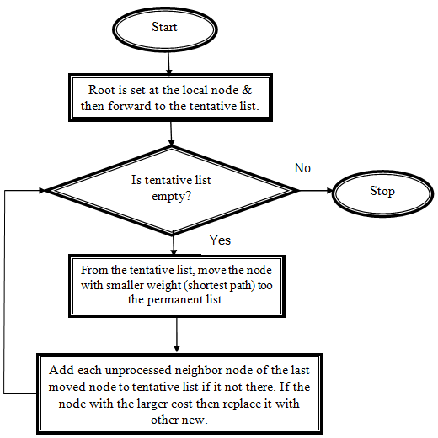
DIJKSTRAS--FLOWCHART

Slide 15
RESULTS:
We developed different modules as all are included in website to get all the inputs and perform the scheduling and least distance (cost) algorithms.
Modules are home page, signup , registration, login, profile, service modules (patient, doctor, pharmacies), billing , status, clinic, logout.
The result will be the directions that the delivery boy should follow to deliver the products with less effort and in less time.
Note: 75% of the project is completed, remaining will update in the github by the next week.(Only the algorithm demonstration is pending).

Slide 16
CONCLUSION:
From this project we can conclude that using FIFO and priority scheduling algorithms are used to deliver the medicines on first come and priority based. Kruskal’s and Dijkstra’s algorithms are used to deliver the medicines with least cost if there are no priorities in delivering the products. The medicines will be delivered accordingly based on the customer choice. The delivery of the products will be faster with less cost and least distance using the Dijkstra’s and Kruskal’s algorithm in less time.
By this the social issue which we produced can be cleared or solved in an easy manner.

Slide 17
REFERENCES:
1) Hameed, S. A., Miho, V., AlKhateeb, W., & Hassan, A. (2010, May). Medical emergency and healthcare model: Enhancemet with SMS and MMS facilities. In International Conference on Computer and Communication Engineering (ICCCE'10) (pp. 1-6). IEEE.
2) Dridi, A., Tissaoui, A., & Sassi, S. (2015, June). The medical project management (MPM) system. In 2015 Global Summit on Computer & Information Technology (GSCIT) (pp. 1-6). IEEE.
3) Liszka, H. A., Steyer, T. E., & Hueston, W. J. (2006). Virtual medical care: how are our patients using online health information?. Journal of community health, 31(5), 368-378.
4) Fotsch, E., DelGuidice, D., & Yuan, L. (2004). U.S. Patent Application No. 10/641,982.
5) Journal of the American Medical Informatics Association, Volume 21, Issue 6, November 2014, Pages 1113–1117, https://doi.org/10.1136/amiajnl-2013-002350
6) F. Anjum, A. S. M. Shoaib, A. I. Hossain and M. M. Khan, "Online health care," 2018 IEEE 8th Annual Computing and Communication Workshop and Conference (CCWC), Las Vegas, NV, 2018, pp. 580-583, doi: 10.1109/CCWC.2018.8301617
7) Ma, Y., Wang, Y., Yang, J., Miao, Y., & Li, W. (2016). Big health application system based on health internet of things and big data. IEEE Access, 5, 7885-7897.
8) R. V. Vaidya and D. K. Trivedi, "M-health : A complete healthcare solution," 2017 International Conference on Computing Methodologies and Communication (ICCMC), Erode, 2017, pp. 556-561, doi: 10.1109/ICCMC.2017.8282527
9) A. K. Tripathy, R. Carvalho, K. Pawaskar, S. Yadav and V. Yadav, "Mobile based healthcare management using artificial intelligence," 2015 International Conference on Technologies for Sustainable Development (ICTSD), Mumbai, 2015, pp. 1-6, doi: 10.1109/ICTSD.2015.7095895.
10) P. Desai, B. Pattnaik, S. Dey, T. S. Aditya, K. Rajaraman and M. Aarthy, "All Time Medicine and Health Device," 2019 5th International Conference on Advanced Computing & Communication Systems (ICACCS), Coimbatore, India, 2019, pp. 5-9, doi: 10.1109/ICACCS.2019.8728306.

