Slide 1
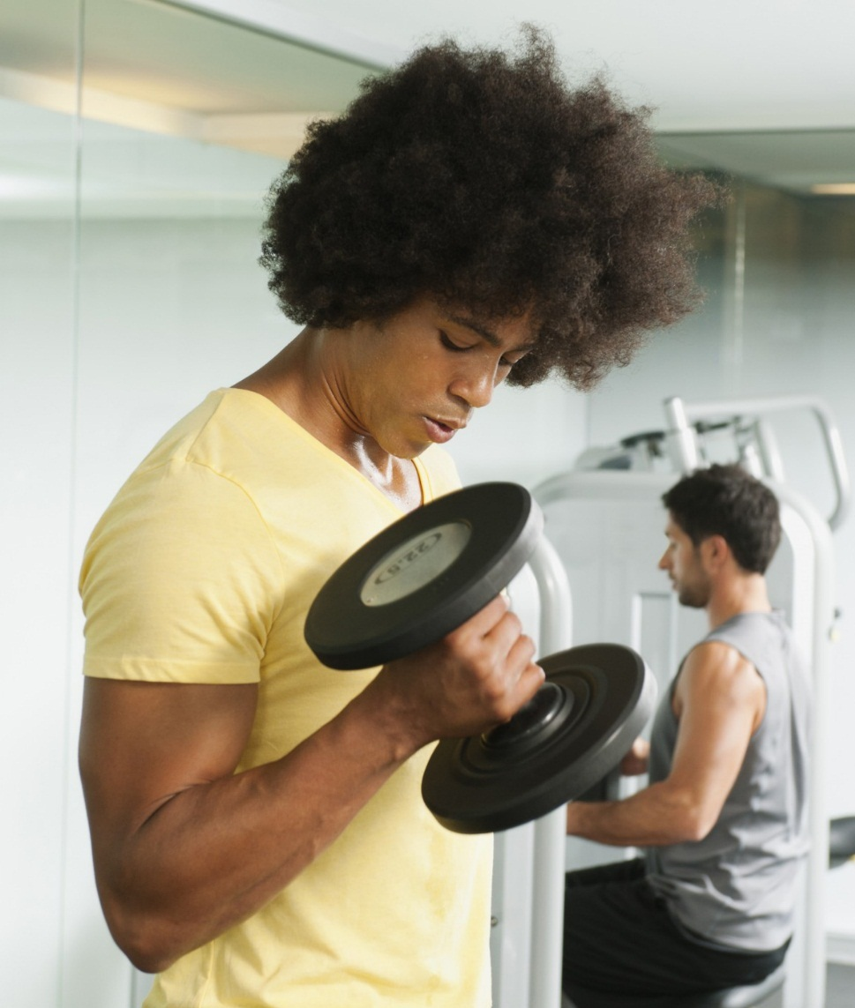

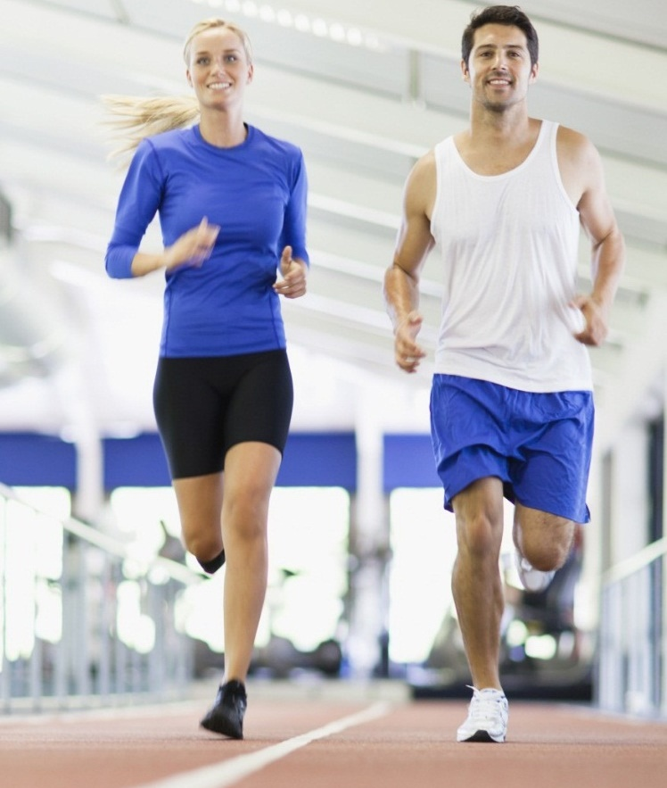
PHYSICAL HEALTH ACTIVITY TRACKER
phat

Slide 2
INTRODUCTION
Work out at home.
This PHAT app will help to track all your exercise, also create your own exercise and share with world. We believe fitness should be accessible to everyone and everywhere.

Slide 3
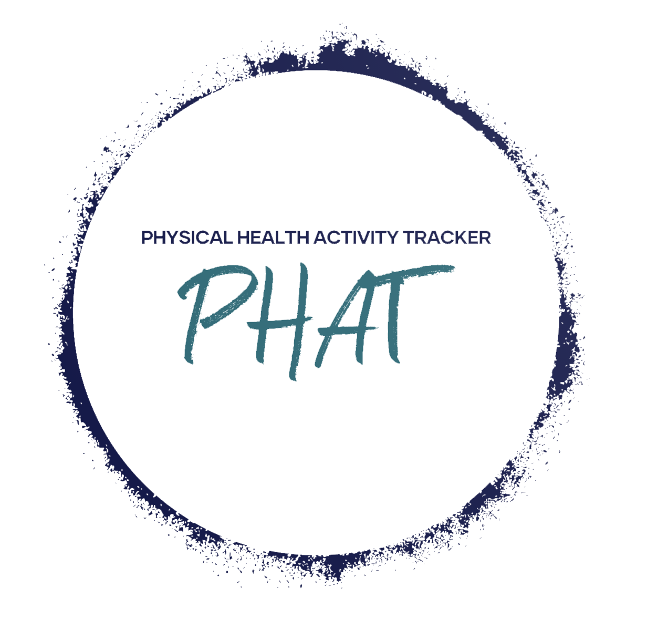
OUR FOCUS
FOR
People are not 100%
Hard to acquire accurate personal training needs.
WE
Provide a timer for runners.
Shows example exercises and workouts
Allow users to create and manage their own regimes

Slide 4
STEPS
STEP ONE
TWO

Slide 5
PRESENTATION

Slide 6
FUTURE DEVELOPMENT
Guide to healthier you / Nutrition
Calendar - Schedule
calories burned/average bpm
Female / Male only pages
Login – Forgotten password
Mobile App
Wearable syncing/ tracking (Apple Watch, Samsung, Fit-Bit, etc.)
Factor into different body types (endomorph, ectomorph, mesomorph) could be an option prompted when taken to gender page. Between user profile and exercises.

